Slide 1
PROJECT 1
Instagram Data Analysis using Hadoop And Hive

Slide 2
DESCRIPTION
The dataset used in this project is taken from kaggle.
Tools used in the project are hadoop and hive in hortonworks sandbox
Initially I created a directory named instadb and uplodaed the instadatset in that directory
After that I performed various analyzing operation with the help oh hive query language.

Slide 3
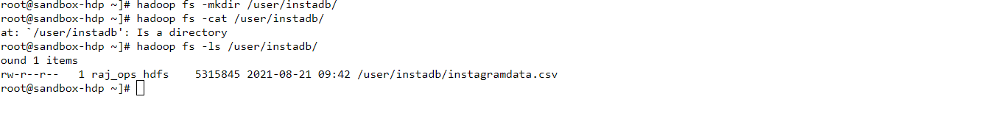
Creating new directory named instadb in hdfs

Slide 4
Creating a new table named instadata in hive
Syntax:
create table instadata (id int,age int,day int,year int,month int,gender string,tenure int,followers int,follower_init int, likes int,likes_received int,mlikes int,mlikes_received int,wlikes int,wlikes_received int) row format delimited fields terminated by ',' stored as textfile location '/user/instadb/';

Slide 5
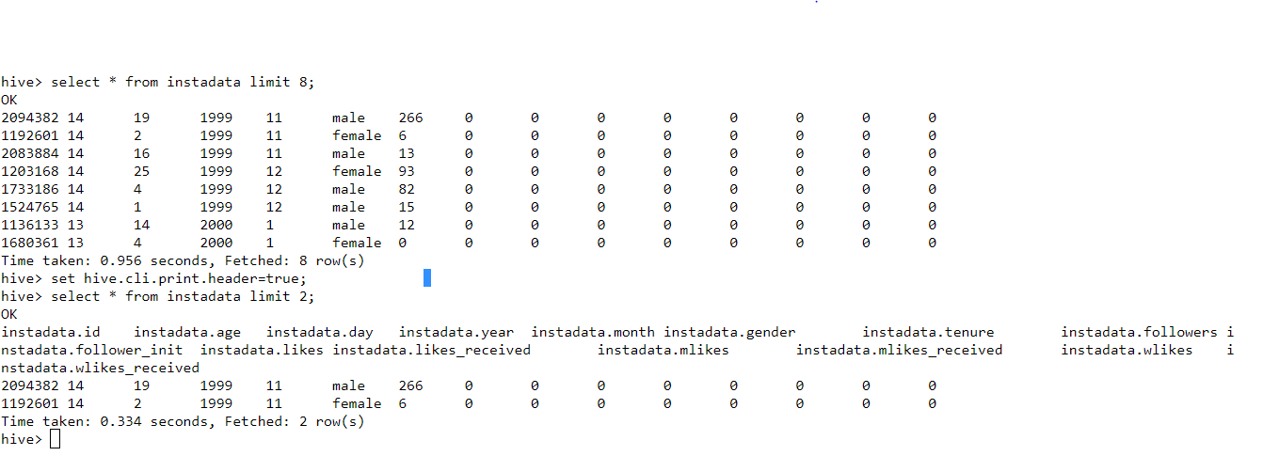
Sample table and column names

Slide 6
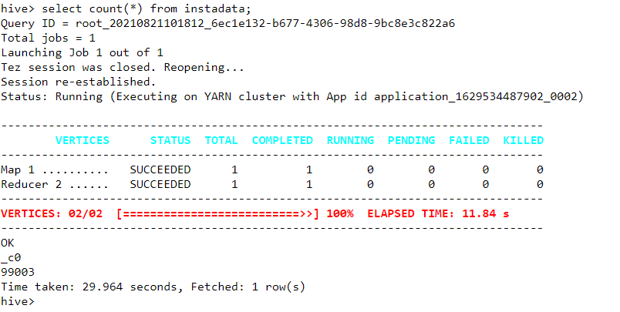
Finding total number instagram users
Syntax:
select count(*) from instadata;

Slide 7
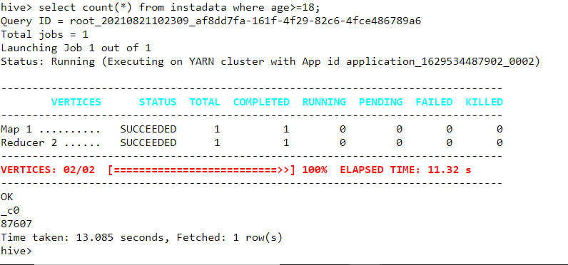
Total number of adult users
Syntax:
select count(*) from instadata where age=>18;

Slide 8
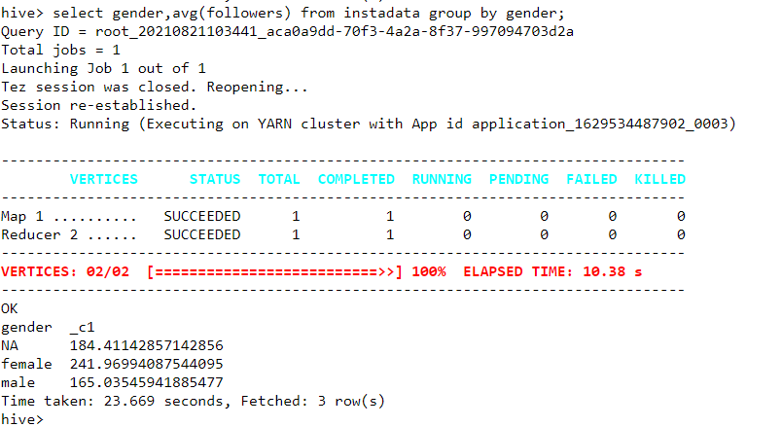
Who have more followers male or female
Syntax:
select gender,avg(followers) from instadata group by gender;
(women have more followers than men)

Slide 9
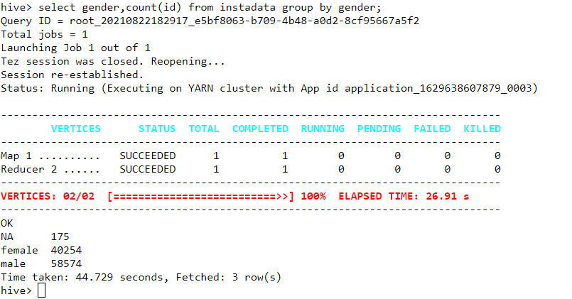
Total number of male and female users
Syntax:
select gender,count(id) from instadata group by gender;

Slide 10
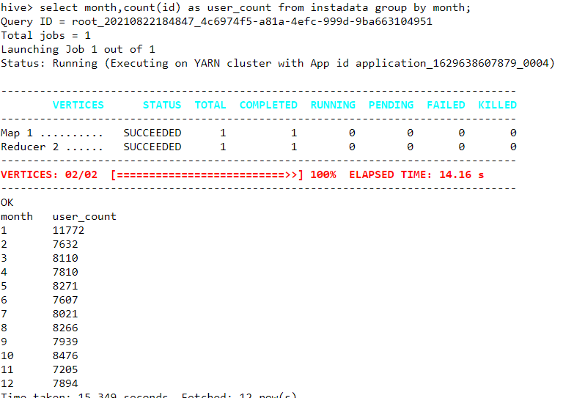
Birthday month based user count
Syntax:
select month,count(id) as user_count from instadata group by month;

Slide 11
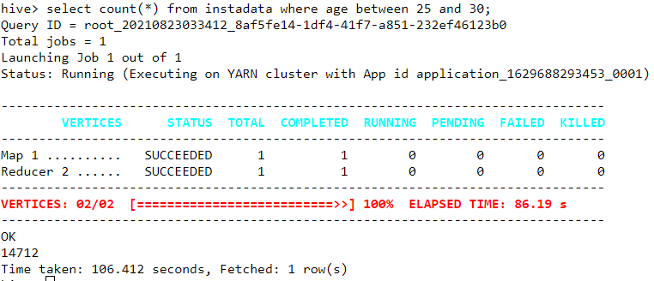
Number of users in the age group of 25 to 30
Syntax:
select count(*) from instadata where age between 25 and 30;

Slide 12
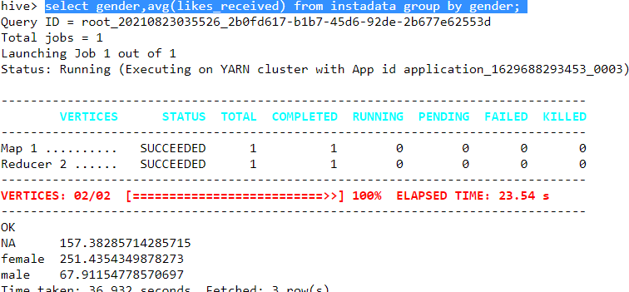
Number of likes for male vs female
Syntax:
select gender,avg(likes_received) from instadata group by gender;
(women getting 4 times higher likes than men)

Slide 13
Partioning based on gender column
Syntax:
create table instadata2(id int,age int,day int,year int,month int,tenure int,followers int,follower_init int, likes int,likes_received int,mlikes int,mlikes_received int,wlikes int,wlikes_received int)partitioned by (gender string);

Slide 14
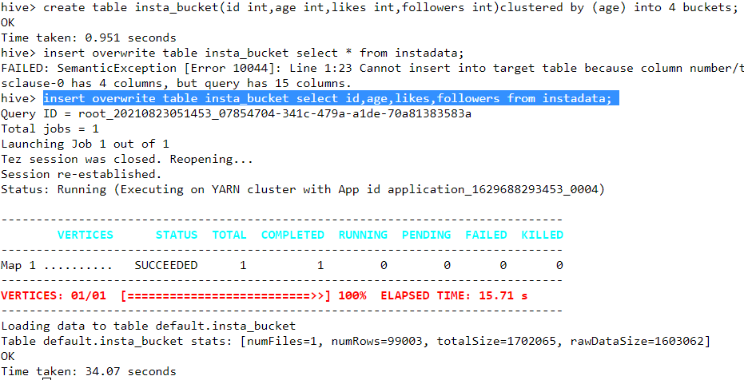
Bucketing based on age column
Syntax:
create table insta_bucket(id int,age int,likes int,followers int)clustered by (age) into 4 buckets;
insert overwrite table insta_bucket select id,age,likes,followers from instadata;

Slide 15
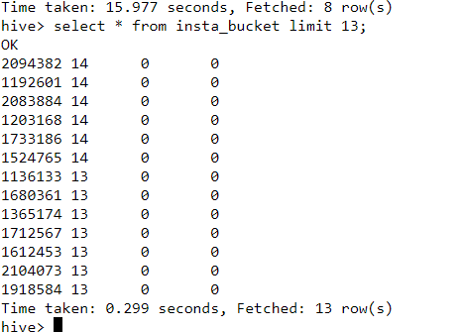
Bucketed items
Syntax:
select * from insta_bucket limit 13;

Slide 16
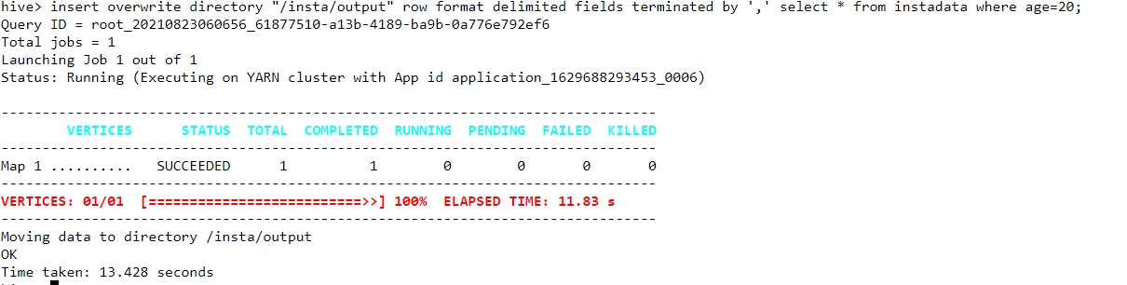
Moving data from hive to hdfs
Syntax:
insert overwrite directory "/insta/" row format delimited fields terminated by ',' select * from instadata where age=20;

Slide 17
URL
GITURL:
https://github.com/stephen-eng/instagram-data-analysis-using-hadoop-and-hive
TINYURL:
https://tinyurl.com/eukcw4mf

Slide 18
THANK YOU

