Slide 1
PROJECT 1
Instagram Data Analysis using Hadoop And Hive

Slide 2
DESCRIPTION
The dataset used in this project is taken from kaggle.
Tools used in the project are hadoop and hive in hortonworks sandbox
Initially I created a directory named instadb and uplodaed the instadatset in that directory
After that I performed various analyzing operation with the help oh hive query language.

Slide 3
Operations performed in hive
Creating a new table named instadata
Finding total number of instagram users
Finding total number of adult users
Analyzing which gender have more followers
Finding total number of male and female users
Finding user count based on their birthday month.

Slide 4
Number of users in the age group of 25 to 30.
Analyzing which gender getting more likes.
Partioning based on gender column
Performing bucket operation based on age colum
Moving hive data to hdfs.

Slide 5
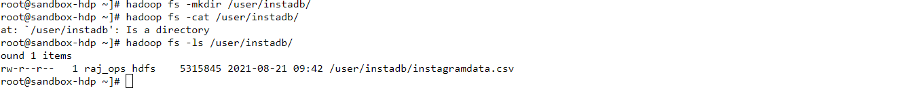
Creating new directory named instadb in hdfs

Slide 6
Creating a new table named instadata in hive
Syntax:
create table instadata (id int,age int,day int,year int,month int,gender string,tenure int,followers int,follower_init int, likes int,likes_received int,mlikes int,mlikes_received int,wlikes int,wlikes_received int) row format delimited fields terminated by ',' stored as textfile location '/user/instadb/';

Slide 7
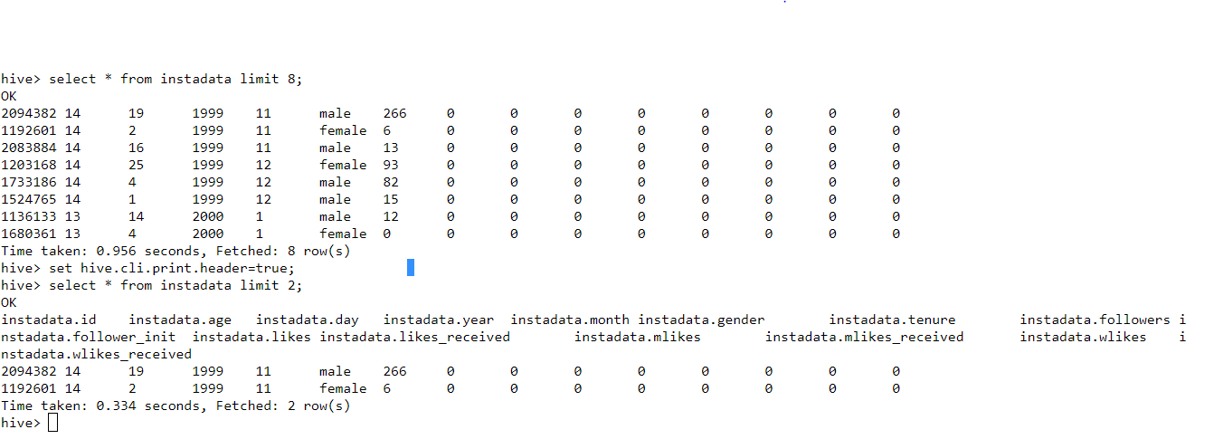
Sample table and column names

Slide 8
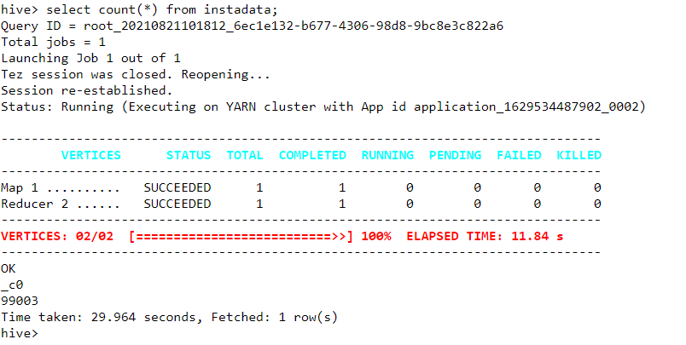
Finding total number instagram users
Syntax:
select count(*) from instadata;

Slide 9
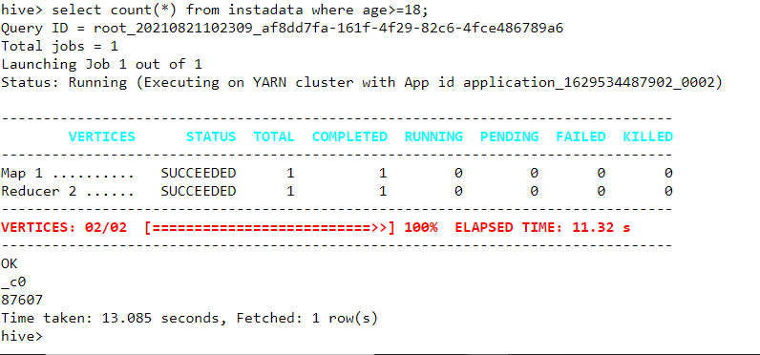
Total number of adult users
Syntax:
select count(*) from instadata where age=>18;

Slide 10
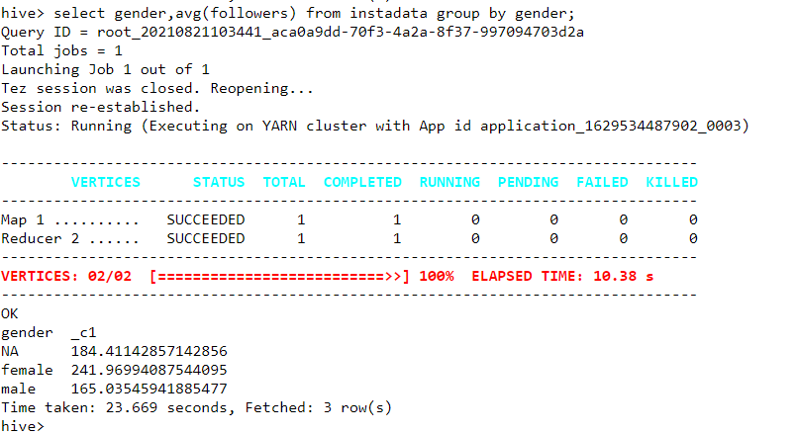
Who have more followers male or female
Syntax:
select gender,avg(followers) from instadata group by gender;
(women have more followers than men)

Slide 11
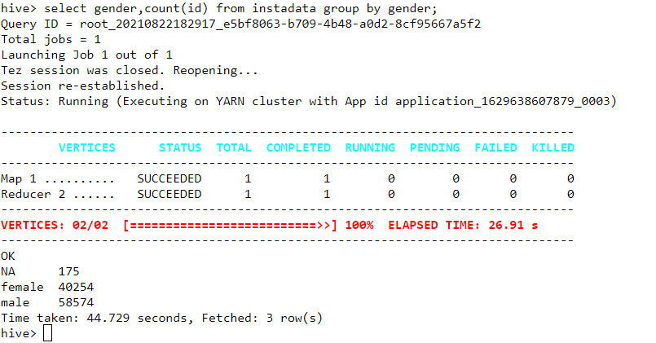
Total number of male and female users
Syntax:
select gender,count(id) from instadata group by gender;

Slide 12
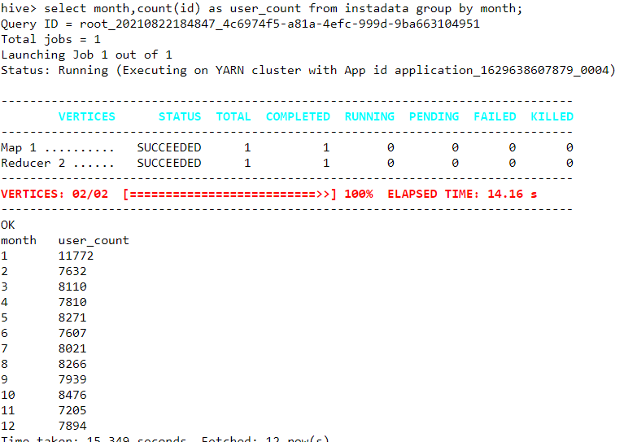
Birthday month based user count
Syntax:
select month,count(id) as user_count from instadata group by month;

Slide 13
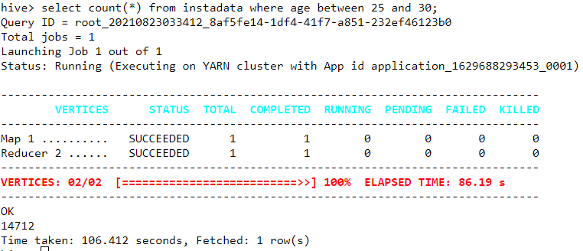
Number of users in the age group of 25 to 30
Syntax:
select count(*) from instadata where age between 25 and 30;

Slide 14
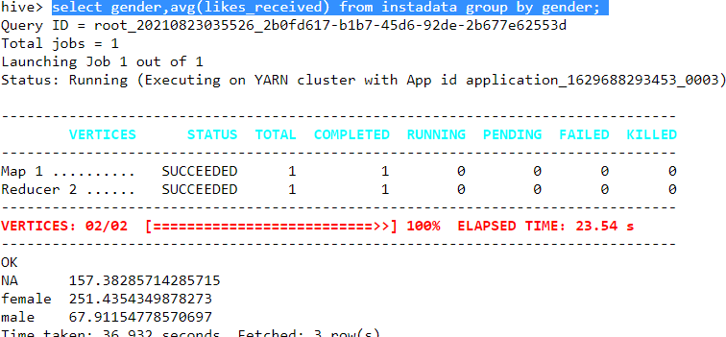
Number of likes for male vs female
Syntax:
select gender,avg(likes_received) from instadata group by gender;
(women getting 4 times higher likes than men)

Slide 15
Partioning based on gender column
Syntax:
create table instadata2(id int,age int,day int,year int,month int,tenure int,followers int,follower_init int, likes int,likes_received int,mlikes int,mlikes_received int,wlikes int,wlikes_received int)partitioned by (gender string);

Slide 16
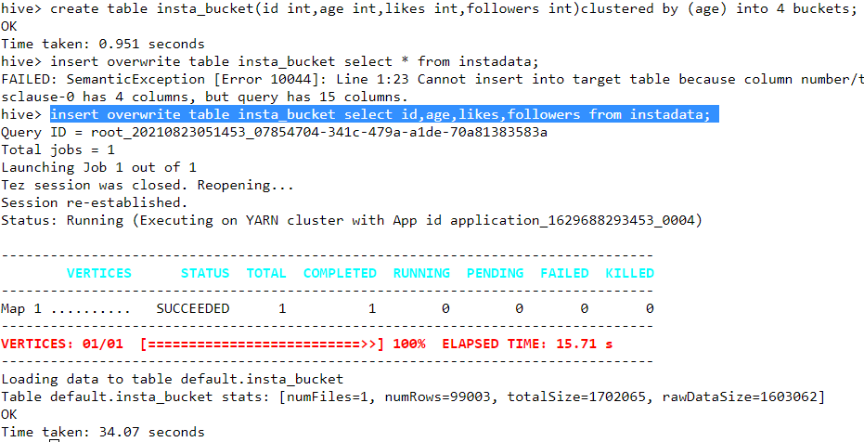
Bucketing based on age column
Syntax:
create table insta_bucket(id int,age int,likes int,followers int)clustered by (age) into 4 buckets;
insert overwrite table insta_bucket select id,age,likes,followers from instadata;

Slide 17
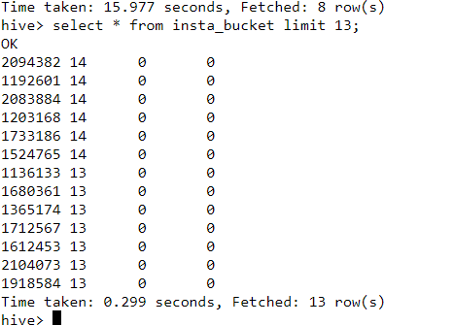
Bucketed items
Syntax:
select * from insta_bucket limit 13;

Slide 18
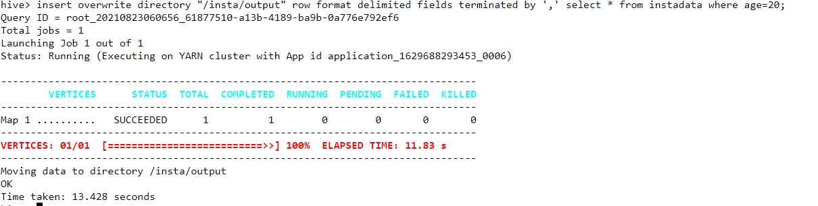
Moving data from hive to hdfs
Syntax:
insert overwrite directory "/insta/" row format delimited fields terminated by ',' select * from instadata where age=20;

Slide 19
URL
GITURL:
https://github.com/stephen-eng/instagram-data-analysis-using-hadoop-and-hive
TINYURL:
https://tinyurl.com/eukcw4mf

Slide 20
THANK YOU

