Slide 1
WANDERLUST TRAVEL APP
Team Members
-David Vedha Jerome A (715522104013)
-Cheran U (715522104011)
-Ilayaraja P (715522104302)
-Dhruv R (715522104018)

Slide 2
DESCRIPTION :
AI-Powered Itinerary Planner : Offers personalized trip recommendations based on user interests, travel history, and real-time information, allowing users to explore both popular attractions and hidden gems effortlessly.
Offline-Enabled Interactive Maps : Provides GPS navigation and offline access, ensuring travelers stay oriented and connected even in remote locations with limited internet.
Real-Time Alerts and Local Updates : Keeps users informed with live updates on weather, transportation changes, safety alerts, and other crucial travel details for a smooth journey.
In-App Travel Community and Social Sharing : Connects travelers to share tips, recommendations, and experiences, helping users make informed decisions and foster a global travel community.
Expense Management and Currency Conversion : Simplifies budget tracking with built-in tools for managing daily expenses and converting currencies, ensuring transparency and ease throughout the trip.

Slide 3
Main Activity.java:
package com.example.travelappimport android.content.Contextimport android.content.Intentimport android.os.Bundleimport androidx.activity.ComponentActivityimport androidx.activity.compose.setContentimport androidx.compose.foundation.Imageimport androidx.compose.foundation.clickableimport androidx.compose.foundation.layout.*import androidx.compose.foundation.rememberScrollStateimport androidx.compose.foundation.verticalScrollimport androidx.compose.material.Cardimport androidx.compose.material.Textimport androidx.compose.runtime.Composableimport androidx.compose.ui.Alignmentimport androidx.compose.ui.Modifierimport androidx.compose.ui.draw.scaleimport androidx.compose.ui.graphics.Colorimport androidx.compose.ui.res.painterResourceimport androidx.compose.ui.res.stringResourceimport androidx.compose.ui.text.font.FontFamilyimport androidx.compose.ui.text.font.FontWeightimport androidx.compose.ui.text.style.TextAlignimport androidx.compose.ui.unit.dpimport androidx.compose.ui.unit.sp

Slide 4
class MainActivity : ComponentActivity() {
override fun onCreate(savedInstanceState: Bundle?) {
super.onCreate(savedInstanceState)
setContent {
TravelApp(this)
}
}
@Composable
fun TravelApp(context: Context) {
Column(
modifier = Modifier
.padding(20.dp)
.verticalScroll(rememberScrollState())
) {

Slide 5
Text(
text = "Wanderlust Travel",
fontSize = 40.sp,
color = Color(android.graphics.Color.rgb(120, 40, 251)),
fontFamily = FontFamily.Cursive
)
Spacer(modifier = Modifier.height(20.dp))
// Bali Card
DestinationCard(
context = context,
destinationImageId = R.drawable.bali,
destinationNameId = R.string.place_1,
descriptionId = R.string.description,
onClickActivity = BaliActivity::class.java
)

Slide 6
Spacer(modifier = Modifier.height(20.dp))
// Singapore Card
DestinationCard(
context = context,
destinationImageId = R.drawable.singapore,
destinationNameId = R.string.place_3,
descriptionId = R.string.description,
onClickActivity = SingaporeActivity::class.java
)
Spacer(modifier = Modifier.height(20.dp))
}
}

Slide 7
@Composable
fun DestinationCard(
context: Context,
destinationImageId: Int,
destinationNameId: Int,
descriptionId: Int,
onClickActivity: Class<*>
) {
Card(
modifier = Modifier
.fillMaxWidth()
.height(250.dp)
.clickable {
context.startActivity(Intent(context, onClickActivity))
},
elevation = 8.dp
)

Slide 8
Column(horizontalAlignment = Alignment.CenterHorizontally) {
Image(
painter = painterResource(id = destinationImageId),
contentDescription = null,
modifier = Modifier
.height(150.dp)
.scale(scaleX = 1.2f, scaleY = 1f)
)
Text(
text = stringResource(id = destinationNameId),
fontSize = 18.sp
)
Text(
text = stringResource(id = descriptionId),
fontWeight = FontWeight.Light,

Slide 9
fontSize = 16.sp,
textAlign = TextAlign.Center
)
Text(
text = stringResource(id = R.string.plan),
color = Color.Gray,
fontSize = 16.sp
)
}
}
}
}

Slide 10
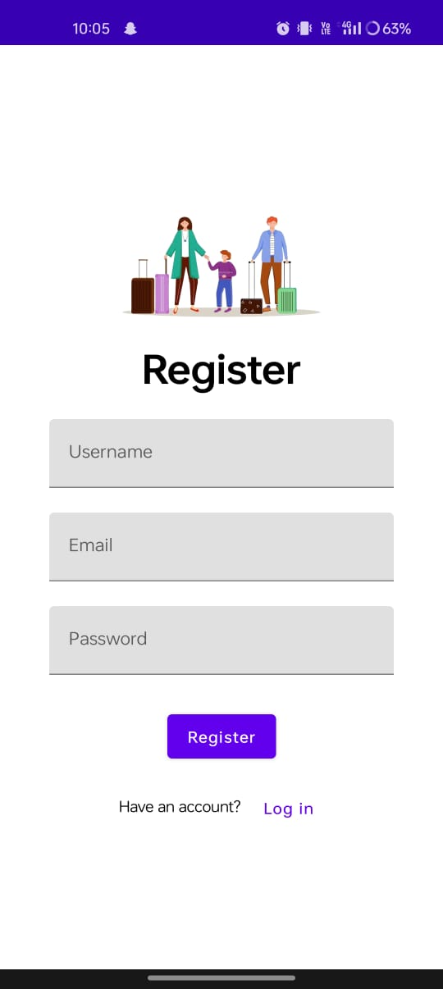
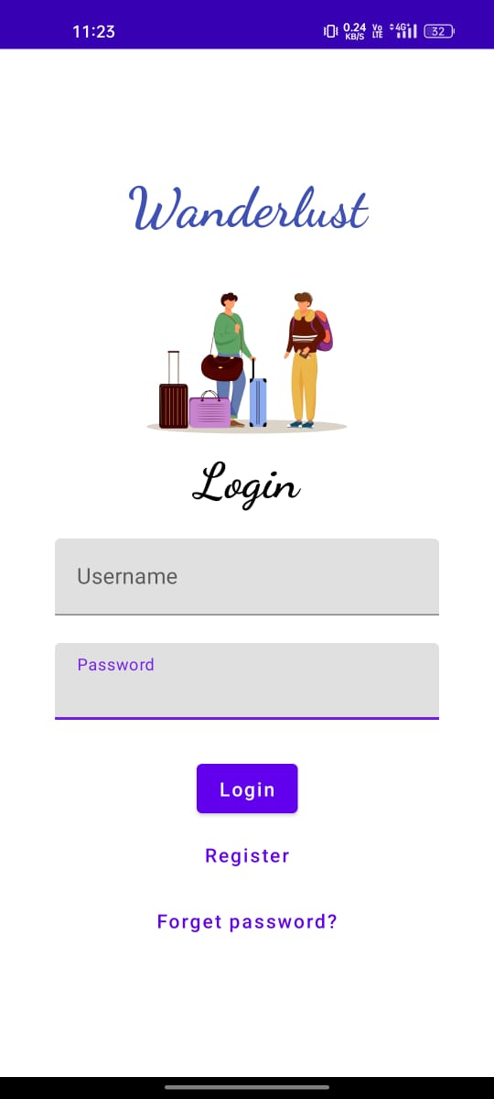
OUTPUT :

Slide 11
