Slide 1

LPI UNIFIED PLATFORM
The future of Licensing,
Permitting & Inspections -
in one platform.
MVP / POC walkthrough · Built on Microsoft Power Platform
Demo & technical overview · June 2026

Slide 2



WHY WE BUILT THIS
Where the market is heading
Jurisdictions are increasingly asking for one platform instead of three disconnected systems. The signal was clear, and we decided to get ahead of it.
Step 1
Step 2
Step 3
The signal
Our decision
The foundation
The Bismarck city RFP called for a single unified platform combining licensing, permitting, inspections & code enforcement.
We couldn't respond to that RFP in time, so we chose to build an MVP / POC, ready for the next opportunity.
We used the Bismarck RFP requirements as the blueprint, building toward the unified model the market now expects.
02

Slide 3
THE SHIFT
This isn't traditional LPI. It's what LPI becomes.
THE OLD MODEL
THE LPI UNIFIED PLATFORM
Separate, siloed systems
One platform, one record
Licensing, permitting & inspections run apart
All four workflows on a single platform
Data re-entered across disconnected tools
One shared property record connects everything
A violation in one system can't touch another
A code violation auto-freezes active permits
Citizens chase status across many portals
Citizens track everything in one portal
03

Slide 4

THE CORE IDEA
One Shared Property Record connects it all
A Permit, a License, an Inspection and a Code case at the same address aren't separate records, they're different views of the same property. That single anchor is what makes the platform unified.
Permits
Licensing
Shared
Property
Record
In practice
Code
Enforcement
Inspections
Open a code violation -> every active permit at that address freezes automatically. Resolve it and pay the fines -> the holds release on their own. No manual linking.
04

Slide 5
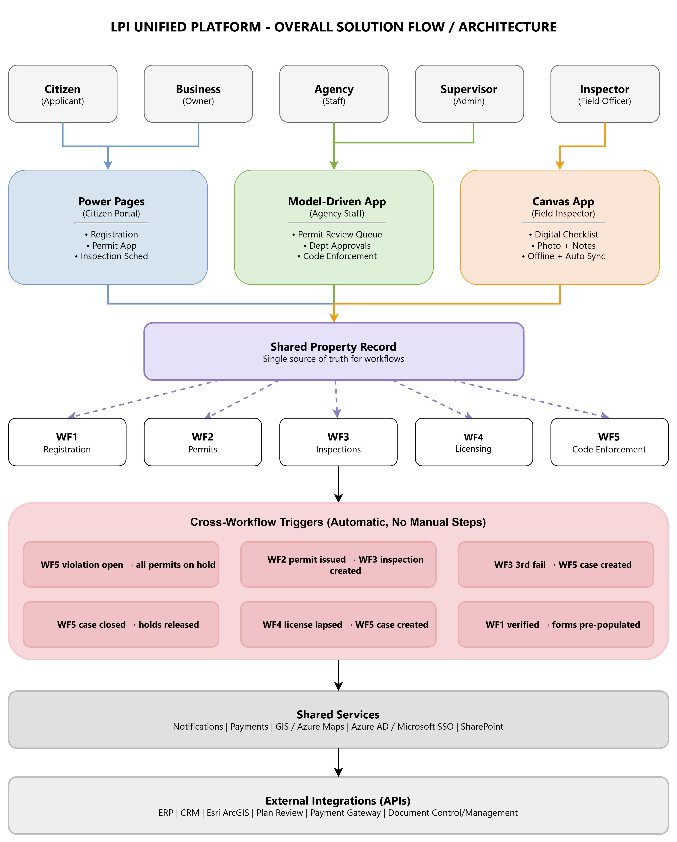
The Full Picture
Unified Architecture
Multiple user types, three apps, one shared record, and a layer of automatic triggers that make the workflows talk to each other without anyone clicking a thing.
Each user works in the app built for them, Citizens, Business Owners and Contractors in Power Pages, Staff in the Model-Driven App, and Inspectors in the Canvas app.
Everything writes to one Shared Property Record i.e. the single source of truth all five workflows read from.
The Cross-Workflow Triggers fire automatically. A code violation freezes permits, a passed permit spawns inspections, a lapsed license opens a code case. No manual steps.
Shared services (payments, notifications, GIS, SSO) and external APIs (ERP, CRM, plan review, payment gateway) plug in underneath.
05

Slide 6
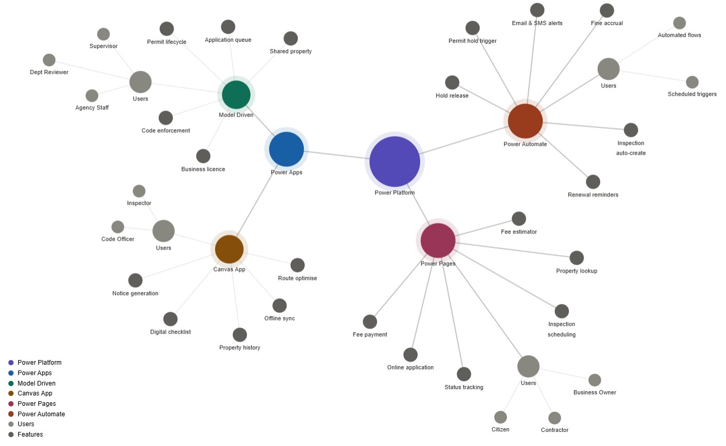




UNDER THE HOOD
Built entirely on Microsoft Power Platform
The four building blocks
Model-Driven App
Staff back-office: review, routing, code cases.
Power Pages
Public citizen portal: apply, pay, track.
Canvas App
Inspector mobile: offline checklist & photos.
Power Automate
The automation engine: a lot of flows already built.
Architecture & feature map
06

Slide 7



WHERE WE ARE TODAY
What's live, What's in progress, What's next
WF 1 - Registration & Onboarding
LIVE
Power Pages portal complete. Account types, verification, dashboard.
WF 2 - Permit Application Lifecycle
LIVE
Power Pages + Model-Driven App. Apply, pay, review, issue certificate.
WF 3 - Inspection Management
IN PROGRESS
Canvas mobile app built - inspector views, pass/fail, comments. Wiring up.
WF 4 - Business Licence Lifecycle
DESIGNED
Full workflow designed & documented. Build not yet started.
WF 5 - Code Enforcement
DESIGNED
Full workflow designed & documented. Build not yet started.
07

Slide 8
LIVE DEMO
Let's follow a citizen through the platform
From applying for a permit, to staff review, to an inspector in the field, across Power Pages, the Model-Driven App, and the Canvas mobile app.
08

Slide 9
DEMO · PART 1 · WF 1 + WF 2
The Citizen applies, And the Staff review
Citizen · on Power Pages portal
1
2
3
4
5
6
Register / log in
Select permit type
Fill multi-step form
Upload documents
Pay fee online
Track status
submit triggers automated flows + staff notification
Agency staff · on Model-Driven App
Application lands in queue
Review docs & details
Approve -> inspection stage
or request rework w/ comments
09

Slide 10
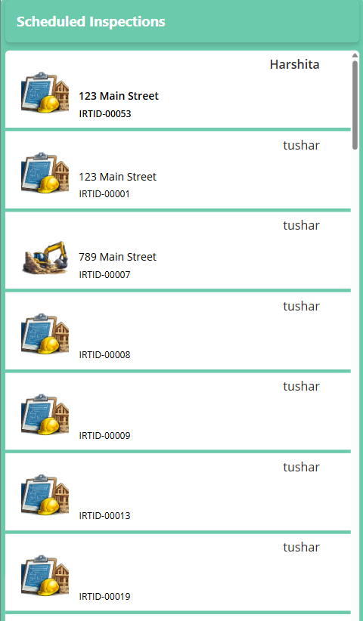




DEMO · PART 2 · WF 3
The On-Field Inspector screen - Canvas app
What we'll show
Assigned inspections
The inspector sees the list of inspections scheduled and assigned to them.
Inspection detail & checklist
Open a record, work the digital checklist, mark each item pass / fail / N/A.
Comments & evidence
Add notes (and photos) against the inspection right from the field.
Result syncs back
Submit -> status flows back to the Model-Driven App in real time.
Can work fully offline · syncs on reconnect
10

Slide 11
WHAT'S NEXT
The road to a complete unified platform
NEXT
THEN
Finish WF 3
Build WF 5
Complete inspection scheduling, assignment & sync end-to-end.
Code enforcement, violations, holds, fines, hold release.
THEN
GOAL
Build WF 4
DEMO-Ready
Business licence lifecycle - renewals, amendments, compliance.
A complete MVP / POC to demo to the next unified-platform RFP.
11

Slide 12

Not a rebuild of LPI, but a reinvention of it.
One platform. One shared property record. Four workflows that talk to each other automatically. This accelerator is how we'll be ready the next time a city asks for it.
Thank you

