Slide 1
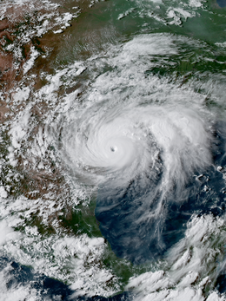
The Consequences of Hurricane Harvey on Resilience Related Attitudes and Behaviors
Kirby Goidel Yikai Zhao
Nicholas T. Davis Stephanie Brown
Texas A&M University

Slide 2
Overarching project motivation
Motivated by need to study local resiliency in TX:
Coastal communities along Gulf Coast are notable in diversity of populations, geography, culture, and economies.
While they face similar potential hazards, they do not experience the same level of threat or exposure.
Still, most gulf counties score “low” or “very low” on at least one dimension of resilience (Ross 2013).

Slide 3
Initial data collection
Original data collection sponsored by Texas Sea Grant: four county study (Brazoria, Nueces, Galveston, and Cameron) focused on perceptions of community resilience.
Individual households were selected using Address Based Sampling (ABS).
Contacted using an initial invitation letter describing the study and providing a link to take the survey online...
If / When that failed: then via follow-up phone calls and mailings.

Slide 4
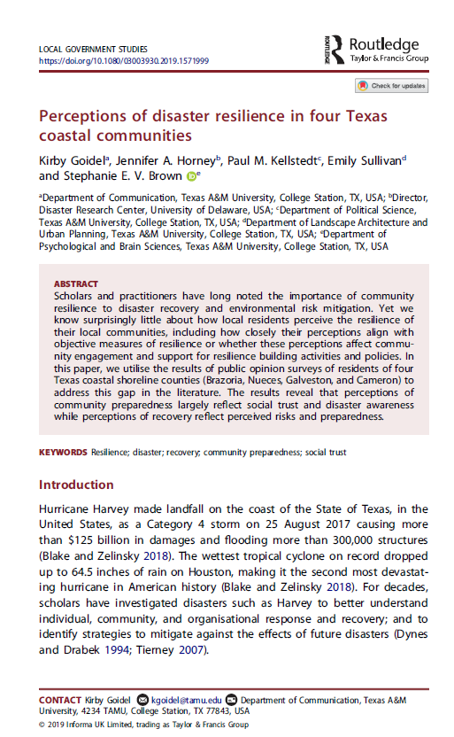
Findings
Community perceptions of resilience do not neatly map onto expert assessments of resilience.
Residents expressed high levels of awareness about disaster resources, higher levels of social trust were more likely to believe their community was better prepared for a disaster.
Perceptions regarding the ability of a community to recover from a disaster were associated with perceived risks and preparation.

Slide 5
Motivation of current project
Research on disaster planning, response, and recovery is well-developed.
Missing from this research, however, is good panel data bracketing disasters.
By chance, PPRI surveyed community resilience months (Brazoria) and just days prior to (Galveston) Hurricane Harvey’s landfall on August 25th.
Unique opportunity to go back into the field to collect data on post-Harvey attitudes
Brazoria County - September 9 to December 21, 2016
Galveston County - May 1 to July 31, 2017

Slide 6
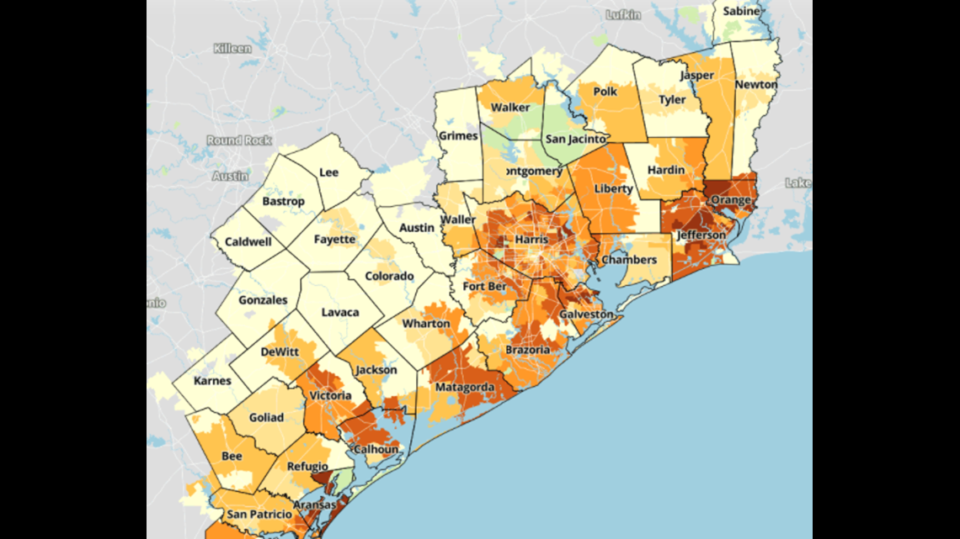

Slide 7
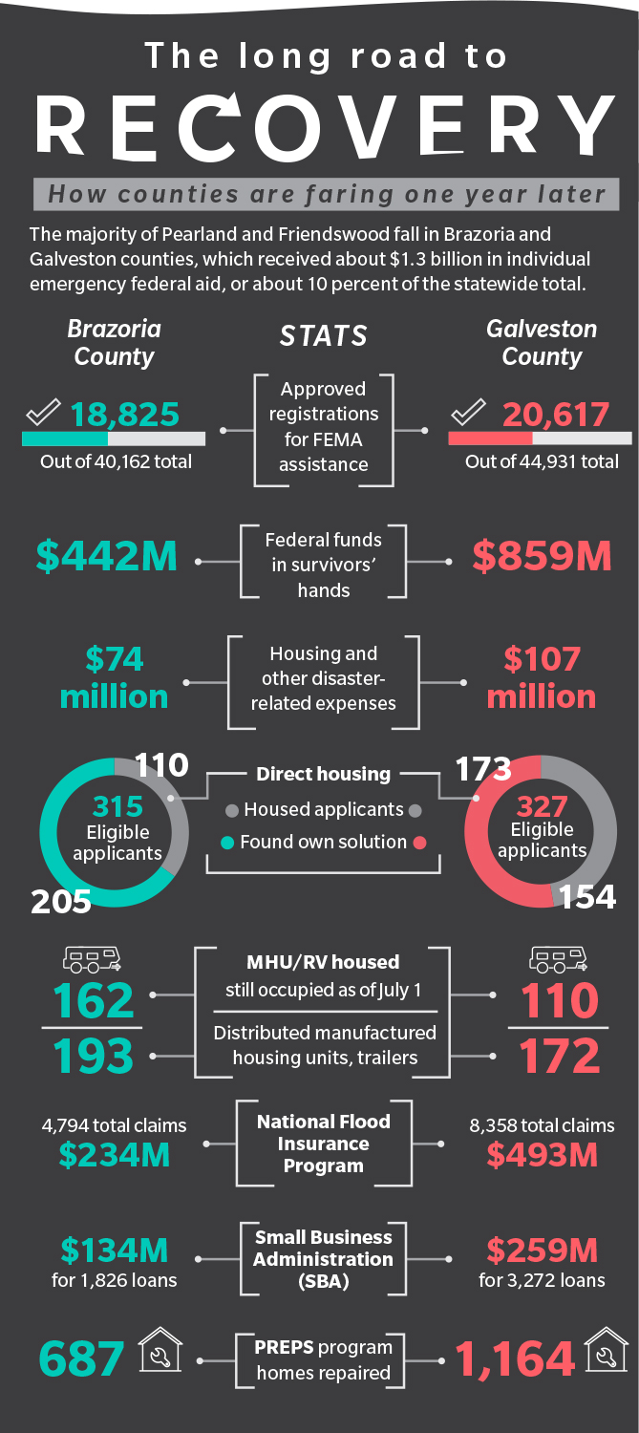

Slide 8
Design / Data
Leverage Hurricane Harvey as “natural experiment”
Panel study in which household to the our original surveys were re-contacted and asked similar or slightly different questions.
308 respondents responded to the study.
289 respondents could be matched back to a household in the original sample
239 could be matched based on age and sex to the original respondents.
150 of the respondents were from Brazoria while 139 were from Galveston.
Subsequent analyses are based on 289 respondents and examine attitude shifts before and after the storm.

Slide 9
Who responded?
Characteristic | Unweighted Sample Estimate
Age (Mean) | 57 years
Sex (% Female) | 55.9
Race (% Nonwhite) | 13.2
Hispanic (%) | 8.3
Poverty (%) | 3.1
Within 30 miles of coast | 78.6

Slide 10
Design / Data
For the purposes of this analysis, we ask how Hurricane Harvey affected:
Perceptions of disaster preparedness and disaster risk
Confidence in local government institutions
Support for resilience building policies
Social Trust

Slide 11
Perceived personal preparedness (post-hurricane)
People thought they were more prepared than they actually were.
(Note: Both questions are asked after the storm).

Slide 12
Perceived personal preparedness (post-hurricane)
Post-hurricane, respondents were more likely to say local government was doing too little to plan for and mitigate against the effects of a disaster.

Slide 13
Evaluation of local government response / recovery
Respondents evaluate local government positively for their response to and recovery from Hurricane Harvey.

Slide 14
Likelihood of disaster in the next 5 years
No significant effect on perceptions of disaster risk (t=1.60), though notably disaster risk pre/post hurricane is only moderated correlated (r=.35) so there are considerable shifts at the individual level.

Slide 15
Perceived recovery time from Hurricane Harvey
After the hurricane, respondents recognized recovery would take longer than expected. The differences for community (t=2.02) and economic recovery (t=1.81) are statistically significant. The effects for infrastructure are not (t=0.04).
Notes:
Might we conclude that the damage to infrastructure is expected but larger effects are not? Overall effects are not large.

Slide 16
Confidence in organizations
After the hurricane, confidence significantly increased for every type of organization EXCEPT nonprofits
Notes:
Not difference in question wording. Before the storm, the question asked about confidence in the organizations to respond, post-storm the questions asked about actual response.

Slide 17
Support for Resiliency-building policies
Mixed support for policy solutions

Slide 18
Social trust
Social trust increases after the storm as people become more positive about their community and their neighbors.

Slide 19
Initial Conclusions
While respondents do not perceive the risk of a future hurricane differently, they do:
Recognize they were personally less prepared and their community was less prepared after the storm.
Recognize recovery will take longer than expected.
Evaluate local organizations more positively.
Become more supportive of resilience building policies, including restricting new housing and the type of new structures in high risk areas.
However, classic “something-for-nothing” paradox.
Grow more trusting of the people in their community.
Hurricane (and disaster-related) experiences may create more resilient communities?

Slide 20
Explaining Shifts in Social Trust
The more individuals relied on local networks and the more positively they evaluated local response and recovery, the more trusting they became after the hurricane.

Slide 21
Explaining Shifts in Policy Support
Increasing Building Standards
Owning your own home, believing government had done too little before the storm but had responded well increased support for building standards. Paying attention to local news and identifying as a conservative decreased support.

Slide 22
Explaining Shifts in Policy Support
Restricting New Structures
Same pattern for restricting new structures in high risk areas with a few exceptions. Hurricane damage and social trust influence support for restricting new structures.

Slide 23
Explaining Shifts in Policy Support
Restricting New Housing
Similar pattern for restricting new housing.

Slide 24
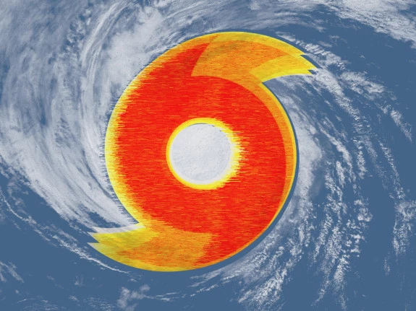
Hurricanes & Resilience
Local Government Response & Recovery
Social Trust
Social Trust
Resilience Building Activities
Planning & Mitigation
Resilience Building Activities
Pre-Hurricane
Post-Hurricane

