Slide 1
Text Mining Crisis Project

Slide 2
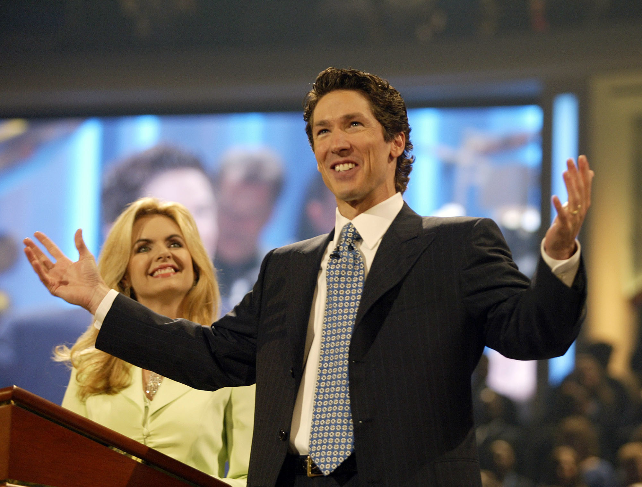

Slide 3
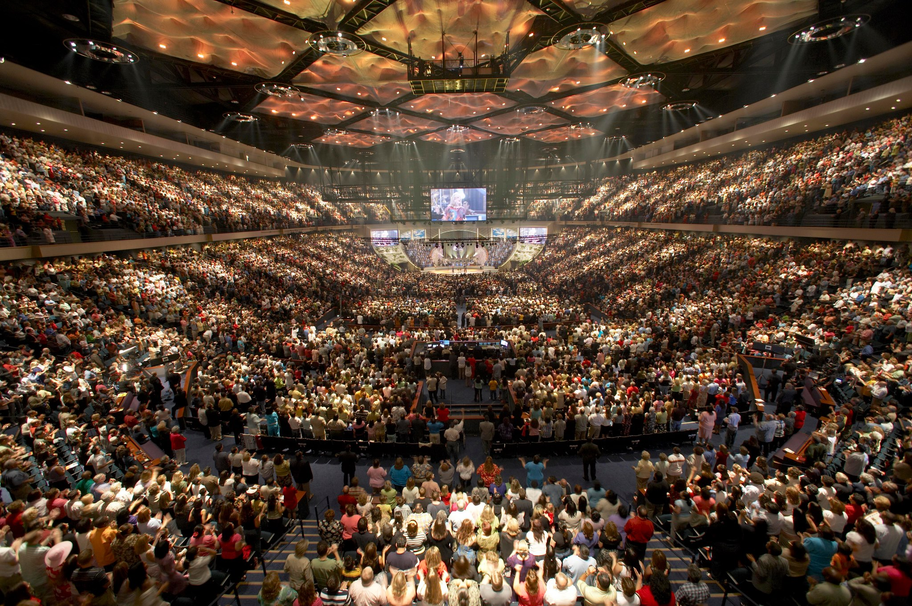

Slide 4
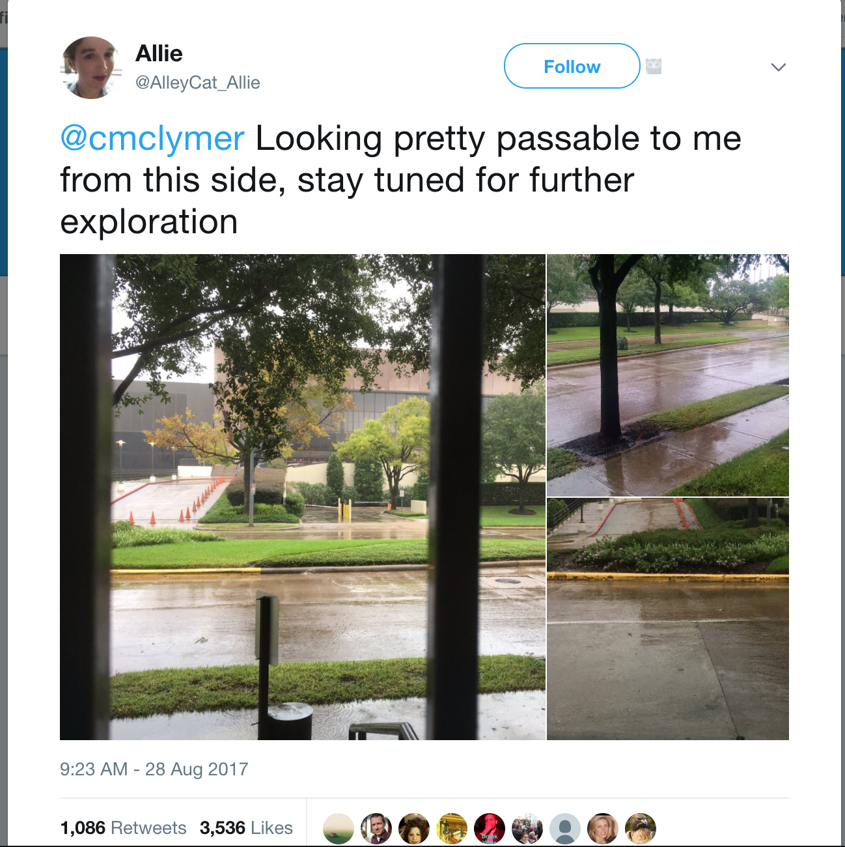

Slide 5
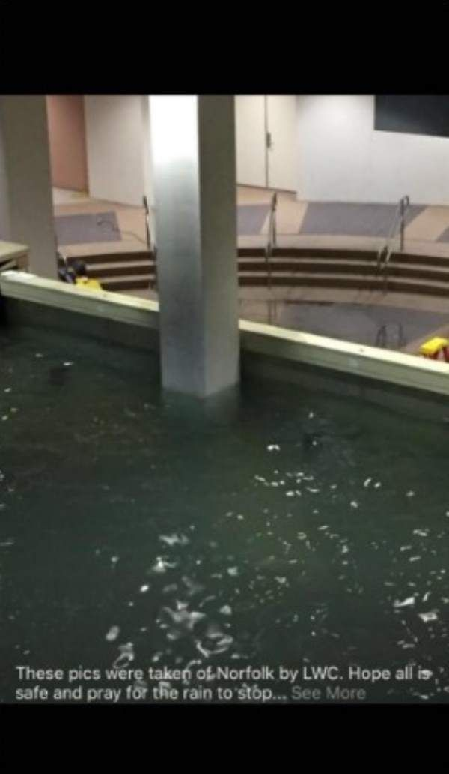
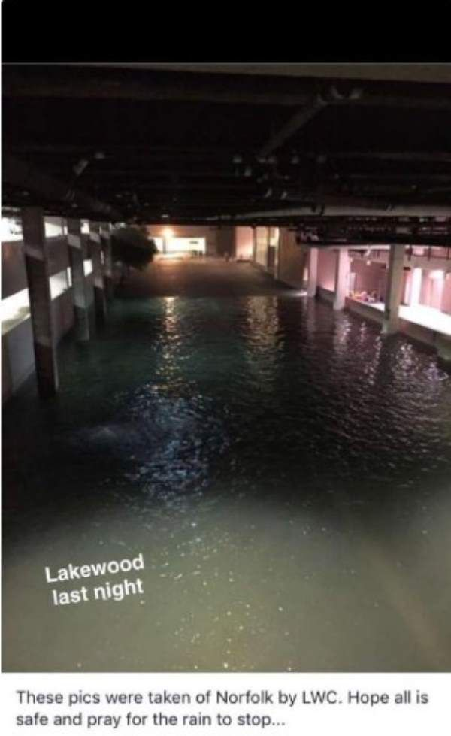

Slide 6
Whole data:
260 000 + tweets

Slide 7
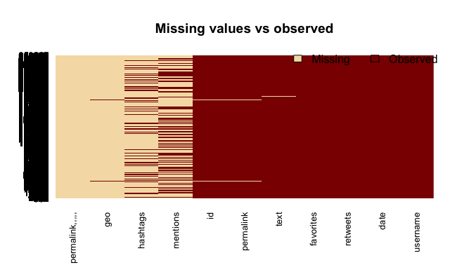

Slide 8
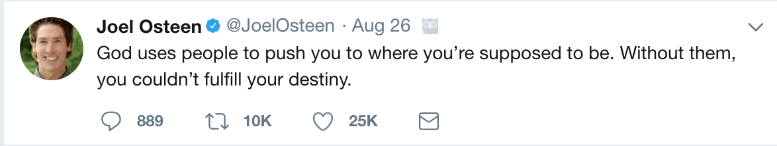

Slide 9
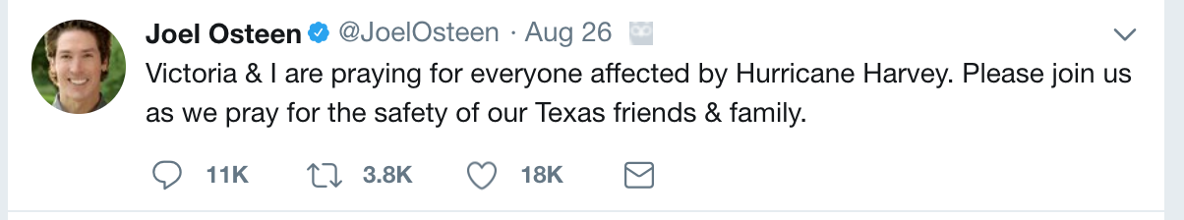

Slide 10
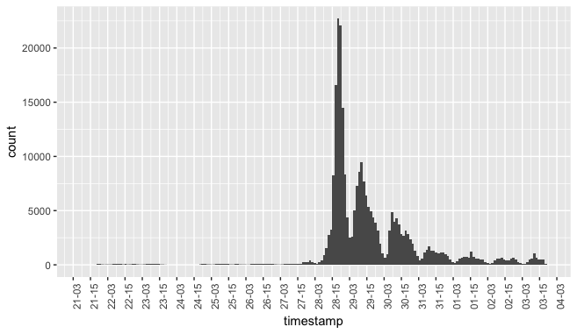

Slide 12
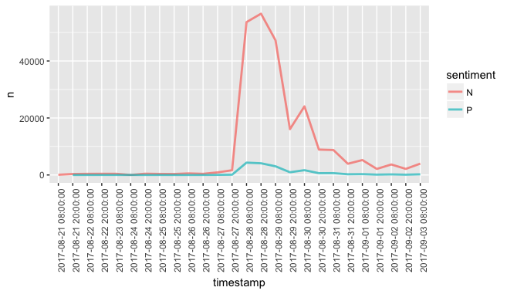

Slide 13
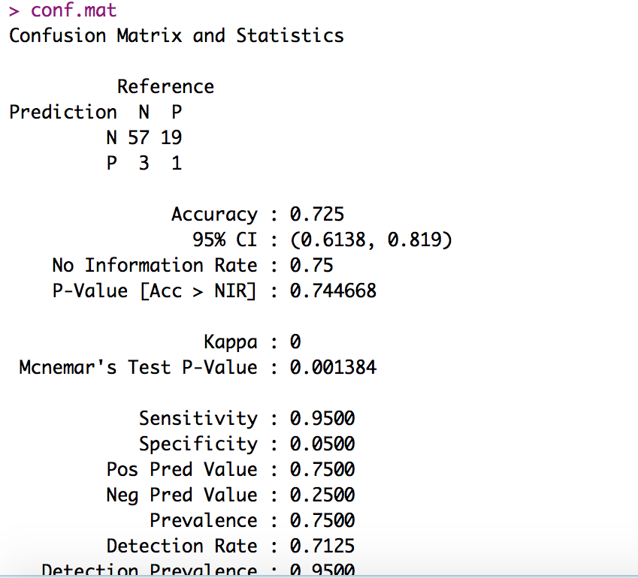
Sentiment prediction model accuracy
Caveat: Positive sentiment is under-predicted.
Need more prediction training data and other models.

Slide 14
Influence index = Favorite + retweet * 2

Slide 15
Hashtag across the whole time span

Slide 16
Hashtag on the 28th – the explosion date

Slide 20
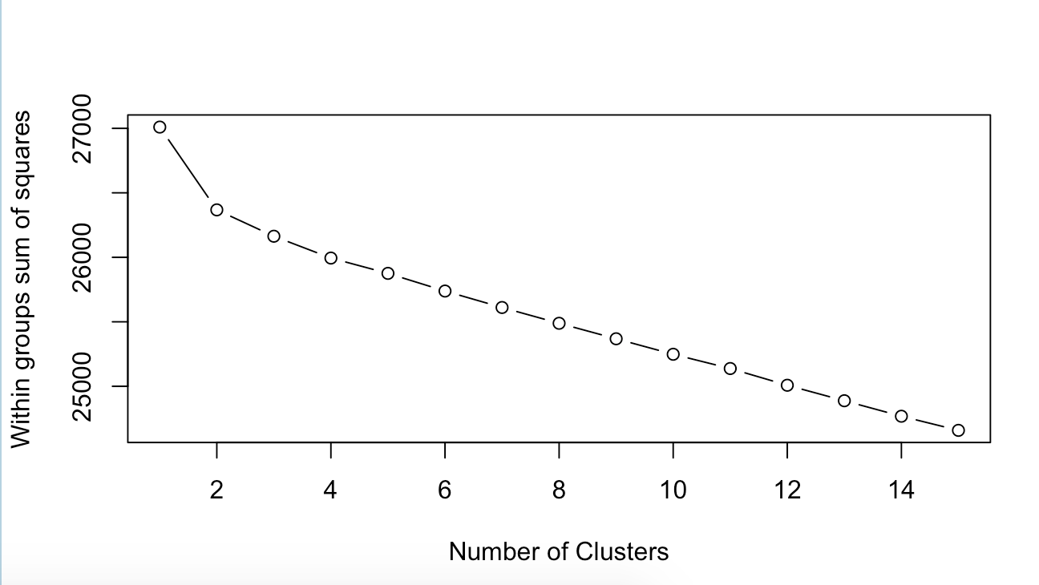

Slide 21
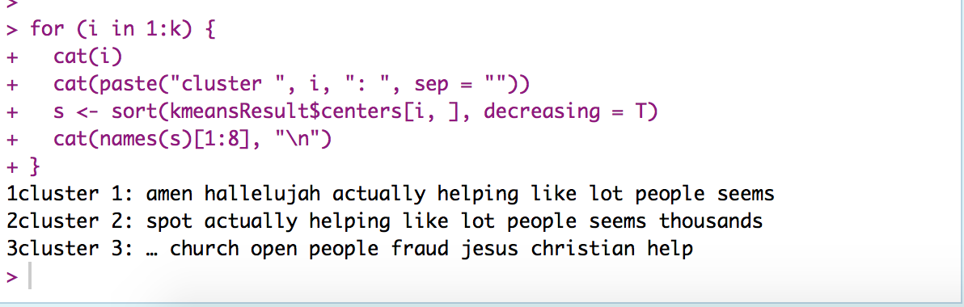
Interpretations of the three clusters:
Faith-holders who interacts with Joel’s tweets on a daily base and their supportive comments when the crisis was on going.
Information related to the church started taking people
Hate-holders’ criticism and their proposed action — open the church.

