Slide 1
Project 1
Employee Reimbursement System
Developed by David Guijosa and Ben Paser

Slide 2
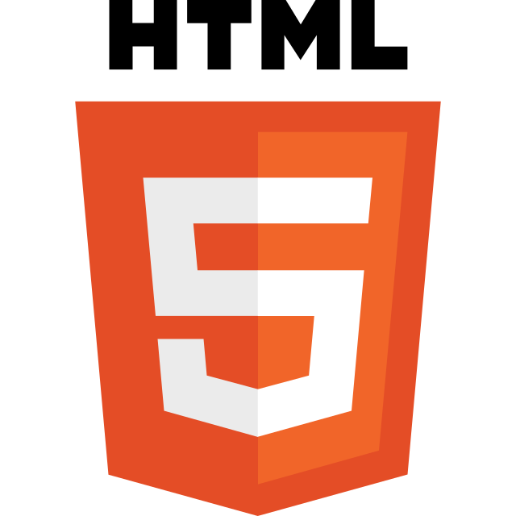

Technologies used
Java: application development
Prostgres: Database
JDBC: Java Database connection
Javalin: HTTP handler
HTML: webpage development
CSS: webpage style/design
Javascript: webpage logic
GCP compute engine: cloud host VM for application
Docker: Container
Jenkins: Continuous integration framework

Slide 3
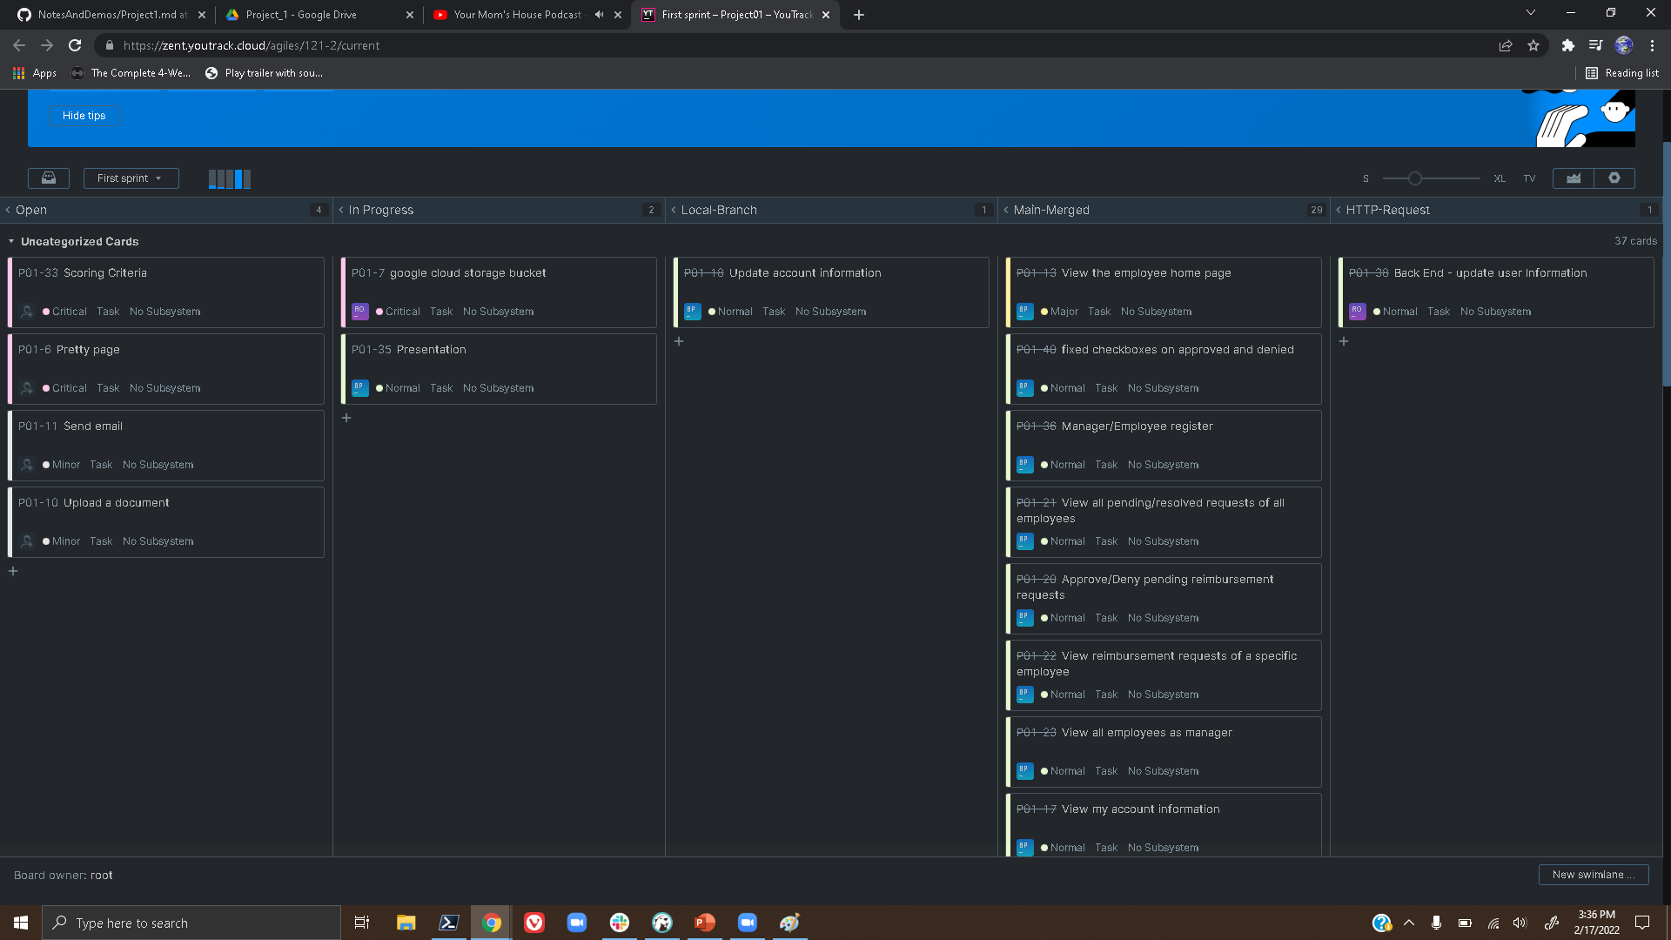
Methodologies used
Scrum
Sprints
Daily standups
Partner Programming
Utilized Youtrack

Slide 4
Features
Manager
approve/deny Reimbursements
login/logout
View approved Denied and pending reimbursements
View certain reimbursements based on different criteria e.g. user, amount, etc
View and alter account information
Employee
Request new reimbursement
login/logout
View own pending, denied, and approved reimbursements
View and alter account information

Slide 5


Challenges faced
CORS
Working with git/youtrack

Slide 6
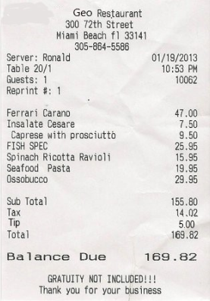

Addition features for the future
Sending emails for account registration
Uploading receipts when submitting reimbursements

Slide 7
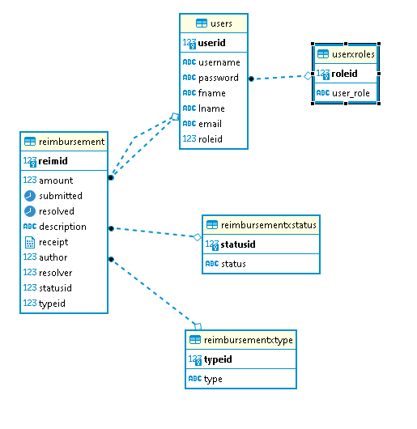
ERD

Slide 8
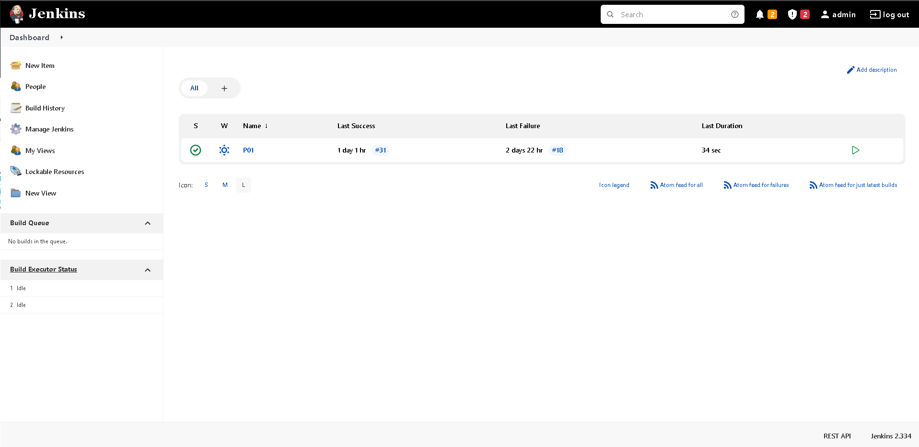
Jenkins

Slide 9
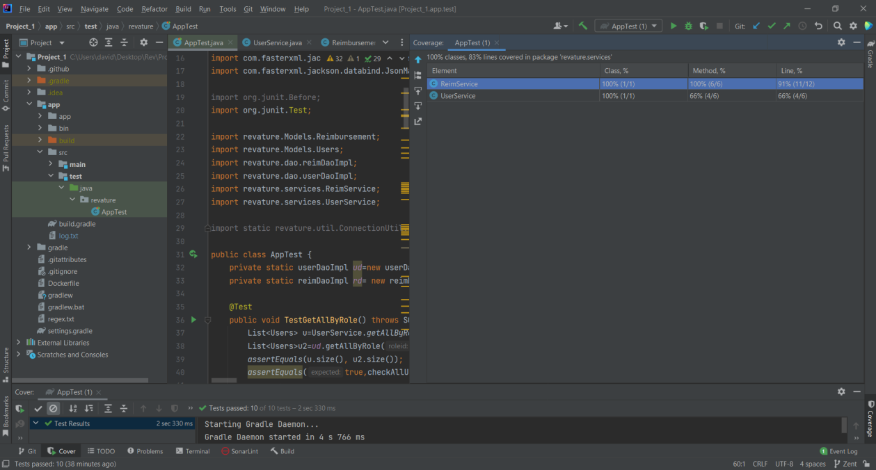
83% Service class Coverage

