Slide 1
CMCSC 1101: Introduction to Data Science and Applications for Decision making
Convolutional neural network
PRESENTER: DAVID OWINO

Slide 2
Introduction
All data scientist around the globe work on numerous aspects of AI and turn visions into reality - and one such amazing area is the domain of Computer Vision.
This field aims to enable and configure machines to view the world as humans do, and use the knowledge for several tasks and processes (such as Image Recognition, Image Analysis and Classification).
The advancements in Computer Vision with Deep Learning have been a considerable success, particularly with the Convolutional Neural Network algorithm.
Have you ever wondered how facial recognition works on social media, or how object detection helps in building self-driving cars, or how disease detection is done using visual imagery in healthcare? It’s all possible because of convolutional neural networks (CNN).

Slide 3
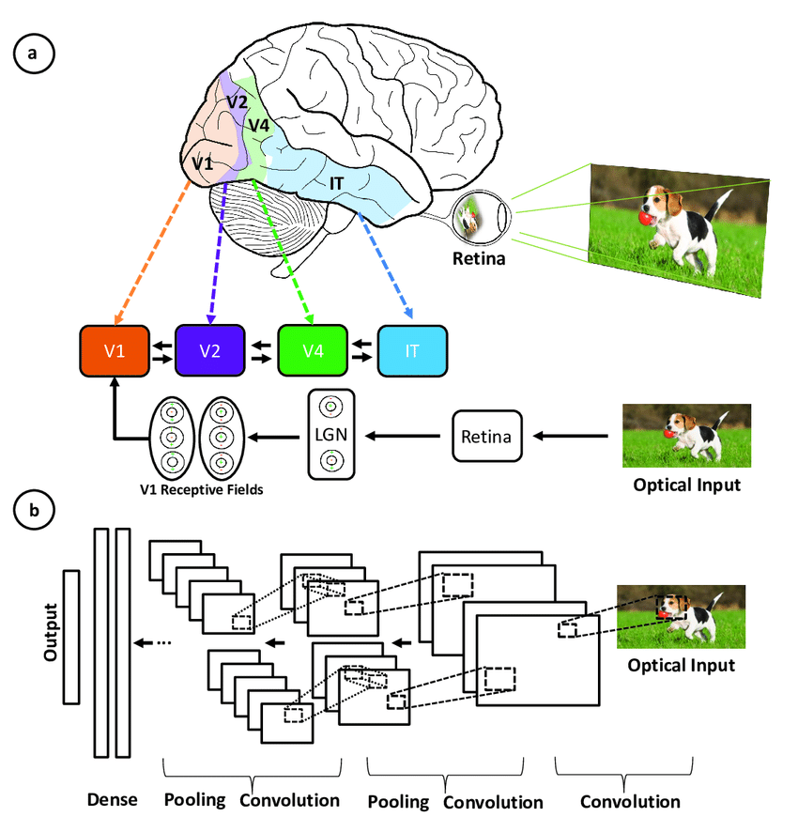

Slide 4
What is Convolutional Neural Network?
A convolutional neural network is a feed-forward neural network that is generally used to analyze or process data with a grid-like topology (visual images).
CNN are the foundation for most modern computer vision applications to detect features within visual data
Convolution operation
The convolution operation forms the basis of any convolutional neural network. Let’s consider two matrices, a and b, of 1 dimension.
a = [5,3,7,5,9,7]
b = [1,2,3]
In convolution operation, the arrays are multiplied element-wise, and the product is summed to create a new array, which represents a*b.
The first three elements of the matrix a are multiplied with the elements of matrix b. The product is summed to get the result.

Slide 5
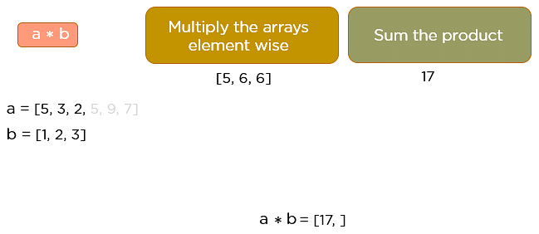
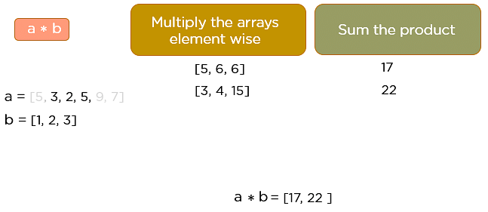
This process continues until the convolution operation is complete

Slide 6
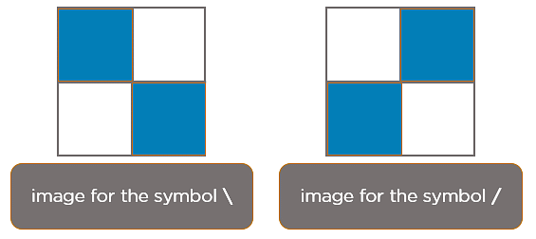
How Does CNN Recognize Images?
In CNN, every image is represented in the form of an array of pixel values.
When you press backslash (\), the below image gets processed.
When you press forward-slash (/), the below image is processed

Slide 7
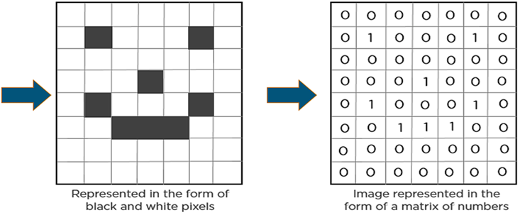
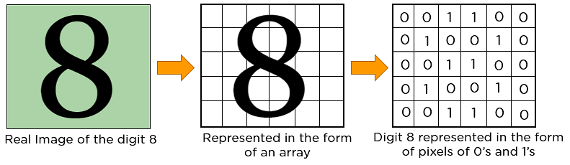

Slide 8
Layers in a Convolutional Neural Network
A convolution neural network has multiple hidden layers that help in extracting information from an image. The four important layers in CNN are:
Convolution layer
ReLU layer
Pooling layer
Fully connected layer

Slide 9
EXAMPLE
Imagine there’s an image of a bird, and you want to identify whether it’s really a bird or some other object.
The first thing you do is feed the pixels of the image in the form of arrays to the input layer of the neural network (multi-layer networks used to classify things).
The hidden layers carry out feature extraction by performing different calculations and manipulations.
There are multiple hidden layers like the convolution layer, the ReLU layer, and pooling layer, that perform feature extraction from the image.
Finally, there’s a fully connected layer that identifies the object in the image.

Slide 10
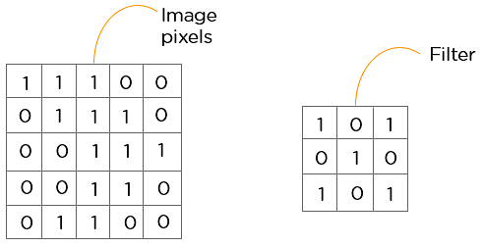
Convolution Layer
This is the first building block of a CNN for extracting valuable features from an image. A convolution layer has several filters that perform the convolution operation. Every image is considered as a matrix of pixel values.
Consider the following 5x5 image whose pixel values are either 0 or 1. There’s also a filter matrix with a dimension of 3x3. Slide the filter matrix over the image and compute the dot product to get the convolved feature matrix.
1*1+1*0+1*1+0*0+1*1+1*0+0*1+0*0+1*1

Slide 11
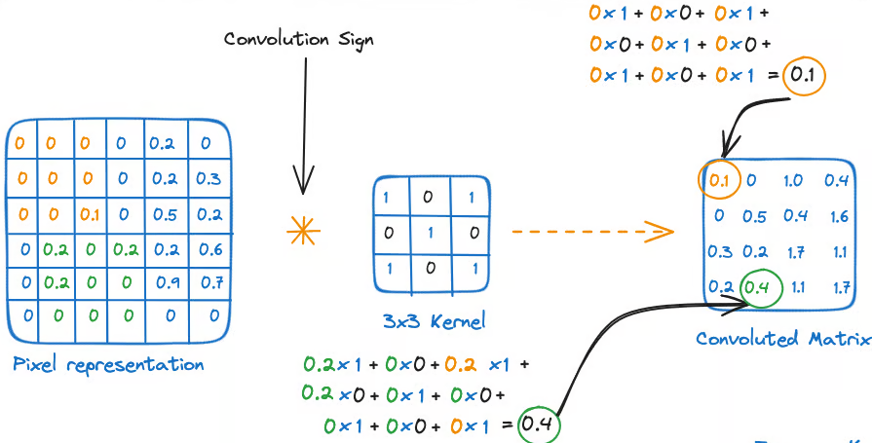

Slide 12
SUMMARY
The main mathematical task performed is called convolution, which is the application of a sliding window function to a matrix of pixels representing an image. The sliding function applied to the matrix is called kernel or filter.
In the convolution layer, several filters of equal size are applied, and each filter is used to recognize a specific pattern from the image, such as the curving of the digits, the edges, the whole shape of the digits, and more.
In the convolution layer, we use small grids (called filters or kernels) that move over the image. Each small grid is like a mini magnifying glass that looks for specific patterns in the photo, like lines, curves, or shapes.
As it moves across the photo, it creates a new grid that highlights where it found these patterns.

Slide 13
Activation Layer
Activation function is applied after each convolution operation. The activation layer introduces nonlinearity into the network by applying an activation function to the output of the previous layer.
This is crucial for the network to learn complex patterns.
Common activation functions, such as ReLU and its variants, Tanh, Sigmoid, and Softmax, transform the input while keeping the output size unchanged.
For instance, ReLU function helps the network learn non-linear relationships between the features in the image, hence making the network more robust for identifying different patterns. It also helps to mitigate the vanishing gradient problems.

Slide 14
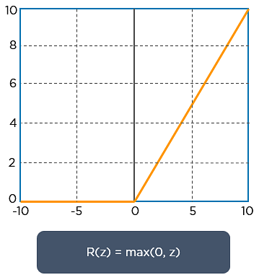
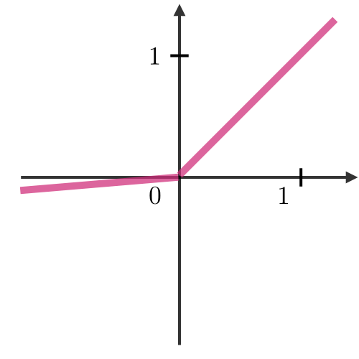
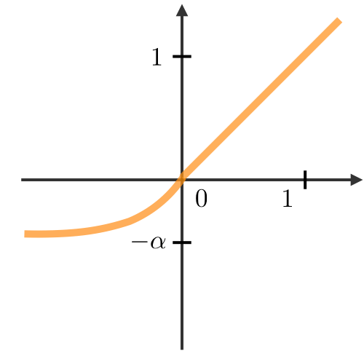
ReLU layer
ReLU (rectified linear unit). Once the feature maps are extracted, the next step is to move them to a ReLU layer.
ReLU performs an element-wise operation and sets all the negative pixels to 0. It introduces non-linearity to the network, and the generated output is a rectified feature map. Below is the graph of a ReLU function and other variants:
Leaky ReLU
ELU
g(z)=max(ϵz,z) with ϵ≪1ϵ≪1
g(z)=max(α(ez−1),z) with α≪1α≪1
Addresses dying ReLU issue for negative values
Differentiable everywhere

Slide 15
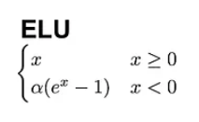
Exponential linear unit (ELU)
In contrast to ReLU, ELU have negative values, which allows them to push mean unit activations closer to zero, thereby making them less prone to vanishing gradients. Also, having mean activations closer to zero causes faster learning and convergence.
Vanishing gradient problem:
During training if the input is very large or very small (in the tails of the curve, close to 1 or -1), the gradients become very close to zero, which can slow down or stop the training process

Slide 16
ELU
ELU is very similiar to RELU except negative inputs. They are both in identity function form for non-negative inputs. On the other hand, ELU becomes smooth slowly until its output equal to −α whereas RELU sharply smoothes.
Pros
ELU becomes smooth slowly until its output equal to −α whereas RELU sharply smoothes.
ELU is a strong alternative to ReLU.
Unlike to ReLU, ELU can produce negative outputs.
Cons
For x>0, it can blow up the activation with the output range of [0, inf].

Slide 17
ReLU
Pros
It avoids and rectifies vanishing gradient problem.
ReLu is less computationally expensive than tanh and sigmoid because it involves simpler mathematical operations.
Cons
One of its limitations is that it should only be used within hidden layers of a neural network model.
Some gradients can be fragile during training and can die. It can cause a weight update which will makes it never activate on any data point again. In other words, ReLu can result in dead neurons.
In another words, For activations in the region (x<0) of ReLu, gradient will be 0 because of which the weights will not get adjusted during descent. That means, those neurons which go into that state will stop responding to variations in error/ input (simply because gradient is 0, nothing changes). This is called the dying ReLu problem.
The range of ReLu is [0,∞). This means it can blow up the activation.

Slide 18
LeakyRelu
LeakyRelu is a variant of ReLU. Instead of being 0 when z<0, a leaky ReLU allows a small, non-zero, constant gradient α (Normally, α=0.01). However, the consistency of the benefit across tasks is presently unclear. [1]
Pros
Leaky ReLUs are one attempt to fix the “dying ReLU” problem by having a small negative slope (of 0.01, or so).
Cons
As it possess linearity, it can’t be used for the complex Classification. It lags behind the Sigmoid and Tanh for some of the use cases.

Slide 19
Pooling Layer
Pooling is a down-sampling operation that reduces the dimensionality of the feature map
The goal of the pooling layer is to pull the most significant features from the convoluted matrix. The rectified feature map now goes through a pooling layer to generate a pooled feature map.
The pooling layer uses various filters to identify different parts of the image like edges, corners, body, feathers, eyes, and beak (e.g., bird).

Slide 20
Types of Pooling layer
Max pooling, which is the maximum value of the feature map. It preserves detected features hence most commonly used
Sum pooling corresponds to the sum of all the values of the feature map
Average pooling is the average of all the values. It downsamples feature map. Used in LeNet

Slide 21
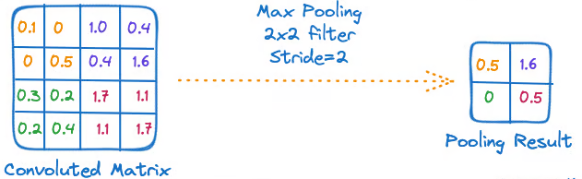
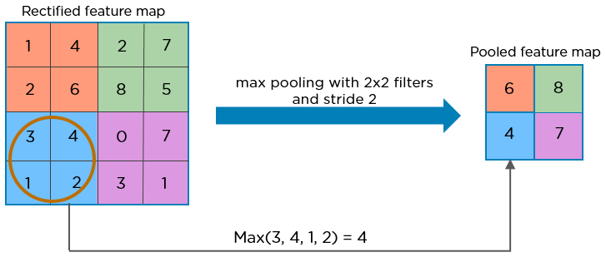
The last pooling layer flattens its feature map so that it can be processed by the fully connected layer.

Slide 22
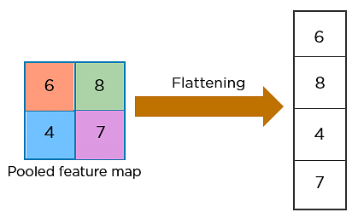
Flattening
After the convolution and pooling operations, the feature maps still exist in a multi-dimensional format.
Flattening is used to convert all the resultant 2-Dimensional arrays from pooled feature maps into a single long continuous linear vector (one-dimensional vector)
This process is essential because it prepares the data to be passed into fully connected layers for classification or regression tasks.

Slide 23
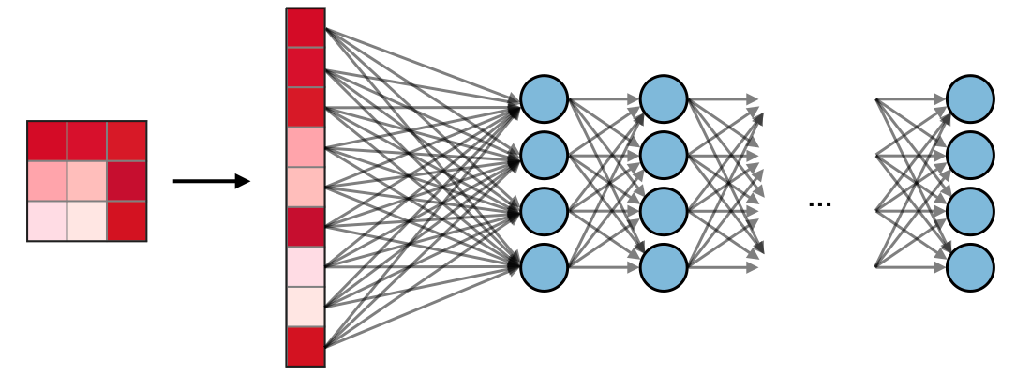
Fully Connected (FC)
The fully connected layer (FC) operates on a flattened input where each input is connected to all neurons. If present, FC layers are usually found towards the end of CNN architectures and can be used to optimize objectives such as class scores.

Slide 24
Output Layer
In the output layer, the final result from the fully connected layers is processed through a logistic function, such as sigmoid or softmax.
These functions convert the raw scores into probability distributions, enabling the model to predict the most likely class label.
Sigmoid: Great for yes/no decisions. Use when you need a binary choice, like deciding to attend a concert based on cost.
Tanh: Useful for handling positive/negative distinctions, like scoring with both positive and negative values.
Softmax: Use when you want a probability across multiple options, like choosing a favourite flavour with weighted preferences.

Slide 25
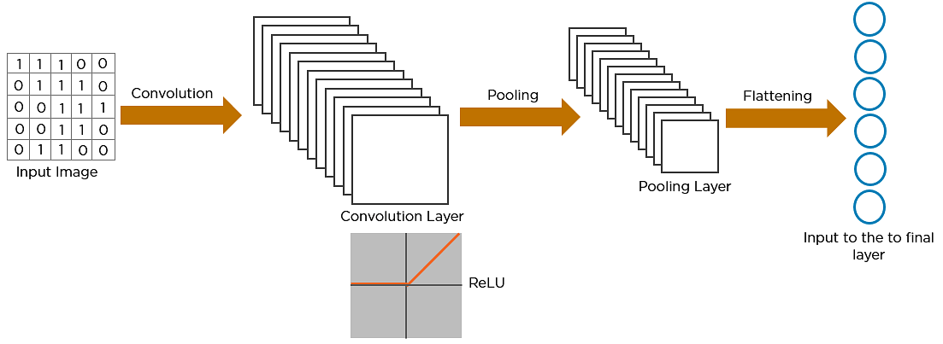
How exactly CNN recognizes an image
The pixels from the image are fed to the convolutional layer that performs the convolution operation. It results in a convolved map
The convolved map is applied to a ReLU function to generate a rectified feature map
The image is processed with multiple convolutions and ReLU layers for locating the features
Different pooling layers with various filters are used to identify specific parts of the image
The pooled feature map is flattened and fed to a fully connected layer to get the final output
CNN = AUMATIC FEATURE SELECTION + CLASSIFIER

Slide 26
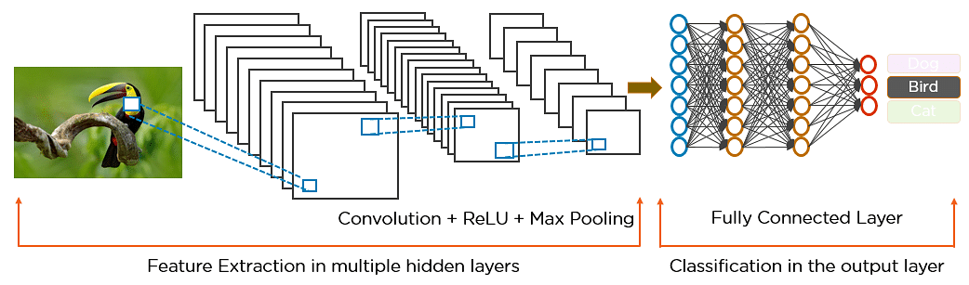
CNN = AUMATIC FEATURE SELECTION + CLASSIFIER

Slide 27
Training Convolutional Neural Network
Training a Convolutional Neural Network (CNN) involves guiding the model to recognize patterns in data through a step-by-step learning process. This is typically done using supervised learning, where the CNN is fed a bunch of images with their correct labels, and it gradually learns how to associate images with the right labels. The process:
Data Preparation: The images need to be prepared before training can start. This means making sure all the images are uniform in terms of format and size. This will ensure that the CNN gets consistent input, which is crucial for its learning process.
Loss Function: Once the images are ready, the next step is to figure out how well the CNN is doing. This is a scorecard that measures the difference between what the model predicted and the actual label of the image. The smaller the difference, the better the model is performing, so the goal is to reduce this gap as much as possible.

Slide 28
Optimizer: we now know how well (or poorly) the CNN is performing, it must be improved. The optimizer is like a coach that adjusts the network’s weights to help it do better. It tweaks the model's parameters to minimize the loss function, ultimately leading to more accurate predictions over time.
Backpropagation: It’s the process of figuring out how much each weight in the network contributed to the errors and then adjusting those weights accordingly. The optimizer uses this information to make smarter updates, helping the model get better with each round of training.

Slide 29
Evaluating CNN
Accuracy: Accuracy tells the overall percentage of test images that the CNN correctly classifies.
Precision: Precision focuses on how precise the CNN is when it predicts a particular class. It measures the percentage of test images that were predicted as a specific class and actually belong to that class. High precision means that when the CNN predicts a class, it’s likely correct.
Recall: Recall looks at how well the CNN identifies all instances of a particular class. It measures the percentage of test images that are of a certain class and were correctly identified as that class by the CNN. High recall indicates that the CNN is good at finding all relevant examples of a class.
F1 Score: This combines precision and recall into a single metric by calculating their harmonic mean. Suitable for evaluating the CNN’s performance on classes where there’s an imbalance. It provides a balanced measure that considers both false positives and false negatives, offering a more comprehensive view of the CNN’s performance.

Slide 30
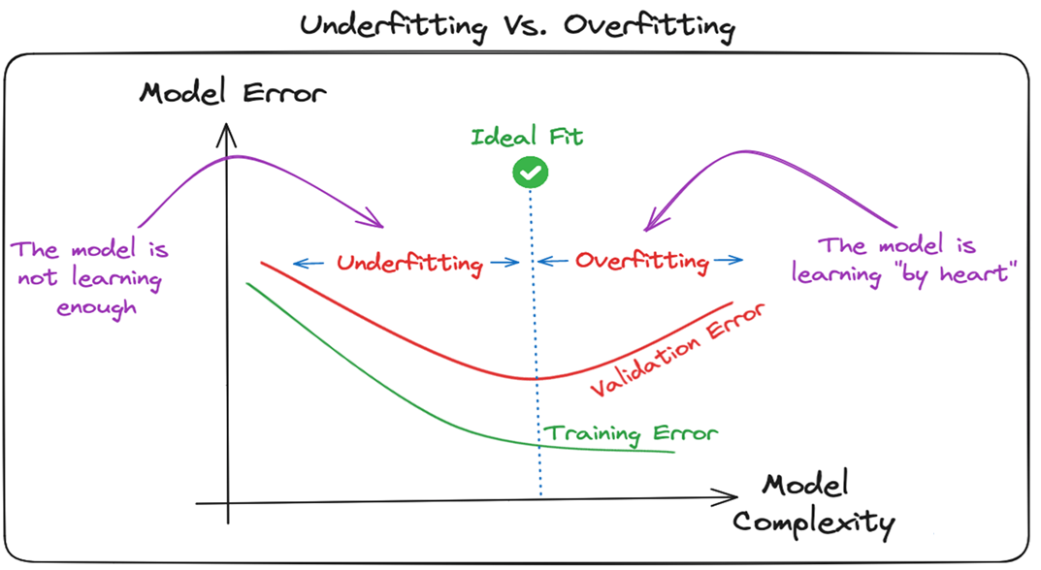
Overfitting and Regularization in CNNs

Slide 31
Overfitting is a common challenge in machine learning models and CNN deep learning projects.
It happens when the model learns the training data too well, including its noise and outliers. Such a learning leads to a model that performs well on the training data but badly on new, unseen data.
This can be observed when the performance on training data is too low compared to the performance on validation or testing data.
Deep learning models, especially Convolutional Neural Networks (CNNs), are particularly prone to overfitting due to their capacity for high complexity and their ability to learn detailed patterns in large-scale data.

Slide 32
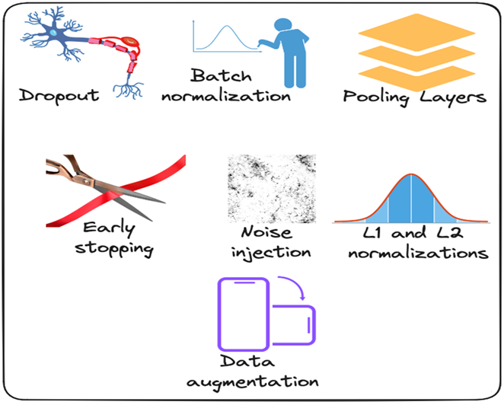
Strategies to mitigate Overfitting in CNNs

Slide 33
Dropout: This consists of randomly dropping some neurons during the training process, which forces the remaining neurons to learn new features from the input data.
Batch normalization: The overfitting is reduced at some extent by normalizing the input layer by adjusting and scaling the activations. This approach is also used to speed up and stabilize the training process.
Pooling Layers: This can be used to reduce the spatial dimensions of the input image to provide the model with an abstracted form of representation, hence reducing the chance of overfitting.
Early stopping: This consists of consistently monitoring the model’s performance on validation data during the training process and stopping the training whenever the validation error does not improve anymore.
Noise injection: This process consists of adding noise to the inputs or the outputs of hidden layers during the training to make the model more robust and prevent it from a weak generalization.
L1 and L2 normalizations: Both L1 and L2 are used to add a penalty to the loss function based on the size of weights. More specifically, L1 encourages the weights to be spare, leading to better feature selection. On the other hand, L2 (also called weight decay) encourages the weights to be small, preventing them from having too much influence on the predictions.
Data augmentation: This is the process of artificially increasing the size and diversity of the training dataset by applying random transformations like rotation, scaling, flipping, or cropping to the input images.

Slide 34
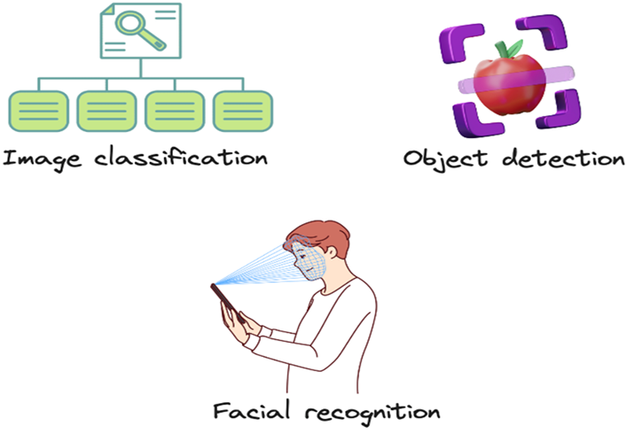
Applications of CNN

Slide 35
Image Classification: CNN in deep learning excels at image classification, which involves sorting images into predefined categories. They can effectively identify whether an image depicts a cat, dog, car, or flower, making them indispensable for tasks that require sorting and labeling large volumes of visual data.
Object Detection: CNNs are particularly skilled in object detection, allowing them to identify and pinpoint specific items within an image. Whether it's recognizing people, cars, or buildings, CNNs can locate these objects and highlight their positions, which is crucial for applications needing accurate object placement and identification.
Image Segmentation: CNNs are highly effective for tasks that involve breaking down an image into distinct parts. Image segmentation allows CNNs to distinguish and label different objects or regions within an image. This capability is essential in fields like medical imaging, where detailed analysis of structures is required, and in robotics, where intricate scenes need to be understood.
Video Analysis: CNNs are also adept at video analysis, where they can track objects and detect events over time. This makes them valuable for applications like surveillance and traffic monitoring, where continuously analyzing dynamic scenes helps in understanding and managing real-time activities.

Slide 36
Advantages of CNN
Apart from their diverse applications, here are some notable advantages of CNN in deep learning that highlight their effectiveness and versatility:
High Accuracy: Convolutional Neural Networks are known for their exceptional accuracy in image recognition tasks. They perform impressively in areas like classifying images, detecting objects, and segmenting visuals, setting a high benchmark for performance in these fields.
Efficiency: These networks are particularly efficient when used with specialized hardware such as GPUs. This efficiency allows CNNs to process large amounts of data quickly, which is crucial for applications that require heavy computational power.
Robustness: Convolutional Neural Networks handle noisy or inconsistent input data with impressive resilience. Their ability to maintain performance despite data imperfections makes them dependable for real-world applications where conditions can vary.
Flexibility: Another key advantage of Convolutional Neural Networks is their adaptability. They can be tailored to different tasks simply by altering their architecture. This makes them versatile tools that can be easily repurposed for diverse applications, from medical imaging to autonomous vehicles.

Slide 37
Disadvantages of Convolutional Neural Networks (CNNs)
Although Convolutional Neural Networks (CNNs) are powerful, they come with their own set of challenges:
Complexity and Training Difficulty: CNNs are intricate, and this complexity can make them difficult to train, especially when working with large datasets. Managing and fine-tuning the layers requires a deep understanding of the architecture, making it challenging even for seasoned professionals.
High Computational Demands: Another significant disadvantage is the high computational power required to train and deploy CNNs effectively. Advanced hardware, such as GPUs, is often necessary, which increases costs and limits access for those without these resources. This makes it difficult for smaller organizations to utilize CNNs efficiently.
Large Data Requirements: CNNs need a large amount of labeled data to perform well. Gathering and labeling data is time-consuming and expensive. For more complex applications, such as medical imaging, the precision needed in data labeling further increases the cost and effort involved.
Lack of Interpretability: One of the most notable challenges with CNNs is their black-box nature. It’s often difficult to understand why a CNN makes a certain prediction, which can be a significant issue in areas where decision-making transparency is important. This lack of interpretability can limit the trust placed in CNN-based systems, especially in critical applications like healthcare.

Slide 38
Types of Convolutional Neural Networks
LeNet: developed by Yann LeCun and his team in the late 1990s, is one of the earliest CNN architectures designed for handwritten digit recognition. It features a straightforward design with 2 convolutional and pooling layers followed by subsampling, and 3 fully connected layers. It laid the groundwork for modern CNNs.
AlexNet: created by Alex Krizhevsky and colleagues in 2012, revolutionized image recognition by winning the ImageNet Large Scale Visual Recognition Challenge (ILSVRC). Its architecture includes 5 convolutional layers and 3 fully connected layers, with innovations like ReLU activation and dropout.
ResNet or Residual Networks: introduced the concept of residual connections, allowing the training of very deep networks without overfitting. Its architecture uses skip connections to help gradients flow through the network effectively, making it well-suited for complex tasks.

Slide 39
GoogleNet: (InceptionNet), is known for its efficiency and high performance in image classification. It introduces the Inception module, which allows the network to process features at multiple scales simultaneously. With global average pooling and factorized convolutions, it achieves high accuracy while using fewer parameters and computational resources.
MobileNets: designed for mobile and embedded devices, offering a balance of high accuracy and computational efficiency. It use depth-wise separable convolutions to reduce the model size and computational demand while maintaining strong performance in image classification.
VGG networks: are simple and effective. They use a series of convolutional and pooling layers followed by fully connected layers. They are used in image recognition tasks, including object detection in self-driving cars.

Slide 40
END
STAY SAFE

