Slide 1

Note: The data and information in this document is reflective of a hypothetical situation and client. This document is to be used for KPMG Virtual Internship purposes only.
Sprocket Central Pty Ltd
Data analytics approach
[Division Name] - [Engagement Manager], [Senior Consultant], [Junior Consultant]

Slide 2
Note: The data and information in this document is reflective of a hypothetical situation and client. This document is to be used for KPMG Virtual Internship purposes only.
Agenda
Introduction
Data Exploration
Model Development
Interpretation

Slide 3
Note: The data and information in this document is reflective of a hypothetical situation and client. This document is to be used for KPMG Virtual Internship purposes only.
Introduction
The aim of this project is to build a predictive model that determines customer demographic and product characteristics that influences bike purchase and identify target customers based on their demographic attributes
We do a preliminary exploration of the data to comprehend the structure, oddities and patterns, isolating and rectifying anomalies to optimize data quality and reports and attempt to answer the following questions:
Are there any seasonal patterns in bike purchases?
What is the distribution of bike purchases across different age groups and genders?
How do bike purchases vary by state?
Which job industry categories have the highest number of bike purchases?
How does product size correlate with the number of purchases and profit margin?
What product classes are most popular among different age groups and genders?
How does the profit margin vary across different product sizes and classes?

Slide 4
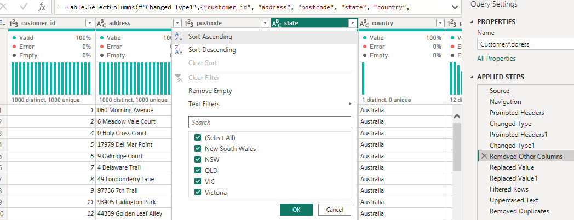
Note: The data and information in this document is reflective of a hypothetical situation and client. This document is to be used for KPMG Virtual Internship purposes only.
Introduction
After gathering, data exploration is vital step in data analysis process.
The following anomalies were identified and corrected: missing values, inconsistent records, incorrect data types and duplicate data.
We focused on variable identification, univariate and bi-variate analysis, treatment of missing values and outliers, feature engineering and variable creation, and summary statistics and visualization.

Slide 5
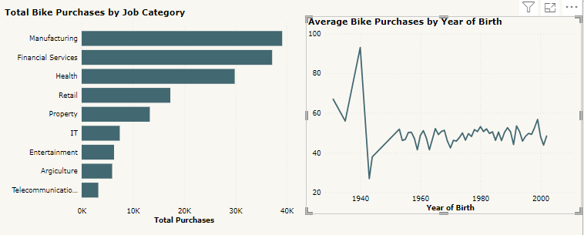
Note: The data and information in this document is reflective of a hypothetical situation and client. This document is to be used for KPMG Virtual Internship purposes only.
Data Exploration
We examine each variable by itself and then study relationships among the variables.
This is bi-variate analysis, showing variations of job category with summary statistics, sum of bike purchases made in the last three years.
The year of birth also varies with the average of bike purchases over the last three years.

Slide 6
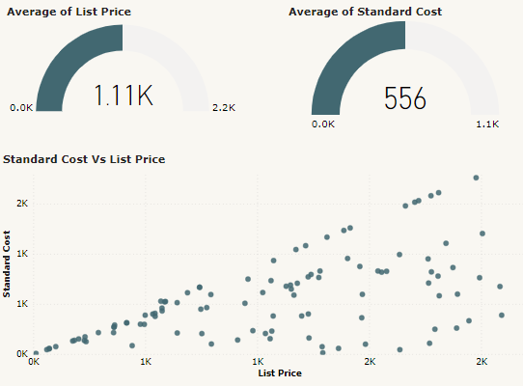
Note: The data and information in this document is reflective of a hypothetical situation and client. This document is to be used for KPMG Virtual Internship purposes only.
Data Exploration
This focusses on univariate analysis for list price and standard cost.
It also explores the relationship between standard cost and list price.
Summary statistics minimum, mean and maximum are used to highlight the important insights.

Slide 7
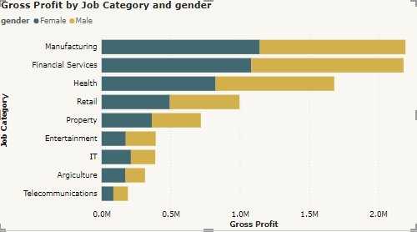
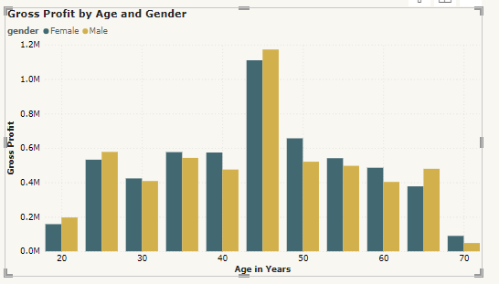
Note: The data and information in this document is reflective of a hypothetical situation and client. This document is to be used for KPMG Virtual Internship purposes only.
Data Exploration
These represent multivariate analysis of age, gender, job category and gross profit.
We created three measures using the List Price and Standard Cost.
Gross Profit, which is the difference between the list price (the selling price) and the standard cost (the cost of production).
Gross Profit Margin, which is the ratio of gross profit to list price and is expressed as a percentage.
Markup Percentage, which is the amount by which the cost of a product is increased to derive the selling price.

Slide 8
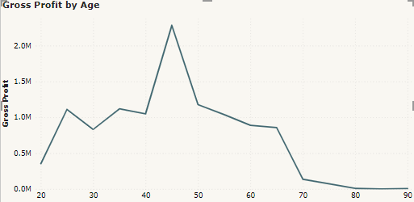
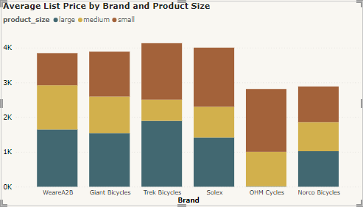
Note: The data and information in this document is reflective of a hypothetical situation and client. This document is to be used for KPMG Virtual Internship purposes only.
Data Exploration
We focusses on variable creation and feature engineering.
The variable gross profit has created to store the difference between list price and standard cost.
The graphs show the variation of gross profit with age, and among different brands of bike based on the product size.

Slide 9
Note: The data and information in this document is reflective of a hypothetical situation and client. This document is to be used for KPMG Virtual Internship purposes only.
Model Development
We develop a hypothesis related to the business question that can be answered with the data and determine the validity of the hypothesis by performing statistical testing
We want to determine customer demographic and product characteristics that influences the number of bike purchases.
Feature engineering and creation of variables, converting DOB into age and age groups and creating product and profit margins.
Develop the predictive model using various machine learning algorithms such as linear regression, Random forest and Decision Tree.
Random Forest
Mean Absolute Error (MAE): 2.235
Mean Squared Error (MSE): 30.96
Root Mean Squared Error (RMSE): 5.564
R_squraed (R_Squared): 0.9625
(b) Decision Tree
Mean Absolute Error (MAE): 0.5469
Mean Squared Error (MSE): 23.70
Root Mean Squared Error (RMSE): 4.868
R_squraed (R_Squared): 0.9713

Slide 10
Note: The data and information in this document is reflective of a hypothetical situation and client. This document is to be used for KPMG Virtual Internship purposes only.
Model Development
Chose the optimal model
Mean Absolute Error (MAE): Decision Tree (DT) has a lower MAE (0.5469) compared to the Random Forest (RF) (2.2347) hence better performance in terms of average error magnitude.
Mean Squared Error (MSE): Is low in DT (23.7020) compared to RF (30.9548) hence DT penalizes larger errors more heavily.
Root Mean Squared Error (RMSE): Again is low in DT (4.8685) compared to the RF (5.5637) hence better performance with greater sensitivity to outliers.
R-squared (R²): DT has a higher R² (0.9713) compared to the RF (0.9625) hence it explains more variance in the target variable and thus has better explanatory power.
Therefore, the Decision Tree model is the better choice between the two.

Slide 11
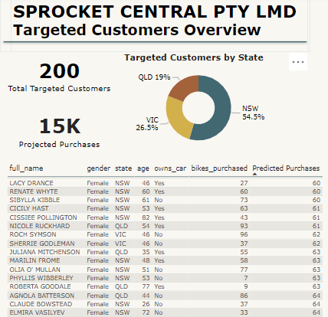
Note: The data and information in this document is reflective of a hypothetical situation and client. This document is to be used for KPMG Virtual Internship purposes only.
Interpretation
We visualize and presents the findings.
This shows the number of female customers in the new_customer_list, which were predicted by the model.
These customers, out of 1000 new customers are once who should be targeted by SPROCKET LTD to improve their bike sales

Slide 12
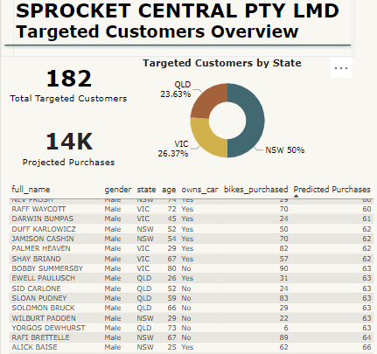
Note: The data and information in this document is reflective of a hypothetical situation and client. This document is to be used for KPMG Virtual Internship purposes only.
Interpretation
This shows the number of male customers in the new_customer_list, which were predicted by the model.
These customers, out of 1000 new customers are once who should be targeted by SPROCKET LTD to improve their bike sales and maximize profit.
From the model prediction, there are more female target customers than the males. Also, most of the targeted customers are from New South Wales state, most of whom do not own a car and are of advanced age.

Slide 13
Note: The data and information in this document is reflective of a hypothetical situation and client. This document is to be used for KPMG Virtual Internship purposes only.
Appendix

Slide 14
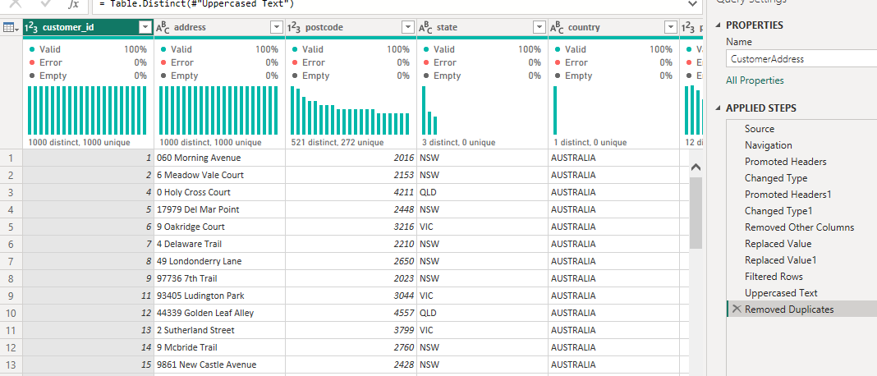
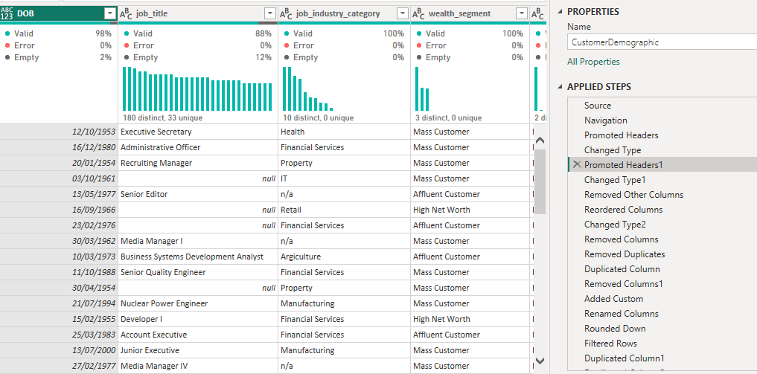
Note: The data and information in this document is reflective of a hypothetical situation and client. This document is to be used for KPMG Virtual Internship purposes only.
Appendix
The sample anomalies and steps to mitigate them are attached

Slide 15
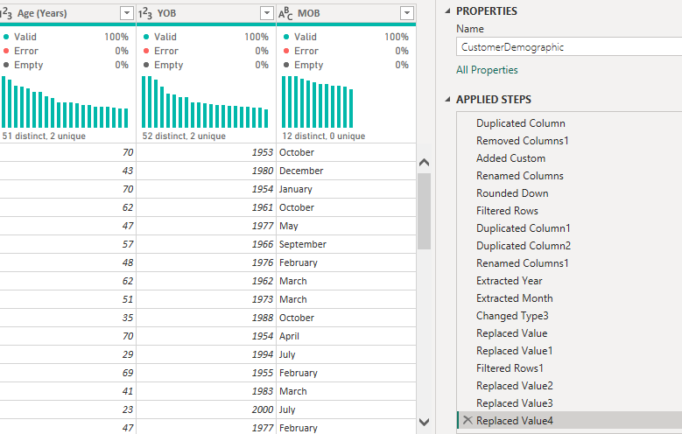
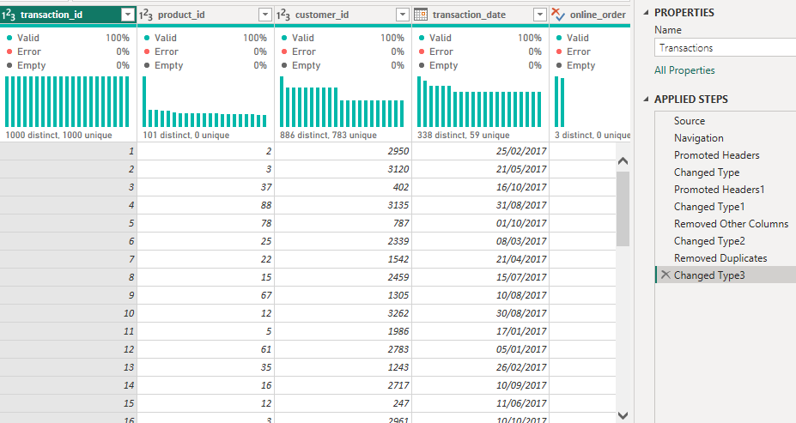
Note: The data and information in this document is reflective of a hypothetical situation and client. This document is to be used for KPMG Virtual Internship purposes only.
Appendix

