Slide 1
CSS PART 1
KNOWLEDGE SHADE

Slide 2
Use of CSS
KNOWLEDGE SHADE
CSS is used to style it and lay it out. For example, you can use CSS to alter the font, color, size, and spacing of your content, split it into multiple columns, or add animations and other decorative features

Slide 3
Modules to learn CSS
KNOWLEDGE SHADE
CSS First Step
CSS (Cascading Style Sheets) is used to style and layout web pages
— for example, to alter the font, color, size, and spacing of your content, split it into multiple columns, or add animations and other decorative features. This module provides a gentle beginning to your path towards CSS mastery with the basics of how it works, what the syntax looks like, and how you can start using it to add styling to HTML

Slide 4
Modules to learn CSS
KNOWLEDGE SHADE
2. CSS building blocks
This module carries on where CSS first steps left off — now you've gained familiarity with the language and its syntax, and got some basic experience with using it, it's time to dive a bit deeper. This module looks at the cascade and inheritance, all the selector types we have available, units, sizing, styling backgrounds and borders, debugging, and lots more.
The aim here is to provide you with a toolkit for writing competent CSS and help you understand all the essential theory, before moving on to more specific disciplines like text styling and CSS layout.

Slide 5
Modules to learn CSS
KNOWLEDGE SHADE
3. CSS Styling Text
With the basics of the CSS language covered, the next CSS topic for you to concentrate on is styling text — one of the most common things you'll do with CSS. Here we look at text styling fundamentals, including setting font, boldness, italics, line and letter spacing, drop shadows, and other text features. We round off the module by looking at applying custom fonts to your page, and styling lists and links

Slide 6
Modules to learn CSS
KNOWLEDGE SHADE
4. CSS Layouts
At this point, we've already looked at CSS fundamentals, how to style text, and how to style and manipulate the boxes that your content sits inside. Now it's time to look at how to place your boxes in the right place with respect to the viewport, and one another. We have covered the necessary prerequisites so we can now dive deep into CSS layout, looking at different display settings, modern layout tools like flexbox, CSS grid, and positioning, and some of the legacy techniques you might still want to know about.

Slide 7
CSS First Step
KNOWLEDGE SHADE
Q - What is difference between Block level and Inline level Element?
Block level elements always start with new line,
assigned full width of the page and
space is given as margin before and after the block level element defined
Inline Level elements does not start new line and
will take default width of the element.

Slide 8
CSS First Step
KNOWLEDGE SHADE
Block Level Elements
<address>
<article>
<aside>
<blockquote>
<canvas>
<dd>
<div>
<dl>
<dt>
<fieldset>
<figcaption>
<figure>
<footer>
<form>
<h1>-<h6>
<header>
<hr>
<li>
<main>
<nav>
<noscript>
<ol>
<p>
<pre>
<section>
<table>
<tfoot>
<ul>
<video>

Slide 9
CSS First Step
KNOWLEDGE SHADE
Inline Level Elements
<a>
<abbr>
<acronym>
<b>
<bdo>
<big>
<br>
<button>
<cite>
<code>
<dfn>
<em>
<i>
<img>
<input>
<kbd>
<label>
<map>
<object>
<output>
<q>
<samp>
<script>
<select>
<small>
<span>
<strong>
<sub>
<sup>
<textarea>
<time>
<tt>
<var>

Slide 10
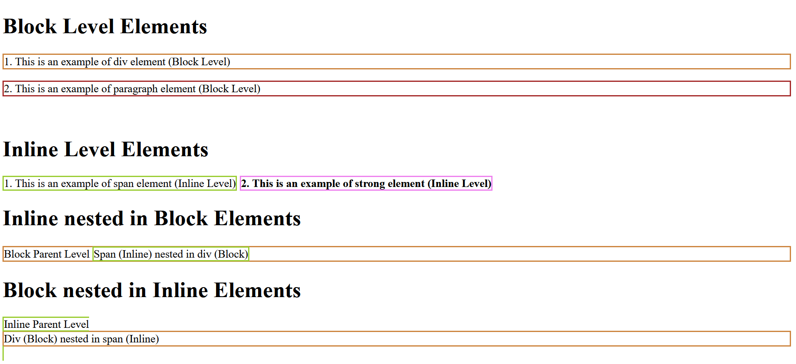
CSS First Step
KNOWLEDGE SHADE
Block Level and Inline Element Example
Check out File
Code/blockvsinline.html

Slide 11
CSS First Step
KNOWLEDGE SHADE
CSS Using Types in HTML
Inline CSS
Internal CSS
External CSS
By Using Style Attribute in HTML Element (Always write in String Quotes “” )
By using a <style> element in the <head> section
By using a <link> element to link to an external CSS file

Slide 12
CSS First Step
KNOWLEDGE SHADE
Examples of ways CSS can be added in HTML
Inline CSS
<p style=“background-color: yellowgreen; border: 1px solid grey”>This is Paragraph</p>
<html>
<head>
<style>
div{
background-color: yellowgreen;
}
</style>
</head>
<body>
<div>This is div Element</div>
</body>
</html>
2. Internal CSS
3. External CSS
<link rel=“stylesheet” href=“./style.css” ></link>

Slide 13
CSS First Step
Topics to cover
1. CSS Selectors (Click Here)

Slide 14
CSS First Step
Types of CSS Selectors
Simple CSS Selectors
Attribute Selectors
Grouping CSS Selector
CSS Combinators
Pseudo-class Selector
Pseudo-element Selector

Slide 15
CSS First Step
Simple CSS Selectors
1. Universal selector ( *{ } )
This is use to select all elements in document or body
2. Type selector
Used for selecting same type of element eg ( div, p, input, span, strong, button, etc )
3. Class selector (. dot)
Used for selecting multiple elements with same class attribute doesn’t mater the element type
4. ID selector (# hash)
Used to select Only Single Element

Slide 16

CSS First Step
Group CSS Selectors
For Grouping two or more than two elements selector we use comma “ , ”
<div class="Big">This is div with class Big</div>
<div class="Bold">This is div with class Bold</div>
<div id=“red">This is div with id red</div>
Example
In this example we have selected
Big Class , Bold Class and red Id
Using Comma Separator and given
Style to all three at once
<style>
.Big,
.Bold,
#red {
font-size: 20pt;
font-weight: bold;
color: red
}
</style>

Slide 17
CSS First Step
Attribute CSS Selectors
The [attribute] selector
The [attribute="value"] selector
The [attribute~="value"] selector
The [attribute^="value"] selector
The [attribute$="value"] selector
The [attribute*="value"] selector
Presence And Value Selector
Substring matching Selector

Slide 18
CSS First Step
Attribute CSS Selectors
Presence and value selectors
Selector | Example | Description
[attr] | a[title] | Matches elements with an attr attribute (whose name is the value in square brackets).
[attr=value] | a[href="https://example.com"] | Matches elements with an attr attribute whose value is exactly value — the string inside the quotes.
[attr~=value] | p[class~="special"] | Matches elements with an attr attribute whose value is exactly value, or contains value in its (space separated) list of values.

Slide 19
CSS First Step
Attribute CSS Selectors
Substring matching selectors
Selector | Example | Description
[attr^=value] | li[class^="box-"] | Matches elements with an attr attribute, whose value begins with value.
[attr$=value] | li[class$="-box"] | Matches elements with an attr attribute whose value ends with value.
[attr*=value] | li[class*="box"] | Matches elements with an attr attribute whose value contains value anywhere within the string.

Slide 20
CSS First Step
CSS Combinators Selectors
Descendant combinator
Direct child combinator
General sibling combinator
Adjacent sibling combinator

Slide 21
CSS First Step
Pseudo Class CSS Selectors
Pseudo-class selectors for links
Pseudo-class selectors for inputs
Pseudo-class selectors for position

Slide 22
CSS First Step
Pseudo Element Selectors
The ::before pseudo-element
The ::after pseudo-element
The ::first-letter pseudo-element
The ::first-line pseudo-element

Slide 23
CSS Inheritance
Inheritance in CSS means which CSS declaration type will be given more priority than other
Declaration Priority
Inline CSS > Internal CSS > External CSS
Selector Priority
Id Selector > Class Selector > Universal Selector

