Slide 1
Internet
Problem
Before 1960s in those days computers were build with large Architecture and was immobile
For transferring data we need magnetic tapes to be transferred with data inbounded
Solution
So for sharing the data from one computer to other computer an network is created which is called Internet
The Internet started in the 1960s for government research
January 1, 1983 is considered the official birthday of the Internet.
Prior to this, the various computer networks did not have a standard way to communicate with each other.
A new communications protocol was established called Transfer Control Protocol/Internetwork Protocol (TCP/IP)

Slide 2
Birth of Web
Problem
Data started sharing among internet in form of complex text.
Difficult to understand by normal people
Require High Knowledge of Networking Protocols
Solution
A way to get centralized , simple and organized data in human readable form.
So Tim Berners-Lee, a British scientist, invented the World Wide Web (WWW) in 1989, while working at CERN.
The Web was originally conceived and developed to meet the demand for automated information-sharing between scientists in universities and institutes around the world

Slide 3
HTML
Hyper Text Markup Language
HTML was created by Sir Tim Berners-Lee in late 1991 but was not officially released. It was published in 1995 as HTML 2.0. HTML 4.01 was published in late 1999 and was a major version of HTML. HTML is a very evolving mark-up language and has evolved with various versions updating

Slide 4
HTML Structure
The basic structure of an HTML document consists of 5 elements:
1. <!DOCTYPE >
2. <html>
3. <head>
4. <title>
5. <body>

Slide 5
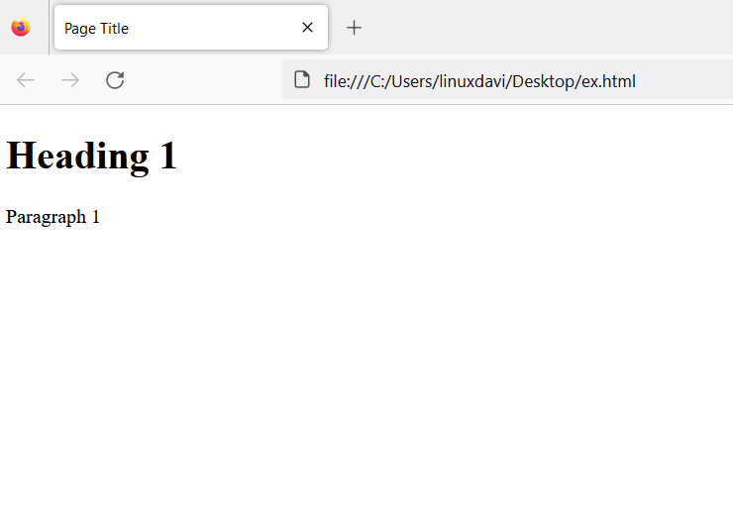
HTML Structure E.g.
<!DOCTYPE html>
<html>
<head>
<title>Page Title</title>
</head>
<body>
<h1>Heading 1</h1>
<p>Paragraph 1</p>
</body>
</html>

Slide 6
Structure Elements Explanation
The <!DOCTYPE html> declaration defines that this document is an HTML5 document
The <html> element is the root element of an HTML page
The <head> element contains meta information about the HTML page
The <title> element specifies a title for the HTML page (which is shown in the browser's title bar or in the page's tab)
The <body> element defines the document's body, and is a container for all the visible contents, such as headings, paragraphs, images, hyperlinks, tables, lists, etc.
The <h1> element defines a large heading
The <p> element defines a paragraph

Slide 7
Recommended Editor
Visual Studio (Microsoft Corporation)
Notepad++ (Microsoft Corporation)
Sublime Text (Created by Jon Skinner - it is a product of Sublime HQ Pty Ltd)

Slide 8
Starter Extension for Visual Studio
Prettier
Live Server

Slide 9
Introduction with <tags>
HTML tags are like keywords which defines that how web browser will format and display the content.
With the help of tags, a web browser can distinguish between an HTML content and a simple content.
HTML tags contain three main parts: opening tag, content and closing tag. But some HTML tags are unclosed tag
Browser read tags from top to bottom and left to right
<h1> Heading </h1>
Opening Tag
Content
Closing Tag

Slide 10
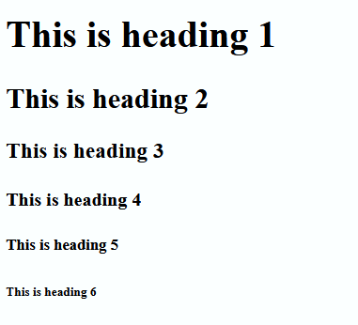
Basic of HTML tags
HTML Headings
HTML Headings are defined in range from h1 to h6
h1 is the Largest
h6 is the Smallest
Example
<!DOCTYPE html>
<html>
<body>
<h1> This is heading 1</h1>
<h2> This is heading 2</h2>
<h3> This is heading 3</h3>
<h4> This is heading 4</h4>
<h5> This is heading 5</h5>
<h6> This is heading 6</h6>
</body>
</html>

Slide 11
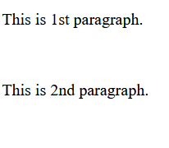
Basic of HTML tags
HTML Paragraph
HTML paragraphs are defined with the <p> tag
Example
<!DOCTYPE html>
<html>
<body>
<p> This is 1st paragraph. </p> <p> This is 2nd paragraph. </p>
</body>
</html>

Slide 12
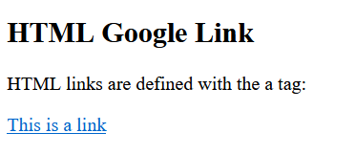
Basic of HTML tags
HTML Links
HTML links are defined with the <a> tag
Example
<!DOCTYPE html>
<html>
<body>
<h2> HTML Google Link </h2>
<p> HTML links are defined with the a tag: </p>
<a href="https://www.google.com"> This is a link </a>
</body>
</html>

Slide 13
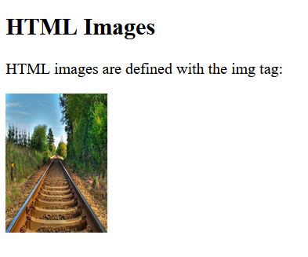
Basic of HTML tags
HTML Images
HTML images are defined with the <img> tag.
The source file (src), alternative text (alt), width, and height are provided as attributes:
Example
<!DOCTYPE html>
<html>
<body>
<h2>HTML Images</h2>
<p>HTML images are defined with the img tag:</p>
<img src="https://images.freeimages.com/images/large- previews/ac9/railway-hdr-1361893.jpg" alt="Train Rails" width="104" height="142">
</body>
</html>

Slide 14
Basic of HTML tags
HTML Images
HTML images are defined with the <img> tag.
The source file (src), alternative text (alt), width, and height are provided as attributes:
Example
<!DOCTYPE html>
<html>
<body>
<h2>HTML Images</h2>
<p>HTML images are defined with the img tag:</p>
<img src="https://images.freeimages.com/images/large- previews/ac9/railway-hdr-1361893.jpg" alt="Train Rails" width="104" height="142">
</body>
</html>

Slide 15
Basic of HTML tags
Introduce Single sided tags
<br /> (Break Row)
<hr /> (Horizontal Line)

Slide 16
More tags to explore
<i></i> Italic format tag
<u></u> Underline format tag
<b></b> Bold tag
<s></s> Strike Throw Text

Slide 17
HTML Table
<table>
<tr>
<th>Column1</th>
<th>Column2</th>
<th>Column3</th>
</tr>
<tr>
<td>Row1 Data1</td>
<td>Row2 Data2</td>
<td>Row 3 Data3</td>
</tr>
</table>
<table> -> table tag
<tr> -> table row
<th> -> table header
<td> -> table data

Slide 18
HTML List
Unordered List Attribute
type
Can change via style EG
style:”list-style-type:disc”
Disc
Circle
Square
Order List Attributes
1. type
2. Start
3. reversed
Unordered List <ul>
Ordered List <ol>
Other Lists
Type = “A”
Type = “1”
Type = “a”
Type = “I”
Type = “i”

