Slide 1
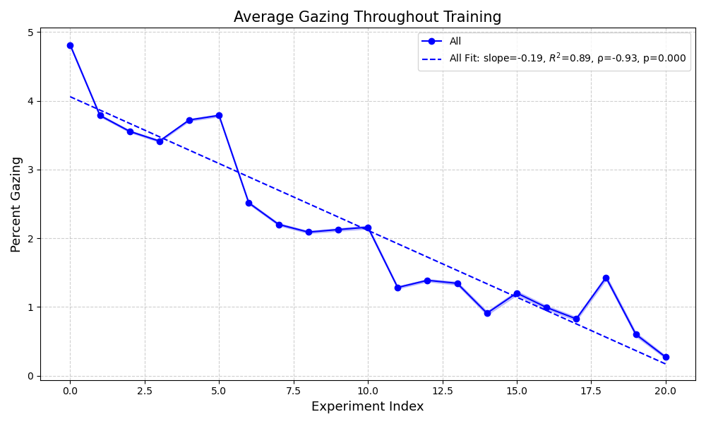
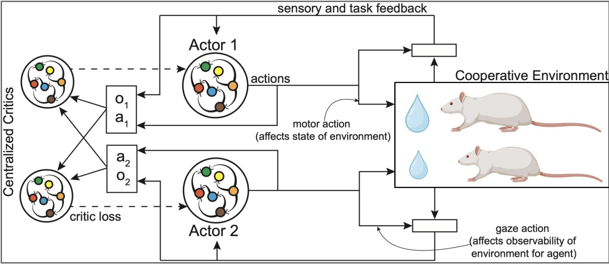
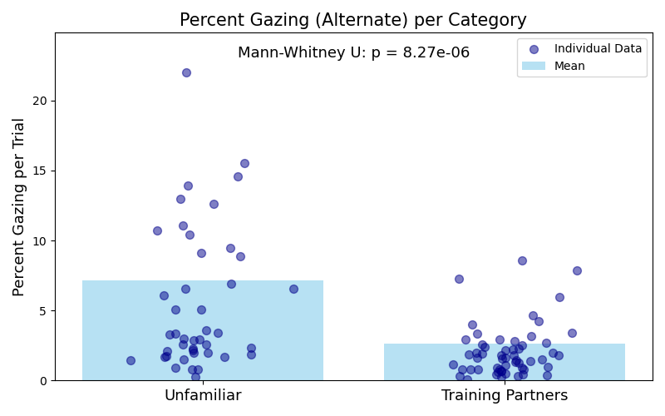
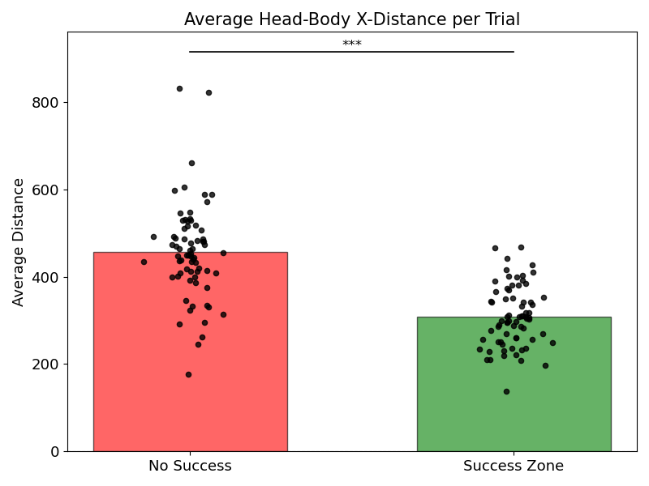
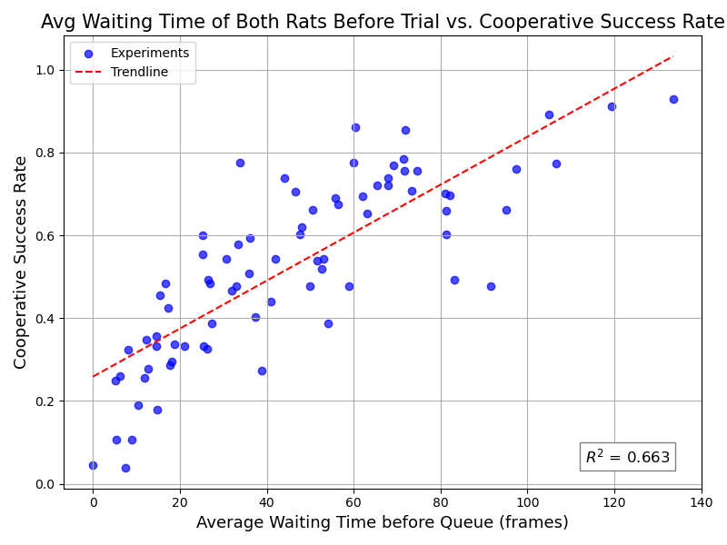
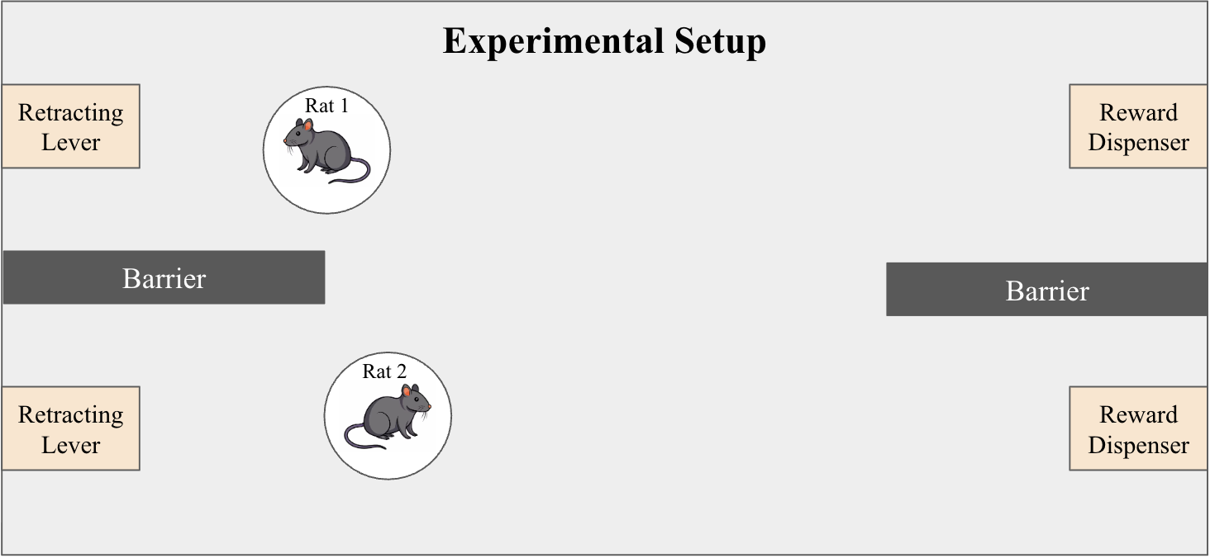
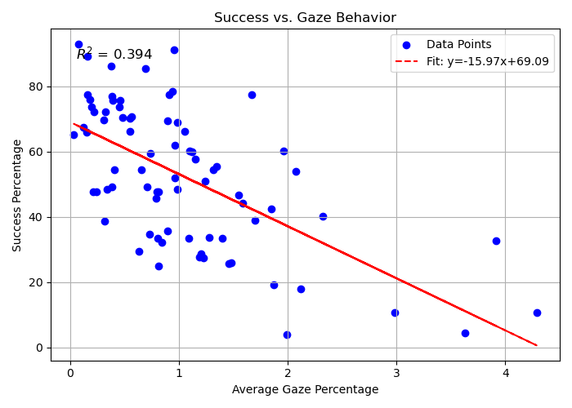
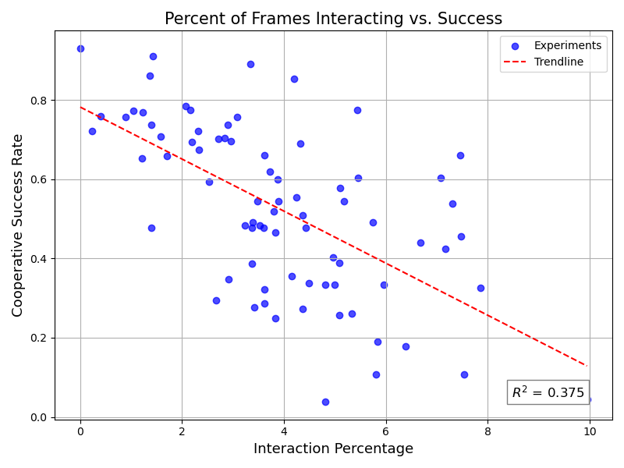
A Computational Framework for Studying Social Cooperation in Rats
David Backer Peral Wu Tsai Institute, Yale University
Introduction
Modeling Approach
Effects of Familiarity
Understanding the neural mechanisms that drive social cooperation is crucial for advancing our knowledge of social behavior and developing treatments for conditions such as autism spectrum disorder and early-life stress. Animals such as rats can model these mechanisms, though their behavioral variability makes analysis inherently challenging. While reinforcement learning (RL) has emerged as a promising framework for modeling animal behavior, multi-agent RL algorithms have not yet been applied to the study of social cooperation.
In order to test the validity of RL, we used experimental data of a freely behaving cooperative task in rats from Jane Taylor’s Lab to attempt to analyze the extent to which the models capture animal behavior.
Since we are interested in modeling cooperation, we are using the multi-agent deep deterministic policy gradient (MADDGP) algorithm in order to accurately model the cooperative aspect of the task.
Conclusions
Methods
Training: Animals were first subjected to Pavlovian Condition between the sound queue and the reward. Then they did Instrumental Training to learn to press a lever at the sound queue to obtain the reward.
Sessions: At the end of training, experimental sessions consisted of two rats in a cage with two levers on the left side and two reward dispensers on the right side. Each session had 30+ trials in which the levers came out at random periodic intervals with a sound queue. Rats were rewarded with a food pellet if they pressed the lever within 1 second of each other at the reward dispensers.
Cooperative Strategies
1)
Synchronization
Waiting
Success Rate by Number of Rats at Lever at Cue
FIGURE 1: Rats appear to be more synchronized in successful trials, where synchronization is defined as lower horizontal distance be
How Behaviors Influence Success
Experimental Modifications: Experimental sessions were conducted across different cohorts of rats with varying levels of familiarity. 1) Training Partners were pairs of rats that had been trained together, 2) Unfamiliar Rats had been trained with another partner but had not seen their current partner.
References
Last, Firstname (Year). Title. Journal. (pt 24)
Last, Firstname (Year). Title. Journal.
Last, Firstname (Year). Title. Journal.
logo 1
This research was funded by…
logo 2
david.backerperal@yale.edu

Slide 2
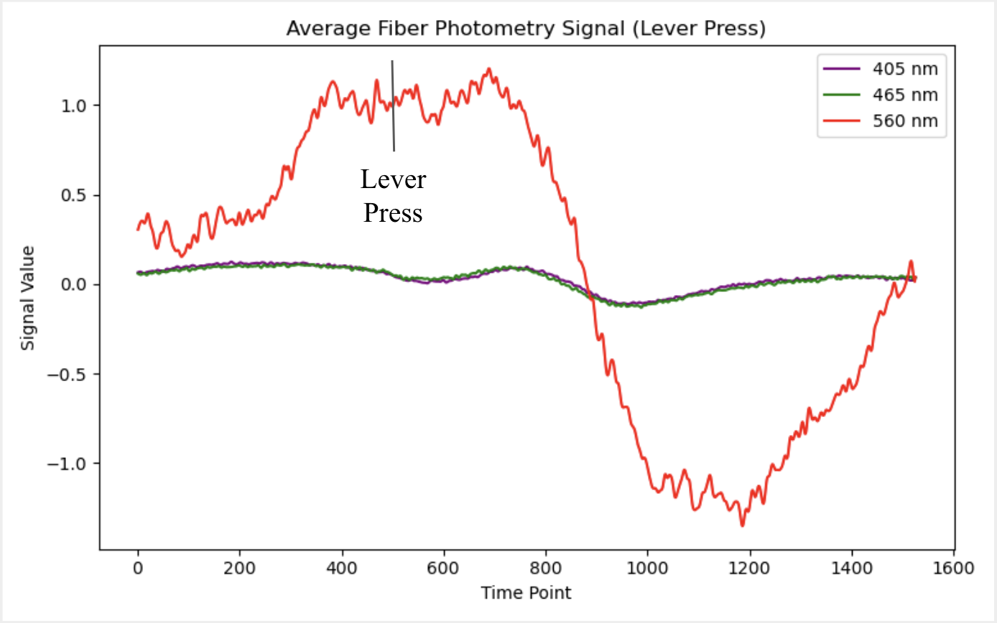
A Computational Framework for Studying Social Cooperation in Rats
David Backer Peral Wu Tsai Institute, Yale University
Introduction
Synchronization
Cooperative Strategies
Behavioral Conclusions
Understanding the neural mechanisms that drive social cooperation is crucial for advancing our knowledge of social behavior and developing treatments for conditions such as autism spectrum disorder and early-life stress. Animals such as rats can model these mechanisms, though their behavioral variability makes analysis inherently challenging. While reinforcement learning (RL) has emerged as a promising framework for modeling animal behavior, multi-agent RL algorithms have not yet been applied to the study of social cooperation.
In order to test the validity of RL, we used experimental data of a freely behaving cooperative task in rats from Jane Taylor’s Lab to attempt to analyze the extent to which the models capture animal behavior.
Strategy conclusions
Behavioral Conclusions
Familiarity Conclusions
FIGURE 1: Rats appear to be more synchronized in successful trials, where synchronization is defined as lower horizontal distance be
Waiting
Modeling Approach
Methods
Since we are interested in modeling cooperation, we are using the multi-agent deep deterministic policy gradient (MADDGP) algorithm in order to accurately model the cooperative aspect of the task.
Training:
Pavlovian Conditioning – Associate sound queue with reward
Instrumental Training – Associate lever press at sound queue with reward
Sessions:
Two rats in a cage with two levers on the left side and two reward dispensers on the right side with barriers in between
Rats rewarded if levers pressed within 1 second of each other
Experimental Modifications:
Training Partners – pairs of rats that have trained together
Unfamiliar – pairs of rats that have been trained but have not seen current partner
How Behaviors Influence Success
Success Rate by Number of Rats at Lever at Cue
How Behaviors Influence Success
Fiber Photometry
References
Fiber photometry data was collected in the Anterior Cingulate Cortex (ACC), specifically in the pathways to the Basolateral Amygdala (BLA) and Anterior Insulate Cortex (AIC); these brain regions have previously been found to be associated with cooperation [].
Control (405 nm)
ACC → BLA (465 nm)
ACC → AIC (560 nm)
Last, Firstname (Year). Title. Journal. (pt 24)
Last, Firstname (Year). Title. Journal.
Last, Firstname (Year). Title. Journal.
logo 1
This research was funded by…
logo 2
FIGURE 1. Neural Signals before and after lever press
david.backerperal@yale.edu

Slide 3

A Computational Framework for Studying Social Cooperation in Rats
David Backer Peral Wu Tsai Institute, Yale University
Introduction
Synchronization
Cooperative Strategies
Behavioral Conclusions
Understanding the neural mechanisms that drive social cooperation is crucial for advancing our knowledge of social behavior and developing treatments for conditions such as autism spectrum disorder and early-life stress. Animals such as rats can model these mechanisms, though their behavioral variability makes analysis inherently challenging. While reinforcement learning (RL) has emerged as a promising framework for modeling animal behavior, multi-agent RL algorithms have not yet been applied to the study of social cooperation.
In order to test the validity of RL, we used experimental data of a freely behaving cooperative task in rats from Jane Taylor’s Lab to attempt to analyze the extent to which the models capture animal behavior.
Strategy conclusions
Behavioral Conclusions
Familiarity Conclusions
FIGURE 1: Rats appear to be more synchronized in successful trials, where synchronization is defined as lower horizontal distance be
Waiting
Modeling Approach
Methods
Since we are interested in modeling cooperation, we are using the multi-agent deep deterministic policy gradient (MADDGP) algorithm in order to accurately model the cooperative aspect of the task.
Training:
Pavlovian Conditioning – Associate sound queue with reward
Instrumental Training – Associate lever press at sound queue with reward
Sessions:
Two rats in a cage with two levers on the left side and two reward dispensers on the right side with barriers in between
Rats rewarded if levers pressed within 1 second of each other
Experimental Modifications:
Training Partners – pairs of rats that have trained together
Unfamiliar – pairs of rats that have been trained but have not seen current partner
How Behaviors Influence Success
Success Rate by Number of Rats at Lever at Cue
How Behaviors Influence Success
Fiber Photometry
References
Fiber photometry data was collected in the Anterior Cingulate Cortex (ACC), specifically in the pathways to the Basolateral Amygdala (BLA) and Anterior Insulate Cortex (AIC); these brain regions have previously been found to be associated with cooperation [].
Control (405 nm)
ACC → BLA (465 nm)
ACC → AIC (560 nm)
Last, Firstname (Year). Title. Journal. (pt 24)
Last, Firstname (Year). Title. Journal.
Last, Firstname (Year). Title. Journal.
logo 1
This research was funded by…
logo 2
FIGURE 1. Neural Signals before and after lever press
david.backerperal@yale.edu

