Slide 1
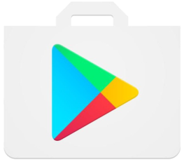
User
Management Computer
Download
Create account
The Internet
Web Server
Send and
Retrieve Data
User
Information for use of app
Web Server Database
Information from users

