Slide 1

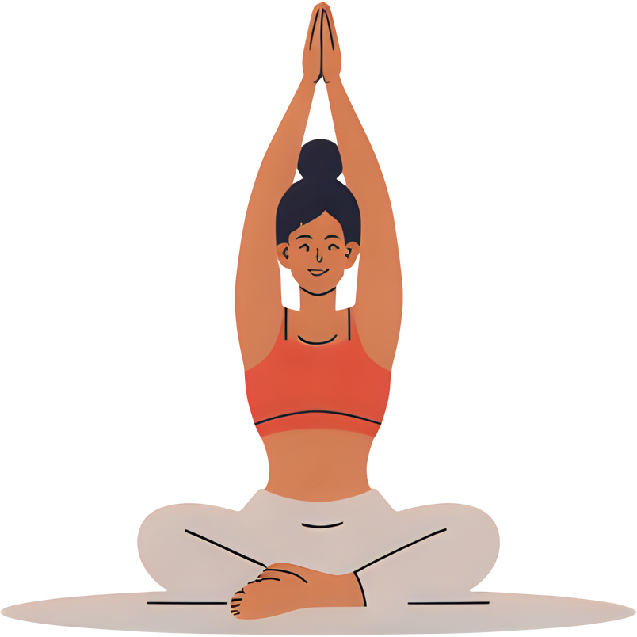


Case Study
By: Davina Flores

Slide 2

at a Glance
Health and Wellness company that was founded in 2014.
Bellabeat has created health-focused smart products designed to empower women through data and technology.
By gathering insights on activity, sleep, stress, and reproductive health, Bellabeat provides women with a clear understanding of their overall well-being.

Slide 3

ASK
What are some trends in smart device usage?
How could these trends apply to Bellabeat customers?
How could these trends help influence Bellabeat marketing strategy?

Slide 4

PREPARE
The dataset used for this case study is the FitBit Fitness Tracker Data, publicly available on Kaggle.
It contains data collected from 30 Fitbit users who consented to share their daily activity, sleep, and heart rate information over a period of approximately two months (March–May 2016).
These records include minute-level details of steps, heart rate, calories, and sleep logs, providing a detailed view of daily lifestyle patterns.

Slide 5


Process
Category | Description | Purpose/ Outcome
Tools Used | Utilized BigQuery for cleaning, transformation, and SQL queries. | Efficiently managed and analyzed large datasets.
Data Integrtiy | Verified dataset credibility from Kaggle. Checked for duplicates, nulls, and unrealistic values. | Ensured data accuracy and reliability.
Cleaning steps | Removed duplicates, standardized names, fixed dates, and merged tables by Id and Date. | Prepared clean, consistent data for analysis.
Documentation | Saved and labeled all queries in BigQuery. Created “cleaned_” versions of each file. | Ensured reproducibility and transparency in the cleaning process.

Slide 6
ACTIVITY LEVELS Categories
Sedentary | Lightly Active | Fairly Active | Very Active
<5000 Steps per day | 5,000 – 7,499 Steps per day | 7,500-9999 Steps per day | 10,000+ Steps per day

Slide 7
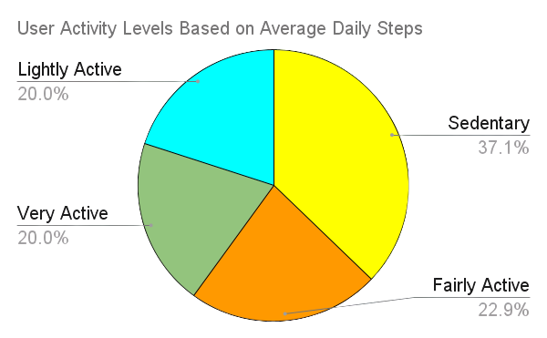

Slide 8
INSIGHTS
The dataset revealed key insights into how much time users spend in different activity intensities:
Very Active: Users spent an average of ≈ 730 minutes engaging in higher-intensity physical activity.
Lightly Active: Users averaged ≈ 185 minutes of light physical movement such as casual walking or everyday tasks.
Sedentary: Users were inactive for approximately ≈ 671 minutes, indicating a large portion of the day spent sitting or stationary.

Slide 9
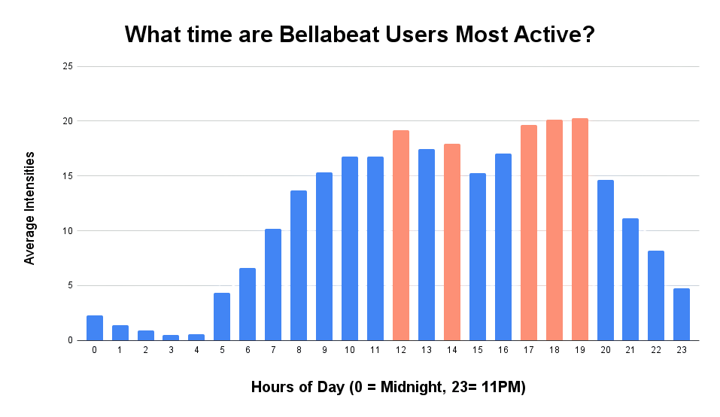
The chart demonstrates the average hourly activity intensity of Bellabeat users throughout the day. The data reveals that users are generally less active during early morning hours, with activity levels steadily increasing as the day progresses. Notably, there is a midday uptick around 12 PM to 2 PM, followed by a significant rise in physical activity between 5 PM and 7 PM, suggesting that users tend to be most active after work hours.

Slide 10




Recommendations
After Work Unwind Program | Evening activity peaks between 5 PM and 7 PM, showing users prefer exercising after work. Bellabeat can launch short guided routines like yoga, stretching, meditation/ relaxation sessions to help users de-stress and maintain consistent evening wellness habits.
Community Challenges by Time of Day | Activity spikes at predictable hours suggest opportunities for group motivation. Bellabeat can create time-based community challenges (e.g., “Lunch Break Movers,” “Evening Energizers” or a Steps Leaderboard) to encourage accountability and build engagement during users’ most active times.
Mindful Break Reminders | A small midday uptick between 12 PM and 2 PM shows users move more during breaks. Bellabeat can send gentle reminders encouraging stretching, desk yoga, or short guided breathing exercises to help reduce stress. Notifications can also include uplifting quotes or affirmations, inspiring users to pause, breathe, and reset throughout their day.

