Slide 1
Movies Database – ETL PROJECT
BY Christine, Davinder & Fatima

Slide 2
Datasets used to EXTRACT
The Movies Dataset from Kaggle:
Metadata on over 45,000 movies. 26 million ratings from over 270,000 users.
https://www.kaggle.com/rounakbanik/the-movies-dataset
5 data files:
movies_metadata (45,466 rows x 24 columns)
credits (45,476 rows x 3 columns)
keywords (45,410 rows x 2 columns)
links (45,843 rows x 3 columns)
ratings (26,024,289 rows x 4 columns)

Slide 3
TRANSFORM
Before
After
Dictionaries in columns for cast, crew, keywords and movie genres
5 files
Columns with different data types
Created separate lists to be extracted into separate tables for 3 files
1 database with 9 tables
Updated like columns to same data types
Assigned primary and foreign keys for relational database

Slide 4
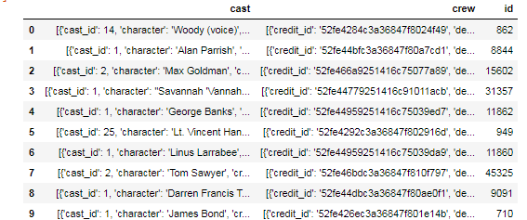
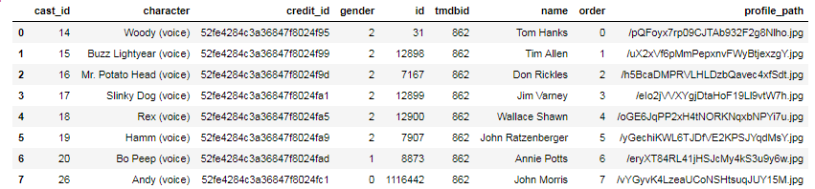
Transform
Credits_df before
Cast_df after

Slide 5
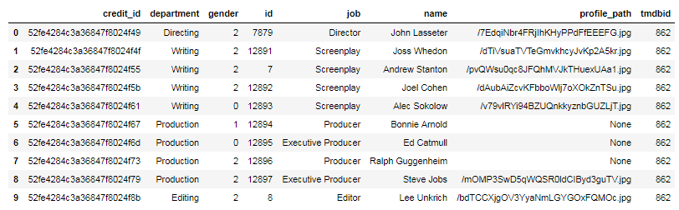
Transform
Credits_df before
Crew_df after

Slide 6
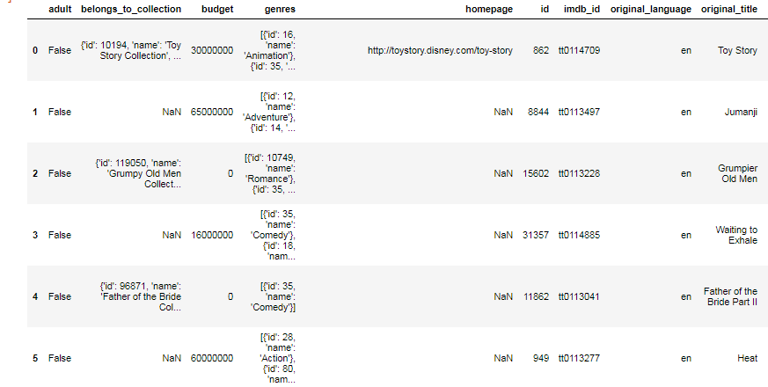
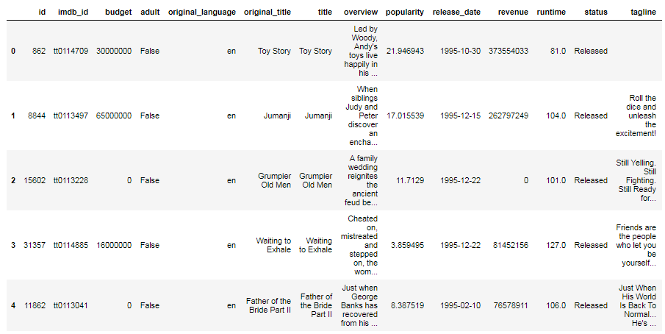
Transform
Movies_metadata_df before
Movies_metadata_df after

Slide 7
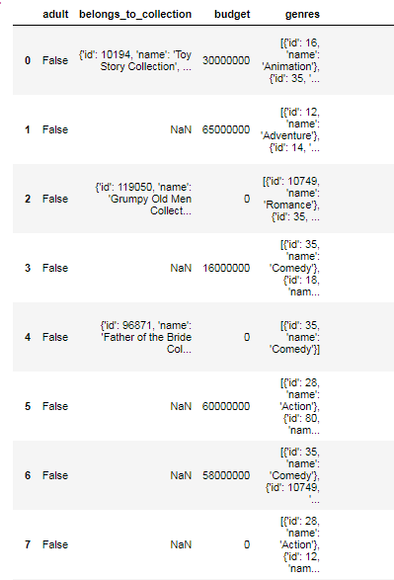
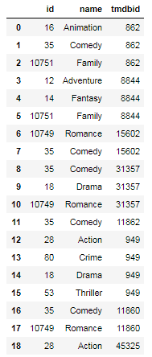
Transform
Movies_metadata_df before
genres_df after

Slide 8
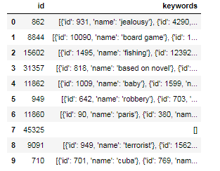
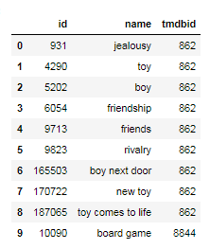
Transform
KEYWORDs_df before
KEYWORDS_df after

Slide 9
ETL Process Summary
5 csv files with columns in dictionary and string formats
Separate dictionaries into lists, clean dataframes removing duplicates, join tables using like ID’s tmdbIDs and movie_IDs
Loaded 9 tables with primary and foreign keys into MySQL relational database called movies_db
Extract 5 data files
Transform into 9 clean tables
Load 1 Relational Database

Slide 10
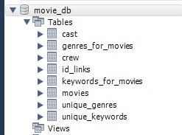
LOAD movie_db MySQL Relational Database

Slide 11
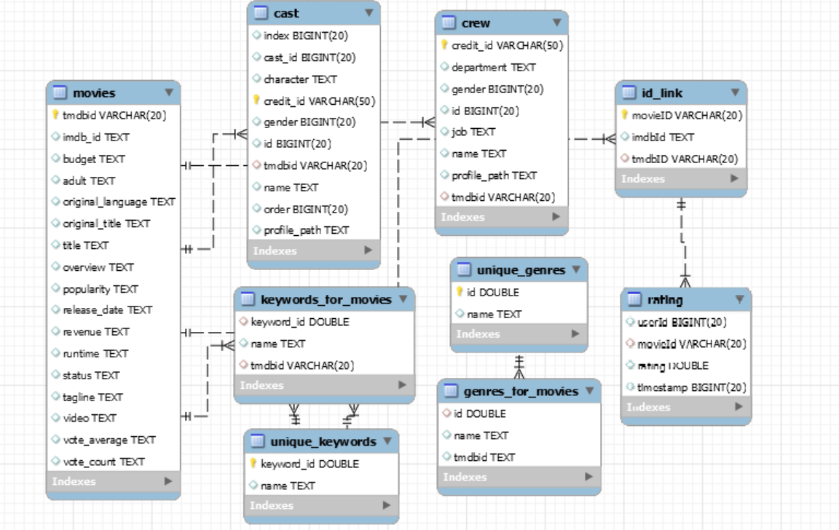
LOAD Schema MySQL Database

