Slide 1
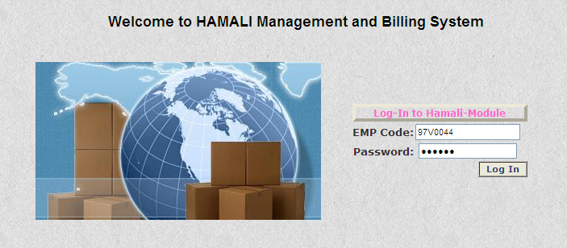
HAMALI
Login Form Detail
Employee Code
Employee Password
*** By Default Password is mahyco for all employee. ***

Slide 2

Main Menu Form Detail

Slide 3
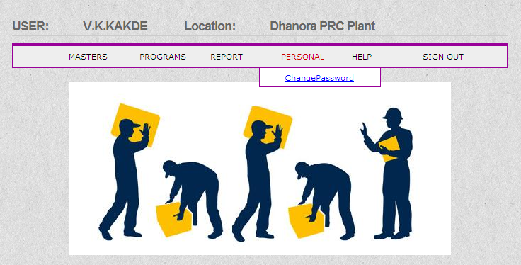
User Main Menu Change Password Form Option

Slide 4
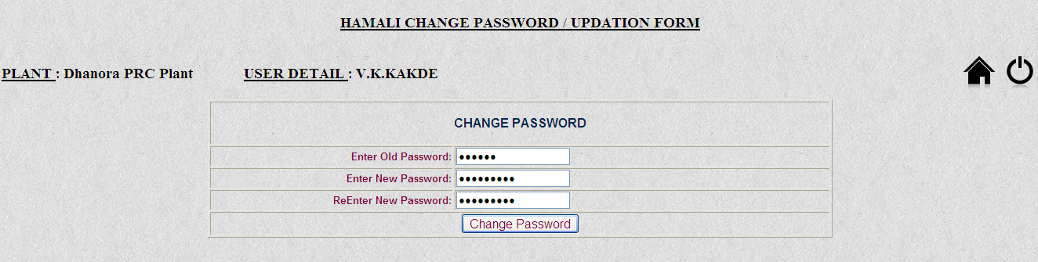
User Change Password Form
*** All the field are mandatory in this form.
Note –
1) In this form User is able to change his / her password.
2) For Changing password user need to enter his Old Password first and then New Password.
5) After Filling All Mandatory values on form click on button

Slide 5
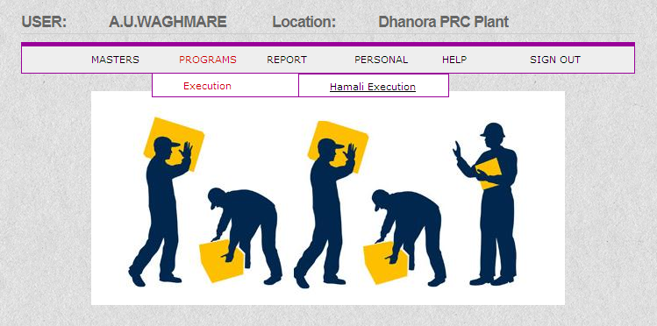
Supervisor Main Menu Form Option

Slide 6
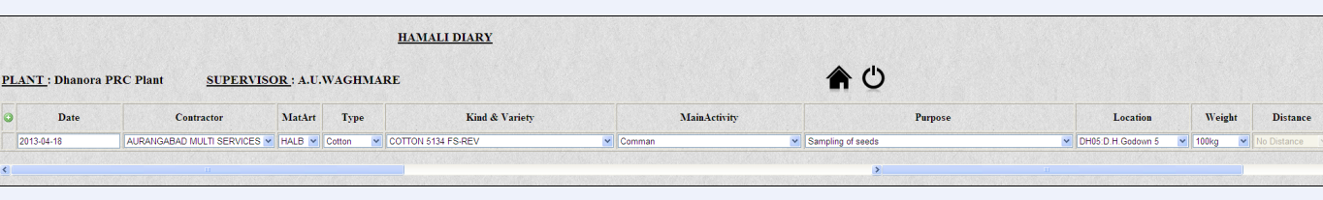

Supervisor Action Form
*** All the field are mandatory in this form.
Note –
1) While doing data entry relating to Bale-G.Bag , Bundle-G.Bag, Comman, Stacking/Restacking distance above 105 feet, Stacking/Restacking distance above 205 feet, Varai Loading/Unloading Charges for Ton ,Varai Loading/Unloading Charges for Truck, Varai Loading/Unloading Charges for Canter, selection of perticular activity is compulsory from MainActivity option
2) for Weight basis operation select Common Activity from MainActivity.
3) Selection of Purpose for perticular activity accordingly.
4) for New Line Entry click on button and for Removal of Entry click on button
5) After Filling All Mandatory values on form click on button

Slide 7
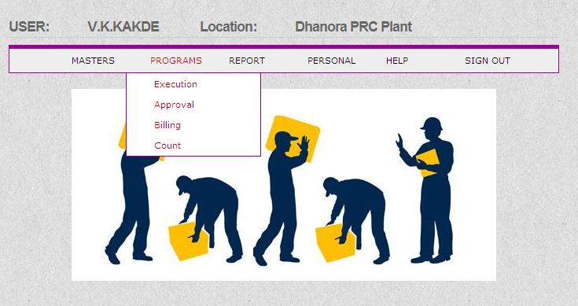
In-charge Main Menu Form Option

Slide 8
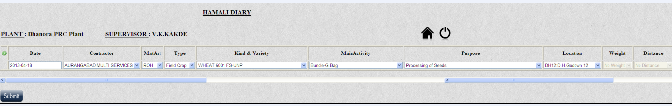
In-Charge Execution Form
*** All the field are mandatory in this form.
Note –
1) While doing data entry relating to Bale-G.Bag , Bundle-G.Bag, Comman, Stacking/Restacking distance above 105 feet, Stacking/Restacking distance above 205 feet, Varai Loading/Unloading Charges for Ton ,Varai Loading/Unloading Charges for Truck, Varai Loading/Unloading Charges for Canter, selection of perticular activity is compulsory from MainActivity option
2) for Weight basis operation select Common Activity from MainActivity.
3) Selection of Purpose for perticular activity accordingly.
4) for New Line Entry click on button and for Removal of Entry click on button
5) After Filling All Mandatory values on form click on button

Slide 9
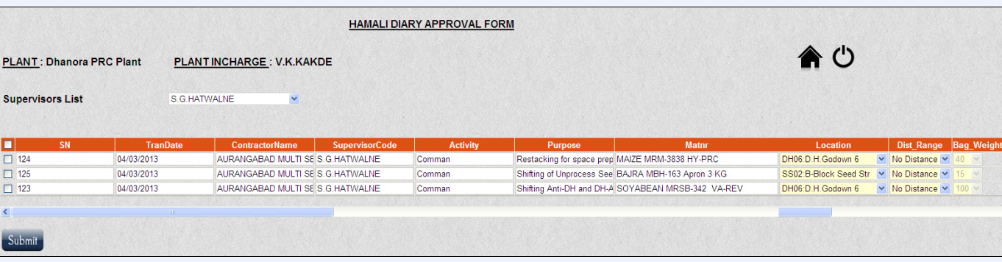
In-Charge Approval Form
*** All the field are mandatory in this form.
Note –
1)When Approval page is open In-charge need to select Supervisor Name from Supervisor List Dropdown option whose Execution in-charge want to Approve.
2)Here In-Charge is able to modify Record details entered by Supervisor if required.
3)Befor clicking Submit button In-charge need to select Checkbox for approving record.
4) In-charge can approve Multiple record at single time too, Making All checkbox Checked
and click on button.

Slide 10
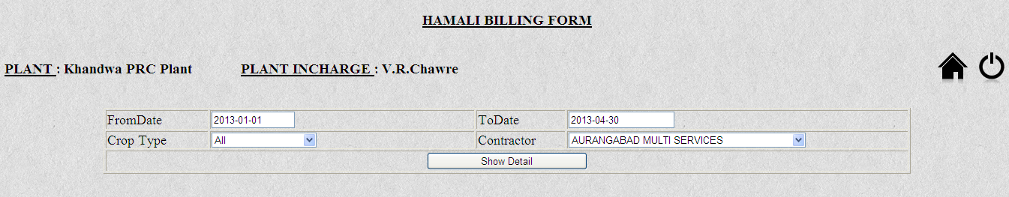
In-Charge Billing Form
*** All the field are mandatory in this form.
Note –
1) After Approval by In-charge, He/ she is able to see the Detail of Bill using this form.
2)In Crop Type Drop Down option user is able to see All or Group-wise (Cotton, Field, Vegetable, Store-other) type Crop bill detail .
3) After Filling All Mandatory values on form click on button
4)User will get Bill detail in Report format in other page.

Slide 11
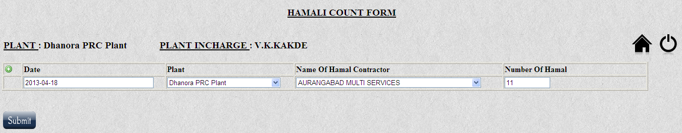
In-Charge Count Form
*** All the field are mandatory in this form.
Note –
1)Here In-Charge Need to entered Date and Number of Hamal required for palnt.
2) for New Line Entry click on button and for Removal of Entry click on button
3) After Filling All Mandatory values on form click on button

Slide 12
Thank You

