Slide 1
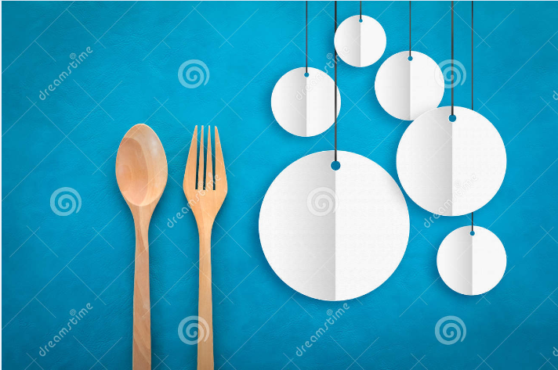
Dish And The Spoon
Submitted To: Sakshi Sharma
Submitted by: Jagdeep Sharma 1893739
Vivek Kumar 1893481
Davinder Singh Kharoud 1893033
Harkirat Singh 1895155

Slide 2
Introduction
Easier for the people to reserve seats and order food online at any time.
People can choose different filters to search appropriate restaurant for them.
Customers can earn giftcards and special offers by using the app.

Slide 3
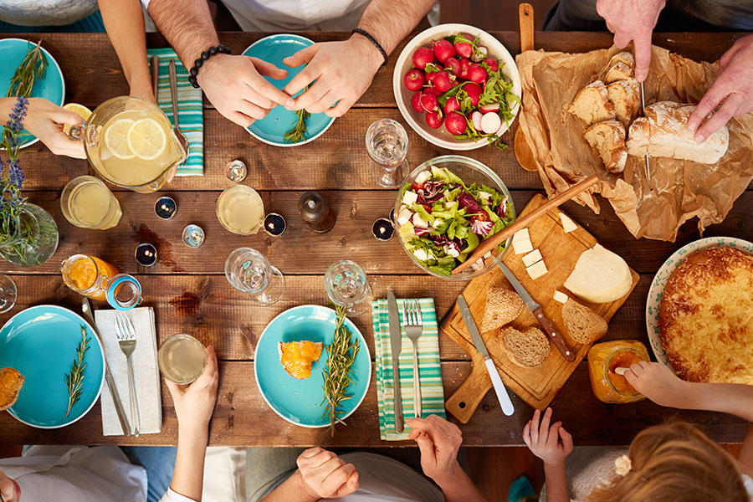
Purpose
Reserve Seats.
Order Food.
Save Time.
Restaurants Can Build a Solid Brand Image.

Slide 4
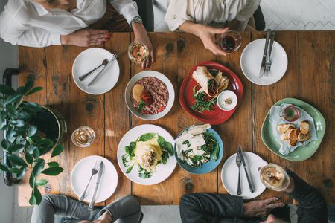
Scope
Naming
User Friendly
Gift Cards
Special Offers
Advertise

Slide 5
2. General Description
Application support
Search Filters
Reserve Seats And Order Food
Gift Cards
Rating And Review
Help

Slide 6
3. Analysis Models
User Case Diagram of this app describe a set of actions that can perform in collaboration with one or more actors of the system.
Sequence Diagram shows the different processes that live simultaneously and the messages exchanged between them in the order,in which they occur.
User Class Diagram shows the classes,their attributes,methods and the relationalships among objects.

Slide 7
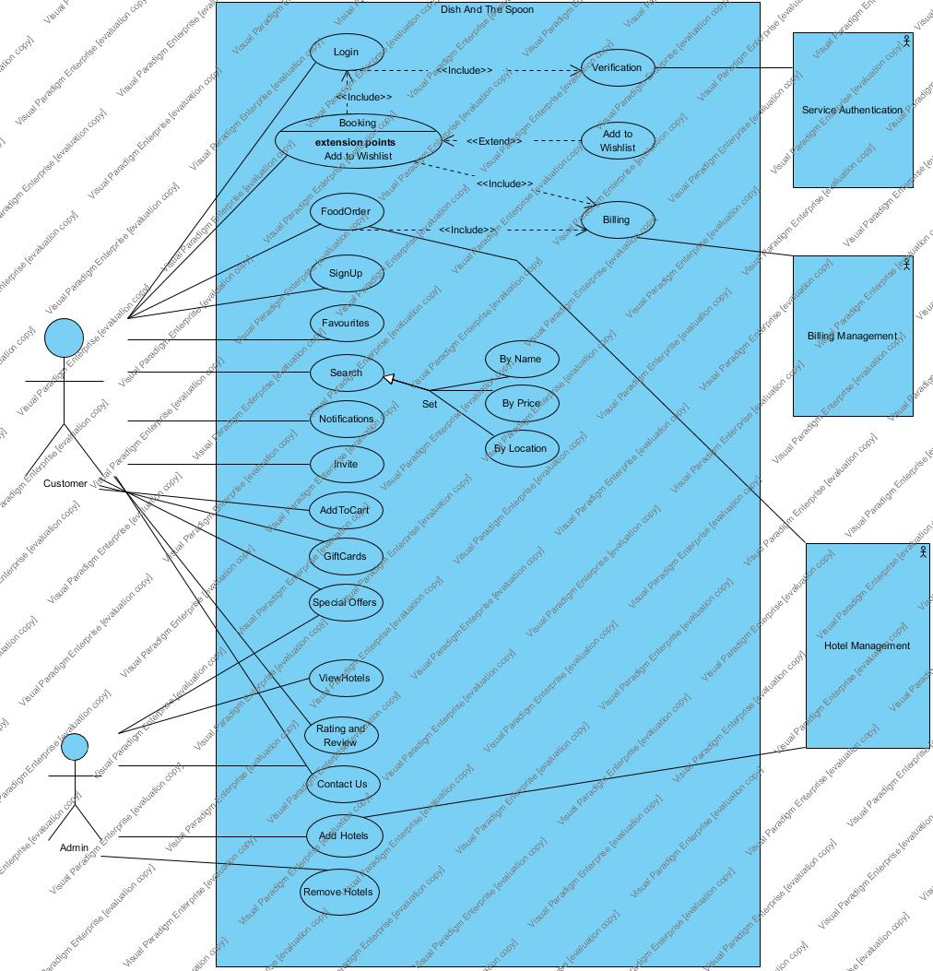
3.1 User Case Diagram

Slide 8
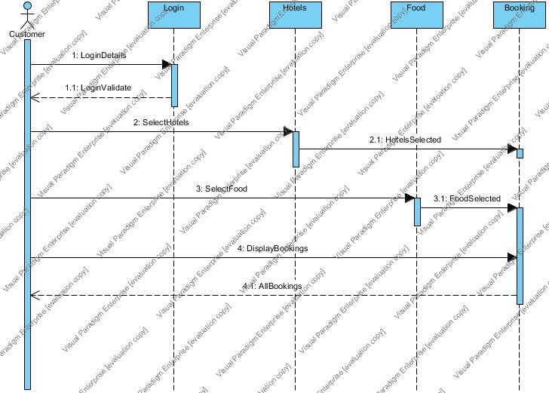
3.2 Sequence Diagram Booking Table

Slide 9
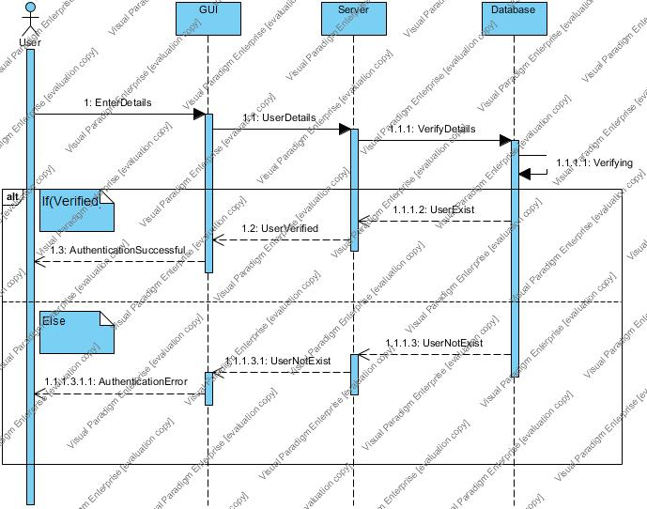
3.2.1 LOGIN Sequence Diagram

Slide 10
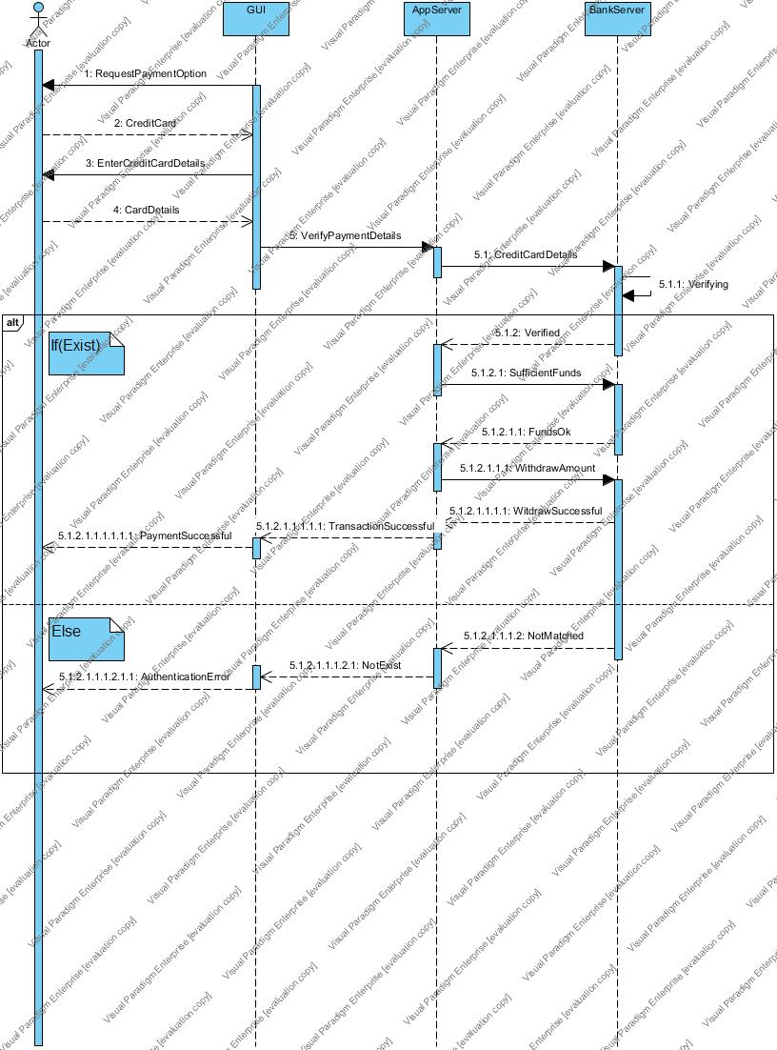
3.2.3 Payment Sequence Diagram

Slide 11
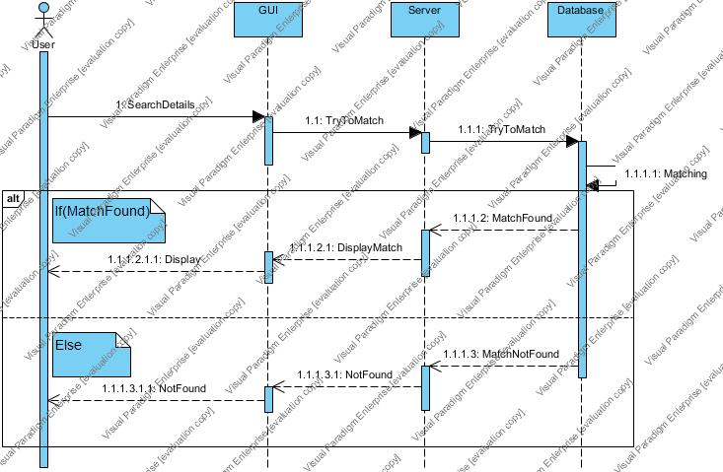
3.2.4 Search Sequence Diagarm

Slide 12
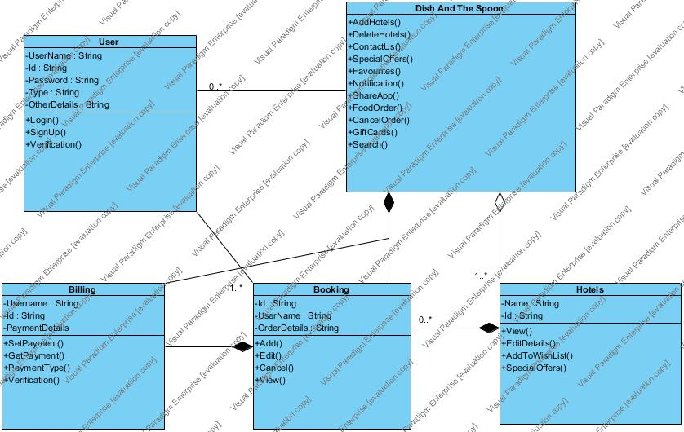
3.3 Class Diagarm

Slide 13
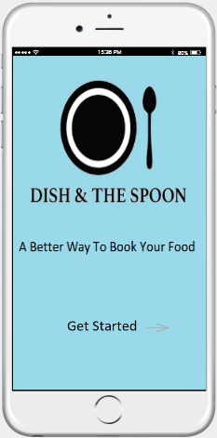
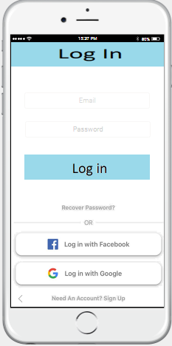
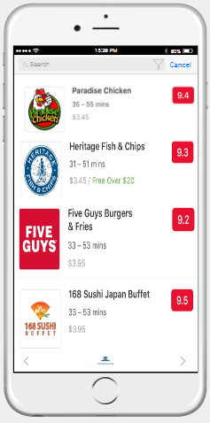
4. Screen Flow Diagram →View Hotels

Slide 14
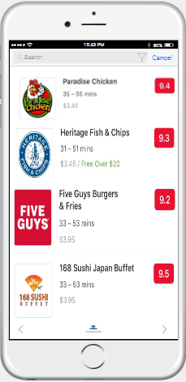
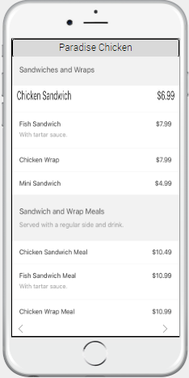
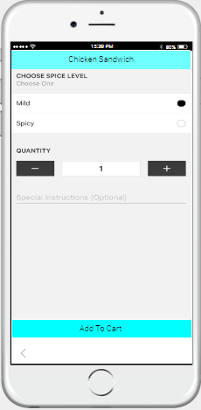
→Booking Hotels

Slide 15
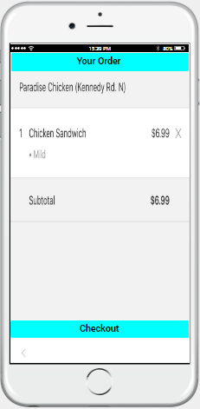
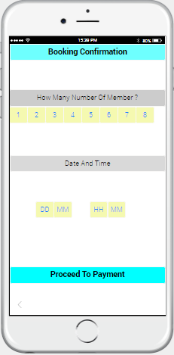
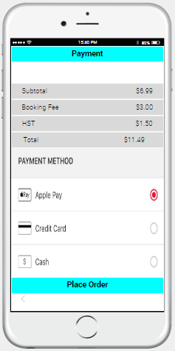

Slide 16
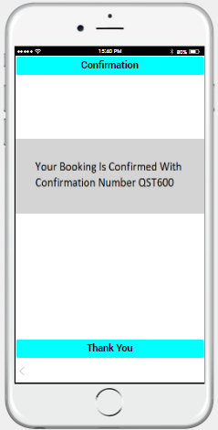

Slide 17
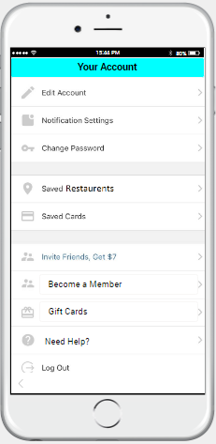
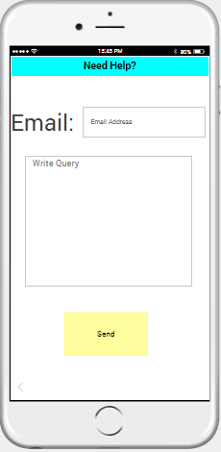
→ Need Help

Slide 18
Thank You
Reference:
https://github.com/DavinderSinghKharoud/Dish-And-The-Spoon.git

