Slide 1
Library Management system
Guidded by:sakkaravarthi ramanathan
Subject:420 enp mt object-oriented programming section 309
Prepared by:Davinder singh kharoud 1893033
Jagdeep sharma 1893739

Slide 2
Objective
EASIER FOR PEOPLE
REDUCE THE EFFORTS FOR MANAGEMENT AS WELL AS PEOPLE.

Slide 3
Existing solutions
Lucidea integrated library systems
Sierra etc.
Pros and cons

Slide 4
Approach
Admin(add ,view and delete librarian)
Login credentials
Manually Issue books
barcode

Slide 5
Algorith Design
1)Admin
1.1Add Librarian
1.2View Librarian
1.3Delete Librarian
1.4exit
2)Librarian
2.1Add Books
2.2 View books
2.3 issue book
2.4 books issued
2.5 Return books
2.6 exit
3)Book Issue scanner
3.1 enter personal details
3.2 provide id
3.3 exit

Slide 6

Implementation and errors
1) "==" operator and .string() method
boolean adminVerify(String AdminName){
if (AdminName=="sunny"){return true;}
else{return false;}
}
Input:AdminName="sunny"
The output should be true but output was false.

Slide 7
BOOLEAN ADMINVERIFY(STRING ADMINNAME){
IF (ADMINNAME.EQUALS("SUNNY"){RETURN TRUE;}
ELSE{RETURN FALSE;}
}
INPUT:ADMINNAME="SUNNY"
NOW OUTPUT IS TRUE; 2)"This" keyword String LibrarianName;
void addLibrarian(String LibrarianName) {
LibrarianName = LibrarianName;
}
Intput: addLibrarian(“jagdeep”)
Output: LibrarianName=null;

Slide 8
String LibrarianName;
void addLibrarian(String LibrarianName) {
this.LibrarianName = LibrarianName;
}
Intput: addLibrarian(“12”)
Output: LibrarianName=12; 3)Try and catch

Slide 9
try {
System.out.println("Enter the phone Number");
long phonenumber =scan.nextlong();
IssueBook("kharoud", "234", " sunny", phonenumber);
} catch (Exception e) {
System.out.println("Enter integer value");
}

Slide 10
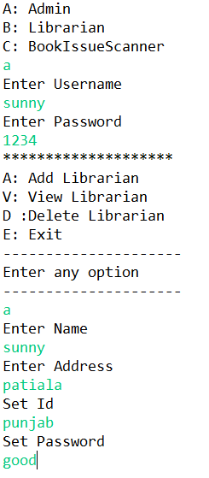
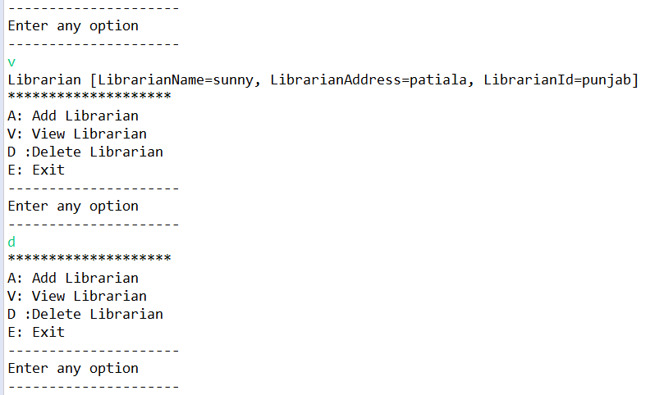
Eclipse console

Slide 11
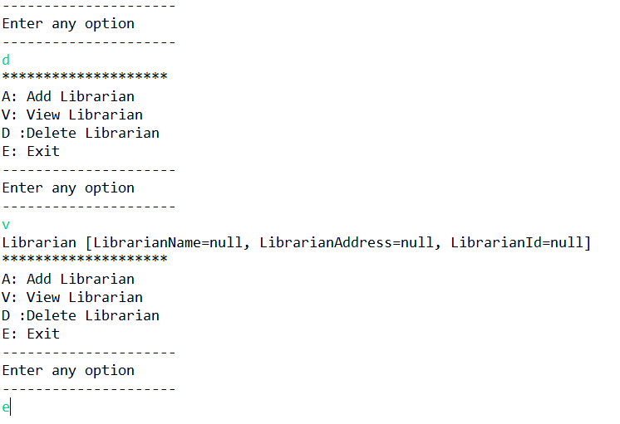
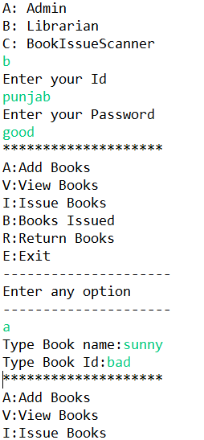

Slide 12
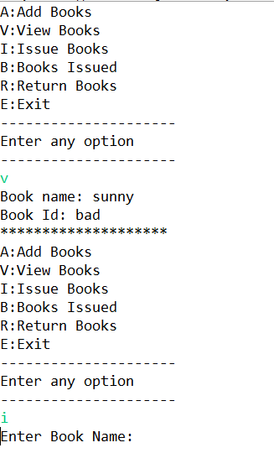
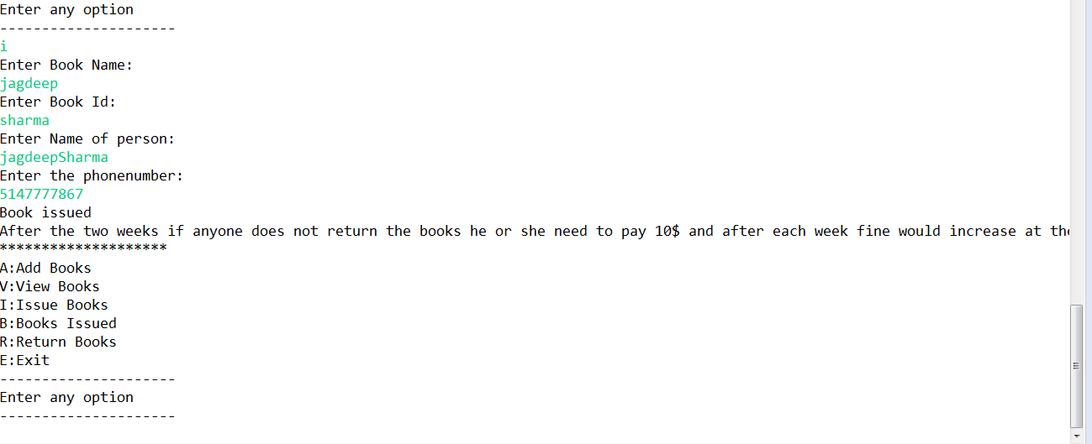

Slide 13
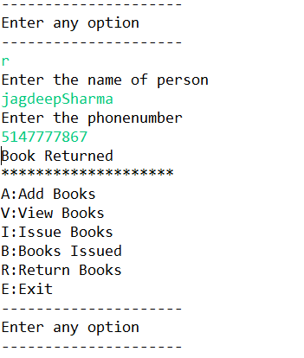

Slide 14
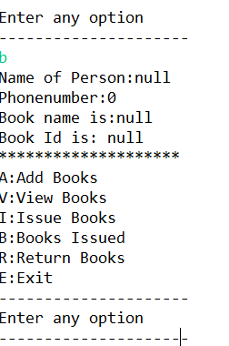
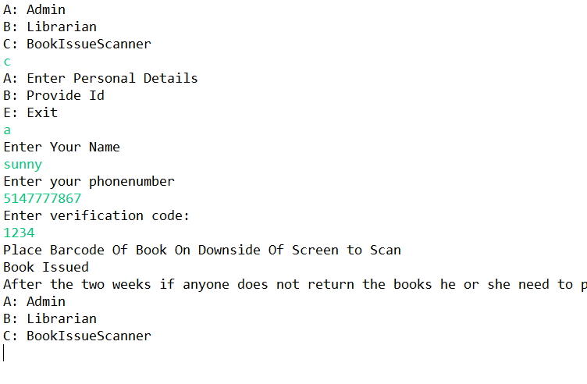

Slide 15
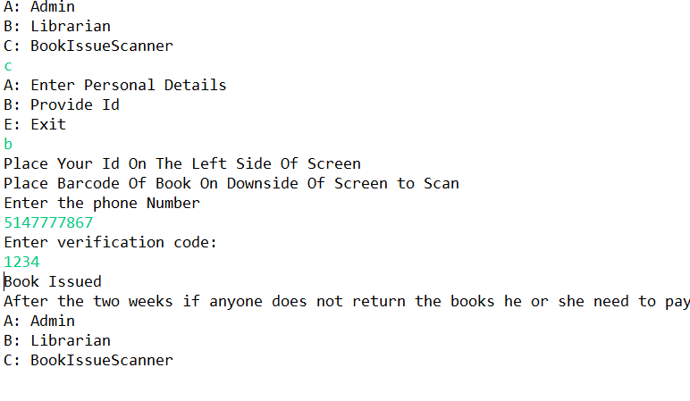

Slide 16
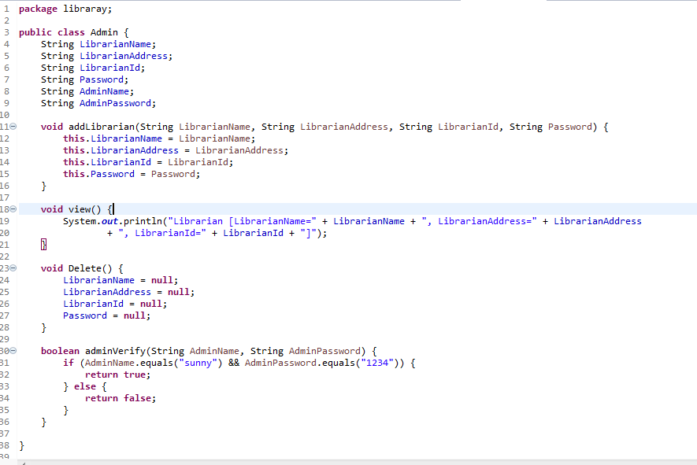
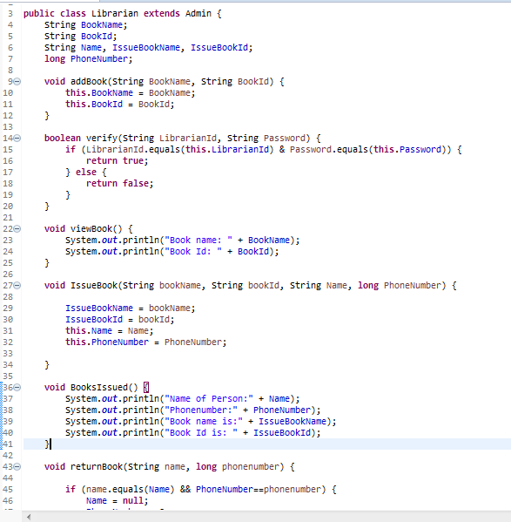
Eclipse code

Slide 17
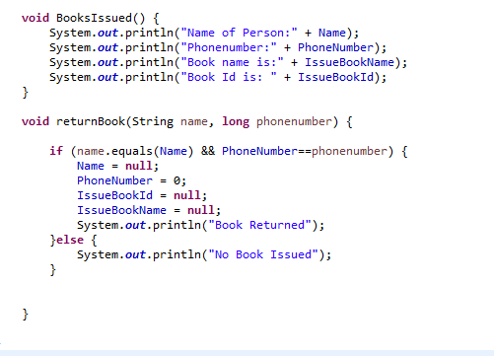
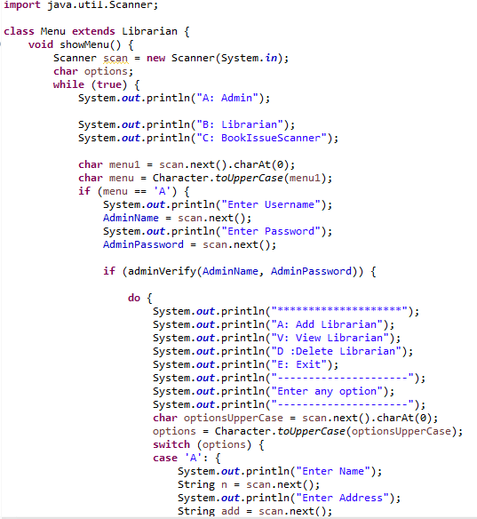

Slide 18
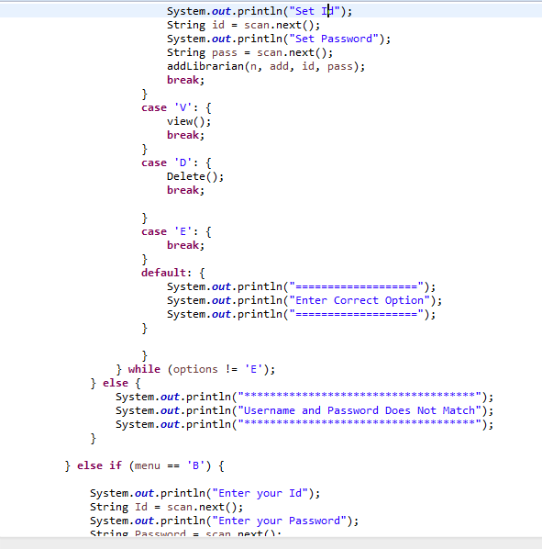
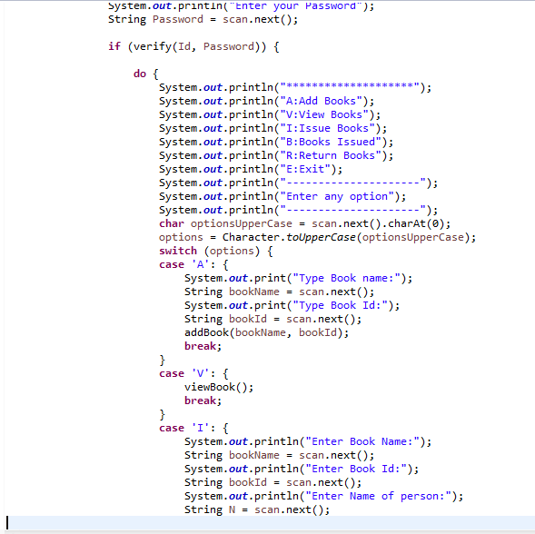

Slide 19
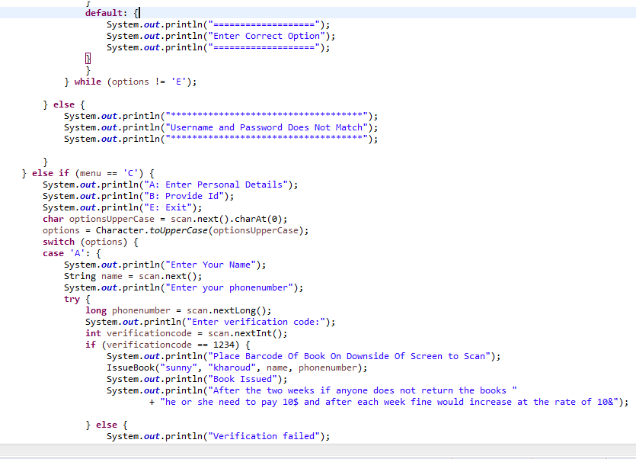
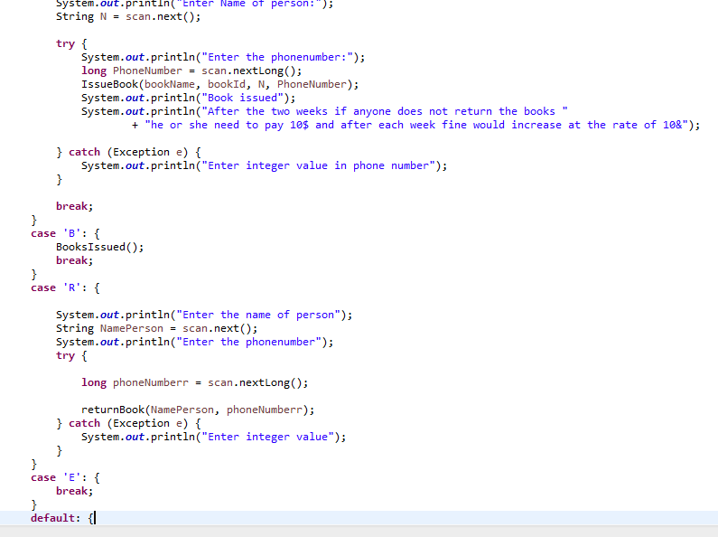

Slide 20
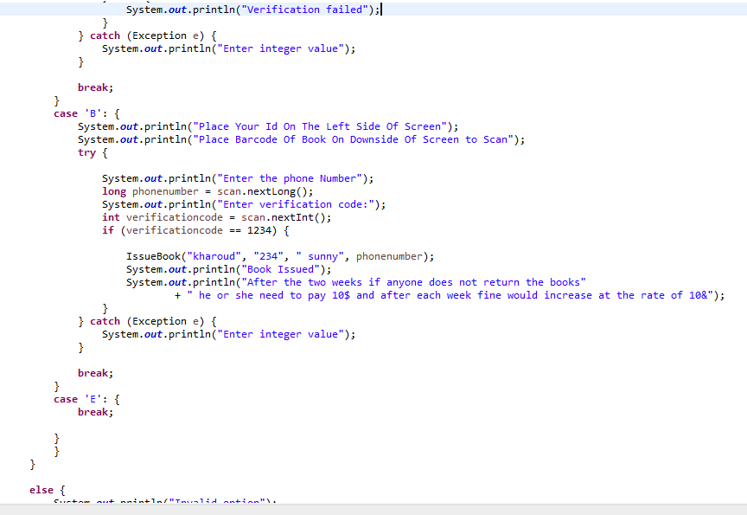
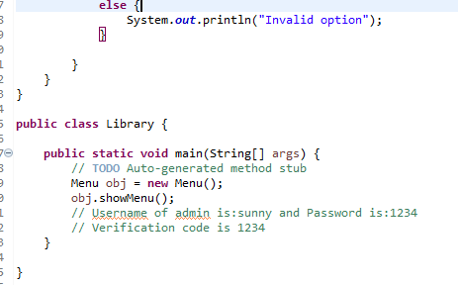

Slide 21
Conclusion And reference
Barcode scanner
Easy to use
User friendly and handy
You can check our code by visiting
https://github.com/DavinderSinghKharoud/Library-Management-System

