Slide 1

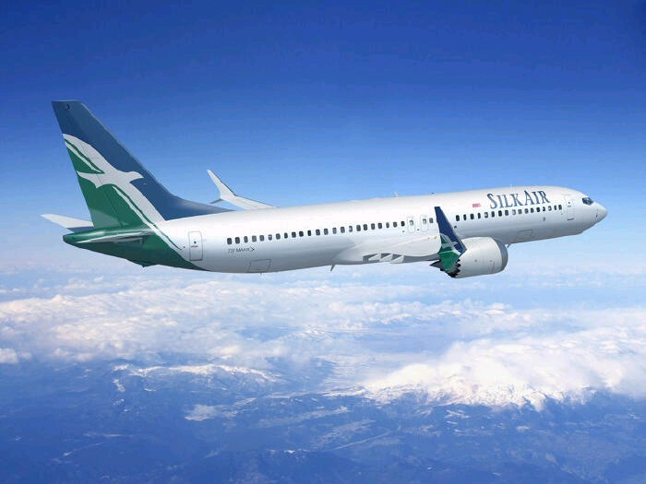

AIRLINE RESERVATION SYSTEM
(Six-Week Industrial Training)

Slide 2
PROJECT BY:-
Davinder Singh
Manpreet Singh

Slide 3








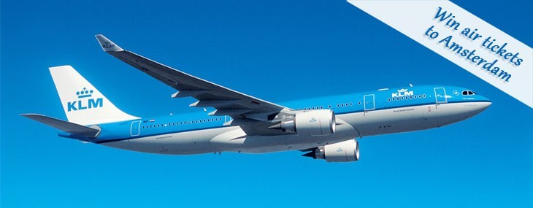
About Institute
Introduction system.
Technologies to used
of Airline
Reservation

Slide 4

Institute Name :Pious Institute
educational institute certified by ISO 9001:2008 offers its best in computer software education.

Slide 5

Airline reservation System is a computerized system
Enhancing the relationship between customers and airline agencies
Convenient for the customers to book the flights
Allow the employee to access database and allow new employee will be added by admin.

Slide 6
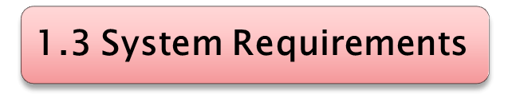
Software Requirements Hardware Requirements
Operating System: Processor: any Windows or linux or MAC
User Interface: Netbeans Hard Disk: 10 GB minimum
Programming Language: RAM: 256MB or more JAVA
Database: MYSQL Any Screen
Server used:xampp
6

Slide 7
Te ch noll ogii es to be us ed::
PHP:PHP stands for PHP: Hypertext Preprocessor, PHP is a server-side scripting language,PHP is a widely used, general-purpose scripting language that was originally designed for web develoment, to producedynamic web pages. It can be embedded into HTML and generally runs on a web server, which needs to be configured to process PHP code and create web page content from it. It can be deployed on most web servers and on almost every operating system and platform free of charge. PHP is installed on over 20 million websites and 1 million web server
The main implementation of PHP is now produced by The PHP Group and serves as the for PHP as there is no formal specification. PHP is free software released under the PHP license, That's a mouthful, but if we break the definition down into smaller pieces, it is easier to understand.

Slide 8
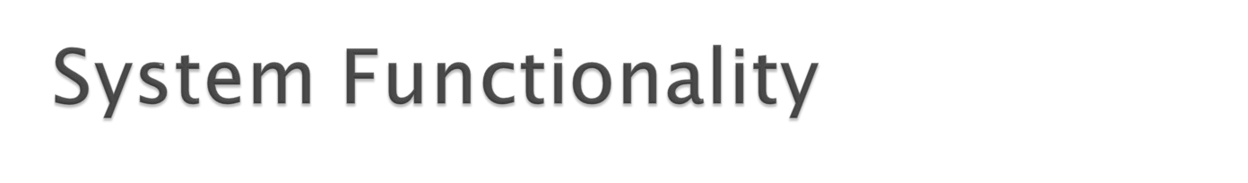
 The functionality for the project is divided among the employee and administrators of the Airline Reservation System.
 employee Functionality
 Administrator Functionality

Slide 9

 Cust_details
 View_cust
 Login/Logout
 Book flights
 Flight info
 View the booking history

Slide 10

 Login/Logout
 Add/Delete/update customer information
 Add/Delete/update flight information
 Add/Delete/update package or motel information
 Cancellation of Reservations
 Add/delete source and destination
 Change the password of admin

Slide 11
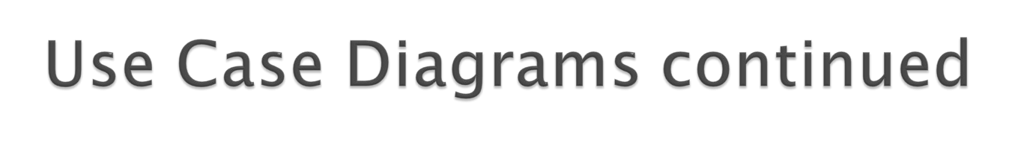
 Administrator Use Case Diagram

Slide 12
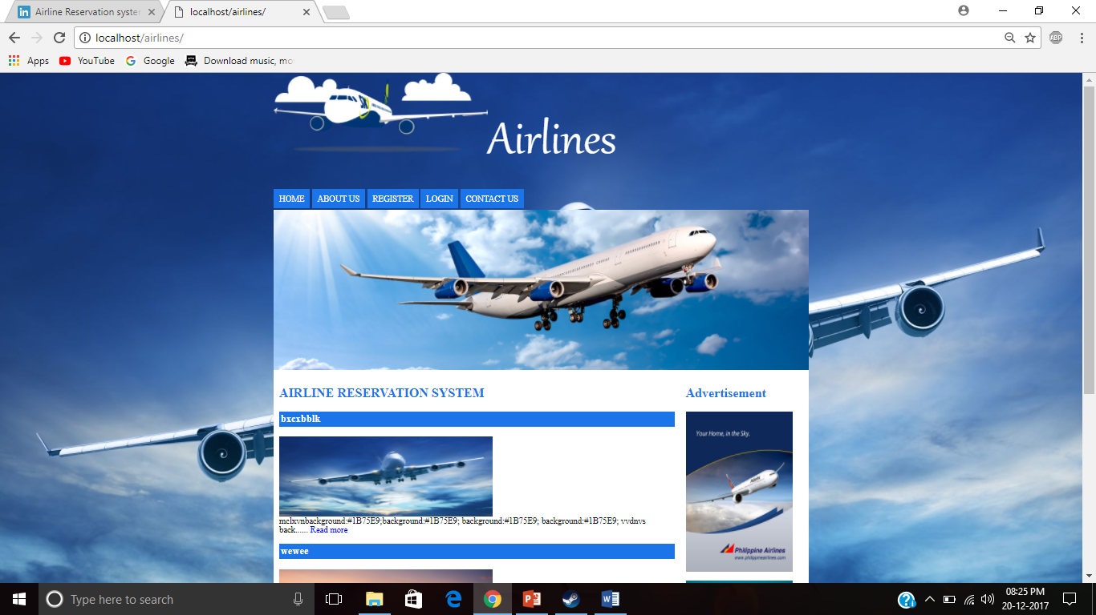
Home Page
13

Slide 13

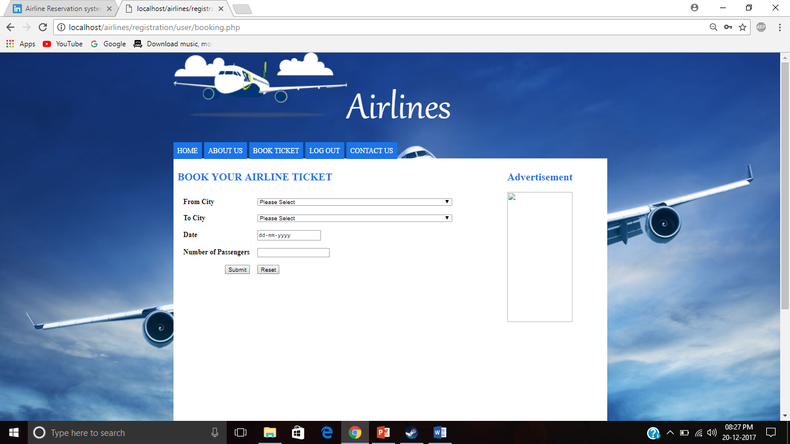
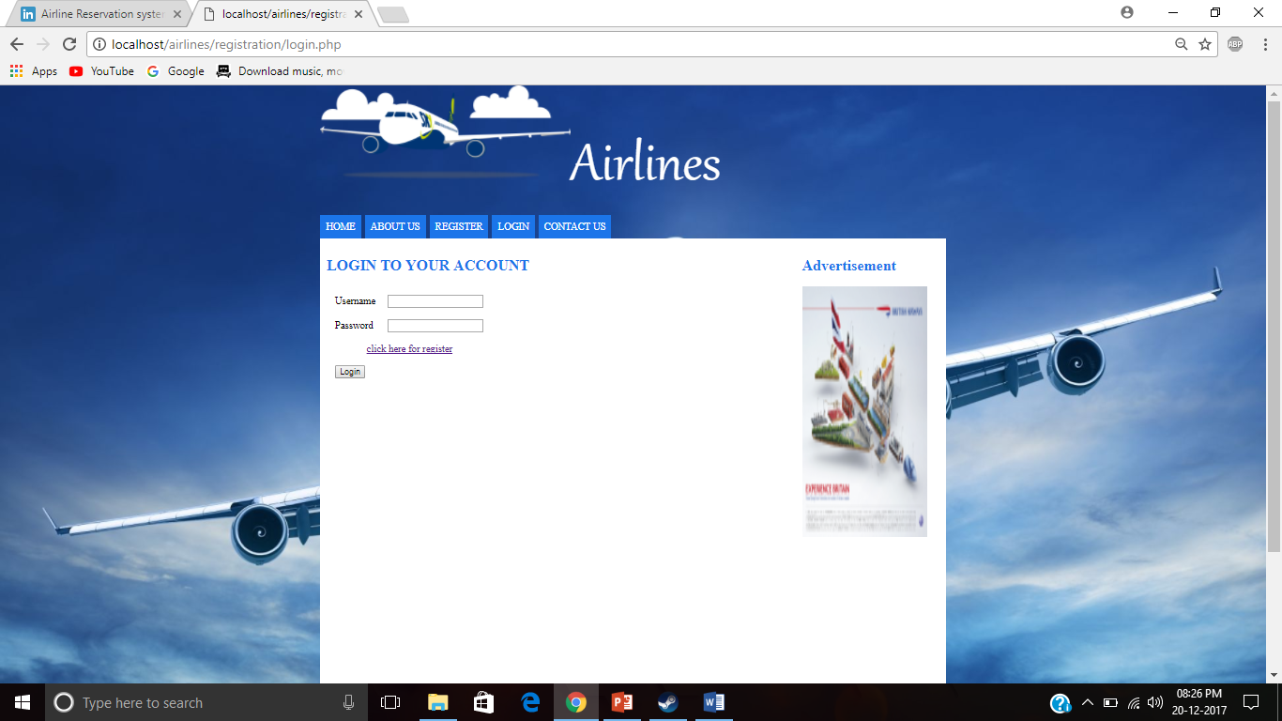
Ticket reservation page
Login page :-

Slide 14
Conclusion
The application is developed in php.
Airline Reservation System Is an application Which provides ticket reservation system .
It is used by employee of airline reservation system.
16
`

