Slide 1
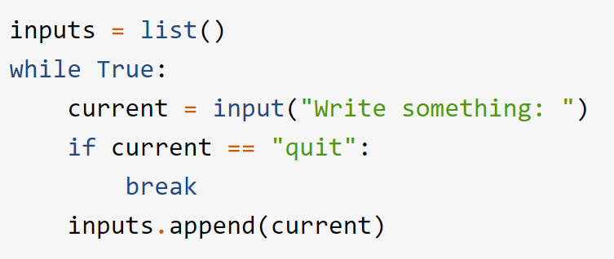
Exercise 1: Walrus
Using the following snippet of code, introduce the walrus operator to re-write the code using less lines.
Aim for half of the lines used while producing and preserving the same output that this code provides

Slide 2
Exercise 2: Dictionaries
Create a dictionary with keys ‘firstname’, ‘lastname’ and ‘age’, with some values assigned to each
Add an additional key ‘address’ to the dictionary
Print out the list of keys of your dictionary
Create a ‘name’ key with the value as a string containing both first and last name keys. Is it possible to do this without typing in your name once again? If so make the modification, and when done remove the two other older keys.

