Slide 1
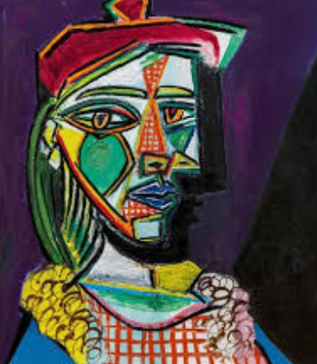
Exercise 3-2 – Reading files
Modify your code to look for lines that contain either of the following artists: Pablo Picasso or Claude Monet and print only those two lines out.
Return the two rows in a separate file called output.txt
Bonus: Remove the two above lines from Artists.csv and save the new file as Artists2.csv separately.
Artists.csv: https://media.githubusercontent.com/media/MuseumofModernArt/collection/master/Artists.csv

Slide 2
Exercise 3-3 – Reading files
Using Artists.csv, write a query that returns all lines that are female artists only, with begin date greater than 1950 but no greater than 2000
Write a query that will return all lines of British Male artists, who's first names starts with the letter ‘A’ and has an end date earlier than 1990
Write a query that will write to a file all lines that have Japanese Artists who’s difference of end date and begin date exceeds 100 years. I.e. if artist begins in 1900 and ends in 2005, then they would be included in the output (2005-1900 = 105 years)
Write a query that will write and find to a file the artist who’s been at the Museum the longest (the widest gap between Begin Date and End Date)

