Slide 1
Activity 5

Slide 2

Exercise 1 : Tuples
Create a tuple called triple of size 3 containing the numbers 1,2,3
Create three separate variables x, y, z and use the tuple triple to initialize the values
Create a separate tuple called quad of size 4 (with numbers 1,2,3,4) and try to initialize the values, what happens?
Tuples support slicing, make some modifications if possible using slicing to fix this problem.

Slide 3
Exercise 2: while Loop
Using the piece of code on the previous slide, modify the code removing the x += 1 portion and run the code.
What happens?
Now modify the code to print the numbers but in reverse order
Lastly, modify the code to print the numbers 1 through 10 which are not divisible by 3

Slide 4
Exercise 3: Loops
Create the following list of numbers: [3,7,5,2,9,7]
Write a while loop that will print out the numbers
Write a for loop that will print out the numbers
Using a loop, write the code that will print out all elements that are larger than their neighbor i.e.: (7,9)
Write the code that will loop through the list and for every odd number prints: “Odd” and every even number “Even”

Slide 5
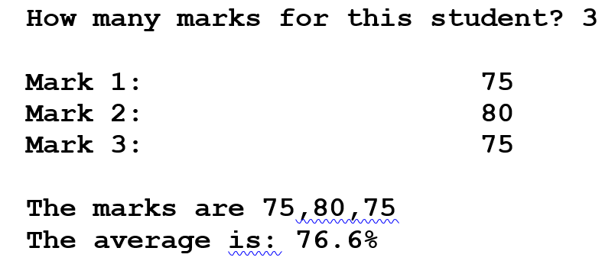
Exercise 4: Calculate Average
Create the a python program that will generate the output as shown aside
Let’s create a list of marks for a student
The program needs to ask how many marks the user can enter
Take the input, then display each mark again and show the average of the student
How the program should interact with the user ➔

Slide 6
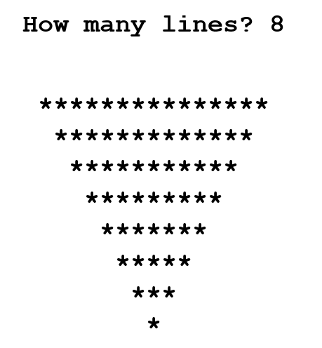
Exercise 5: Print Patterns
Placing one loop inside the body of another loop is called nesting. When you "nest" two loops, the outer loop takes control of the number of complete repetitions of the inner loop.
Write the code that will generate the output as shown below:
-Ask the user, how many lines this triangle must contain. (1 to n lines)
-The display pattern must respect the pattern below.
How the program should interact with the user: ➔

