Slide 1
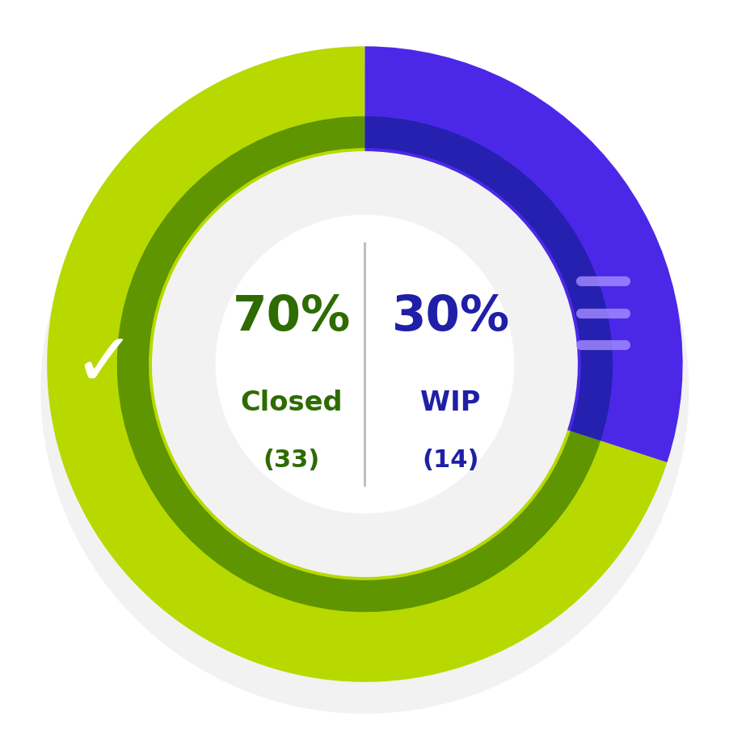
Automation and Digitization Progress Update
Status chart
Closed
WIP

Slide 2
Automation and Digitization Progress Update
Quarterly progress table
Quarter | Completed | WIP | Planned in Next FY | Total
Q1-Q2 | 9 | - | - | 9
Q3 | 13 | - | - | 13
Q4 | 11 | 11 | 3 | 25
Total | 33 | 11 | 3 | 47

Slide 3
