Slide 1

Welcome to DAFUEL — revolutionizing energy supplementation through clean, plant-based innovation. Fueling performance worldwide.
Reimagining How The World Energizes
UAE Investor Edition | 2026
World's First Yerba Mate Kombucha
Clean Energy. Elevated.
DAFUEL — Confidential | 2026

Slide 2
What is DAFUEL?
Performance Nutrition. Plant-Powered. Purpose-Built.
DAFuel is a pioneering performance nutrition brand committed to revolutionizing energy supplementation through clean, plant-based innovation. Our flagship product, Truyerba Power Gummies, offers fast-acting, natural caffeine from yerba mate — a healthier, more convenient alternative to traditional stimulants.
Designed for athletes, professionals, and high-performers, DAFuel products are rooted in cutting-edge food science, sustainability, and modern lifestyle needs — focusing on taste, efficacy, and clean ingredients.
We're the only brand in India making Yerba Mate products and the World's First Yerba Mate Kombucha Maker
Athletes & Gym-Goers
Busy Professionals
Health-Conscious Consumers
Natural pre-workout energy without synthetic caffeine or crashes.
Sustained focus for long work hours — portable and convenient.
Clean-label, organic, plant-based — aligned with modern wellness trends.
DAFUEL — Confidential | 2026

Slide 3
Our Mission & Vision
Plant-Powered. Performance-Driven. Global.
Our Mission
Our Vision
Empower high-performance individuals with clean, plant-based nutrition that delivers sustained energy and enhances focus — without compromising health benefits.
Become the global leader in plant-powered performance nutrition, transforming energy with sustainable, science-backed alternatives.
Our Values
Clean Ingredients
Science-Backed
Sustainability
Performance
No synthetics, no compromises
Formulations rooted in food science
Eco-conscious production practices
Efficacy at every dose
DAFUEL — Confidential | 2026

Slide 4
The Problem: Fueling Your Life, The Right Way
1. Unhealthy Caffeine Consumption
2. Lack of Convenient Options
3. One-Size-Fits-All Solutions
Reliance on sugar-laden drinks and acidic coffee leads to crashes and long-term health issues.
Limited portable, fast-acting, clean-label alternatives for on-the-go professionals and athletes.
Current energy products lack personalized nutrition and tech-enabled performance tracking.
4. Limited Innovation
5. Overdependence on Synthetics
The functional food sector needs more clean, plant-based delivery formats aligning with current trends.
Many mainstream products contain artificial additives, harming performance and long-term wellness.
DAFUEL — Confidential | 2026

Slide 5
DAFUEL Solutions: Clean Energy, Elevated
Healthy, Clean Caffeine
Convenient Energy Gummies
Naturally extracted yerba mate for smooth, crash-free energy — free from sugar or harmful additives.
Portable, fast-acting gummies for instant energy — perfect for athletes and busy professionals.
100% Plant-Based & Clean-Label
Personalized Tech Integration
Organic, non-GMO ingredients, free from synthetic caffeine or preservatives, for sustained performance.
Upcoming app for energy tracking, usage patterns, and tailored recommendations.
DAFUEL — Confidential | 2026

Slide 6
Market Opportunity: India vs. Global
A massive untapped white space — and we are first movers
India Nutraceuticals Market
Yerba Mate Global Market
₹65,000 Cr by 2026
USD 3.5B today → USD 5B by 2030
21% CAGR
CAGR 2.5%
UAE Functional Beverages
Clean-Label Consumer Shift
~USD 1.2B market
72% millennials avoid artificial additives
Growing ~8% CAGR
Nielsen 2023
DAFUEL — Confidential | 2026

Slide 7
Why Now? The Perfect Time for DAFUEL
Massive Market Growth
Clean-Label Consumer Preference
India's nutraceuticals market projected ₹65,000 Cr by 2026 at 21% CAGR.
72% of millennials prefer products without artificial additives (Nielsen 2023).
Global Yerba Mate Popularity
High Demand for Clean Energy
Icons like Messi & Ronaldo driving global Yerba Mate awareness (Forbes, ESPN).
76% of professionals seek clean energy without crashes (LinkedIn Report).
No Dominant Market Player
Yerba Mate market at USD 3.5B with no established global leader — massive entry opportunity.
DAFUEL — Confidential | 2026

Slide 8
DAFUEL: Our Go-To-Market Strategy
Target Audience & Positioning
Product Offering
Health-conscious Gen Z & Millennials in Tier-1 cities seeking 'clean energy on the go.'
Hero SKU: Yerba Mate Gummies (3 flavors), Effervescent tablets, World's first Yerba Mate Kombucha (3 flavors).
Distribution Channel (Phase 1)
Content Strategy & Retention
D2C via website & Instagram Shop, Amazon, Flipkart, Blinkit — Shopify + Razorpay + Shiprocket.
Influencer-led UGC, performance ads (Reels, Shorts), community via WhatsApp/Discord, email drip.
Sampling & Feedback
Key Metrics to Track
Partner with gyms/studios for samples + QR code feedback, offering discounts for responses.
CAC, Repeat Rate, Feedback Score, Organic Follower Growth, UGC Volume, D2C Revenue Per Visitor.
DAFUEL — Confidential | 2026

Slide 9
Fund Utilization Plan
INR 50 Lakhs for 10% Equity in Seed Round
Seeking INR 50 Lakhs | 10% Equity | ₹5 Cr Post-Money Valuation
40%
25%
15%
Product Development, Manufacturing & Expansion
Branding & Marketing
Distribution & Logistics
GMP-compliant production, safety testing, certifications, RTD expansion.
Visual identity, paid influencer campaigns, content creation, sampling drives.
Packaging, warehousing, 2 metro cities launch with 2-hour delivery zones.
10%
10%
Tech & E-Commerce Setup
Team Building & Compliance
D2C website, CRM, loyalty stack, personalization app.
Operations, customer success, legal, and IP protection.
DAFUEL — Confidential | 2026

Slide 10
Unit Economics: Gummies
Updated Price — ₹499 per pack
Selling Price
₹499
EBITDA Summary
Product Cost (COGS)
₹130
EBITDA per unit
₹169
Marketing (Ads, Shopify, Content)
₹100
Shipping / Logistics
₹80
Annual EBITDA (12,000 units)
₹20.28L
Miscellaneous Buffer
₹10
Returns
₹10
EBITDA Margin
33.9%
Total Variable Cost
₹330
Gross Profit
₹169
Fixed Cost (Annual)
₹35,000
Gross Margin
33.9%
Breakeven
~18 units/month
AED (export ref.)
~AED 22
DAFUEL — Confidential | 2026

Slide 11
Unit Economics: Effervescent Tablets
Updated Price — ₹279 per pack
Selling Price
₹279
EBITDA Summary
Product Cost (COGS)
₹65
EBITDA per unit
₹134
Marketing (Ads, Shopify, Content)
₹40
Shipping / Logistics
₹32
Annual EBITDA (12,000 units)
₹16.08L
Miscellaneous Buffer
₹4
Returns
₹4
EBITDA Margin
48.0%
Total Variable Cost
₹145
Gross Profit
₹134
Fixed Cost (Annual)
₹35,000
Gross Margin
48.0%
Breakeven
~22 units/month
AED (export ref.)
~AED 12
DAFUEL — Confidential | 2026

Slide 12
Kombucha Market Opportunity: Global & India
**TRUYERBA is our Trademark
Global Market (Proof of Demand)
India Market (High-Growth White Space)
~USD 4.26B (2024) → ~USD 9.09B by 2030
13.5% CAGR
Growth drivers:
• Rising demand for functional beverages
• Increased gut-health awareness
• Preference for low/zero-alcohol alternatives
• Continuous flavor innovation
~USD 100.8M (2024) → ~USD 439.8M by 2033
17.8% CAGR
India = only 2.4% of global kombucha market in 2024
Substantial headroom for rapid expansion and adoption.
"Kombucha is a fast-growing functional beverage globally, and India is scaling even faster — creating a strong timing + distribution opportunity for DAFuel."
DAFUEL — Confidential | 2026

Slide 13
Why Kombucha Fits DAFuel: Strategic Alignment
Kombucha perfectly complements DAFuel's vision, expanding our clean energy offerings into the rapidly growing functional beverage market.
Functional & Clean-Label
Daily Consumption Behavior
Cross-Sell Flywheel
Integrates seamlessly with our core philosophy of plant-based energy and natural wellness — sharing clean-label values.
Drives higher purchase frequency by positioning DAFuel as a routine, refreshing beverage — not just a supplement.
Kombucha for gut health + refreshment, Gummies/Effervescents for sustained energy. Ideal for bundle packs and subscription models.
Product Roadmap: Gummies → Effervescents → RTD Kombucha → Scale
DAFUEL — Confidential | 2026

Slide 14
Kombucha Go-To-Market Strategy: India
Leveraging DAFuel's established presence, we'll strategically introduce Kombucha to key segments within the Indian market.
Primary Early Adopters
Distribution Channels
Kombucha-Specific Metrics
Targeting health-conscious Gen Z & Millennials in Tier-1 cities: fitness/wellness enthusiasts, premium café patrons, and corporate professionals seeking functional beverages.
Expanding beyond D2C & marketplace to include Quick Commerce partnerships (with cold-chain capabilities) and targeted sampling at gyms and wellness studios.
Tracking repeat purchase rate by flavor, cold-chain CAC uplift, on-trade café reorders, spoilage/returns, and subscription attachment rates to optimize strategy.
DAFUEL — Confidential | 2026

Slide 15
Unit Economics: Kombucha
Price — ₹169 per bottle (Unchanged)
Selling Price
₹169
EBITDA Summary
Product Cost (COGS)
₹93
EBITDA per unit
₹44
Marketing (Ads, Shopify, Content)
₹12
Shipping / Logistics
₹10
Annual EBITDA (12,000 units)
₹5.28L
Miscellaneous Buffer
₹3
Returns
₹3
EBITDA Margin
26%
Total Variable Cost
₹121
Gross Profit
₹48
Fixed Cost (Annual)
₹35,000
Gross Margin
28.4%
Breakeven
~67 units/month
AED (export ref.)
~AED 7.5
DAFUEL — Confidential | UAE Edition | 2026

Slide 16
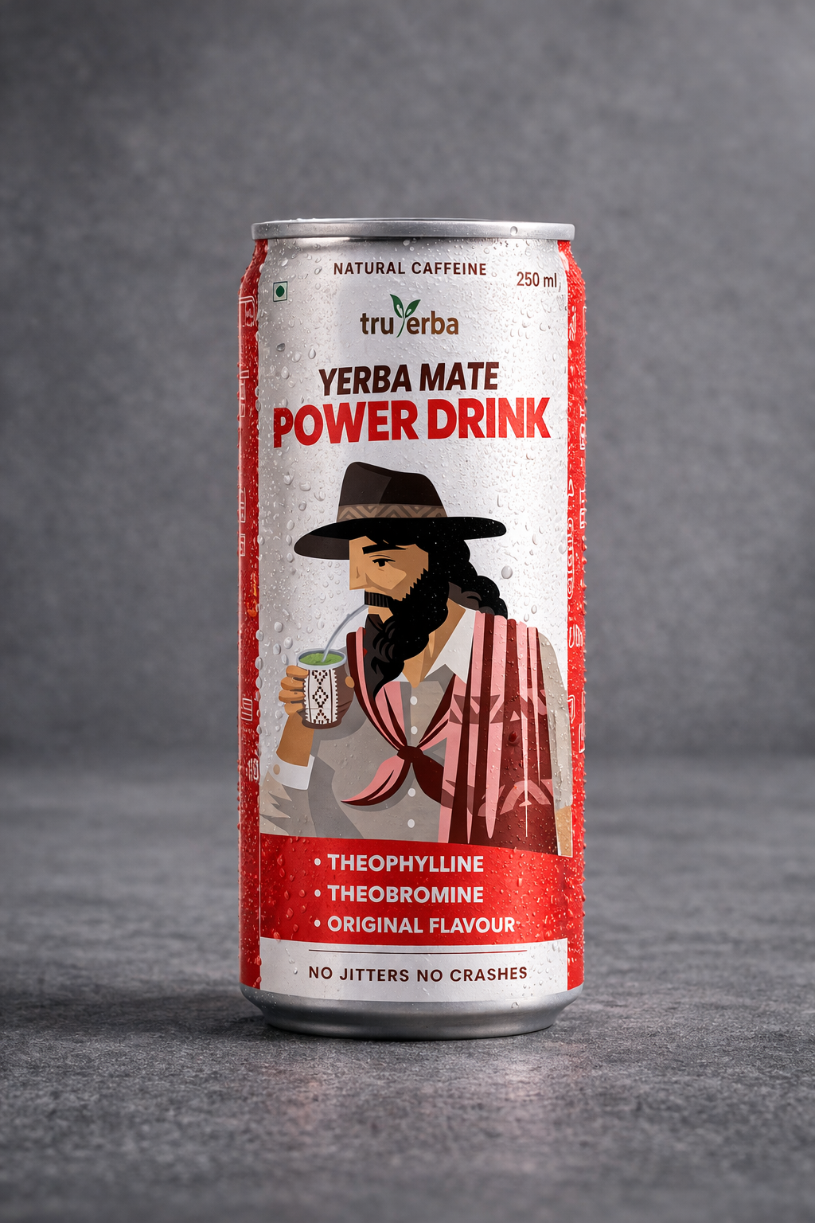
Coming Soon: TRUYERBA Power Drink
The next evolution in clean, plant-based energy — now in a can
TRUYERBA YERBA MATE POWER DRINK
250 ml Can | Natural Caffeine | No Jitters. No Crashes.
Natural Caffeine Source
Pure Yerba Mate extract — zero synthetic stimulants
Theophylline + Theobromine
Three active compounds for smooth, lasting energy
No Jitters. No Crashes.
Clean energy curve without the comedown
Original Flavour
Authentic South American taste profile
Ready-to-Drink
Portable 250 ml can — perfect for gym, office & travel
LAUNCHING SOON
DAFUEL | Confidential | 2026

Slide 17
What You'll Get from DAFUEL?
Exit Potential — Updated Projections
5× EBITDA Multiple (Conservative) | Blended ~36% EBITDA Margin | ₹1Cr EBITDA milestone: Year 3
• 10% equity value at ₹5 Cr valuation = ₹50 L (equals invested principal; upside from profit share & higher exit multiples)
• Expected exit in 3–4 years | Y5 standalone ROI ≈ 111% from profit-share alone
• Sources: Kroll Industry Multiples (Feb 2025), Eqvista & FullRatio Global Benchmarks, Axial M&A Data, CMIE BSE Comps
YEAR
REVENUE
EBITDA (@36%)
INVESTOR'S 10% SHARE
ROI
Y1
₹96 L
₹0.35 Cr
₹3.46 L
6.9%
Y2
₹1.92 Cr
₹0.69 Cr
₹6.92 L
13.8%
Y3
₹3.84 Cr
₹1.38 Cr
₹13.84 L
27.7%
Y4
₹7.68 Cr
₹2.77 Cr
₹27.67 L
55.3%
Y5
₹15.36 Cr
₹5.53 Cr
₹55.34 L
110.7%
★ Y3 highlighted: ₹1 Cr EBITDA milestone reached
DAFUEL — Confidential | UAE Edition | 2026

Slide 18
Meet the Founders
Ankush Sharma
Davinder Pal Singh
Co-Founder
Co-Founder
NIT Jalandhar alumnus with a passion for public wellness and consumer health. His background in civil service and deep understanding of India's evolving consumer behavior offers a strategic advantage in the fast-growing nutraceutical sector.
NIT Jalandhar alumnus with over 5 years of tech industry experience, driving product innovation and scalable digital solutions. His strong tech foundation enables DAFuel to integrate personalization and AI, creating a tech-led differentiation.
Thank You! | DAFUEL — Reimagining How The World Energizes

Slide 19
Get In Touch
Let's build the future of clean energy together
WEBSITE
EMAIL
www.truyerba.in
truyerba@gmail.com
PHONE / WHATSAPP
PRESS & MEDIA
+91 8988804848
press@truyerba.com
INSTAGRAM
ADDRESS
@truyerba
Plot No. 337, WorkYard Coworking Industrial Area Phase 2, Chandigarh
Thank You | DAFUEL Innovation Pvt Ltd
DAFUEL | Confidential | 2026

