Slide 1
Title : Air Quality Data Analysis
Presented By:
Davinder Singh Registration No: 12324257

Slide 2

Air Quality Data Analysis
Air pollution is a serious issue, especially in growing cities where traffic and industry are on the rise. Pollutants like PM2.5, NO2, and SO2 pose major health risks, making it crucial to track and understand air quality trends.
This project uses Excel to analyze multi-year air quality data from U.S. cities, turning raw numbers into clear visuals and interactive dashboards. It highlights pollution patterns, seasonal changes, and city-wise impacts—offering useful insights for policy-makers, planners, and the public.

Slide 3

Dataset Overview
The dataset utilized for this project was sourced from the official U.S. government data repository, specifically the Air Quality dataset available on Data.gov. The dataset can be accessed via the following link: https://catalog.data.gov/dataset/air-quality.
It provides a rich collection of air quality measurements recorded across various locations over time and includes detailed information such as:
Location (City or Region)
Pollutant Name (e.g., PM2.5, NO2, SO2)
Data Value (Pollutant concentration in micrograms per cubic meter)
Start Date (Date of measurement)
Season (Derived from Month or explicitly stated)
Year (Extracted from Start Date)

Slide 4
Objective 1: Most & Least Polluted Areas
General Description:
This objective focuses on analyzing city-wise pollutant concentration levels to rank regions based on overall pollution severity. It helps identify the most polluted urban centers as well as the least affected or cleaner zones.
Analysis results:
➢ Central Harlem - Morningside Heights and East Harlem consistently reported the highest average PM2.5 and PM10 concentrations.
➢ Cities like Rockaways, Willowbrook and South Beach - Tottenville showed significantly lower pollutant levels.
➢ High pollutant values were often associated with densely populated or industrialized areas.
Column Chart: To compare average pollution levels across cities.

Slide 5
Objective 2: Pollution Trends Over Time
General Description:
This objective aims to analyze how pollution levels change over time, whether on a yearly, monthly, or seasonal basis.
Analysis results:
➢ Pollution as maximum in year 2005 as compared to the other years.
➢ A notable decline in pollutant levels was observed in 2020 and 2021, possibly due to COVID-19 lockdowns.
➢ Year-over-year trend indicates slight improvement in some cities.
Line Chart : Showing pollutant values across years.

Slide 6
Objective 3: Compare Different Pollutants & Their Impact
General Description:
This analysis compares the prevalence and severity of different air pollutants, helping determine which ones are the biggest contributors to poor air quality.
Analysis results:
➢ PM2.5 and PM10 were found to be the most consistently high pollutants across cities.
➢ CO and NO2 levels were elevated near traffic-heavy zones.
➢ SO2 and O3 showed lower average values.
Bar Chart: To show contribution of each pollutant by city.

Slide 7
Objective 4: Correlate Pollution with Time Periods & Seasons
General Description:
This objective explores how seasonal factors like temperature and rainfall influence pollutant concentration.
Analysis results:
Pollution levels are highest in Winter due to fog and stagnation.
Clustered Column Chart: Comparing pollution across four seasons.

Slide 8
Objective 5: Identify Sources of Pollution by Indicator Type
General Description:
Different pollutants are emitted by different sources. This objective aims to map specific pollutants to potential sources like vehicles, industries, or combustion.
Analysis results:
➢ NO2 and CO are highest in cities with dense traffic (Central Harlem - Morningside Heights and East Harlem).
➢ SO2 is elevated near industrial zones (Durgapur, Asansol).
➢ O3 is more evenly spread but increases in summer.
Pie Chart: Showing pollutants, source category by indicator type.

Slide 9
Objective 6: Categorize Areas by Pollution Severity
General Description:
This step involves classifying cities or zones into severity levels like Good, Unhealthy and Hazardous based on average pollutant thresholds.
Analysis results:
➢ Tier-1 cities largely fall into the ‘Good’ category.
➢ Tier-2 and rural areas often lie in the Unhealthy and Hazardous category.
➢ Allows easy visual mapping of high-risk zones.
column Chart:
Indicating severity level.

Slide 10
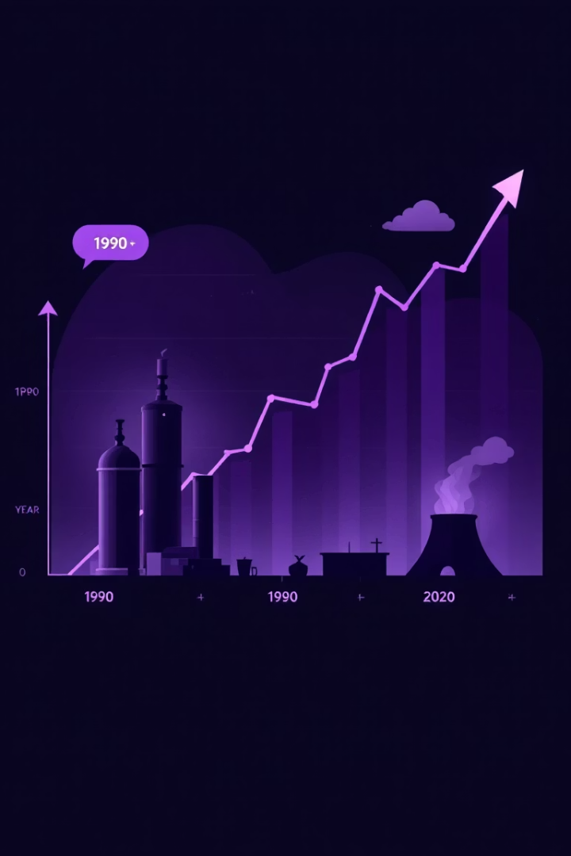
Objective 7: Year-over-Year Change
General Description:
This analysis tracks changes in pollution from one year to the next to evaluate progress or decline in air quality.
Analysis results:
➢ Major cities showed ~80–90% drop in pollutant levels from 2019 to 2020.
➢ Post-COVID, levels rebounded slightly but remained below pre-pandemic levels in some areas.
➢ Some rural cities had stable or slightly increased pollution.
Combo Chart: Showing Pollution Trends & Year-over-Year Change.

Slide 11

Conclusion
This project demonstrated Excel’s effectiveness in analyzing air quality data across U.S. cities. Using advanced tools like pivot tables and charts, it uncovered key insights on pollution trends, seasonal variations, and major pollutants such as PM2.5 and PM10. Year-over-year analysis and source attribution (e.g., NO2 from vehicles, SO2 from industries) highlighted the impact of policies and urban activity. The interactive dashboard serves as a valuable resource for decision-makers to develop targeted, data-driven environmental strategies.

