Slide 1
MARKET RHYTHM,
INFORMATION AND PRIORITISATION

Slide 2
the Rhythm of Marketing
Logo here​
Marketing Opportunity Review
Marketing Strategy Refresh
Alignment & Resource Allocation
Execution
SGM
ODM
Co Plan
SGM
ODM
Co Plan
Portfolio Strategy & i1-2 (Core Brand Opportunity) are key brand inputs into MOR
Significant changes to i3 and i4 can inform update of Marketing Agenda
Brand Product Pipeline and Activation Territories are basis for the Resource Allocation discussion
i7 outputs feed directly into execution.
End Markets take brand guidelines via SGM and present back plans for execution in ODM before locking down company plan
MOR outputs inform the Brand Code development in the very beginning of the process
Updates to Marketing Agenda can confirm the strategic directions you should take
Resource Allocation can affect implementation of Brand innovation or activation in particular markets – but unlikely to impact Brand Code at strategic level
*
Portfolio
Strategy
Y1
*
I1-2
I3
I4
I5
I6
YEAR(S) OF REVAMP
360° Activation
I7
REMARKS
* Portfolio and I1-I2 have a dual interaction with MOR, working both as Input/Outputs to each other. A Brand Perspective Analysis provides inputs to MOR in order to set opportunities and outputs from MOR provide a consolidating view of the business to develop Portfolio Strategy
Deployment Plan Alignment
I7
Brand library
I7
Activation Guideline
Brand Guidelines
I7

Slide 3



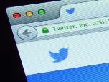


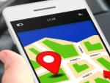





Are you ready to deal with infobesity?
Logo here​
1+ billion
Websites
90%
of world’s data created in past 2 years
Notes:
We are experiencing an explosion in the availability of consumer behavioural data – often delivered in real time
It is the age of ‘infobesity’
It is a huge opportunity for brands – but how you harness the power of all this data is key

Slide 4
answer three critical questions
Logo here​
What does it mean?
(So What?)
What is happening?
Why is it happening?
Notes:
The critical question here is the ‘So What?’ and indeed the ‘Now What?’
We are looking for implications and insights that will drive opportunities for our brand

Slide 5
Brand Opportunity Identification funnel
Logo here​
Go WIDE
Dig DEEP
Stay TIGHT
Explore multiple data and information sources to identify internal and external factors which could affect your brand
Develop hypotheses and dig deeper from surface level to the root cause
Be selective: crisply articulate only the most important factors in an actionable SWOT
Notes:
Summarising these three bigger questions (from slide before), we translate it into something that is easier to remember: 1. Go WIDE; 2. Dig DEEP; 3. Stay TIGHT
Go WIDE = collecting your data
Dig DEEP = scrutinise your data and get to opportunities and threats
Stay TIGHT = prioritise that what is important and park what is less important

Slide 6

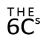






Brand Opportunity Identification funnel
Logo here​
Consumer
Company
Channel
Competitors
Context
Category
High
Low
 | Hard | Easy
O
Who? What?
O
When? Where?
Gain
O
I
Why? Why? Why?
Dig DEEP
So what?
I
I
or
O
Pain
6Cs Analysis to Information
Information to Opportunities or Threats
Prioritized Opportunities or Threats
Notes:
In the first part (‘what is happening’) we will collect all the information we need
Then we will start to interrogate the information to translate it into opportunities or threats
This long list of opportunities and threats still contains too much to handle, and not all of it is really important.
That’s why the third step is to prioritise by using some simple but relevant criteria
We will go into each of these steps in more depth
Now we have identified relevant themes (information) from all essential information sources, it is time to better translate this information into Opportunities and Threats

Slide 7
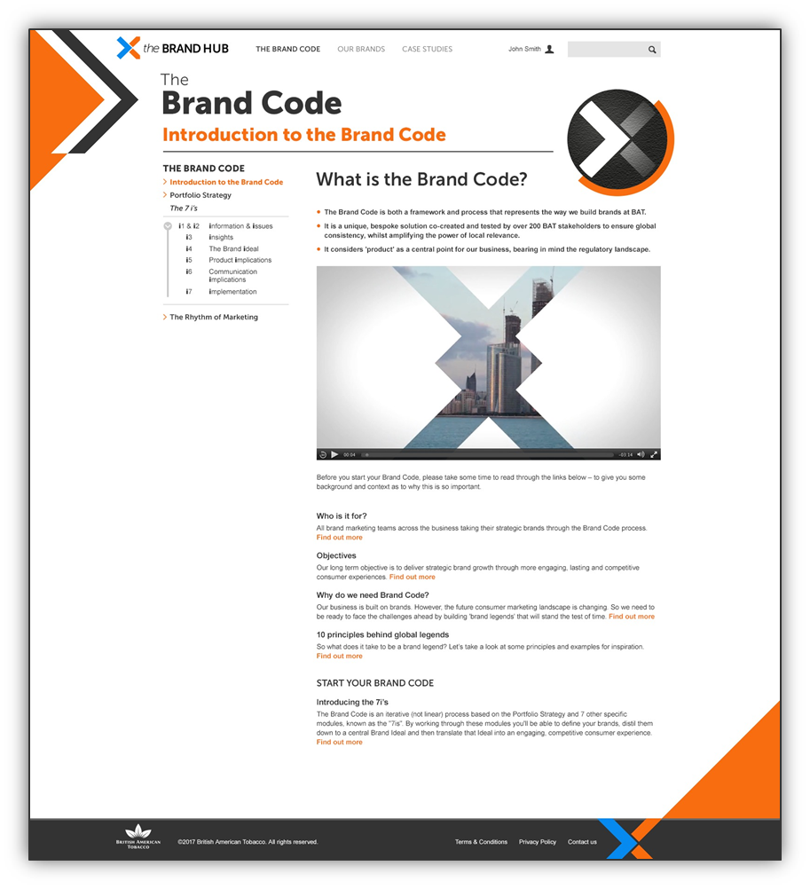
Map all learnings into a SWOT
Logo here​
STRENGTHS
WEAKNESSES
OPPORTUNITIES
THREATS
Brand hub
CORE BRAND OPPORTUNITY

Slide 8
DEVELOPING Opportunities to grow Your business
Logo here​
# More consumers
# More often
# More value
More/new consumers in existing markets
Consumers Buying More Frequently
Persuade Consumers To Trade Up To Higher Price
Start selling to new markets
Increasing The Amount Bought Per Trip
Winning in the contestable & dynamic space
Notes:
The reason for selecting the Core Brand Opportunity is that there are so many marketing levers available that it is tempting to focus on multiple things at the same time
At BAT we strongly believe that we should focus, and that means making choices.
Looking at the above examples of how you can grow your business… We all know situations in which we seriously considered (or did) go after multiple of these opportunities.
Note: Dynamic space is a new analysis construct that goes further than contestable space to capture all smokers whose behaviour is dynamic either via repertoire or trial. It allows us to identify the consumers who are actively looking out for new offers!

Slide 9
Logo here​
Opportunity prioritization: does it add up?
Do your opportunities align to your portfolio vision?
Do you think you can deliver on all your opportunities?
No
Yes
We need to prioritise the activities
Can you do better with your investments?
How?
Always
Pain – Gain Matrix
Notes:
To help going after the right opportunities, there are a couple of questions you can ask yourself whether you need to do a prioritization exercise
Opportunities for your brand should in the first place align to your portfolio vision
Then there is a business reality of whether you can deliver on all opportunities
Even if you can – are there other business needs that need investment more than going after all the opportunities?
Ultimately (and in most cases), you will end up having to do a prioritization exercise.

Slide 10

Logo here​
the Rhythm of Marketing
High
Low
 | Hard | Easy
Size of Prize
Longer term impact
Low hanging fruit
‘Gain’
Cherry pick
Complexity and resource requirement
‘Pain’
Notes:
The simple tool that can help you to go after the right opportunity/opportunities is the PAIN/GAIN matrix.
On the y-axis you see the Gain, aka. The Size of the prize. It represent the (financial) business improvement that can be reached (when deducted investment costs). Think about incremental turnover, profits, consumer base, etc.
On the x-axis you see the Pain, aka. The Complexity and Resource requirement. It represents the actual costs of going after the opportunity, the chance to succeed, business risk, etc.
It is a relative/qualitative tool which means that you will position opportunities first and foremost relative to another.
Pick an opportunity that is relatively easy to map and plot it on the map. The second, third, fourth – still map them in the right box but make sure it’s relativity to other opportunities is right.
Ideally you will end up going after the opportunities and threats in the Low Hanging Fruit box, but at times it can be wise to seriously consider considering some in the Longer Term impact and Cherry pick as well.

Slide 11
KPI setting is critical at every level of marketing
Logo here​
Brand dynamics & financial returns
Strategic level: long-term brand health metrics
Share growth
Profitability
Brand equity
Value & Volume
Buying behaviour
Penetration rate
Operational level: granular goals for brand/product
Purchase frequency
Share of segment
Trial
Marketing Mix
Tactical level:
end market / media
execution measures
Promotional ROI
Product Perception
Advertising ROI
Price margin
Pack: on-shelf impact measures
Place: number of distribution points
Notes:
Depending on your selected Core Brand Opportunity – it is important to set KPIs that are relevant, challenging but realistic.
KPIs can be set at different levels:
Strategic level is more for opportunities that are about overarching goals for a category
Operational level more for opportunities that go towards granular goals for brand/product
Tactical level more for opportunities that focus on end market / media execution

Slide 12
HOW YOU BRING YOUR BRAND IDEAL TO LIFE THROUGH COMMUNICATION
Logo here​
Creative Idea
(& Briefing)
Design System
Communication Strategy
(From – To Destination)
360 Activation
Notes:
We will look at how to bring your brand ideal to life through communication.
There are 4 components here.
Communication Strategy
Creative Idea (and briefing)
Design System
360 Activation

Slide 13
More connected devices…
Logo here​
Data
People
2008
2015
2020
Connected Society
!
7
Billion
25
Billion
50
Billion
Connected devices
Process
Devices
212 Billion
Sensor enabled devices
Notes:
The number of connected devices to the internet is even more astonishing
Whereas 2008 marked the date that the number of devices connected to the internet exceeded the number of people on the planet
In 2015 this was already 25 billion (over the 3.2 billion people who have access to them, that is at about 8 per person, not just laptops and smartphones obviously
Expected is that by 2020 this number has doubled again, and the number of devices that are able equipped with sensors (e.g. health tracking devices) exceeds 200 billion

Slide 14
Millennials will soon be the biggest consumer group and won’t see digital as something ‘new’ or separate!
Logo here​
Insert image here
Insert image here
IN
Notes:
Digital has been a “new” topic for way too long
It’s time to embrace it as the new normal
Not adopting this mind-set is not an option

Slide 15
A generation that shops differently & trust peers over brands
Logo here​
92%
of consumers trust peer recommendations over advertisement
Insert image here
Insert image here
84%
Of smartphone shoppers use their device to help shop while in store
Notes:
There is a natural reluctance towards what brands tell you (consumers start to disbelieve the marketing messages by large corporations) and instead rely on peer to peer communications (the equivalent of word of mount in a digital era)
Consumers more often than not use their phone in store to see whether they can find the very same product cheaper elsewhere. Comparison websites make pricing transparent and leave it up to the consumer whether they want to pay a premium for external factors such as service, location, etc.

Slide 16
A large amount of time spent on media is dedicated to “me time”
Logo here​
Insert image here
68% of consumers’ smartphone use happens at home.
And users’ most common activity is not shopping or socializing but engaging in “me time.”
Notes:
To marketers, the prospect of reaching shoppers through their smartphones is tantalizing. But mobile doesn’t always mean on the go. New data show that 68% of consumers’ smartphone use happens at home. And users’ most common activity is not shopping or socializing but engaging in what researchers at BBDO and AOL call “me time.”
Seven primary motivations The reasons consumers use smartphones can be broken down into the goals listed at right, along with the average monthly minutes and percentage of interactions devoted to each.
“Seven Shades of Mobile” study, conducted by InsightsNow for AOL and BBDO, 2012. In the first phase, 24 users completed a seven-day diary and in-depth interviews. In the second, 1,051 U.S. users ages 13 to 54 were surveyed, data on 3,010 mobile interactions were collected, and the mobile activities of two-thirds of those users were tracked for 30 days.

Slide 17
By 2006 Burberry was in trouble
Logo here​
Brand
Sales
Organisation
Customer experience
Marketing
Insert image here
Insert image here
Insert image here
Insert image here
Insert image here
Outdated image and lost of brand identity
Iconic trenchcoat doesn’t sell
Slow decision making & low employee engagement
No brand interaction & inconsistent store experience
Lack of clear target definition
& old marketing tactics
Notes:
Brand:
British brand with a back dated, ‘dusted’ image
Iconic pattern has been copied countless times
Loosing it’s brand identity and luxurious image
Design, collection & production:
Several Design Teams worldwide, not aligned on design principles
Iconic trench coats only account for small % of sales
Target group & marketing:
Lacking differentiation from other luxury brands
Target customer not really defined
No ‘serious’ digital offer, local website clutter and no e-commerce
Selling and advertising rather than connecting with consumers
Organization:
Inefficient organization, slow decision making, local independence
Challenge to focus on the big picture
Not equipped for digital development
Customer experience and Sales associates:
Low customer engagement, no brand interaction
No online offer
Inconsistent store experience

Slide 18
Burberry Digital Strategy
Logo here​
OBJECTIVES
Create a flawless consumer experience with new experiences
&
Increase market share among a redefined target audience
BRAND IDEAL
Functional luxury with a British flair
MARKETING TASK
Invite consumers to participate to the Burberry brand experience anywhere and whenever
ROLE OF DIGITAL
Create a consumer experience that enables anyone who wants to touch the brand to have access to it
Insert image here
Insert image here
Insert image here
Notes:
Summarising in terms of Brand Code language but mostly highlight the role of digital in Burberry

Slide 19
Objective is driving excellence in 360 Activation to deliver a total brand experience
Logo here​
From…
To…
Passive communication at retail focusing on Awareness
Active brand activation in and outside of retail focusing on Awareness, Trial & Retention
Focused on retail touch points, limited application in dark markets
Touch points activation in and out of retail to expand dark market and cross category capabilities
Fragmented communication across touch points
Integrated 360°communication across touch points
Slot-based cycle plan to support key missiles
“Always on” engagement to support portfolio
Notes:
As much as we are changing our mind-set, our ways of working around activation have to change as well.
These FROM-TO come primarily from ATSM (Trade Shopper Marketing) toolkits

Slide 20
How to get to 360 Activation?
Logo here​
Review ACT insights
Engagement Platforms
Touchpoints
Notes:
The Brand Code process describes a three step process to get to 360 Activation, which we will now look at in more detail now

Slide 21
Understanding the key moments for your ACT
Logo here​
A ‘day in the life’
Free time activities
Holiday preferences
General consumption habits
Ownership habits
Advertising & Media consumption
Notes:
The way to start to understand your local actionable consumer target is to understand their lives

Slide 22
Key moments are the input for your activation on your Touchpoints
Logo here​
Key moments…
…determine your touch points
Notes:
As could be seen from the example, it is those moments in the ACT’s life in which they are most receptive for your brand that determine your Touchpoints (retail, 121, entertainment, digital)

Slide 23
Map these key moments to explore & connect them
Logo here​
Key moments
ACT |  | Communication task from Strategic Quest
Key Moment
 | Linked to your target audience/category and brand
Points in Time (When)
 | Just before/during/after the Key moment
Places (Where)
 | Where are they at the key moments?
Touchpoints
 | By whom or how might they be influenced?
TIPS
Go beyond the regular track
Explore routines, highlights, rituals
Notes:
A template that can help you to write up these key moments can be seen here
If you want to understand your ACT, you need to have a deep look at their media affinity and consumption.
What media does your consumer like or over-consume? Are they digitally savvy or traditional media focused? Make as much research as possible with your media partner to determine what their media usage looks like.

Slide 24
Insert image here
Logo here​
Key Moment
Insight in the Moment
Insert image here
He eats lunch at his desk at work every day
Insert image here
I have good intentions to take lunch break but I let work get in the way
Brand Opportunity
McDonalds
It’s your lunch, take it!
Motivate people to take their lunch time and convince that McDonalds matches their needs
Insert image here
Insert image here
Notes:
The logic in this campaign goes as follows.
Key moment in the ACT’s life (see previous slide for ACT profile) is that he/she always eats lunch at his/her desk – every day.
What we know is an anchor for the brand to play a role (tension) is that although it is assumed eating lunch at your desk makes you look like you work better/ harder, personally you always think and tell people that you do NOT intend to eat at your desk anymore.
McDonalds plays onto that tension by leveraging the brand opportunity in the key moment: motivating people to take their lunch break back – by making people remember their own resolutions and offering the solution

Slide 25
Logo here​
Key moments
ACT | Busy office workers that spend their lunch breaks indoors at the desk, and either order in or eat a packed lunch | Communication task from Strategic Quest | Get them to go outside and eat McDonalds for lunch by convincing them that they deserve that time and should make a stand and claim their lunch break back!
Key Moment | Making packed lunch | Commute to work | When getting hungry for lunch | Having lunch
 | Linked to your target audience/category and brand
Points in Time (When) | Mornings between 8 and 8.30 | 8:30~9am | Between 11 and 12 am | 13 pm
 | Just before/during/after the Key moment
Places (Where) | At home | Car or bus/metro | At work | Office desk
 | Where are they at the Key moment?
Touchpoints | Radio / TV | Radio / Online | Online | Online / OOH
 | By whom or how might they be influenced?
Notes:
This is what it looks like in the key moments template we saw earlier
Finding the correct key moments is key to the input of Touchpoints. You MUST define key moments first...the path to defining the most relevant touch points is then much easier. Digital advert/ or email just before lunch at work? Tv commercial in morning whilst people are watching the news? etc

Slide 26
Remember the purchase barriers we discussed for Lucky Strike Double Click in Spain?
Logo here​
Primary
Secondary
Insert image here
I’m not sure about the product
Pack or Comms are not attractive enough for me
I’m not sure I’m getting my money worth
I do not see it nor find it
Has little standout / I’m not sure it will be accepted in my group
Don’t like the product
Not good quality
It’s not the right price for me
Don’t like the brand
as much as others
Not good as others
Not innovative, unique enough
I cannot afford it more often
Product Perception
& Experience
Proximity
Brand Values Expression
Price
Perception
Notes:
Let’s re-visit the Lucky Strike example we looked at earlier through the Strategic Quest

Slide 27
We can apply AIA to address these purchase barriers
Logo here​
Insert image here
Insert image here
Insert image here
I’m not sure about the product
I’m not sure about the product
I’m not sure I’m getting my money worth
I’m not sure about the product
I’m not sure I’m getting my money worth
Notes:
We can apply AIA to address the Lucky Strike purchase barriers in the example

Slide 28
What is 121?
Logo here​
121 Channel = direct to consumer communication via face to face interaction
Retailer / Staff
Brand Ambassador
Trade Marketing Representative
Insert image here
Insert image here
Insert image here
Choose people who embody your brand – they are a key touchpoint!
Notes:
There are 3 categories of 121. The one in-store (retailer/staff) is mostly linked to Retail. The Brand Ambassador is mostly linked to Events. The Trade Marketing Representative is mostly linked to the customer (not consumer)
ATSM = ADULT TOBACCO SHOPPER MARKETING

Slide 29
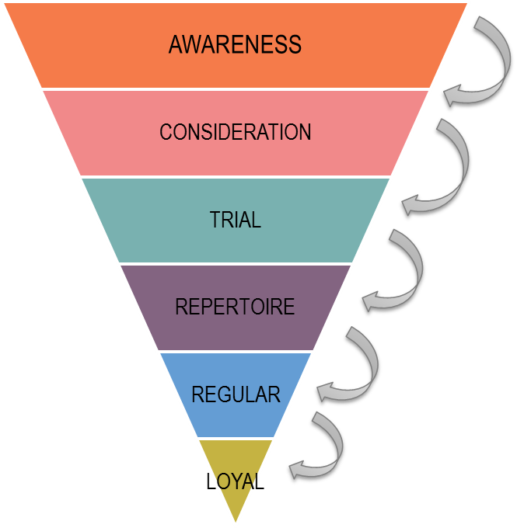
To understand purchase barriers we need to look at the Consumer Decision Funnel (CDF)
Logo here​
What consumers THINK of the brand/product
What consumers EXPERIENCED of the brand/product
Notes:
Going from current (FROM) to the desired (TO) often is not an easy job
There is a purchase barrier that needs to be overcome.

Slide 30
Purchase barriers can then be mapped against the Consumer Decision Funnel (CDF)
Logo here​
I’m not sure about the product
Pack or Comms are not attractive enough for me
I’m not sure I’m getting my money worth
I do not see it nor find it
Has little standout / I’m not sure it will be accepted in my group
Don’t like the product
Not good quality
It’s not the right price for me
Don’t like the brand
as much as others
Not good as others
Not innovative, unique enough
I cannot afford it more often
Product Perception
& Experience
Proximity
Brand Values Expression
Price
Perception

Slide 31
Capture consumer data
Logo here​
Acquiring consumers via 121 into the consumer database (CRM)
Engaging the acquired consumers further on the webpage
Insert data here
Insert data here
Notes:
An important element of 1-2-1 is to also capture data, so you can follow up or send them promotion materials
That way you can also bring them along on the journey towards purchase, e.g. following up with an e-mail that brings them to a promotional website where they can further engage with the brand and drive consideration
Resulting in:
Highest open and unique clique rate in LS online history
First time possibility to analyse registration of consumer without POP/OOH as 121 started before other touchpoints

Slide 32
What is Digital?
Logo here​
Digital = all channels with aspirational target consumer that are intermediated by technology
Social
App
CRM/Targeted comms
Insert image here
Insert image here
Insert image here
Insert image here
Insert image here
Insert image here
Insert image here
Insert image here
Insert image here
Notes:
We already know that digital disruption is opening up a multitude of activation opportunities and touchpoints
Here are just 3 (social, App and CRM/ targeted comms)

Slide 33
Logo here​
Talk football 24/7
Invite friends to play
Access to trials
Latest products & news
Engaging Retail/Online + Personalisation
Notes:
The Nike Football app features custom football emojis within its chat feature to extend the dressing room camaraderie, and uses geo-tracking technology to allow members to set up matches around the world… The app allows players to create their own micro-communities with the “Crew” feature, staying connected to their friends and teammates and making sure they never miss a chance to play. Using the “Play” section, members can set up a time and location for a game or kick-about and track who is in.

