Slide 1



Slide 2

Background
Problem
Solution
How It Works
Traction
Market Size
Competition
Market Validation
Team
Partnership
Roadmap
Ask Seed Stage
Exit

Slide 3

BACKGROUND
Healthcare technology, commonly referred to as “healthtech,” refers to the use of technologies developed for the purpose of improving any and all aspects of the healthcare system. .
Healthcare technology is improving the lives of patients by individualizing treatment plans and
making hospital processes more efficient.
The way we purchase healthcare is becoming more accessible to a wider group of people through the insurance technology industry, sometimes called "insurtech." Patient waiting times are declining and hospitals are more efficiently staffed thanks to artificial intelligence and predictive analytics. Even surgical procedures and recovery times are being reduced thanks to ultra-precise robots that assist in surgeries and make some procedures less evasive.
1
www.healthtech.com

Slide 4
BACKGROUND
Fitness
Fitness is obviously becoming a larger focus of the healthtech ecosystem.The industry has developed hundreds of wearables, apps and other tools that do everything from track our workouts to measure our sleep schedules, all in the name of increasing fitness and reducing preventable costs on the healthcare system.
1
1
www.healthtech.com

Slide 5
PROBLEM
Fitness
Fitness is obviously becoming a larger focus of the healthtech ecosystem.The industry has developed hundreds of wearables, apps and other tools that do everything from track our workouts to measure our sleep schedules, all in the name of increasing fitness and reducing preventable costs on the healthcare system.
1
1
www.healthtech.com

Slide 6
SOLUTION
Change is a constant in healthcare and medicine. Surgical techniques improve. Patient care becomes more personalized. Drug discovery is streamlined. And, in an increasing number of cases, patient health monitoring no longer requires doctor visits.
wearable devices are giving people a far more active role keeping tabs on their own healthcare. And they're much more than mere Fitbits. From heart monitors and electrocardiogram applications to temperature and reproductive cycle trackers, wearables are becoming more prominent in the day-to-day management of illnesses and chronic conditions.
1
www.healthtech.com

Slide 7
SOLUTION
Healthtech makes a wide range of devices, including fitness and health tracking wearables for adults and children.
Healthtech also offers an all day activity tracker that counts steps, distance, intensity and calories, helping users maintain health and fitness goals.
1
www.healthtech.com

Slide 8


HOW IT
WORKS
Healthtech makes a wide range of devices, including fitness and health tracking wearables for adults and children.
Healthtech makes a wide range of devices, including fitness and health tracking wearables for adults and children.
1
www.healthtech.com

Slide 9

TRACTION
$ 332 K
2020
Year till
date
Year till date
1
www.healthtech.com

Slide 10
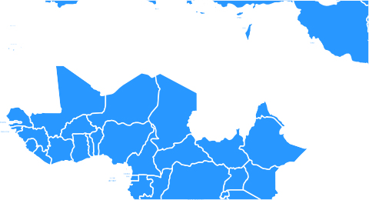







MARKET SIZE
1
www.healthtech.com

Slide 11


COMPETITION
GARMIN
GARMIN
GARMIN
HEALTHTECH
Crowdfunding
Fractionalization
Tokenization
Exchange Platform
Transaction Fees
1
www.healthtech.com

Slide 12

TEAM
Healthtech makes a wide range of devices, including fitness and health tracking wearables for adults and children.
Healthtech makes a wide range of devices, including fitness and health tracking wearables for adults and children.
Healthtech makes a wide range of devices, including fitness and health tracking wearables for adults and children.
1
www.healthtech.com

Slide 13





PARTNERSHIP
1
www.healthtech.com

Slide 14
















ROADMAP
1
www.healthtech.com

Slide 15
ASK SEED
STAGE
We’re looking for $ 1.27 M in Convertible, Notes
80% of which will be spent as initial working capital
15% on team
5% on marketing & parternships.
This will allow us to generate $ 25M venue in the 12 runway.
1
www.healthtech.com

Slide 16
EXIT
1
www.healthtech.com

Slide 17
www.healthtech.com

