Slide 1

X-Blossom
Massive Parallelization of Maximum Matching

Slide 2



Maximum Matching
Matching: a set of edges with no shared vertices
Maximum Matching: a matching that contains the largest possible number of edges
Graph $G$
A valid matching $M$
A maximum matching $M^{∗}$
Red edges are edges in the matching
Notes:
As data scales in modern applications and the demand for real-time processing intensifies, parallel computing solutions have become more and more important. A wide range of real-world applications rely on irregular datacentric algorithms. But developing efficient parallel frameworks for such computations is challenging and requires advances in both algorithm design and hardware implementation.

Slide 3
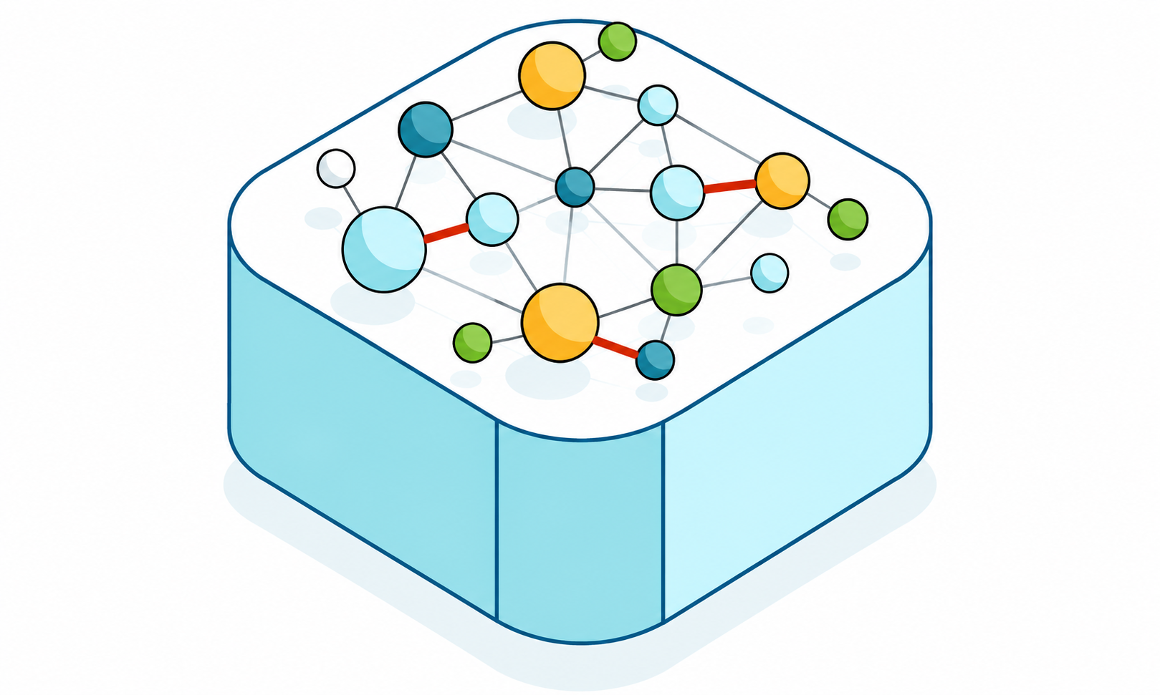
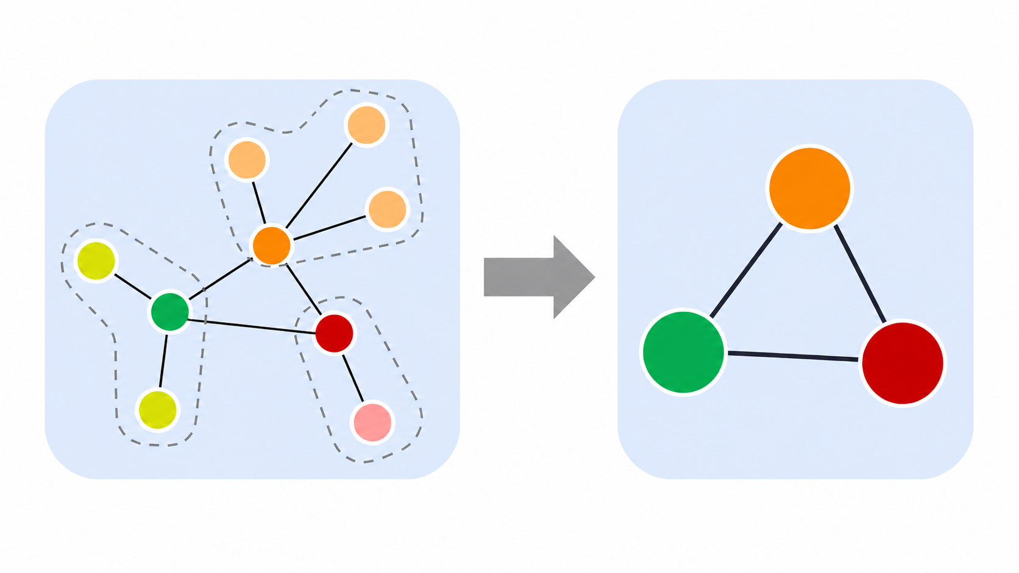
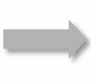
Applications of Maximum Matching
Graph Data Management
Graph databases and graph learning
Notes:
In distributed ML training, communication is often a bottleneck. When workers need to exchange gradients, parameters, or data shards, each worker may only participate in one high-bandwidth transfer at a time. We can model workers as vertices and pending transfers as edges. A matching gives a set of transfers that can run simultaneously without endpoint conflicts, and a maximum matching maximizes the number of concurrent transfers in each scheduling round.

Slide 4
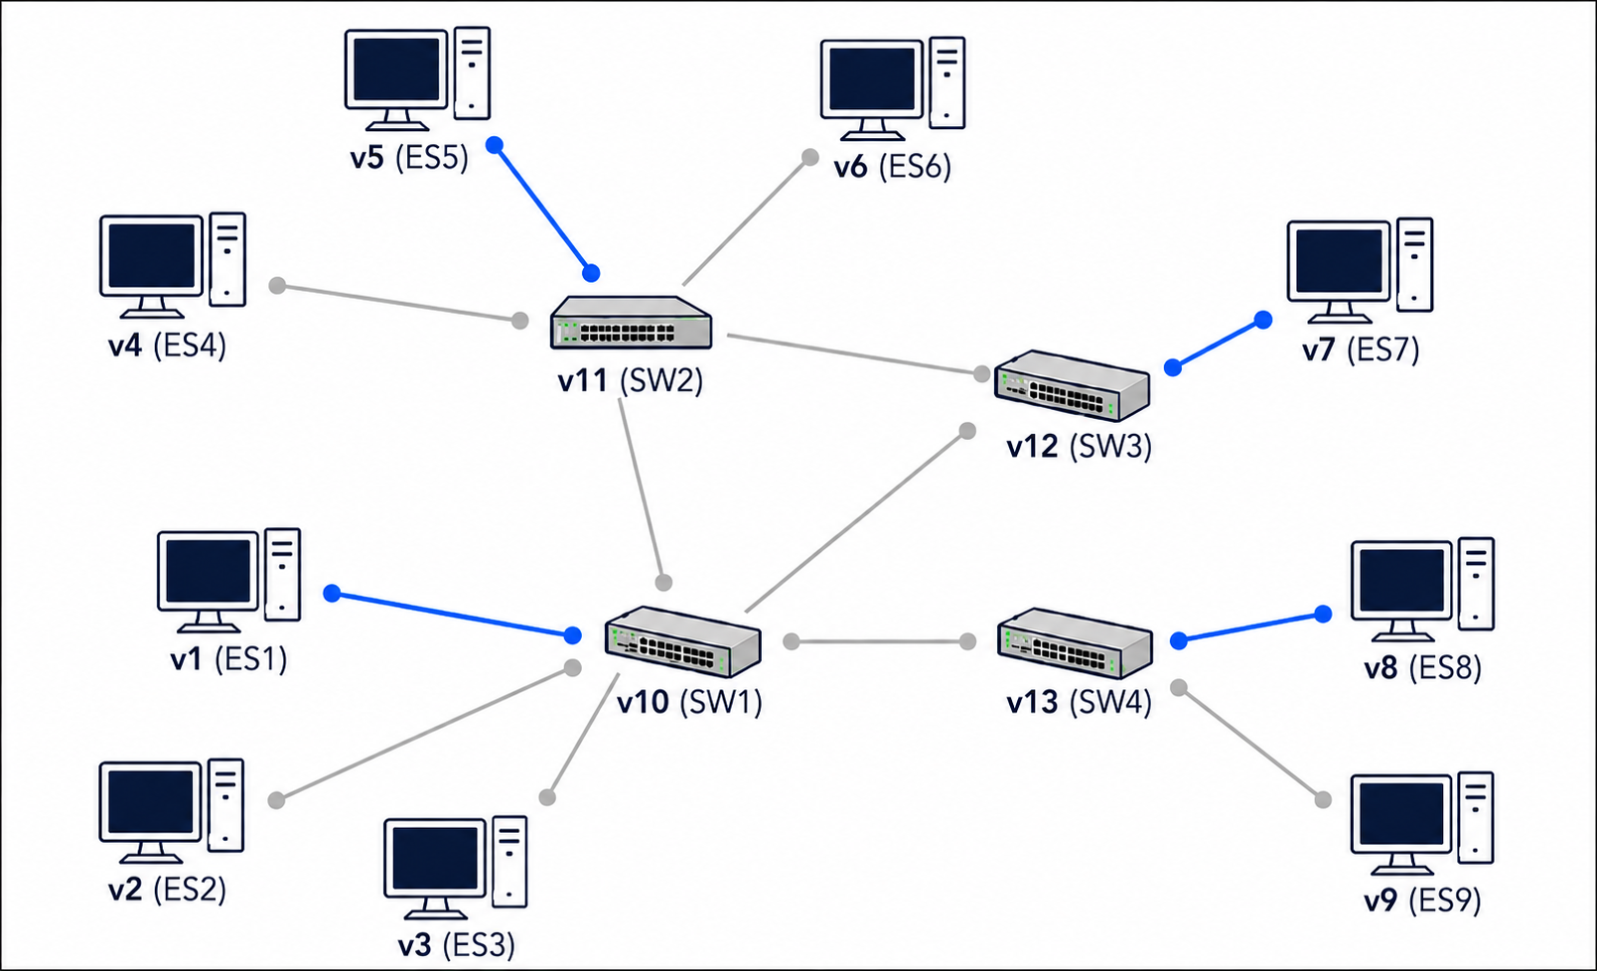

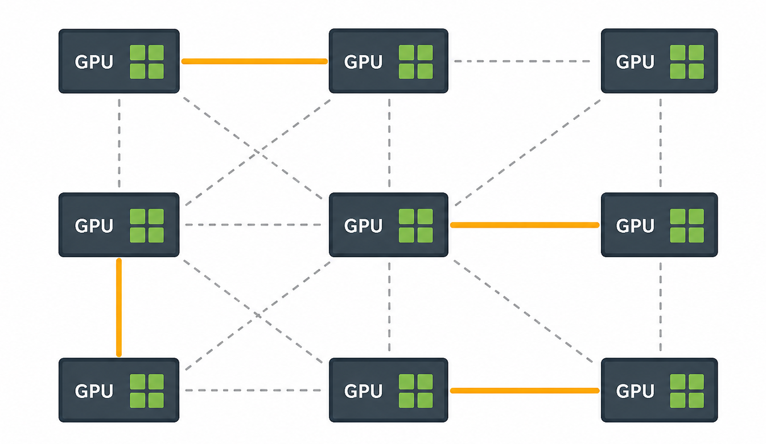
Applications of Maximum Matching
Graph Data Management
Graph databases and graph learning
Distributed Systems
Network scheduling and multi-GPU communication
Notes:
In distributed ML training, communication is often a bottleneck. When workers need to exchange gradients, parameters, or data shards, each worker may only participate in one high-bandwidth transfer at a time. We can model workers as vertices and pending transfers as edges. A matching gives a set of transfers that can run simultaneously without endpoint conflicts, and a maximum matching maximizes the number of concurrent transfers in each scheduling round.

Slide 5
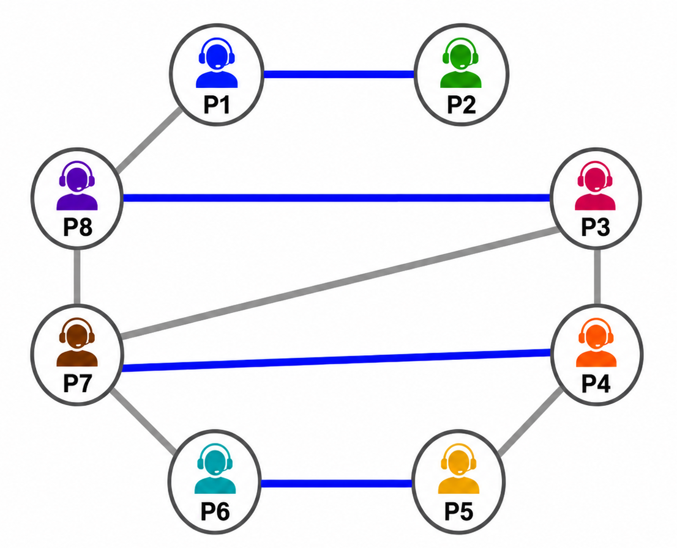
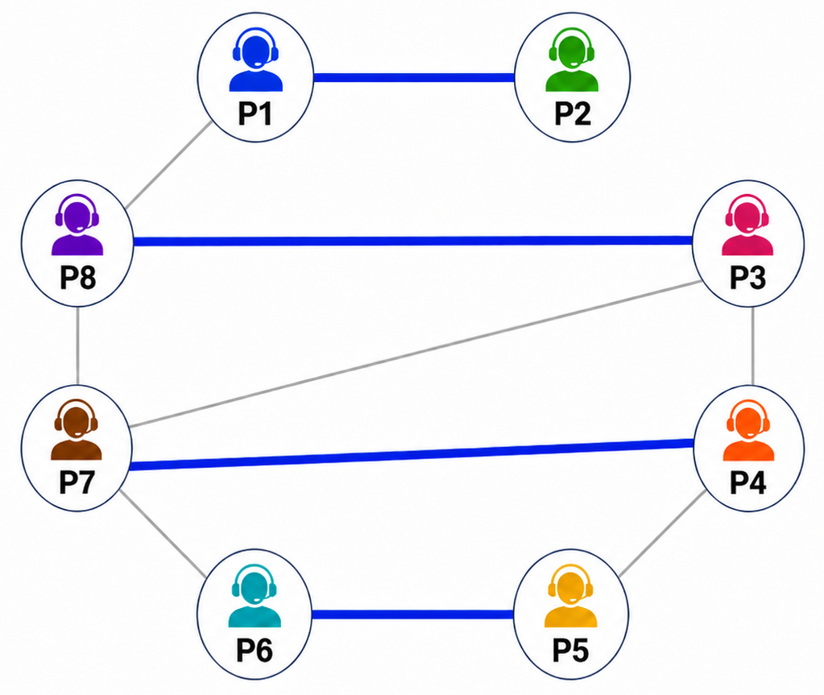

Applications of Maximum Matching
Graph Data Management
Graph databases and graph learning
Distributed Systems
Network scheduling and multi-GPU communication
Online Platforms
User pairing and service dispatch
Notes:
In distributed ML training, communication is often a bottleneck. When workers need to exchange gradients, parameters, or data shards, each worker may only participate in one high-bandwidth transfer at a time. We can model workers as vertices and pending transfers as edges. A matching gives a set of transfers that can run simultaneously without endpoint conflicts, and a maximum matching maximizes the number of concurrent transfers in each scheduling round.

Slide 6
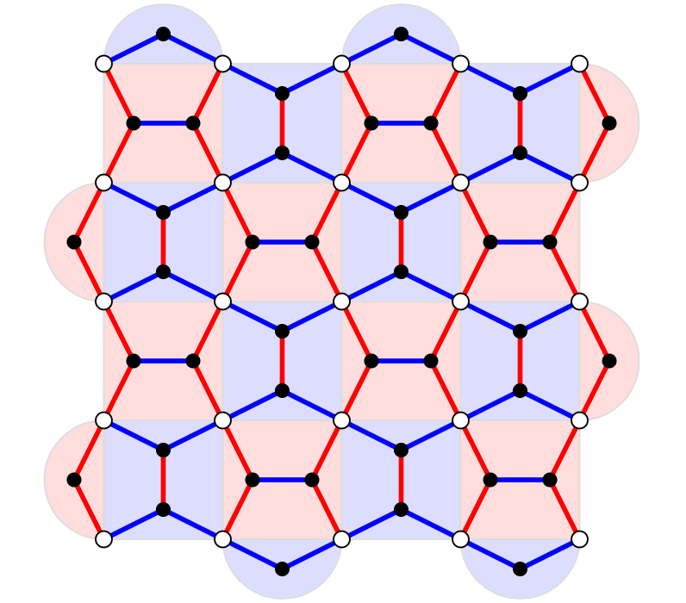
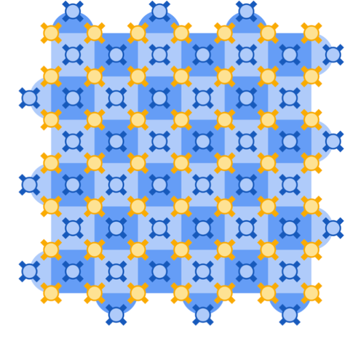
Applications of Maximum Matching
Graph Data Management
Graph databases and graph learning
Distributed Systems
Network scheduling and multi-GPU communication
Online Platforms
User pairing and service dispatch
Quantum Computing
Surface codes and quantum error correction
Notes:
In distributed ML training, communication is often a bottleneck. When workers need to exchange gradients, parameters, or data shards, each worker may only participate in one high-bandwidth transfer at a time. We can model workers as vertices and pending transfers as edges. A matching gives a set of transfers that can run simultaneously without endpoint conflicts, and a maximum matching maximizes the number of concurrent transfers in each scheduling round.

Slide 7

Finding Maximum Matching
Augmenting path
– alternates between unmatched edges and matched edges
– begins and ends with an unmatched node
$$\left|M\right|=2$$
An augmenting path
Notes:
In distributed ML training, communication is often a bottleneck. When workers need to exchange gradients, parameters, or data shards, each worker may only participate in one high-bandwidth transfer at a time. We can model workers as vertices and pending transfers as edges. A matching gives a set of transfers that can run simultaneously without endpoint conflicts, and a maximum matching maximizes the number of concurrent transfers in each scheduling round.

Slide 8

Finding Maximum Matching
Flip an augmenting path
unmatched → matched
matched → unmatched
flip
$$\left|M\right|=2$$
An augmenting path
$$\left|M^{′}\right|=3$$
Notes:
In distributed ML training, communication is often a bottleneck. When workers need to exchange gradients, parameters, or data shards, each worker may only participate in one high-bandwidth transfer at a time. We can model workers as vertices and pending transfers as edges. A matching gives a set of transfers that can run simultaneously without endpoint conflicts, and a maximum matching maximizes the number of concurrent transfers in each scheduling round.

Slide 9
Finding Maximum Matching
1957
Berge’s Theorem
A matching is maximum if and only if
no augmenting path can be found
Notes:
In distributed ML training, communication is often a bottleneck. When workers need to exchange gradients, parameters, or data shards, each worker may only participate in one high-bandwidth transfer at a time. We can model workers as vertices and pending transfers as edges. A matching gives a set of transfers that can run simultaneously without endpoint conflicts, and a maximum matching maximizes the number of concurrent transfers in each scheduling round.

Slide 10


Finding Maximum Matching
1957
Berge’s Theorem
1965
Jack Edmonds
$$O(V^{2}E)$$
2015
Norbert Blum
$$O(\sqrt{V}(V+E))$$
Blossom algorithm
First polynomial-time solution
(The most widely-used)
Notes:
In distributed ML training, communication is often a bottleneck. When workers need to exchange gradients, parameters, or data shards, each worker may only participate in one high-bandwidth transfer at a time. We can model workers as vertices and pending transfers as edges. A matching gives a set of transfers that can run simultaneously without endpoint conflicts, and a maximum matching maximizes the number of concurrent transfers in each scheduling round.

Slide 11
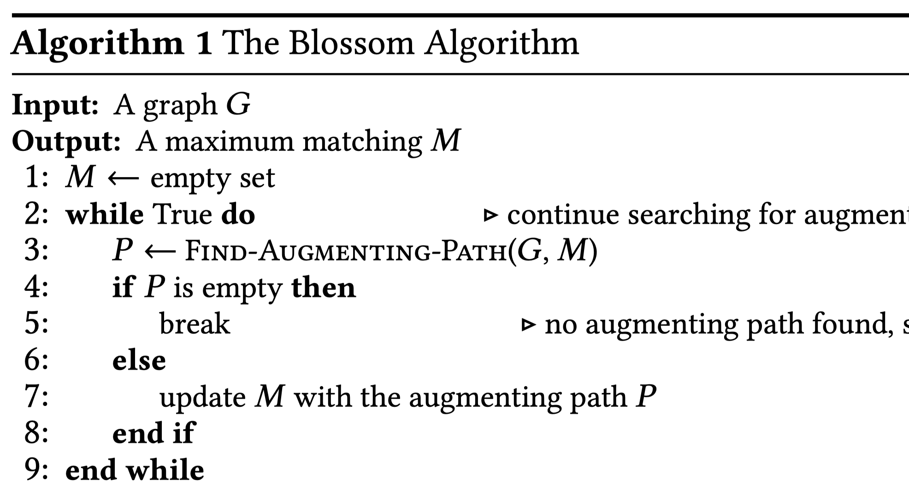

Blossom Algorithm
Key idea – repeatedly find an augmenting path and increase the matching
Notes:
As data scales in modern applications and the demand for real-time processing intensifies, parallel computing solutions have become more and more important. A wide range of real-world applications rely on irregular datacentric algorithms. But developing efficient parallel frameworks for such computations is challenging and requires advances in both algorithm design and hardware implementation.

Slide 12

Blossom Algorithm
Key idea
Builds alternating trees to find augmenting paths
Alternating tree: rooted at an unmatched vertex
- grows by 1 unmatched edge + 1 matched edge at each step
Notes:
As data scales in modern applications and the demand for real-time processing intensifies, parallel computing solutions have become more and more important. A wide range of real-world applications rely on irregular datacentric algorithms. But developing efficient parallel frameworks for such computations is challenging and requires advances in both algorithm design and hardware implementation.

Slide 13
Blossom Algorithm
Key idea
Builds alternating trees to find augmenting paths
If an unmatched edge connects two even nodes from different trees,
Notes:
As data scales in modern applications and the demand for real-time processing intensifies, parallel computing solutions have become more and more important. A wide range of real-world applications rely on irregular datacentric algorithms. But developing efficient parallel frameworks for such computations is challenging and requires advances in both algorithm design and hardware implementation.

Slide 14
Blossom Algorithm
Key idea
Builds alternating trees to find augmenting paths
If an unmatched edge connects two even nodes from different trees,
Notes:
As data scales in modern applications and the demand for real-time processing intensifies, parallel computing solutions have become more and more important. A wide range of real-world applications rely on irregular datacentric algorithms. But developing efficient parallel frameworks for such computations is challenging and requires advances in both algorithm design and hardware implementation.

Slide 15
Blossom Algorithm
Key idea
Builds alternating trees to find augmenting paths
If an unmatched edge connects two even nodes from different trees,
Notes:
As data scales in modern applications and the demand for real-time processing intensifies, parallel computing solutions have become more and more important. A wide range of real-world applications rely on irregular datacentric algorithms. But developing efficient parallel frameworks for such computations is challenging and requires advances in both algorithm design and hardware implementation.

Slide 16
Blossom Algorithm
Key idea
Builds alternating trees to find augmenting paths
If an unmatched edge connects two even nodes from different trees,
an augmenting path is formed
Notes:
As data scales in modern applications and the demand for real-time processing intensifies, parallel computing solutions have become more and more important. A wide range of real-world applications rely on irregular datacentric algorithms. But developing efficient parallel frameworks for such computations is challenging and requires advances in both algorithm design and hardware implementation.

Slide 17
Blossom Algorithm
Key idea
Builds alternating trees to find augmenting paths
Handles odd cycles ("blossoms") in general graphs
Notes:
As data scales in modern applications and the demand for real-time processing intensifies, parallel computing solutions have become more and more important. A wide range of real-world applications rely on irregular datacentric algorithms. But developing efficient parallel frameworks for such computations is challenging and requires advances in both algorithm design and hardware implementation.

Slide 18
Blossom Algorithm
Key idea
Builds alternating trees to find augmenting paths
Handles odd cycles ("blossoms") in general graphs
Notes:
As data scales in modern applications and the demand for real-time processing intensifies, parallel computing solutions have become more and more important. A wide range of real-world applications rely on irregular datacentric algorithms. But developing efficient parallel frameworks for such computations is challenging and requires advances in both algorithm design and hardware implementation.

Slide 19
Blossom Algorithm
Key idea
Builds alternating trees to find augmenting paths
Handles odd cycles ("blossoms") in general graphs
If an unmatched edge connects two even nodes in the same tree,
Notes:
As data scales in modern applications and the demand for real-time processing intensifies, parallel computing solutions have become more and more important. A wide range of real-world applications rely on irregular datacentric algorithms. But developing efficient parallel frameworks for such computations is challenging and requires advances in both algorithm design and hardware implementation.

Slide 20
Blossom Algorithm
Key idea
Builds alternating trees to find augmenting paths
Handles odd cycles ("blossoms") in general graphs
If an unmatched edge connects two even nodes in the same tree, an odd cycle forms
Notes:
As data scales in modern applications and the demand for real-time processing intensifies, parallel computing solutions have become more and more important. A wide range of real-world applications rely on irregular datacentric algorithms. But developing efficient parallel frameworks for such computations is challenging and requires advances in both algorithm design and hardware implementation.

Slide 21
Blossom Algorithm
Key idea
Builds alternating trees to find augmenting paths
Handles odd cycles ("blossoms") in general graphs
If an unmatched edge connects two even nodes in the same tree, an odd cycle forms
Notes:
As data scales in modern applications and the demand for real-time processing intensifies, parallel computing solutions have become more and more important. A wide range of real-world applications rely on irregular datacentric algorithms. But developing efficient parallel frameworks for such computations is challenging and requires advances in both algorithm design and hardware implementation.

Slide 22
Blossom Algorithm
Key idea
Builds alternating trees to find augmenting paths
Handles odd cycles ("blossoms") in general graphs
Contract this blossom into a super node and generate a new graph
contract
Notes:
As data scales in modern applications and the demand for real-time processing intensifies, parallel computing solutions have become more and more important. A wide range of real-world applications rely on irregular datacentric algorithms. But developing efficient parallel frameworks for such computations is challenging and requires advances in both algorithm design and hardware implementation.

Slide 23
Blossom Algorithm
Key idea
Builds alternating trees to find augmenting paths
Handles odd cycles ("blossoms") in general graphs
Find an augmenting path in the new graph
contract
Next recursion level
Notes:
As data scales in modern applications and the demand for real-time processing intensifies, parallel computing solutions have become more and more important. A wide range of real-world applications rely on irregular datacentric algorithms. But developing efficient parallel frameworks for such computations is challenging and requires advances in both algorithm design and hardware implementation.

Slide 24
Blossom Algorithm
Key idea
Builds alternating trees to find augmenting paths
Handles odd cycles ("blossoms") in general graphs
Find an augmenting path in the new graph
contract
Next recursion level
Notes:
As data scales in modern applications and the demand for real-time processing intensifies, parallel computing solutions have become more and more important. A wide range of real-world applications rely on irregular datacentric algorithms. But developing efficient parallel frameworks for such computations is challenging and requires advances in both algorithm design and hardware implementation.

Slide 25
Blossom Algorithm
Key idea
Builds alternating trees to find augmenting paths
Handles odd cycles ("blossoms") in general graphs
Return the augmenting path from recursion
contract
Next recursion level
Notes:
As data scales in modern applications and the demand for real-time processing intensifies, parallel computing solutions have become more and more important. A wide range of real-world applications rely on irregular datacentric algorithms. But developing efficient parallel frameworks for such computations is challenging and requires advances in both algorithm design and hardware implementation.

Slide 26
Blossom Algorithm
Key idea
Builds alternating trees to find augmenting paths
Handles odd cycles ("blossoms") in general graphs
Lift the blossom and restore a valid augmenting path in the original graph
contract
lift
flip
Next recursion level
Notes:
As data scales in modern applications and the demand for real-time processing intensifies, parallel computing solutions have become more and more important. A wide range of real-world applications rely on irregular datacentric algorithms. But developing efficient parallel frameworks for such computations is challenging and requires advances in both algorithm design and hardware implementation.

Slide 27
Fundamental Challenges
Recursive blossom contraction and lifting
Only one augmenting path is returned per iteration
Dynamic data structures are continuously updated
Existing solutions only parallelize execution within each recursion level
------------------------------------------------------------------------------------------------
Shoemaker’16 Schwing’24 X-Blossom
------------------------------------------------------------------------------------------------
Challenge 1 ✗ ✗ ✓
Challenge 2 ◐ ◐ ✓
Challenge 3 ✗ ✗ ✓
------------------------------------------------------------------------------------------------
Notes:
In distributed ML training, communication is often a bottleneck. When workers need to exchange gradients, parameters, or data shards, each worker may only participate in one high-bandwidth transfer at a time. We can model workers as vertices and pending transfers as edges. A matching gives a set of transfers that can run simultaneously without endpoint conflicts, and a maximum matching maximizes the number of concurrent transfers in each scheduling round.

Slide 28
Insights
All nodes in the blossom cycle is contracted to a new node
contract
Next recursion level
Notes:
In distributed ML training, communication is often a bottleneck. When workers need to exchange gradients, parameters, or data shards, each worker may only participate in one high-bandwidth transfer at a time. We can model workers as vertices and pending transfers as edges. A matching gives a set of transfers that can run simultaneously without endpoint conflicts, and a maximum matching maximizes the number of concurrent transfers in each scheduling round.

Slide 29
Insights
All nodes in the blossom cycle is contracted to a new node
contract
Next recursion level
Notes:
In distributed ML training, communication is often a bottleneck. When workers need to exchange gradients, parameters, or data shards, each worker may only participate in one high-bandwidth transfer at a time. We can model workers as vertices and pending transfers as edges. A matching gives a set of transfers that can run simultaneously without endpoint conflicts, and a maximum matching maximizes the number of concurrent transfers in each scheduling round.

Slide 30
Insights
All nodes in the blossom cycle is contracted to a new node
contract
Next recursion level
Notes:
In distributed ML training, communication is often a bottleneck. When workers need to exchange gradients, parameters, or data shards, each worker may only participate in one high-bandwidth transfer at a time. We can model workers as vertices and pending transfers as edges. A matching gives a set of transfers that can run simultaneously without endpoint conflicts, and a maximum matching maximizes the number of concurrent transfers in each scheduling round.

Slide 31
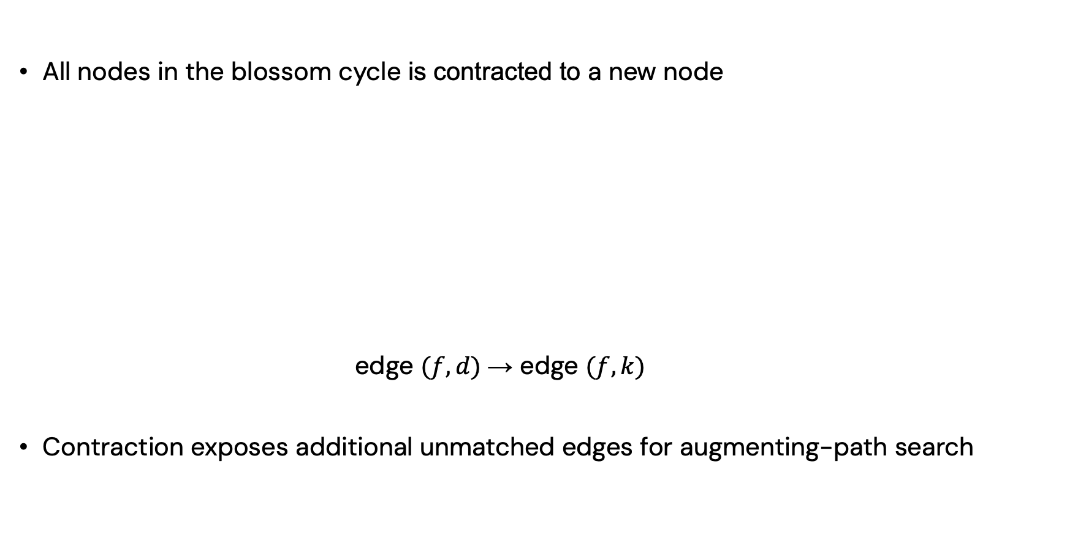
Insights
All nodes in the blossom cycle is contracted to a new node
edge $(f,d)$ → edge $(f,k)$
Contraction exposes additional unmatched edges for augmenting-path search
contract
Next recursion level
Notes:
In distributed ML training, communication is often a bottleneck. When workers need to exchange gradients, parameters, or data shards, each worker may only participate in one high-bandwidth transfer at a time. We can model workers as vertices and pending transfers as edges. A matching gives a set of transfers that can run simultaneously without endpoint conflicts, and a maximum matching maximizes the number of concurrent transfers in each scheduling round.

Slide 32
Eliminating Recursion
Every odd node in a blossom can be treated as an even node
– Each odd node has an even-length path to the root through the cycle
Notes:
In distributed ML training, communication is often a bottleneck. When workers need to exchange gradients, parameters, or data shards, each worker may only participate in one high-bandwidth transfer at a time. We can model workers as vertices and pending transfers as edges. A matching gives a set of transfers that can run simultaneously without endpoint conflicts, and a maximum matching maximizes the number of concurrent transfers in each scheduling round.

Slide 33

Eliminating Recursion
Every odd node in a blossom can be treated as an even node
– Each odd node has an even-length path to the root through the cycle
$b$ → $c$ → $e$ → $d$ → $a$
Notes:
In distributed ML training, communication is often a bottleneck. When workers need to exchange gradients, parameters, or data shards, each worker may only participate in one high-bandwidth transfer at a time. We can model workers as vertices and pending transfers as edges. A matching gives a set of transfers that can run simultaneously without endpoint conflicts, and a maximum matching maximizes the number of concurrent transfers in each scheduling round.

Slide 34
Eliminating Recursion
Every odd node in a blossom can be treated as an even node
– Each odd node has an even-length path to the root through the cycle
$b$ → $c$ → $e$ → $d$ → $a$
Notes:
In distributed ML training, communication is often a bottleneck. When workers need to exchange gradients, parameters, or data shards, each worker may only participate in one high-bandwidth transfer at a time. We can model workers as vertices and pending transfers as edges. A matching gives a set of transfers that can run simultaneously without endpoint conflicts, and a maximum matching maximizes the number of concurrent transfers in each scheduling round.

Slide 35

Eliminating Recursion
Every odd node in a blossom can be treated as an even node
– Each odd node has an even-length path to the root through the cycle
$b$ → $c$ → $e$ → $d$ → $a$
$d$ → $e$ → $c$ → $b$ → $a$
Notes:
In distributed ML training, communication is often a bottleneck. When workers need to exchange gradients, parameters, or data shards, each worker may only participate in one high-bandwidth transfer at a time. We can model workers as vertices and pending transfers as edges. A matching gives a set of transfers that can run simultaneously without endpoint conflicts, and a maximum matching maximizes the number of concurrent transfers in each scheduling round.

Slide 36
Eliminating Recursion
Every odd node in a blossom can be treated as an even node
– Each odd node has an even-length path to the root through the cycle
$b$ → $c$ → $e$ → $d$ → $a$
$d$ → $e$ → $c$ → $b$ → $a$
Notes:
In distributed ML training, communication is often a bottleneck. When workers need to exchange gradients, parameters, or data shards, each worker may only participate in one high-bandwidth transfer at a time. We can model workers as vertices and pending transfers as edges. A matching gives a set of transfers that can run simultaneously without endpoint conflicts, and a maximum matching maximizes the number of concurrent transfers in each scheduling round.

Slide 37
Eliminating Recursion
Every odd node in a blossom can be treated as an even node
– Each odd node has an even-length path to the root through the cycle
$b$ → $c$ → $e$ → $d$ → $a$
$d$ → $e$ → $c$ → $b$ → $a$
Notes:
In distributed ML training, communication is often a bottleneck. When workers need to exchange gradients, parameters, or data shards, each worker may only participate in one high-bandwidth transfer at a time. We can model workers as vertices and pending transfers as edges. A matching gives a set of transfers that can run simultaneously without endpoint conflicts, and a maximum matching maximizes the number of concurrent transfers in each scheduling round.

Slide 38
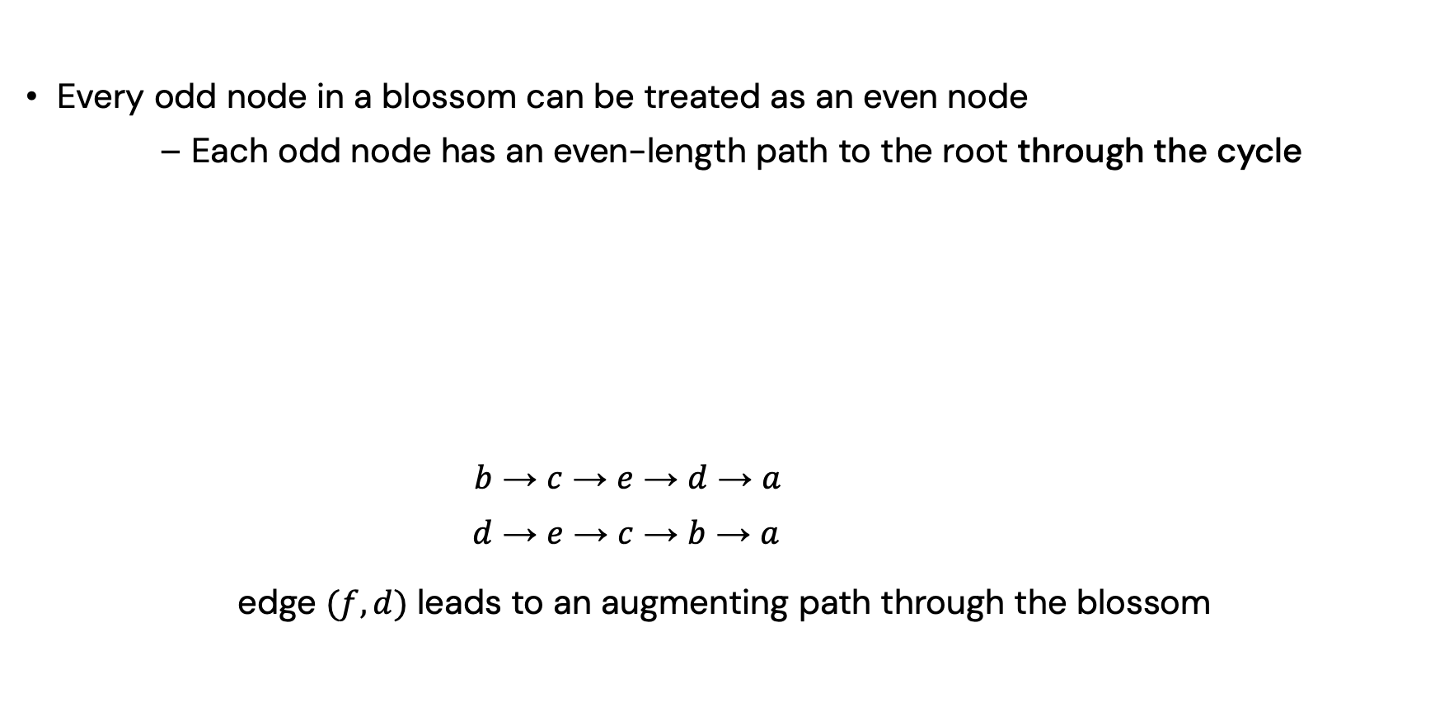
Eliminating Recursion
Every odd node in a blossom can be treated as an even node
– Each odd node has an even-length path to the root through the cycle
$b$ → $c$ → $e$ → $d$ → $a$
$d$ → $e$ → $c$ → $b$ → $a$
edge $(f,d)$ leads to an augmenting path through the blossom
Notes:
In distributed ML training, communication is often a bottleneck. When workers need to exchange gradients, parameters, or data shards, each worker may only participate in one high-bandwidth transfer at a time. We can model workers as vertices and pending transfers as edges. A matching gives a set of transfers that can run simultaneously without endpoint conflicts, and a maximum matching maximizes the number of concurrent transfers in each scheduling round.

Slide 39
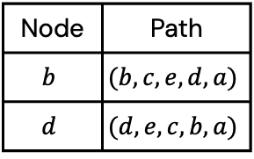
Recursion-Free Framework
Instead of contraction, treat odd nodes in the blossom as even
– Record the even-length paths in a path table
Traditional
contract
Recursion-Free
Node | Path
$$b$$ | $$(b,c,e,d,a)$$
$$d$$ | $$(d,e,c,b,a)$$
odd to even
Notes:
In distributed ML training, communication is often a bottleneck. When workers need to exchange gradients, parameters, or data shards, each worker may only participate in one high-bandwidth transfer at a time. We can model workers as vertices and pending transfers as edges. A matching gives a set of transfers that can run simultaneously without endpoint conflicts, and a maximum matching maximizes the number of concurrent transfers in each scheduling round.

Slide 40
Recursion-Free Framework
Eliminate the recursive data dependencies
Dynamic graph → static graph
Traditional
contract
Recursion-Free
Node | Path
$$b$$ | $$(b,c,e,d,a)$$
$$d$$ | $$(d,e,c,b,a)$$
odd to even
Notes:
In distributed ML training, communication is often a bottleneck. When workers need to exchange gradients, parameters, or data shards, each worker may only participate in one high-bandwidth transfer at a time. We can model workers as vertices and pending transfers as edges. A matching gives a set of transfers that can run simultaneously without endpoint conflicts, and a maximum matching maximizes the number of concurrent transfers in each scheduling round.

Slide 41
Fundamental Challenges
Recursive blossom contraction and lifting
Only one augmenting path is returned per iteration
Dynamic data structures are continuously updated
------------------------------------------------------------------------------------------------
Shoemaker’16 Schwing’24 X-Blossom
------------------------------------------------------------------------------------------------
Challenge 1 ✗ ✗ ✓
Challenge 2 ◐ ◐ ✓
Challenge 3 ✗ ✗ ✓
------------------------------------------------------------------------------------------------
Notes:
In distributed ML training, communication is often a bottleneck. When workers need to exchange gradients, parameters, or data shards, each worker may only participate in one high-bandwidth transfer at a time. We can model workers as vertices and pending transfers as edges. A matching gives a set of transfers that can run simultaneously without endpoint conflicts, and a maximum matching maximizes the number of concurrent transfers in each scheduling round.

Slide 42
Parallel Strategy
Grow multiple trees in parallel
Find multiple disjoint augmenting paths concurrently
Notes:
In distributed ML training, communication is often a bottleneck. When workers need to exchange gradients, parameters, or data shards, each worker may only participate in one high-bandwidth transfer at a time. We can model workers as vertices and pending transfers as edges. A matching gives a set of transfers that can run simultaneously without endpoint conflicts, and a maximum matching maximizes the number of concurrent transfers in each scheduling round.

Slide 43
Parallel Strategy
Grow multiple trees in parallel
Find multiple disjoint augmenting paths concurrently
Notes:
In distributed ML training, communication is often a bottleneck. When workers need to exchange gradients, parameters, or data shards, each worker may only participate in one high-bandwidth transfer at a time. We can model workers as vertices and pending transfers as edges. A matching gives a set of transfers that can run simultaneously without endpoint conflicts, and a maximum matching maximizes the number of concurrent transfers in each scheduling round.

Slide 44
Parallel Strategy
Grow multiple trees in parallel
Find multiple disjoint augmenting paths concurrently
Notes:
In distributed ML training, communication is often a bottleneck. When workers need to exchange gradients, parameters, or data shards, each worker may only participate in one high-bandwidth transfer at a time. We can model workers as vertices and pending transfers as edges. A matching gives a set of transfers that can run simultaneously without endpoint conflicts, and a maximum matching maximizes the number of concurrent transfers in each scheduling round.

Slide 45
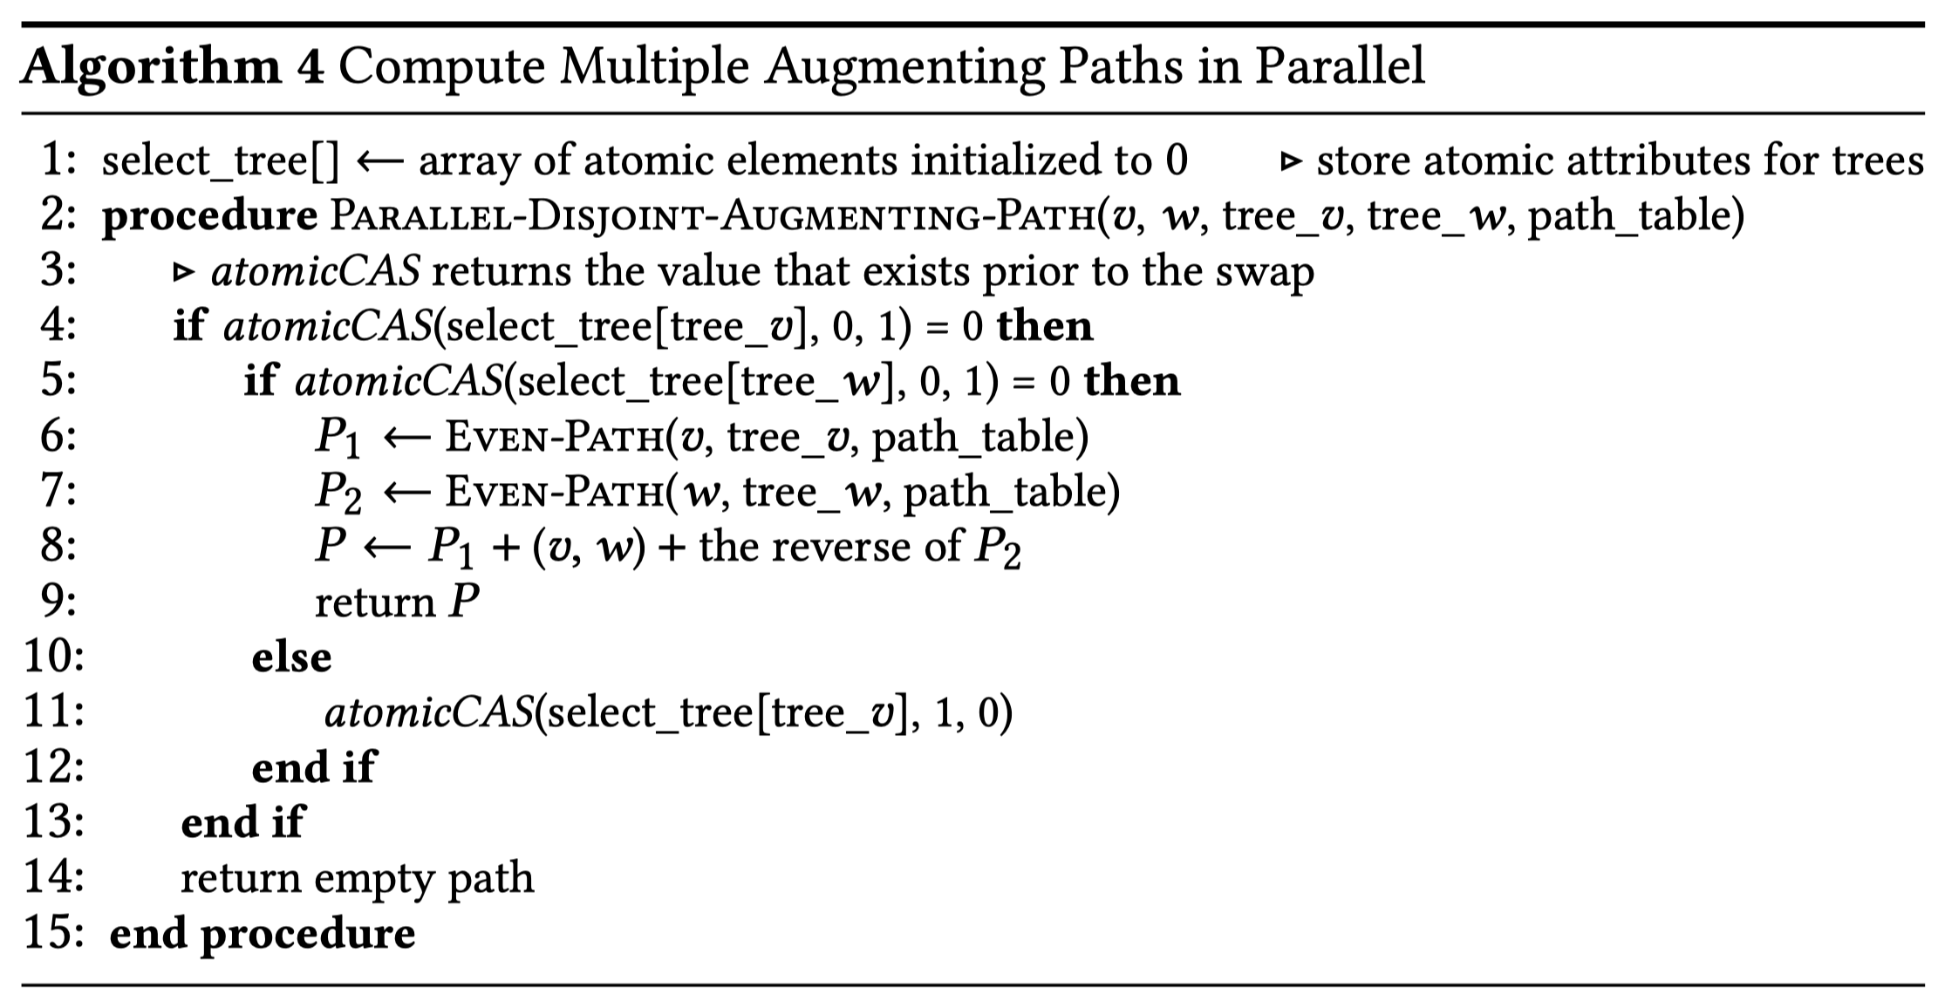
Parallel Strategy
Grow multiple trees in parallel
Find multiple disjoint augmenting paths concurrently
Lock-free synchronization via atomic CAS
Notes:
In distributed ML training, communication is often a bottleneck. When workers need to exchange gradients, parameters, or data shards, each worker may only participate in one high-bandwidth transfer at a time. We can model workers as vertices and pending transfers as edges. A matching gives a set of transfers that can run simultaneously without endpoint conflicts, and a maximum matching maximizes the number of concurrent transfers in each scheduling round.

Slide 46
Fundamental Challenges
Recursive blossom contraction and lifting
Only one augmenting path is returned per iteration
Dynamic data structures are continuously updated
------------------------------------------------------------------------------------------------
Shoemaker’16 Schwing’24 X-Blossom
------------------------------------------------------------------------------------------------
Challenge 1 ✗ ✗ ✓
Challenge 2 ◐ ◐ ✓
Challenge 3 ✗ ✗ ✓
------------------------------------------------------------------------------------------------
Notes:
In distributed ML training, communication is often a bottleneck. When workers need to exchange gradients, parameters, or data shards, each worker may only participate in one high-bandwidth transfer at a time. We can model workers as vertices and pending transfers as edges. A matching gives a set of transfers that can run simultaneously without endpoint conflicts, and a maximum matching maximizes the number of concurrent transfers in each scheduling round.

Slide 47
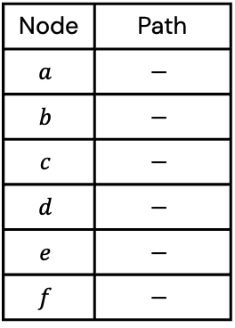
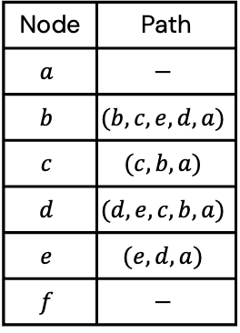
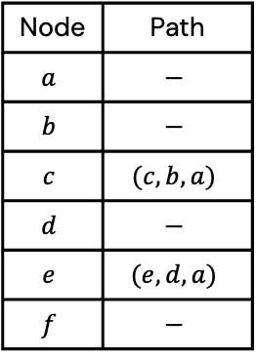
Replacing Dynamic Trees
A single path table stores an even-length alternating path for each even node
Node | Path
$$a$$ | $$−$$
$$b$$ | $$−$$
$$c$$ | $$−$$
$$d$$ | $$−$$
$$e$$ | $$−$$
$$f$$ | $$−$$
Node | Path
$$a$$ | $$−$$
$$b$$ | $$−$$
$$c$$ | $$(c,b,a)$$
$$d$$ | $$−$$
$$e$$ | $$(e,d,a)$$
$$f$$ | $$−$$
Node | Path
$$a$$ | $$−$$
$$b$$ | $$(b,c,e,d,a)$$
$$c$$ | $$(c,b,a)$$
$$d$$ | $$(d,e,c,b,a)$$
$$e$$ | $$(e,d,a)$$
$$f$$ | $$−$$
→
→
Notes:
In distributed ML training, communication is often a bottleneck. When workers need to exchange gradients, parameters, or data shards, each worker may only participate in one high-bandwidth transfer at a time. We can model workers as vertices and pending transfers as edges. A matching gives a set of transfers that can run simultaneously without endpoint conflicts, and a maximum matching maximizes the number of concurrent transfers in each scheduling round.

Slide 48
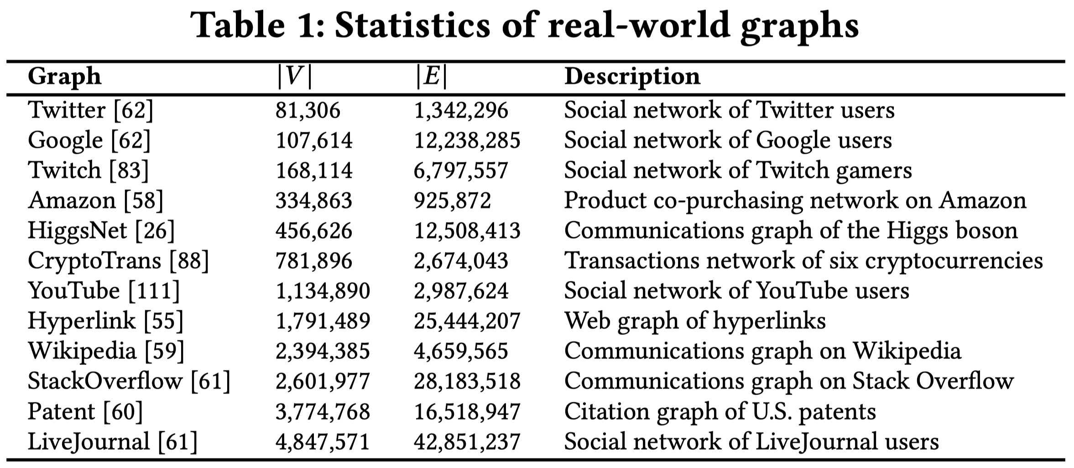
Experiments
Real-world datasets:
Social graphs, economic networks, communication graphs, …
Notes:
In distributed ML training, communication is often a bottleneck. When workers need to exchange gradients, parameters, or data shards, each worker may only participate in one high-bandwidth transfer at a time. We can model workers as vertices and pending transfers as edges. A matching gives a set of transfers that can run simultaneously without endpoint conflicts, and a maximum matching maximizes the number of concurrent transfers in each scheduling round.

Slide 49
Experiments
Real-world datasets:
Social graphs, economic networks, communication graphs, …
Synthetic datasets:
Random graphs with specific densities
Random graphs with specific degrees
Random graphs with gamma-distributed degrees
Platform
A server with dual AMD EPYC 7643 processors and 256 GB of RAM
Notes:
In distributed ML training, communication is often a bottleneck. When workers need to exchange gradients, parameters, or data shards, each worker may only participate in one high-bandwidth transfer at a time. We can model workers as vertices and pending transfers as edges. A matching gives a set of transfers that can run simultaneously without endpoint conflicts, and a maximum matching maximizes the number of concurrent transfers in each scheduling round.

Slide 50
High-Performance Results
Compared with three baselines:
C++ Boost Graph Library
Prior best sequential solution (LEMON)
Prior best parallel solution (Par-EB, 2024)
Speedup of 8-core X-Blossom:
- LEMON (992x)
- Par-EB (327x)
Notes:
In distributed ML training, communication is often a bottleneck. When workers need to exchange gradients, parameters, or data shards, each worker may only participate in one high-bandwidth transfer at a time. We can model workers as vertices and pending transfers as edges. A matching gives a set of transfers that can run simultaneously without endpoint conflicts, and a maximum matching maximizes the number of concurrent transfers in each scheduling round.

Slide 51
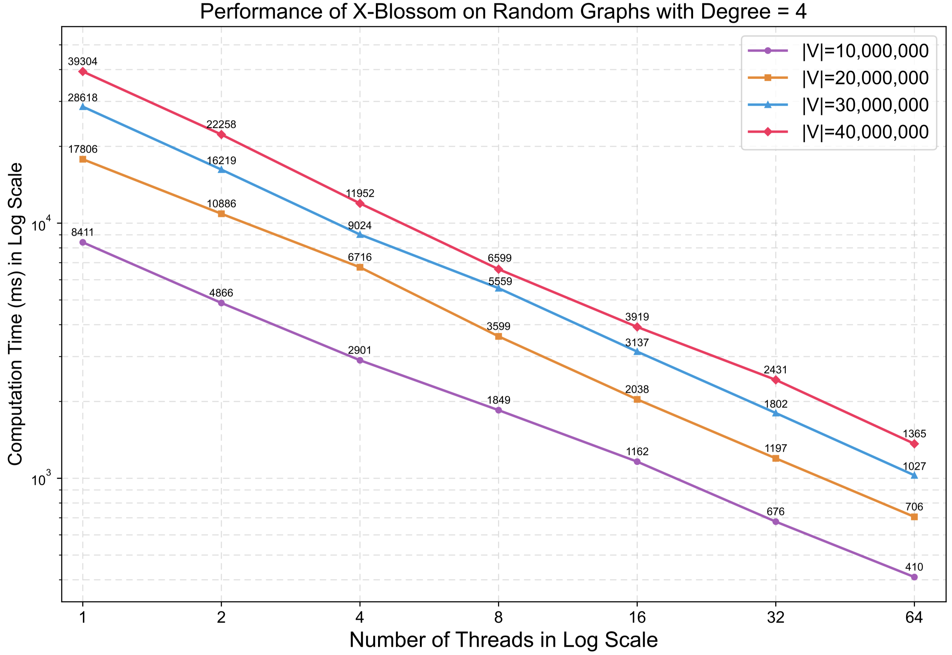
Scalability Test
When # of threads doubles, the average speedup is 1.72x
Notes:
In distributed ML training, communication is often a bottleneck. When workers need to exchange gradients, parameters, or data shards, each worker may only participate in one high-bandwidth transfer at a time. We can model workers as vertices and pending transfers as edges. A matching gives a set of transfers that can run simultaneously without endpoint conflicts, and a maximum matching maximizes the number of concurrent transfers in each scheduling round.

Slide 52
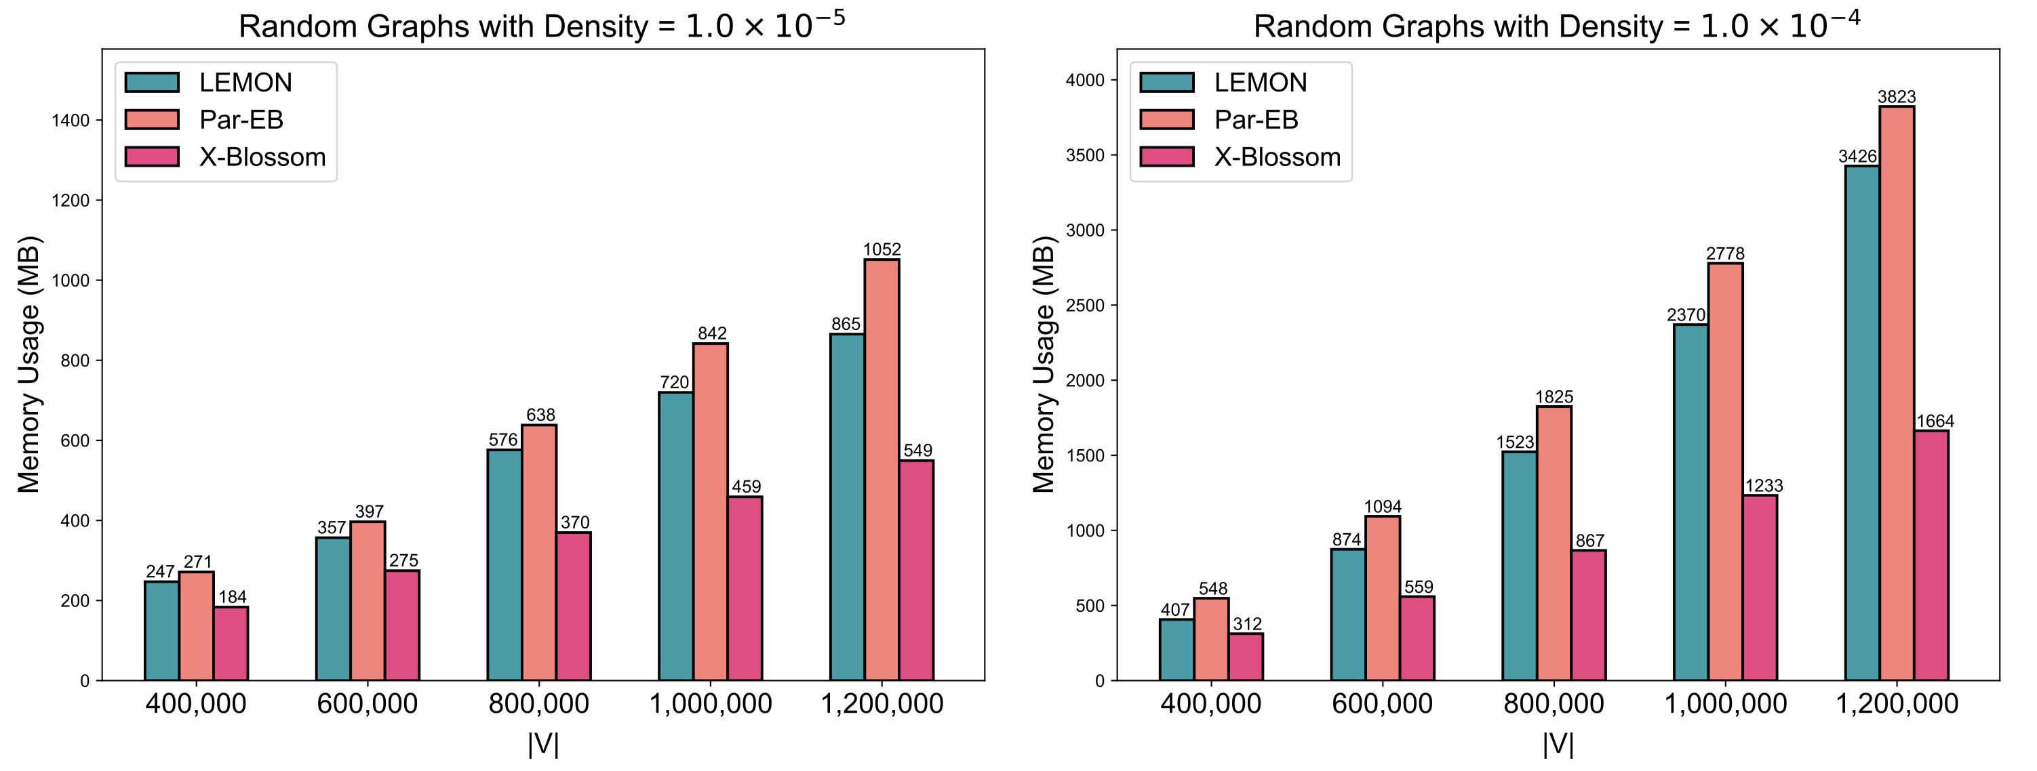
Memory Footprint
Avoids the memory overhead for recursive call stacks and tree reconstruction
Notes:
In distributed ML training, communication is often a bottleneck. When workers need to exchange gradients, parameters, or data shards, each worker may only participate in one high-bandwidth transfer at a time. We can model workers as vertices and pending transfers as edges. A matching gives a set of transfers that can run simultaneously without endpoint conflicts, and a maximum matching maximizes the number of concurrent transfers in each scheduling round.

Slide 53
X-Blossom Summary
X-Blossom (https://github.com/Davis-Fan/X-Blossom)
- a massively parallel computation framework for maximum matching
- the best parallel solution so far
- recursion-free + massively parallel search + path table
Published in VLDB 2025
Dayi Fan, Rubao Lee, and Xiaodong Zhang. X-Blossom: Massive Parallelization of Graph Maximum Matching. PVLDB, 18(10): 3339-3353, 2025.
Notes:
As data scales in modern applications and the demand for real-time processing intensifies, parallel computing solutions have become more and more important. A wide range of real-world applications rely on irregular datacentric algorithms. But developing efficient parallel frameworks for such computations is challenging and requires advances in both algorithm design and hardware implementation.

