Slide 1
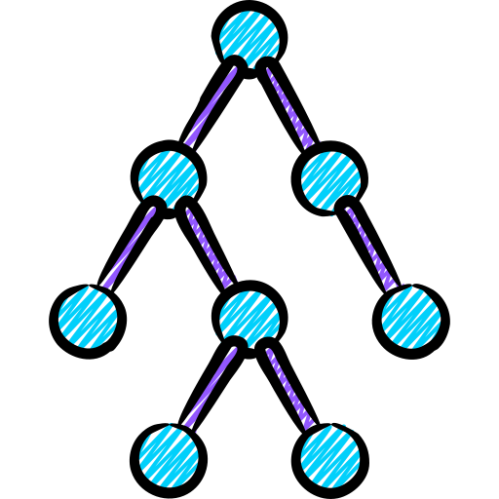
X-TED
Massive Parallelization of Tree Edit Distance

Slide 2
Tree Edit Distance
The minimum cost of transforming one tree into another by edit operations
?
Notes:
As data scales in modern applications and the demand for real-time processing intensifies, parallel computing solutions have become more and more important. A wide range of real-world applications rely on irregular datacentric algorithms. But developing efficient parallel frameworks for such computations is challenging and requires advances in both algorithm design and hardware implementation.

Slide 3
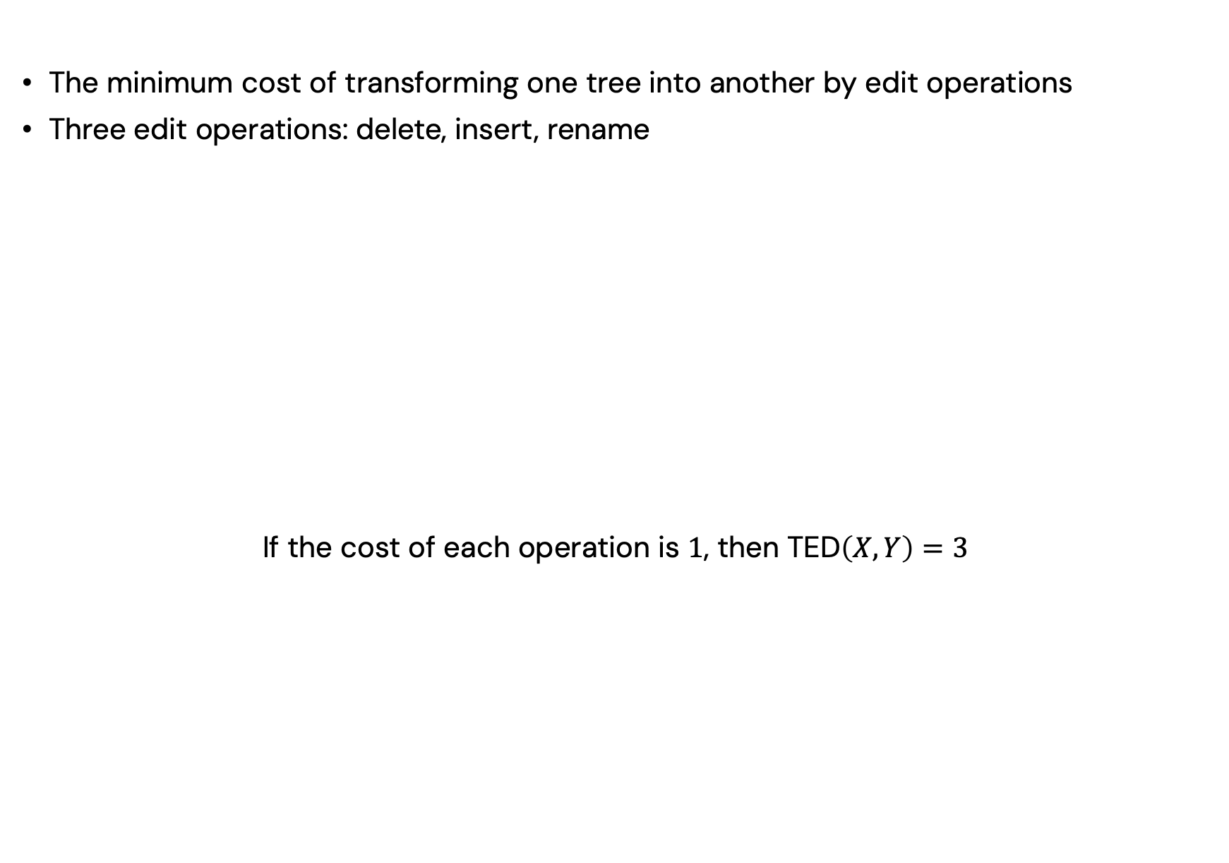
Tree Edit Distance
The minimum cost of transforming one tree into another by edit operations
Three edit operations: delete, insert, rename
If the cost of each operation is $1$, then TED$\left(X, Y\right)=3$
Notes:
As data scales in modern applications and the demand for real-time processing intensifies, parallel computing solutions have become more and more important. A wide range of real-world applications rely on irregular datacentric algorithms. But developing efficient parallel frameworks for such computations is challenging and requires advances in both algorithm design and hardware implementation.

Slide 4
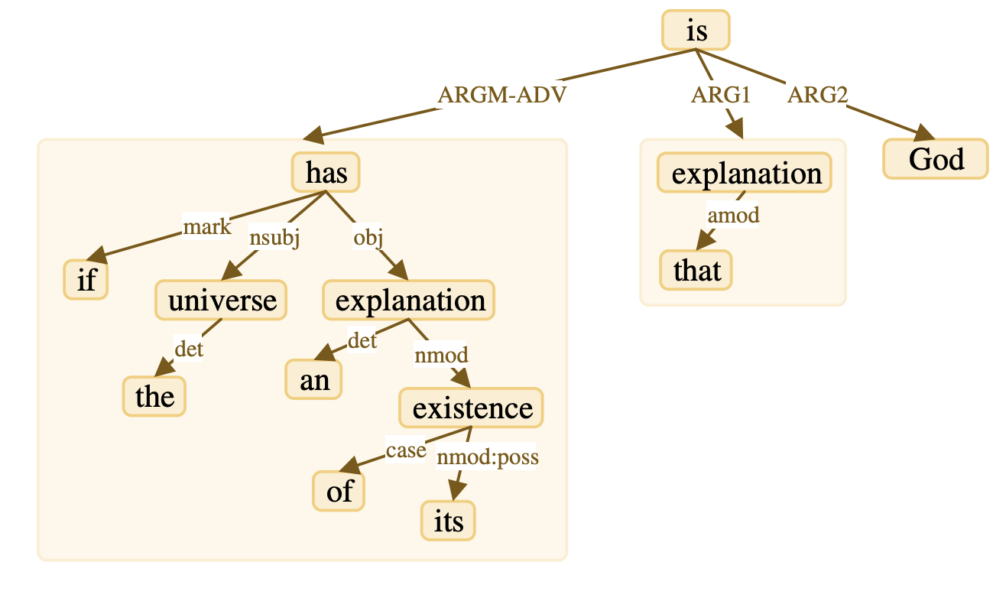
Applications of TED
Natural Language Processing
Parse trees and LLM output evaluation
Notes:
As data scales in modern applications and the demand for real-time processing intensifies, parallel computing solutions have become more and more important. A wide range of real-world applications rely on irregular datacentric algorithms. But developing efficient parallel frameworks for such computations is challenging and requires advances in both algorithm design and hardware implementation.

Slide 5
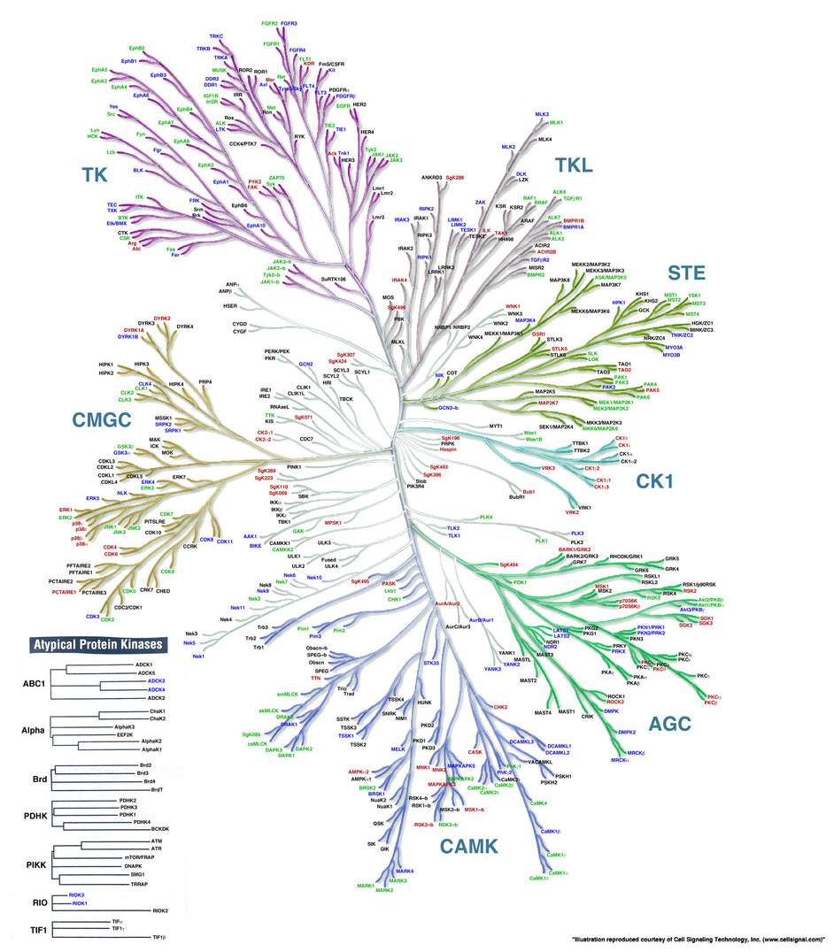
Applications of TED
Natural Language Processing
Parse trees and LLM output evaluation
Bioinformatics
Protein structure and evolutionary analysis
Notes:
As data scales in modern applications and the demand for real-time processing intensifies, parallel computing solutions have become more and more important. A wide range of real-world applications rely on irregular datacentric algorithms. But developing efficient parallel frameworks for such computations is challenging and requires advances in both algorithm design and hardware implementation.

Slide 6
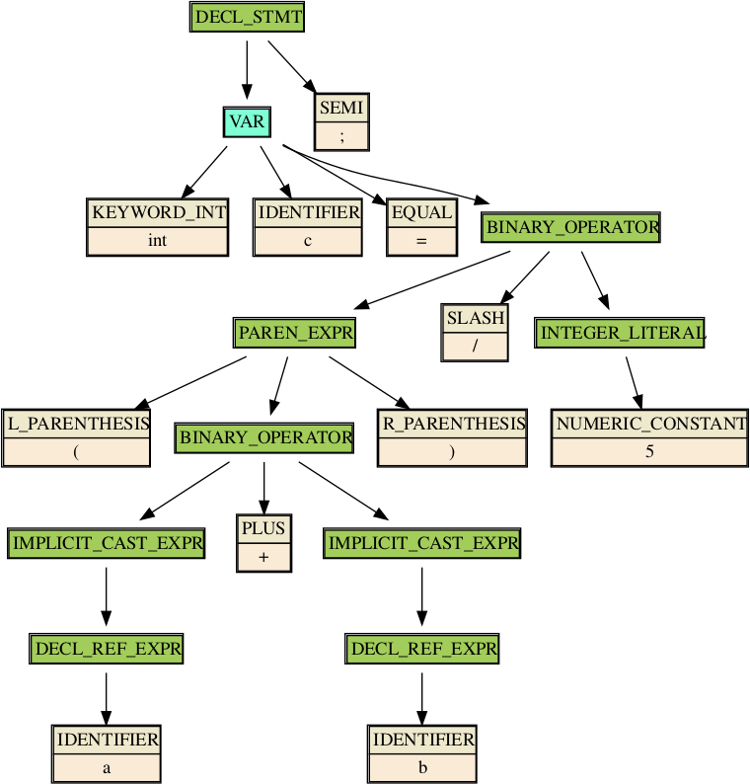
Applications of TED
Natural Language Processing
Parse trees and LLM output evaluation
Bioinformatics
Protein structure and evolutionary analysis
Software Engineering
Code similarity detection
Notes:
As data scales in modern applications and the demand for real-time processing intensifies, parallel computing solutions have become more and more important. A wide range of real-world applications rely on irregular datacentric algorithms. But developing efficient parallel frameworks for such computations is challenging and requires advances in both algorithm design and hardware implementation.

Slide 7
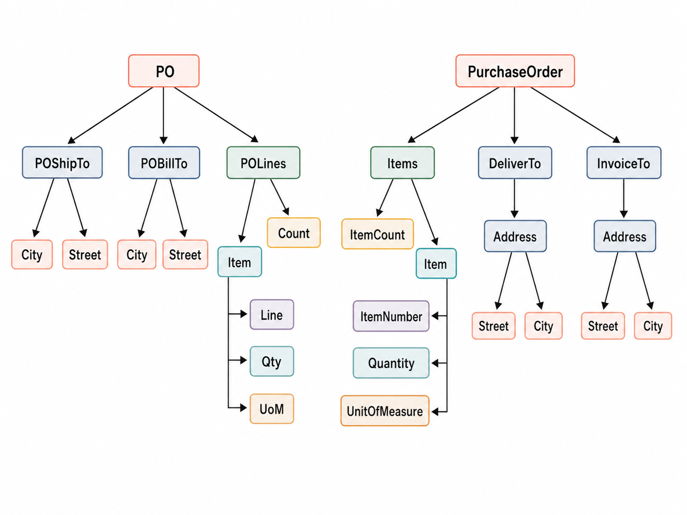
Applications of TED
Natural Language Processing
Parse trees and LLM output evaluation
Bioinformatics
Protein structure and evolutionary analysis
Software Engineering
Code similarity detection
Database Systems
XML/JSON comparison and schema matching
Notes:
As data scales in modern applications and the demand for real-time processing intensifies, parallel computing solutions have become more and more important. A wide range of real-world applications rely on irregular datacentric algorithms. But developing efficient parallel frameworks for such computations is challenging and requires advances in both algorithm design and hardware implementation.

Slide 8

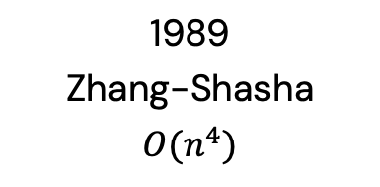
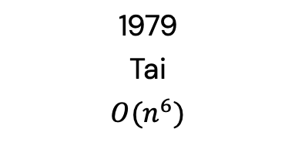
TED Algorithms
1979
Tai
$$O(n^{6})$$
1989
Zhang-Shasha
$$O(n^{4})$$
2010
Demaine et al.
$$O(n^{3})$$
First TED algorithm
Classic TED algorithm
Dynamic programming
(The most widely-used)
Theoretical lower bound
$n$: the maximum size of the two input trees
Notes:
As data scales in modern applications and the demand for real-time processing intensifies, parallel computing solutions have become more and more important. A wide range of real-world applications rely on irregular datacentric algorithms. But developing efficient parallel frameworks for such computations is challenging and requires advances in both algorithm design and hardware implementation.

Slide 9
Classic TED Algorithm
Step 1 - identify subtrees for two input trees
Each subtree starts from the root or a node with a right sibling
and ends at its rightmost reachable node
Nodes are ordered in preorder traversal
Notes:
As data scales in modern applications and the demand for real-time processing intensifies, parallel computing solutions have become more and more important. A wide range of real-world applications rely on irregular datacentric algorithms. But developing efficient parallel frameworks for such computations is challenging and requires advances in both algorithm design and hardware implementation.

Slide 10
Classic TED Algorithm
Step 2 - use DP tables to compute edit distance for each subtree pair
Notes:
As data scales in modern applications and the demand for real-time processing intensifies, parallel computing solutions have become more and more important. A wide range of real-world applications rely on irregular datacentric algorithms. But developing efficient parallel frameworks for such computations is challenging and requires advances in both algorithm design and hardware implementation.

Slide 11

Classic TED Algorithm
Step 2 - use DP tables to compute edit distance for each subtree pair
Table $T_{0}$ for $X_{1}$ and $Y_{1}$
Notes:
As data scales in modern applications and the demand for real-time processing intensifies, parallel computing solutions have become more and more important. A wide range of real-world applications rely on irregular datacentric algorithms. But developing efficient parallel frameworks for such computations is challenging and requires advances in both algorithm design and hardware implementation.

Slide 12

Classic TED Algorithm
Step 2 - use DP tables to compute edit distance for each subtree pair
Table $T_{0}$ for $X_{1}$ and $Y_{1}$; Table $T_{1}$ for $X_{1}$ and $Y_{0}$
Notes:
As data scales in modern applications and the demand for real-time processing intensifies, parallel computing solutions have become more and more important. A wide range of real-world applications rely on irregular datacentric algorithms. But developing efficient parallel frameworks for such computations is challenging and requires advances in both algorithm design and hardware implementation.

Slide 13

Classic TED Algorithm
Step 2 - use DP tables to compute edit distance for each subtree pair
Table $T_{0}$ for $X_{1}$ and $Y_{1}$; Table $T_{1}$ for $X_{1}$ and $Y_{0}$
Table $T_{2}$ for $X_{0}$ and $Y_{1}$
Notes:
As data scales in modern applications and the demand for real-time processing intensifies, parallel computing solutions have become more and more important. A wide range of real-world applications rely on irregular datacentric algorithms. But developing efficient parallel frameworks for such computations is challenging and requires advances in both algorithm design and hardware implementation.

Slide 14

Classic TED Algorithm
Step 2 - use DP tables to compute edit distance for each subtree pair
Table $T_{0}$ for $X_{1}$ and $Y_{1}$; Table $T_{1}$ for $X_{1}$ and $Y_{0}$
Table $T_{2}$ for $X_{0}$ and $Y_{1}$; Table $T_{3}$ for $X_{0}$ and $Y_{0}$
Notes:
As data scales in modern applications and the demand for real-time processing intensifies, parallel computing solutions have become more and more important. A wide range of real-world applications rely on irregular datacentric algorithms. But developing efficient parallel frameworks for such computations is challenging and requires advances in both algorithm design and hardware implementation.

Slide 15
Classic TED Algorithm
Step 3 - return the final TED result after all DP tables are computed
Notes:
As data scales in modern applications and the demand for real-time processing intensifies, parallel computing solutions have become more and more important. A wide range of real-world applications rely on irregular datacentric algorithms. But developing efficient parallel frameworks for such computations is challenging and requires advances in both algorithm design and hardware implementation.

Slide 16
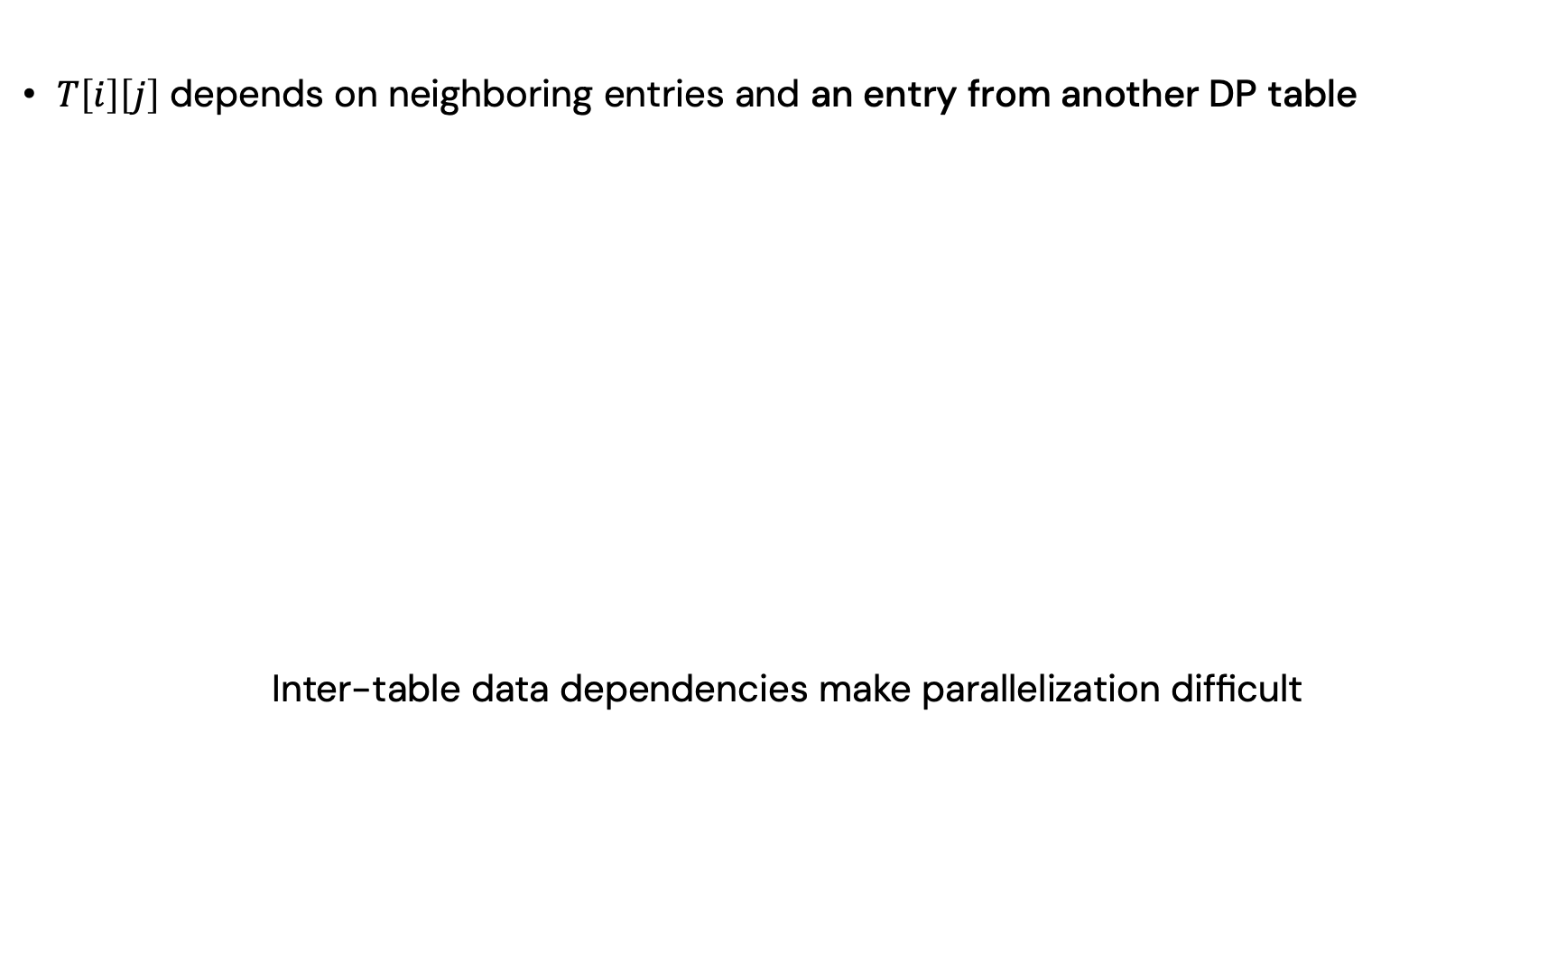
Fundamental Challenges
$T\left[i\right]\left[j\right]$ depends on neighboring entries and an entry from another DP table
Inter-table data dependencies make parallelization difficult
Notes:
As data scales in modern applications and the demand for real-time processing intensifies, parallel computing solutions have become more and more important. A wide range of real-world applications rely on irregular datacentric algorithms. But developing efficient parallel frameworks for such computations is challenging and requires advances in both algorithm design and hardware implementation.

Slide 17
Existing Parallel Solution
Wave-front pattern: compute entries in parallel, wave by wave
Notes:
As data scales in modern applications and the demand for real-time processing intensifies, parallel computing solutions have become more and more important. A wide range of real-world applications rely on irregular datacentric algorithms. But developing efficient parallel frameworks for such computations is challenging and requires advances in both algorithm design and hardware implementation.

Slide 18
Existing Parallel Solution
Wave-front pattern: compute entries in parallel, wave by wave
Notes:
As data scales in modern applications and the demand for real-time processing intensifies, parallel computing solutions have become more and more important. A wide range of real-world applications rely on irregular datacentric algorithms. But developing efficient parallel frameworks for such computations is challenging and requires advances in both algorithm design and hardware implementation.

Slide 19
Existing Parallel Solution
Wave-front pattern: compute entries in parallel, wave by wave
Notes:
As data scales in modern applications and the demand for real-time processing intensifies, parallel computing solutions have become more and more important. A wide range of real-world applications rely on irregular datacentric algorithms. But developing efficient parallel frameworks for such computations is challenging and requires advances in both algorithm design and hardware implementation.

Slide 20
Existing Parallel Solution
Wave-front pattern: compute entries in parallel, wave by wave
Notes:
As data scales in modern applications and the demand for real-time processing intensifies, parallel computing solutions have become more and more important. A wide range of real-world applications rely on irregular datacentric algorithms. But developing efficient parallel frameworks for such computations is challenging and requires advances in both algorithm design and hardware implementation.

Slide 21
Existing Parallel Solution
Wave-front pattern: compute entries in parallel, wave by wave
Large memory footprint
Notes:
As data scales in modern applications and the demand for real-time processing intensifies, parallel computing solutions have become more and more important. A wide range of real-world applications rely on irregular datacentric algorithms. But developing efficient parallel frameworks for such computations is challenging and requires advances in both algorithm design and hardware implementation.

Slide 22
Existing Parallel Solution
Wave-front pattern: compute entries in parallel, wave by wave
Large memory footprint
Frequent synchronizations
Notes:
As data scales in modern applications and the demand for real-time processing intensifies, parallel computing solutions have become more and more important. A wide range of real-world applications rely on irregular datacentric algorithms. But developing efficient parallel frameworks for such computations is challenging and requires advances in both algorithm design and hardware implementation.

Slide 23
Existing Parallel Solution
Wave-front pattern: compute entries in parallel, wave by wave
Large memory footprint
Frequent synchronizations
Load imbalance
Notes:
As data scales in modern applications and the demand for real-time processing intensifies, parallel computing solutions have become more and more important. A wide range of real-world applications rely on irregular datacentric algorithms. But developing efficient parallel frameworks for such computations is challenging and requires advances in both algorithm design and hardware implementation.

Slide 24
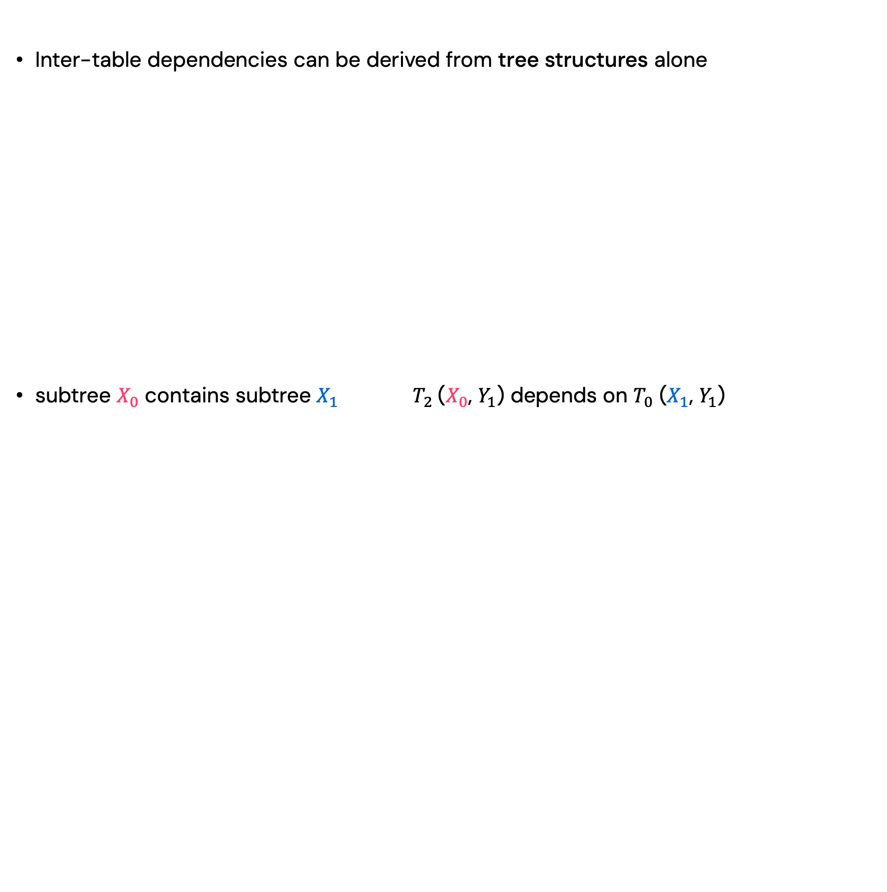
Insights
Inter-table dependencies can be derived from tree structures alone
subtree $X_{0}$ contains subtree $X_{1}$ $T_{2}$($X_{0}$, $Y_{1}$) depends on $T_{0}$ ($X_{1}$, $Y_{1}$)
Notes:
We do not need to inspect the DP tables explicitly.

Slide 25
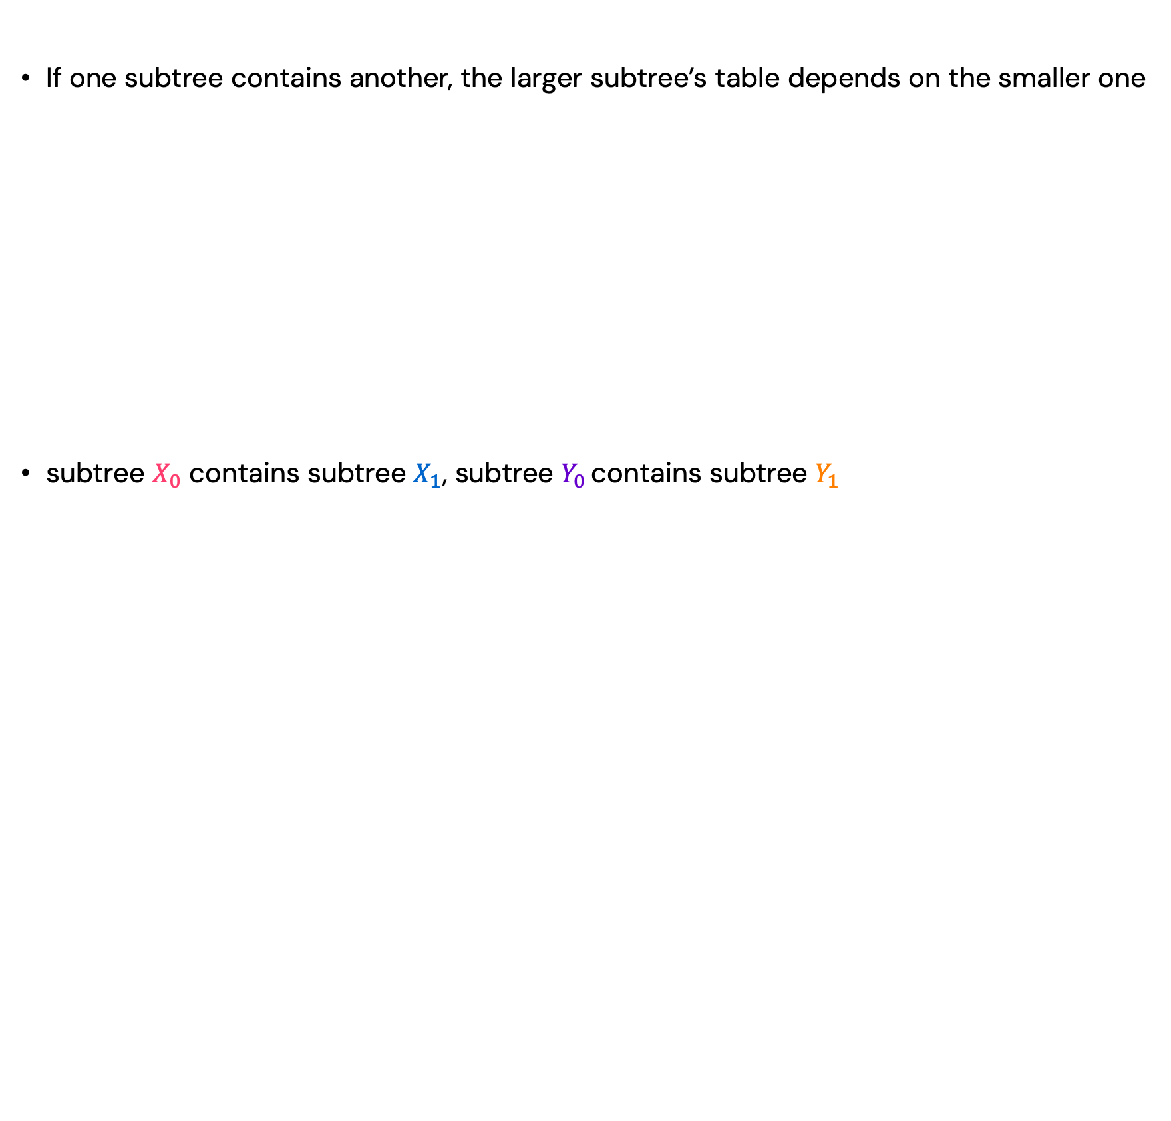
Exploit Parallelism
If one subtree contains another, the larger subtree’s table depends on the smaller one
subtree $X_{0}$ contains subtree $X_{1}$, subtree $Y_{0}$ contains subtree $Y_{1}$
edge: dependency → dependent table
Notes:
We do not need to inspect the DP tables explicitly.

Slide 26
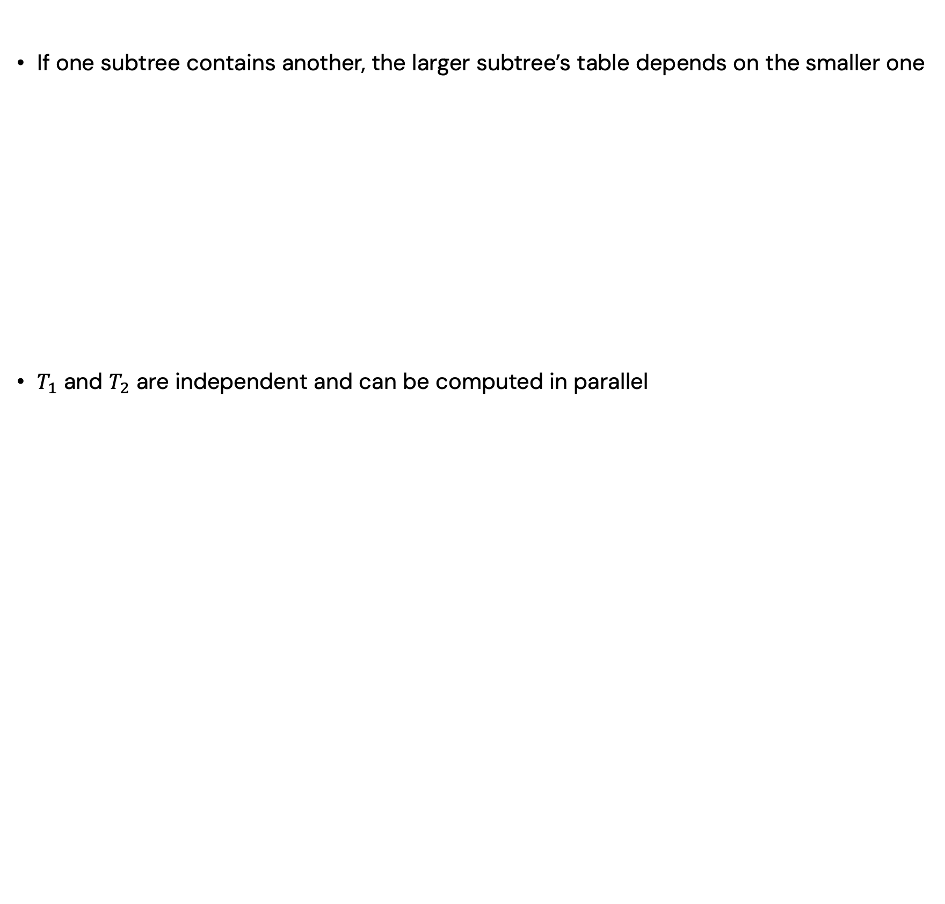
Exploit Parallelism
If one subtree contains another, the larger subtree’s table depends on the smaller one
$T_{1}$ and $T_{2}$ are independent and can be computed in parallel
Notes:
We do not need to inspect the DP tables explicitly.

Slide 27
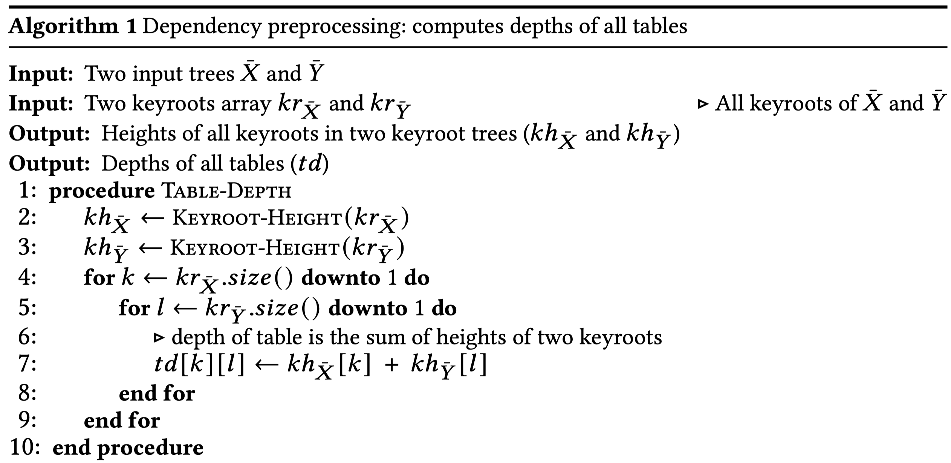

Preprocessing: Reveal Dependencies
Assign each table a dependency level from tree structures, $O(n^{2})$
A rigorous proof is provided in the paper
Notes:
As data scales in modern applications and the demand for real-time processing intensifies, parallel computing solutions have become more and more important. A wide range of real-world applications rely on irregular datacentric algorithms. But developing efficient parallel frameworks for such computations is challenging and requires advances in both algorithm design and hardware implementation.

Slide 28
X-TED
Memory savings
Each processor stores only one table
Fewer synchronization
Synchronize only once per batch
Load balancing
Use different strategies for tables with different size
Notes:
As data scales in modern applications and the demand for real-time processing intensifies, parallel computing solutions have become more and more important. A wide range of real-world applications rely on irregular datacentric algorithms. But developing efficient parallel frameworks for such computations is challenging and requires advances in both algorithm design and hardware implementation.

Slide 29
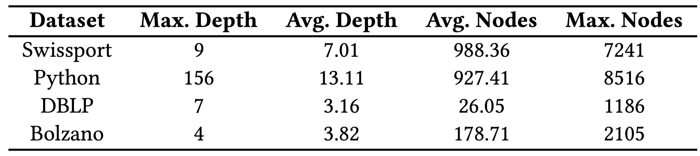
Experiments
Real-world datasets:
Synthetic datasets: random trees with 1000 to 9000 nodes
CPU baseline: Intel Core i9-12900 CPU, 8 cores, 64GB
GPU baseline: NVIDIA RTX 3090, A100-SXM4, H100-PCIe
Notes:
As data scales in modern applications and the demand for real-time processing intensifies, parallel computing solutions have become more and more important. A wide range of real-world applications rely on irregular datacentric algorithms. But developing efficient parallel frameworks for such computations is challenging and requires advances in both algorithm design and hardware implementation.

Slide 30
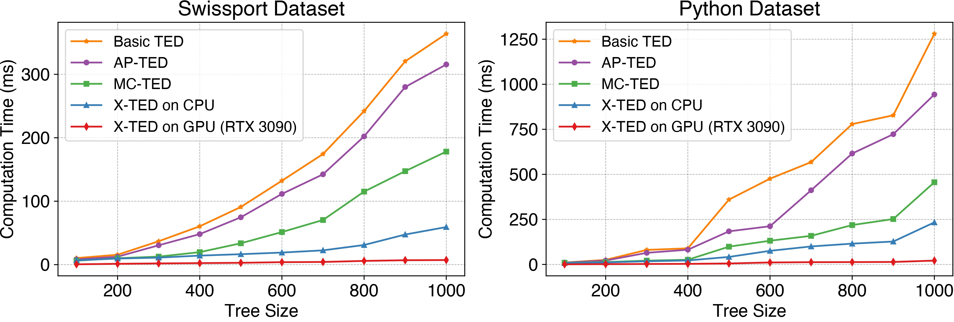
High-Performance Results
Compare with three baselines
Classic TED (1989)
Prior best sequential solution (AP-TED, 2016)
Prior best multicore solution (MC-TED, 2020)
Notes:
As data scales in modern applications and the demand for real-time processing intensifies, parallel computing solutions have become more and more important. A wide range of real-world applications rely on irregular datacentric algorithms. But developing efficient parallel frameworks for such computations is challenging and requires advances in both algorithm design and hardware implementation.

Slide 31
High-Performance Results
Compare with three baselines
Classic TED (1989)
Prior best sequential solution (AP-TED, 2016)
Prior best multicore solution (MC-TED, 2020)
Speedup over AP-TED
X-TED (CPU): 4.8x
X-TED (GPU): 42x
Notes:
As data scales in modern applications and the demand for real-time processing intensifies, parallel computing solutions have become more and more important. A wide range of real-world applications rely on irregular datacentric algorithms. But developing efficient parallel frameworks for such computations is challenging and requires advances in both algorithm design and hardware implementation.

Slide 32
High-Performance Results
Compare with three baselines
Classic TED (1989)
Prior best sequential solution (AP-TED, 2016)
Prior best multicore solution (MC-TED, 2020)
Speedup over MC-TED
X-TED (CPU): 3.8x
X-TED (GPU): 31x
Notes:
As data scales in modern applications and the demand for real-time processing intensifies, parallel computing solutions have become more and more important. A wide range of real-world applications rely on irregular datacentric algorithms. But developing efficient parallel frameworks for such computations is challenging and requires advances in both algorithm design and hardware implementation.

Slide 33
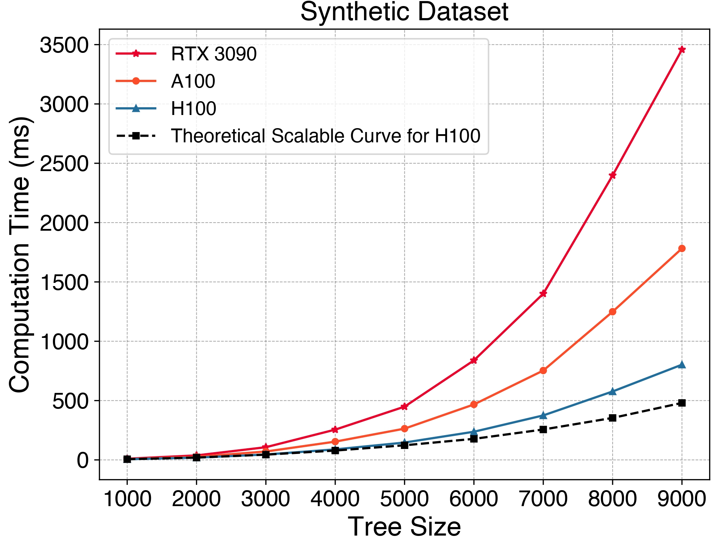
Scalability Test
Tree size increases from 1000 to 9000 nodes
Notes:
As data scales in modern applications and the demand for real-time processing intensifies, parallel computing solutions have become more and more important. A wide range of real-world applications rely on irregular datacentric algorithms. But developing efficient parallel frameworks for such computations is challenging and requires advances in both algorithm design and hardware implementation.

Slide 34
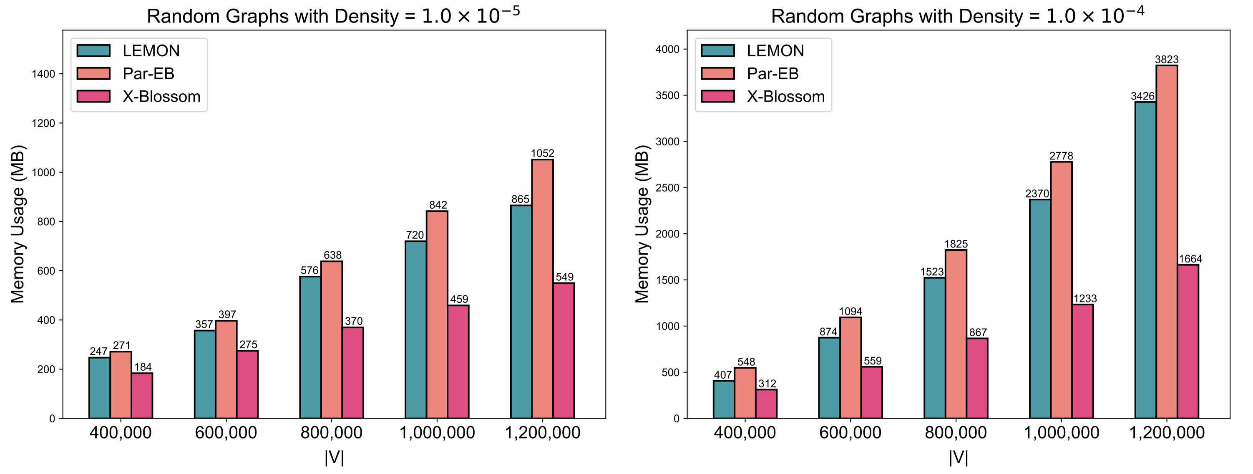

Memory Footprint
Reduce the memory consumption to $O(n^{2})$
Notes:
In distributed ML training, communication is often a bottleneck. When workers need to exchange gradients, parameters, or data shards, each worker may only participate in one high-bandwidth transfer at a time. We can model workers as vertices and pending transfers as edges. A matching gives a set of transfers that can run simultaneously without endpoint conflicts, and a maximum matching maximizes the number of concurrent transfers in each scheduling round.

Slide 35
X-TED Summary
X-TED (https://github.com/Davis-Fan/X-TED)
- a massively parallel computation framework for TED
- the best parallel TED solution so far
- preprocessing algorithm + dynamic parallel strategy
Published in VLDB 2024
Dayi Fan, Rubao Lee, and Xiaodong Zhang. X-TED: Massive Parallelization of Tree Edit Distance. PVLDB, 17(7): 1683-1696, 2024.
Notes:
As data scales in modern applications and the demand for real-time processing intensifies, parallel computing solutions have become more and more important. A wide range of real-world applications rely on irregular datacentric algorithms. But developing efficient parallel frameworks for such computations is challenging and requires advances in both algorithm design and hardware implementation.

