Slide 1

X-Blossom: Massive Parallelization of Graph Maximum Matching
Dayi Fan†, Rubao Lee*, Xiaodong Zhang†
† The Ohio State University
* Freelance

Slide 2


Matching
A set of graph edges such that no two edges share a common vertex
Graph $G$
A valid matching $M$
Invalid matching ❌

Slide 3

Maximum Matching
A matching that contains the largest possible number of edges
- pair up as many vertices as possible
Graph $G$
A valid matching $M$
A maximum matching $M′$

Slide 4
Applications of Maximum Matching

Slide 5


Applications of Maximum Matching
Economics: ride-sharing system, product bundle, recommendation system, …

Slide 6


Applications of Maximum Matching
Social media: game user pairing, date platforms matching, …

Slide 7

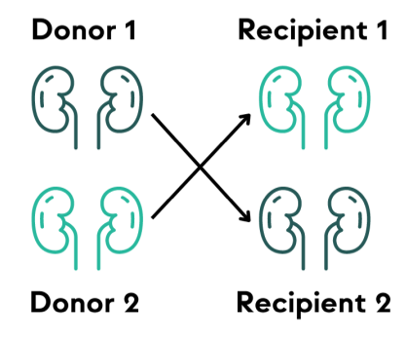
Applications of Maximum Matching
Healthcare: emergency resources allocation, kidney exchange, …

Slide 8

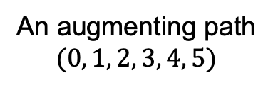
How to Increase a Matching?
Augmenting path is a path in the graph that:
(1) alternates between unmatched edges and matched edges
(2) begins and ends with an unmatched node
$$M=\{\left(1,2\right), (3,4)\}$$
An augmenting path
$$(0, 1, 2, 3, 4, 5)$$

Slide 9

How to Increase a Matching?
Given an augmenting path
- flip unmatched edges to matched edges
- flip matched edges to unmatched edges
Each augmenting path increases the matching size by 1
flip
$$M=\{\left(1,2\right), (3,4)\}$$
An augmenting path
$$(0, 1, 2, 3, 4, 5)$$
$$M′=\{\left(0,1\right), \left(2,3\right), (4,5)\}$$

Slide 10
Find Maximum Matching
Berge’s Theorem
A matching is maximum if and only if no augmenting path can be found.

Slide 11
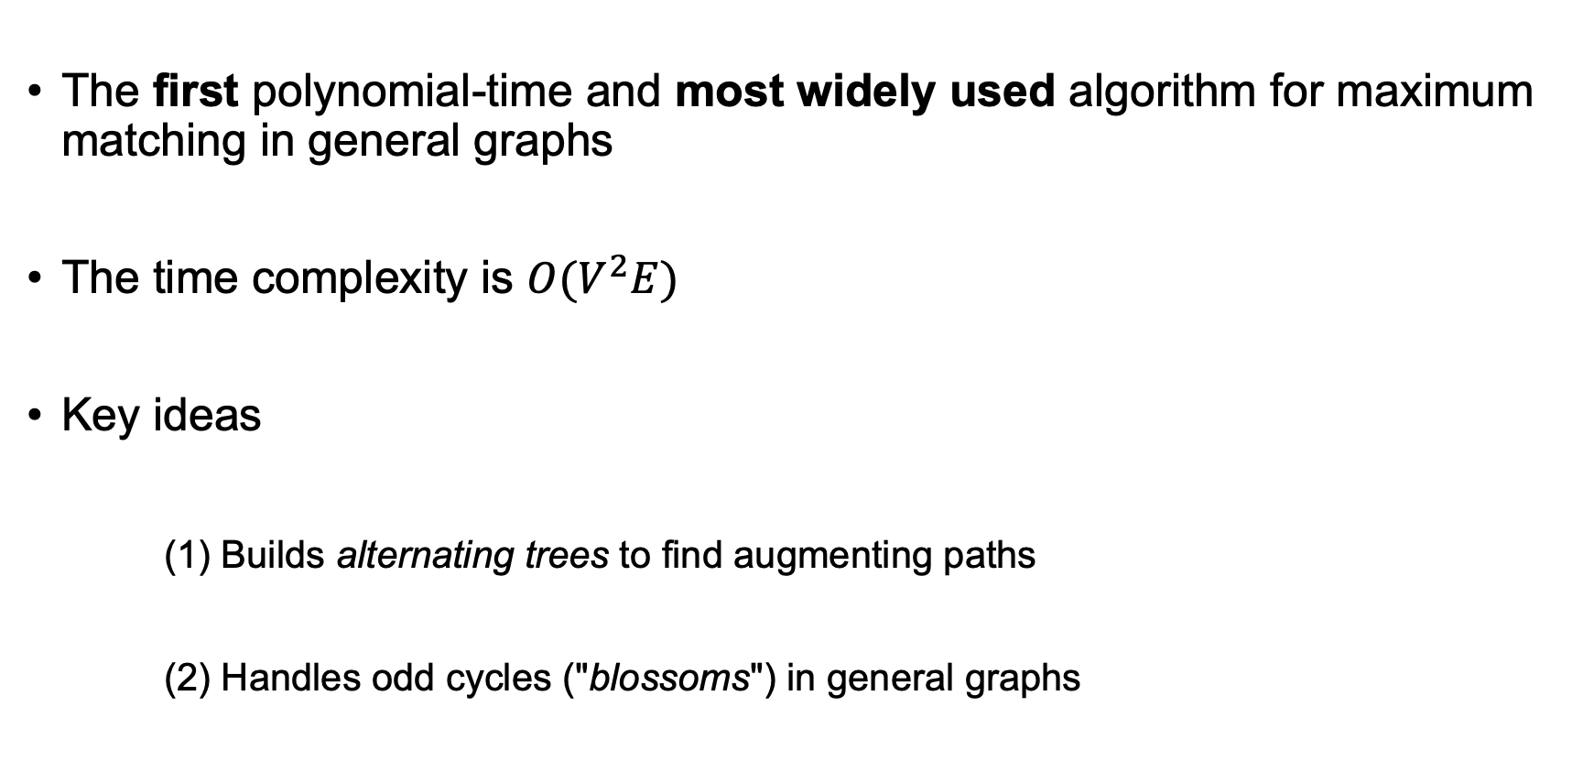
Blossom Algorithm (1965)
The first polynomial-time and most widely used algorithm for maximum matching in general graphs
The time complexity is $O(V^{2}E)$
Key ideas
(1) Builds alternating trees to find augmenting paths
(2) Handles odd cycles ("blossoms") in general graphs

Slide 12
Alternating Tree
An artificial tree rooted at an unmatched vertex
Grows by expanding two edges at a time:
– one unmatched edge + one matched edge

Slide 13
Alternating Tree
An artificial tree rooted at an unmatched vertex
Grows by expanding two edges at a time:
– one unmatched edge + one matched edge

Slide 14
Alternating Tree
Even node: a tree node at an even-depth from the root
If an unmatched edge connects two even nodes from different trees

Slide 15
Alternating Tree
Even node: a tree node at an even-depth from the root
If an unmatched edge connects two even nodes from different trees

Slide 16
Alternating Tree
Even node: a tree node at an even-depth from the root
If an unmatched edge connects two even nodes from different trees

Slide 17
Alternating Tree
Even node: a tree node at an even-depth from the root
If an unmatched edge connects two even nodes from different trees
– An augmenting path is found!
This is a structured way to organize the augmenting path search

Slide 18
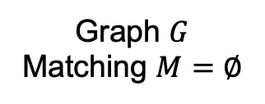
Blossom Algorithm – Execution Pattern
All vertices are unmatched → six alternating trees
Graph $G$
Matching $M=∅$

Slide 19
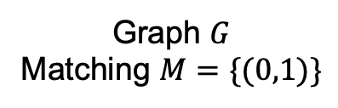

Blossom Algorithm – Execution Pattern
The unmatched edge (0,1) connects even node 0 and even node 1
- find an augmenting path (0, 1)
update $M$
Graph $G$
Matching $M=∅$
Graph $G$
Matching $M=\{(0,1)\}$

Slide 20
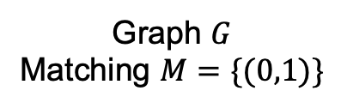
Blossom Algorithm – Execution Pattern
Four vertices are unmatched → four alternating trees
Graph $G$
Matching $M=\{(0,1)\}$

Slide 21
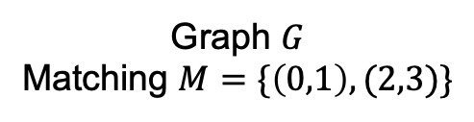
Blossom Algorithm – Execution Pattern
The unmatched edge (2,3) connects even node 2 and even node 3
- find an augmenting path (2, 3)
update $M$
Graph $G$
Matching $M=\{(0,1)\}$
Graph $G$
Matching $M=\{\left(0,1\right), (2,3)\}$

Slide 22

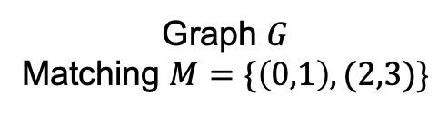
Blossom Algorithm – Execution Pattern
Two vertices are unmatched → two alternating trees
Graph $G$
Matching $M=\{\left(0,1\right), (2,3)\}$

Slide 23
Blossom Algorithm – Execution Pattern
Tree expands
Graph $G$
Matching $M=\{\left(0,1\right), (2,3)\}$

Slide 24
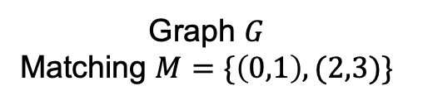
Blossom Algorithm – Execution Pattern
The unmatched edge (1,2) connects two even nodes in the same tree
Graph $G$
Matching $M=\{\left(0,1\right), (2,3)\}$

Slide 25
Blossom Algorithm – Execution Pattern
The unmatched edge (1,2) connects two even nodes in the same tree
An odd-length alternating cycle (“blossom”) forms
Graph $G$
Matching $M=\{\left(0,1\right), (2,3)\}$

Slide 26


Blossom Algorithm – Execution Pattern
The unmatched edge (1,2) connects two even nodes in the same tree
An odd-length alternating cycle (“blossom”) forms
- contract this blossom and generate a new graph
contract
New Graph $G′$
Graph $G$
Matching $M=\{\left(0,1\right), (2,3)\}$

Slide 27

Blossom Algorithm – Execution Pattern
Search the augmenting paths on the contracted graph
- Find an augmenting path $P′$ in $G′$
contract
New Graph $G′$
Graph $G$
Matching $M=\{\left(0,1\right), (2,3)\}$
Next Recursion Depth

Slide 28

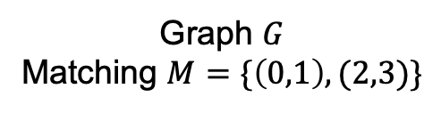
Blossom Algorithm – Execution Pattern
Restore $P′$ in $G′$→ $P$ in $G$
contract
New Graph $G′$
Graph $G$
Matching $M=\{\left(0,1\right), (2,3)\}$
Next Recursion Depth
lift
Matching $M=\{\left(0,4\right), \left(1,2\right), (3,5)\}$

Slide 29
Key Challenges in Parallelization
(1) Recursive process of blossom contraction and lifting
→ a new sequential recursion-free blossom algorithm
(2) Only one augmenting path can be returned by each search
→
(3) Dynamic data structures are continuously being updated

Slide 30
Insights
Contraction: all nodes in the blossom → a single new even node
contract

Slide 31
Insights
Contraction: all nodes in the blossom → a single new even node
The unmatched edge (5,3) → edge (5,6)
Blossom contraction allows more unmatched edges to be checked
contract

Slide 32
Eliminate Recursion
Lemma
- All odd nodes within the blossom cycle may be treated as even nodes.

Slide 33
Eliminate Recursion
Lemma
- All odd nodes within the blossom cycle may be treated as even nodes.

Slide 34
Eliminate Recursion
Lemma
- All odd nodes within the blossom cycle may be treated as even nodes.

Slide 35
Eliminate Recursion
Lemma
- All odd nodes within the blossom cycle may be treated as even nodes.

Slide 36
Eliminate Recursion
Lemma
- All odd nodes within the blossom cycle may be treated as even nodes.

Slide 37
Sequential Recursion-Free Algorithm
Instead of contraction, change all odd nodes within the blossom to be even
- Check all edges incident to these even nodes
- Use a path table to record the correct even-length path (to the unmatched vertex)
contract

Slide 38
Key Challenges in Parallelization
(1) Recursive process of blossom contraction and lifting
→ a new sequential recursion-free blossom algorithm
(2) Only one augmenting path can be returned by each search
→ a new parallel algorithm to search multiple paths
(3) Dynamic data structures are continuously being updated

Slide 39
Parallel Recursion-Free Algorithm
Check all edges incident to even nodes in parallel
Find as many as disjoint augmenting paths concurrently

Slide 40

Parallel Recursion-Free Algorithm
Check all edges incident to even nodes in parallel
Find as many as disjoint augmenting paths concurrently
update $M$

Slide 41
Parallel Recursion-Free Algorithm
Check all edges incident to even nodes in parallel
Find as many as disjoint augmenting paths concurrently
Lock-free

Slide 42
Key Challenges in Parallelization
(1) Recursive process of blossom contraction and lifting
→ a new sequential recursion-free blossom algorithm
(2) Only one augmenting path can be returned by each search
→ a new parallel algorithm to search multiple paths
(3) Dynamic data structures are continuously being updated
→ static graph + no alternating trees

Slide 43
Skip Alternating Tree
Path table
- records the valid even-length alternating path for every even node
- reducing the path tracing cost

Slide 44
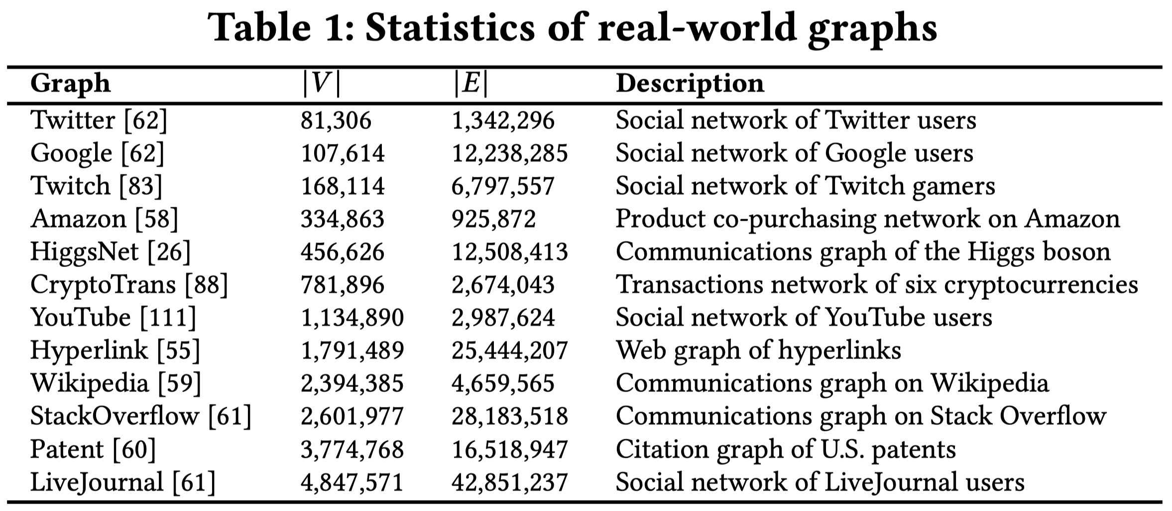
Experiment Setup
Real-World Datasets
- social graphs, economic networks, communication graphs, …

Slide 45
Experiment Setup
Real-World Datasets
- social graphs, economic networks, communication graphs, …
Synthetic Datasets
- random graphs with specific density
- random graphs with specific degree
- random graphs with gamma-distributed degrees
Environment
- a server with dual AMD EPYC 7643 processors and 256 GB of RAM

Slide 46
High Performance of X-Blossom
Baselines
- C++ Boost Graph Library
- High-performance C++ LEMON library
- State-of-the-art parallel solution (8-core Par-EB, 2024)
Speedup of 8-core X-blossom:
- LEMON (~992x)
- Par-EB (~327x)

Slide 47
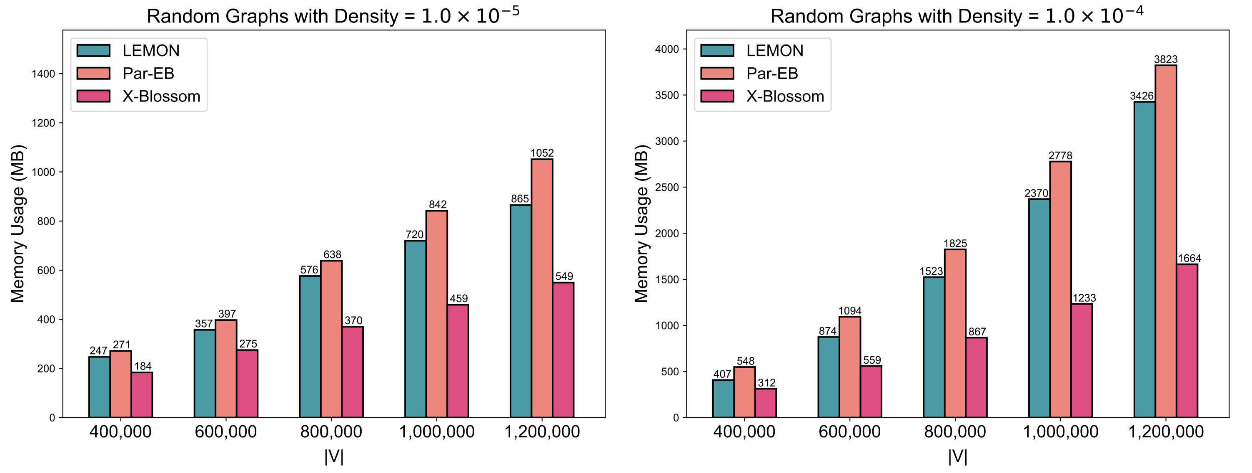
Memory Usage of X-Blossom
Avoids the memory overhead associated with recursive call stacks and tree reconstruction

Slide 48
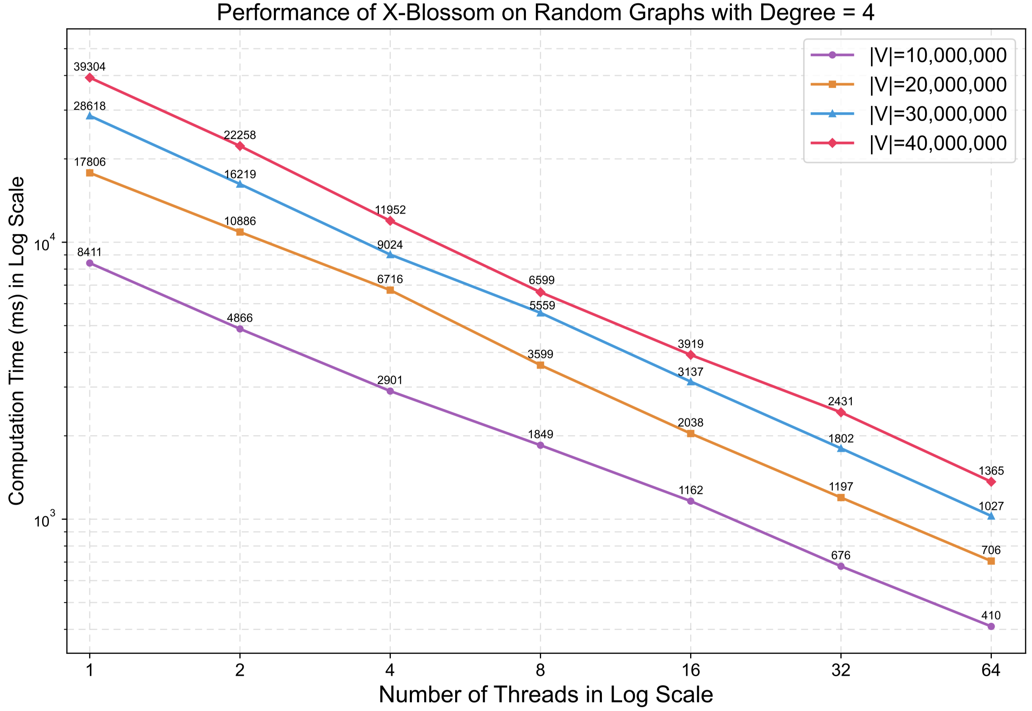
High Scalability of X-Blossom
When # of threads doubles, the average speedup is 1.72x

Slide 49
Conclusion
X-Blossom
- a massive parallel computation framework for maximum matching
- the best parallel solution so far
- recursion-free + massively parallel search + efficient data structure
Open-source project (https://github.com/Davis-Fan/X-Blossom)
My personal webpage (https://davis-fan.github.io)
Thank You!
Email: fan.1090@osu.edu

Slide 51
Image Reference (P4-P6)
We Save Lives. “Ride Sharing – Is It Worth It?” We Save Lives, https://wesavelives.org/ride-sharing-is-it-worth-it/. Accessed 15 Aug. 2025.
Program-Ace. “The Reimagined Nature of VR Entertainment.” Program-Ace Blog, 1 Apr. 2024, https://program-ace.com/blog/the-reimagined-nature-of-vr-entertainment/. Accessed 15 Aug. 2025.
OpenGeeksLab. “Dating Platform Development: An Ultimate Guide.” OpenGeeksLab Blog, https://opengeekslab.com/blog/dating-platform-development/. Accessed 15 Aug. 2025.
Express Healthcare. “Health Minister of Arunachal Pradesh Flags Off BLS Ambulances to Tackle COVID-19 Pandemic.” Express Healthcare, Press Trust of India, 27 July 2020, https://www.expresshealthcare.in/covid19-updates/health-minister-of-arunachal-pradesh-flags-off-bls-ambulances-to-tackle-covid-19-pandemic/423752/. Accessed 15 Aug. 2025.
Stanford Impact Labs. “How Does Applied Economics Maximize Kidney Transplants?” Stanford Impact Labs, 31 Jan. 2024, https://impact.stanford.edu/article/how-does-applied-economics-maximize-kidney-transplants. Accessed 15 Aug. 2025.

