Slide 1
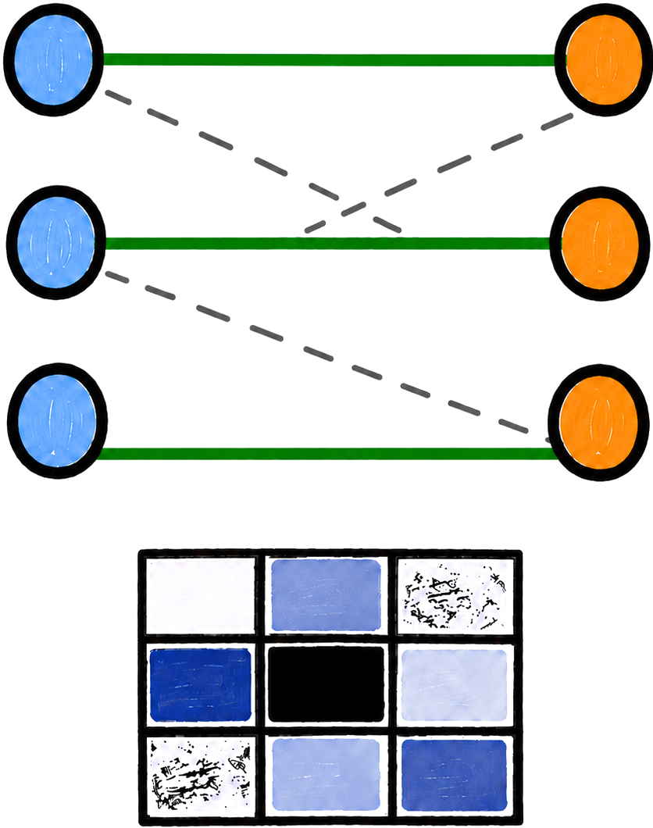
X-Wim
Massive Parallelization of Bipartite Weighted Matching

Slide 2



Bipartite Weighted Matching
A weighted bipartite graph has two disjoint vertex sets $L$ and $R$
A bipartite graph
A matching
A perfect matching
Maximum weighted perfect matching
$$∈L$$
$$∈R$$
Red edges are edges in the matching
Notes:
As data scales in modern applications and the demand for real-time processing intensifies, parallel computing solutions have become more and more important. A wide range of real-world applications rely on irregular datacentric algorithms. But developing efficient parallel frameworks for such computations is challenging and requires advances in both algorithm design and hardware implementation.

Slide 3
Bipartite Weighted Matching
Matching: a set of edges with no shared vertices
A bipartite graph
A matching
A perfect matching
Maximum weighted perfect matching
Red edges are edges in the matching
Notes:
As data scales in modern applications and the demand for real-time processing intensifies, parallel computing solutions have become more and more important. A wide range of real-world applications rely on irregular datacentric algorithms. But developing efficient parallel frameworks for such computations is challenging and requires advances in both algorithm design and hardware implementation.

Slide 4
Bipartite Weighted Matching
Perfect matching: a matching that covers all vertices
A bipartite graph
A matching
A perfect matching
Maximum weighted perfect matching
Red edges are edges in the matching
Notes:
As data scales in modern applications and the demand for real-time processing intensifies, parallel computing solutions have become more and more important. A wide range of real-world applications rely on irregular datacentric algorithms. But developing efficient parallel frameworks for such computations is challenging and requires advances in both algorithm design and hardware implementation.

Slide 5
Bipartite Weighted Matching
Maximum weight perfect matching (MWPM)
– a perfect matching with the maximum total weight
– other weighted matching problems can be reduced to MWPM
A bipartite graph
A matching
A perfect matching
Maximum weight perfect matching
Red edges are edges in the matching
Notes:
As data scales in modern applications and the demand for real-time processing intensifies, parallel computing solutions have become more and more important. A wide range of real-world applications rely on irregular datacentric algorithms. But developing efficient parallel frameworks for such computations is challenging and requires advances in both algorithm design and hardware implementation.

Slide 6
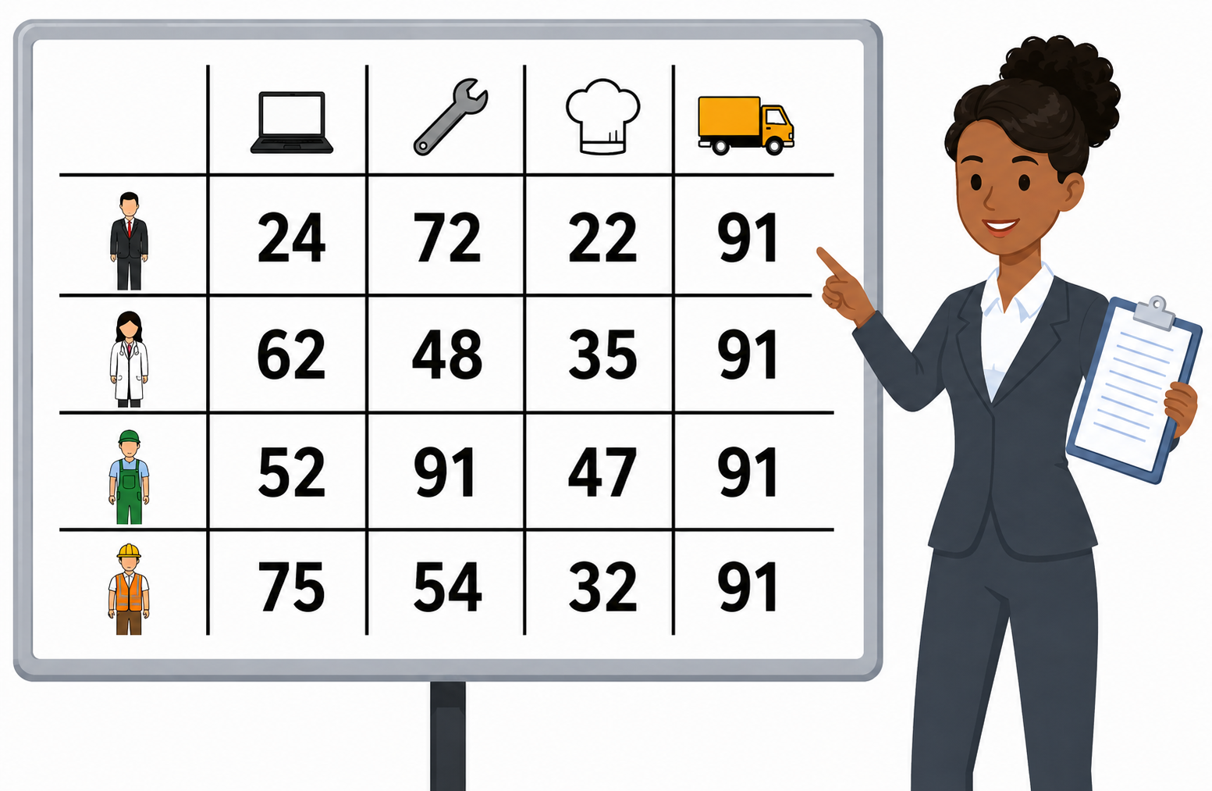
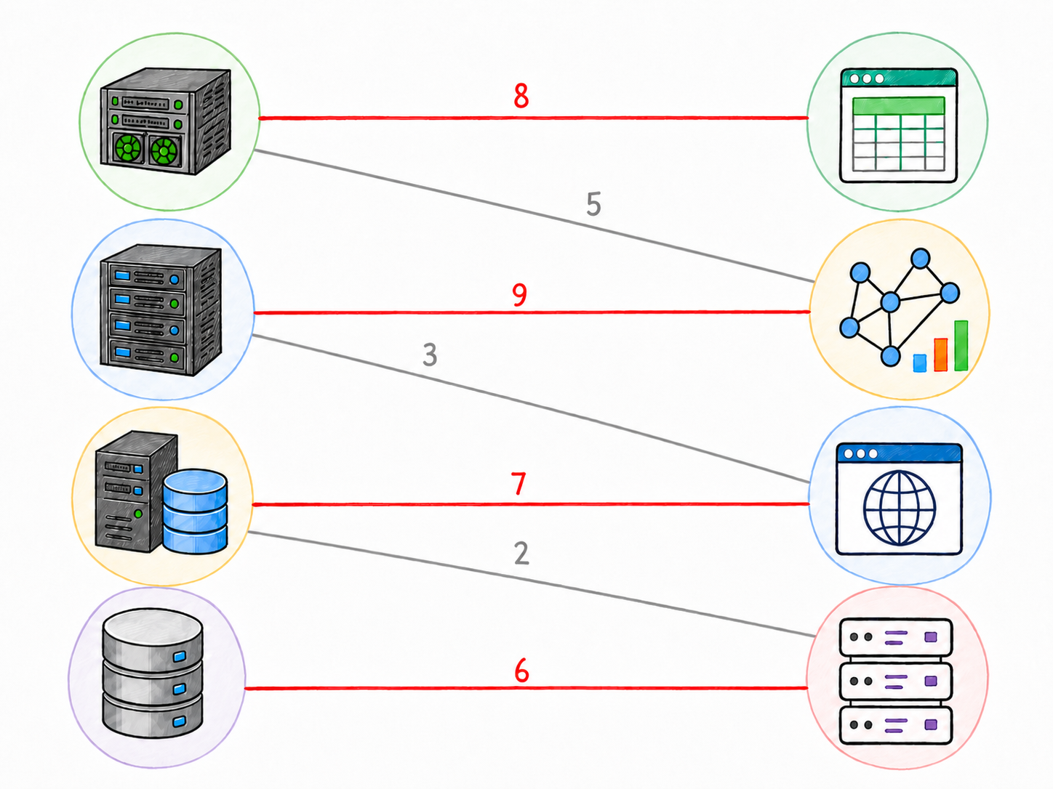
Applications of Bipartite MWPM
Optimal Assignment
Resource allocation and worker-task pairing
Notes:
In distributed ML training, communication is often a bottleneck. When workers need to exchange gradients, parameters, or data shards, each worker may only participate in one high-bandwidth transfer at a time. We can model workers as vertices and pending transfers as edges. A matching gives a set of transfers that can run simultaneously without endpoint conflicts, and a maximum matching maximizes the number of concurrent transfers in each scheduling round.

Slide 7
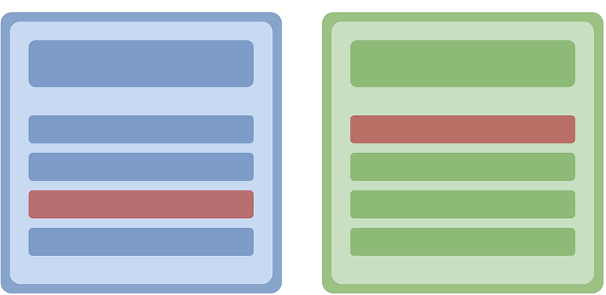

Applications of Bipartite MWPM
Optimal Assignment
Resource allocation and worker-task pairing
Database systems
Entity resolution and graph alignment
Notes:
In distributed ML training, communication is often a bottleneck. When workers need to exchange gradients, parameters, or data shards, each worker may only participate in one high-bandwidth transfer at a time. We can model workers as vertices and pending transfers as edges. A matching gives a set of transfers that can run simultaneously without endpoint conflicts, and a maximum matching maximizes the number of concurrent transfers in each scheduling round.

Slide 8
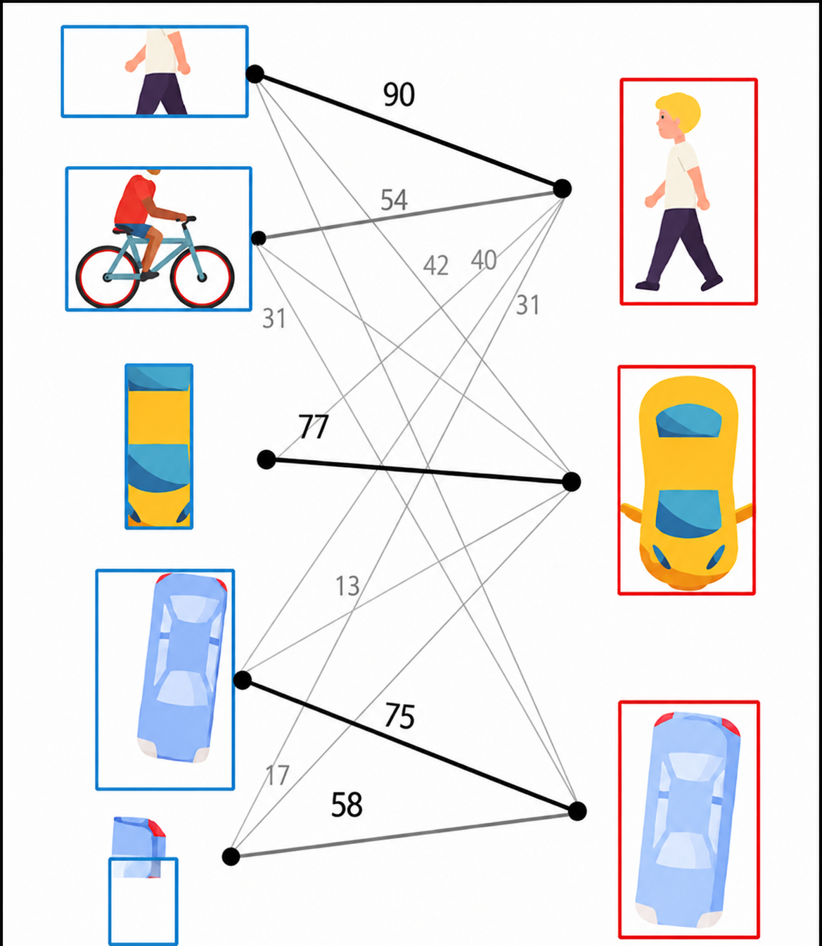
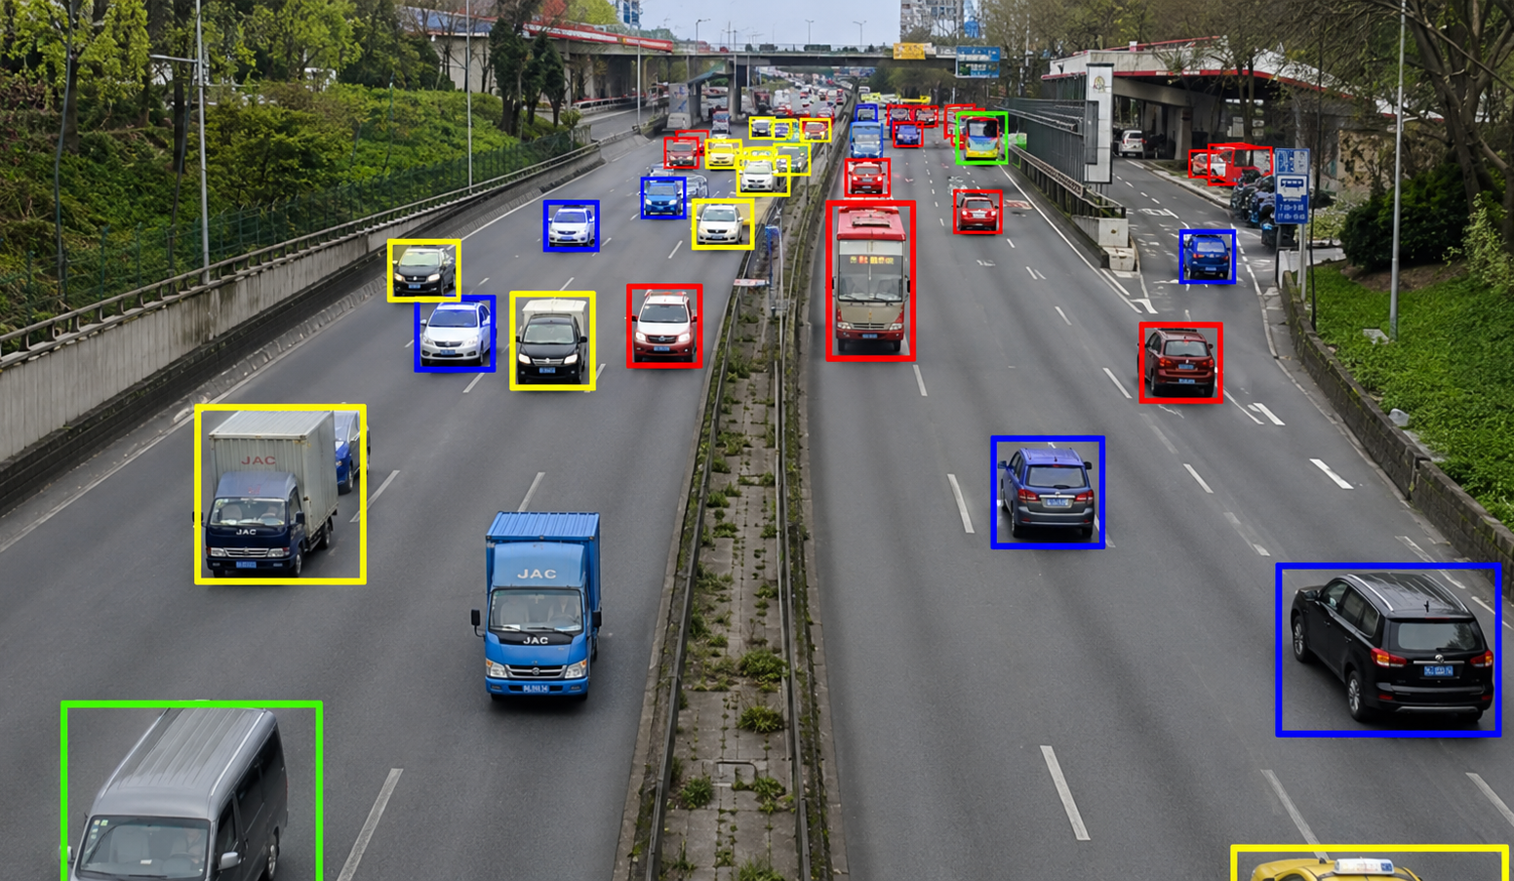
Applications of Bipartite MWPM
Optimal Assignment
Resource allocation and worker-task pairing
Database systems
Entity resolution and graph alignment
Machine learning
Object tracking and data association
Notes:
In distributed ML training, communication is often a bottleneck. When workers need to exchange gradients, parameters, or data shards, each worker may only participate in one high-bandwidth transfer at a time. We can model workers as vertices and pending transfers as edges. A matching gives a set of transfers that can run simultaneously without endpoint conflicts, and a maximum matching maximizes the number of concurrent transfers in each scheduling round.

Slide 9
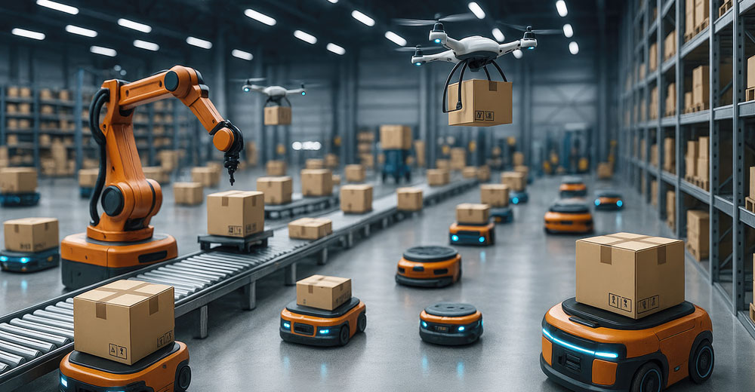
Applications of Bipartite MWPM
Optimal Assignment
Resource allocation and worker-task pairing
Database systems
Entity resolution and graph alignment
Machine learning
Object tracking and data association
Robotics
Multi-robot coordination
Notes:
In distributed ML training, communication is often a bottleneck. When workers need to exchange gradients, parameters, or data shards, each worker may only participate in one high-bandwidth transfer at a time. We can model workers as vertices and pending transfers as edges. A matching gives a set of transfers that can run simultaneously without endpoint conflicts, and a maximum matching maximizes the number of concurrent transfers in each scheduling round.

Slide 10
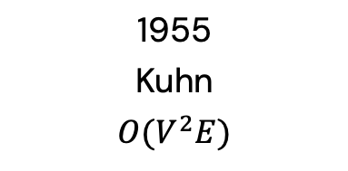

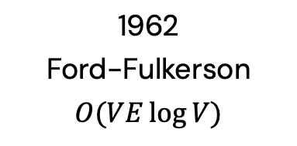
Solving Bipartite MWPM
1955
Kuhn
$$O(V^{2}E)$$
1962
Ford-Fulkerson
$$O(VE\log{V})$$
1972
Edmonds-Karp
$$O(V^{3})$$
Hungarian algorithm
First polynomial-time solution
The foundational method
Network flow formulation
Efficient heaps
Notes:
As data scales in modern applications and the demand for real-time processing intensifies, parallel computing solutions have become more and more important. A wide range of real-world applications rely on irregular datacentric algorithms. But developing efficient parallel frameworks for such computations is challenging and requires advances in both algorithm design and hardware implementation.

Slide 11
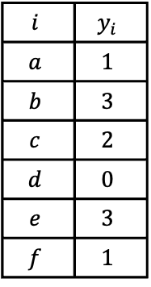

Optimality Principle
Assign a label $y_{i}$ to each vertex $i$ such that $y_{u}+y_{v}≥w\left(u,v\right)$ for every edge
$$i$$ | $$y_{i}$$
$$a$$ | $$1$$
$$b$$ | $$3$$
$$c$$ | $$2$$
$$d$$ | $$0$$
$$e$$ | $$3$$
$$f$$ | $$1$$
Notes:
As data scales in modern applications and the demand for real-time processing intensifies, parallel computing solutions have become more and more important. A wide range of real-world applications rely on irregular datacentric algorithms. But developing efficient parallel frameworks for such computations is challenging and requires advances in both algorithm design and hardware implementation.

Slide 12

Optimality Principle
Assign a label $y_{i}$ to each vertex $i$ such that $y_{u}+y_{v}≥w\left(u,v\right)$ for every edge
– an edge is tight if $y_{u}+y_{v}=w\left(u,v\right)$
$$i$$ | $$y_{i}$$
$$a$$ | $$1$$
$$b$$ | $$3$$
$$c$$ | $$2$$
$$d$$ | $$0$$
$$e$$ | $$3$$
$$f$$ | $$1$$
Notes:
As data scales in modern applications and the demand for real-time processing intensifies, parallel computing solutions have become more and more important. A wide range of real-world applications rely on irregular datacentric algorithms. But developing efficient parallel frameworks for such computations is challenging and requires advances in both algorithm design and hardware implementation.

Slide 13
Optimality Principle
Assign a label $y_{i}$ to each vertex $i$ such that $y_{u}+y_{v}≥w\left(u,v\right)$ for every edge
– an edge is tight if $y_{u}+y_{v}=w\left(u,v\right)$
$$i$$ | $$y_{i}$$
$$a$$ | $$1$$
$$b$$ | $$3$$
$$c$$ | $$2$$
$$d$$ | $$0$$
$$e$$ | $$3$$
$$f$$ | $$1$$
Notes:
As data scales in modern applications and the demand for real-time processing intensifies, parallel computing solutions have become more and more important. A wide range of real-world applications rely on irregular datacentric algorithms. But developing efficient parallel frameworks for such computations is challenging and requires advances in both algorithm design and hardware implementation.

Slide 14

Optimality Principle
Assign a label $y_{i}$ to each vertex $i$ such that $y_{u}+y_{v}≥w\left(u,v\right)$ for every edge
– an edge is tight if $y_{u}+y_{v}=w\left(u,v\right)$
– the equality graph is the subgraph formed by tight edges
$$i$$ | $$y_{i}$$
$$a$$ | $$1$$
$$b$$ | $$3$$
$$c$$ | $$2$$
$$d$$ | $$0$$
$$e$$ | $$3$$
$$f$$ | $$1$$
equality graph
Notes:
As data scales in modern applications and the demand for real-time processing intensifies, parallel computing solutions have become more and more important. A wide range of real-world applications rely on irregular datacentric algorithms. But developing efficient parallel frameworks for such computations is challenging and requires advances in both algorithm design and hardware implementation.

Slide 15

Optimality Principle
Assign a label $y_{i}$ to each vertex $i$ such that $y_{u}+y_{v}≥w\left(u,v\right)$ for every edge
– an edge is tight if $y_{u}+y_{v}=w\left(u,v\right)$
– the equality graph is the subgraph formed by tight edges
If the equality graph contains a perfect matching, it is the MWPM of the original graph
$$i$$ | $$y_{i}$$
$$a$$ | $$1$$
$$b$$ | $$3$$
$$c$$ | $$2$$
$$d$$ | $$0$$
$$e$$ | $$3$$
$$f$$ | $$1$$
equality graph
Notes:
As data scales in modern applications and the demand for real-time processing intensifies, parallel computing solutions have become more and more important. A wide range of real-world applications rely on irregular datacentric algorithms. But developing efficient parallel frameworks for such computations is challenging and requires advances in both algorithm design and hardware implementation.

Slide 16
Optimality Principle
Assign a label $y_{i}$ to each vertex $i$ such that $y_{u}+y_{v}≥w\left(u,v\right)$ for every edge
– an edge is tight if $y_{u}+y_{v}=w\left(u,v\right)$
– the equality graph is the subgraph formed by tight edges
If the equality graph contains a perfect matching, it is the MWPM of the original graph
$$i$$ | $$y_{i}$$
$$a$$ | $$1$$
$$b$$ | $$3$$
$$c$$ | $$2$$
$$d$$ | $$0$$
$$e$$ | $$3$$
$$f$$ | $$1$$
equality graph
Notes:
As data scales in modern applications and the demand for real-time processing intensifies, parallel computing solutions have become more and more important. A wide range of real-world applications rely on irregular datacentric algorithms. But developing efficient parallel frameworks for such computations is challenging and requires advances in both algorithm design and hardware implementation.

Slide 17
Optimality Principle
Assign a label $y_{i}$ to each vertex $i$ such that $y_{u}+y_{v}≥w\left(u,v\right)$ for every edge
– an edge is tight if $y_{u}+y_{v}=w\left(u,v\right)$
– the equality graph is the subgraph formed by tight edges
If the equality graph contains a perfect matching, it is the MWPM of the original graph
$$i$$ | $$y_{i}$$
$$a$$ | $$1$$
$$b$$ | $$3$$
$$c$$ | $$2$$
$$d$$ | $$0$$
$$e$$ | $$3$$
$$f$$ | $$1$$
equality graph
MWPM
Notes:
As data scales in modern applications and the demand for real-time processing intensifies, parallel computing solutions have become more and more important. A wide range of real-world applications rely on irregular datacentric algorithms. But developing efficient parallel frameworks for such computations is challenging and requires advances in both algorithm design and hardware implementation.

Slide 18
Finding Perfect Matching
$$i$$ | $$y_{i}$$
$$a$$ | $$1$$
$$b$$ | $$3$$
$$c$$ | $$2$$
$$d$$ | $$0$$
$$e$$ | $$3$$
$$f$$ | $$1$$
equality graph
Notes:
As data scales in modern applications and the demand for real-time processing intensifies, parallel computing solutions have become more and more important. A wide range of real-world applications rely on irregular datacentric algorithms. But developing efficient parallel frameworks for such computations is challenging and requires advances in both algorithm design and hardware implementation.

Slide 19
Finding Perfect Matching
$$i$$ | $$y_{i}$$
$$a$$ | $$1$$
$$b$$ | $$3$$
$$c$$ | $$2$$
$$d$$ | $$0$$
$$e$$ | $$3$$
$$f$$ | $$1$$
equality graph
Notes:
As data scales in modern applications and the demand for real-time processing intensifies, parallel computing solutions have become more and more important. A wide range of real-world applications rely on irregular datacentric algorithms. But developing efficient parallel frameworks for such computations is challenging and requires advances in both algorithm design and hardware implementation.

Slide 20
Finding Perfect Matching
Augmenting path in equality graph
– begins and ends with an unmatched node
– alternates between matched edges and unmatched edges
$$i$$ | $$y_{i}$$
$$a$$ | $$1$$
$$b$$ | $$3$$
$$c$$ | $$2$$
$$d$$ | $$0$$
$$e$$ | $$3$$
$$f$$ | $$1$$
equality graph
Notes:
As data scales in modern applications and the demand for real-time processing intensifies, parallel computing solutions have become more and more important. A wide range of real-world applications rely on irregular datacentric algorithms. But developing efficient parallel frameworks for such computations is challenging and requires advances in both algorithm design and hardware implementation.

Slide 21
Finding Perfect Matching
Augmenting path in equality graph
– begins and ends with an unmatched node
– alternates between matched edges and unmatched edges
$$i$$ | $$y_{i}$$
$$a$$ | $$1$$
$$b$$ | $$3$$
$$c$$ | $$2$$
$$d$$ | $$0$$
$$e$$ | $$3$$
$$f$$ | $$1$$
equality graph
Notes:
As data scales in modern applications and the demand for real-time processing intensifies, parallel computing solutions have become more and more important. A wide range of real-world applications rely on irregular datacentric algorithms. But developing efficient parallel frameworks for such computations is challenging and requires advances in both algorithm design and hardware implementation.

Slide 22
Finding Perfect Matching
Augmenting path in equality graph
– begins and ends with an unmatched node
– alternates between matched edges and unmatched edges
Flip the path → matching size + 1
$$i$$ | $$y_{i}$$
$$a$$ | $$1$$
$$b$$ | $$3$$
$$c$$ | $$2$$
$$d$$ | $$0$$
$$e$$ | $$3$$
$$f$$ | $$1$$
flip
equality graph
Notes:
As data scales in modern applications and the demand for real-time processing intensifies, parallel computing solutions have become more and more important. A wide range of real-world applications rely on irregular datacentric algorithms. But developing efficient parallel frameworks for such computations is challenging and requires advances in both algorithm design and hardware implementation.

Slide 23
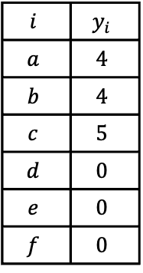

Hungarian Algorithm
Initialize a valid set of labels
for each $i∈L$, $y_{i}=max_{e∋i} w\left(e\right)$
for each $i∈R$, $y_{i}=0$
$$i$$ | $$y_{i}$$
$$a$$ | $$4$$
$$b$$ | $$4$$
$$c$$ | $$5$$
$$d$$ | $$0$$
$$e$$ | $$0$$
$$f$$ | $$0$$
equality graph
Notes:
As data scales in modern applications and the demand for real-time processing intensifies, parallel computing solutions have become more and more important. A wide range of real-world applications rely on irregular datacentric algorithms. But developing efficient parallel frameworks for such computations is challenging and requires advances in both algorithm design and hardware implementation.

Slide 24
Hungarian Algorithm
Repeat until perfect matching:
Search for an augmenting path in equality graph (primal phase)
Adjust labels to create more tight edges (dual phase)
$$i$$ | $$y_{i}$$
$$a$$ | $$4$$
$$b$$ | $$4$$
$$c$$ | $$5$$
$$d$$ | $$0$$
$$e$$ | $$0$$
$$f$$ | $$0$$
equality graph
Notes:
As data scales in modern applications and the demand for real-time processing intensifies, parallel computing solutions have become more and more important. A wide range of real-world applications rely on irregular datacentric algorithms. But developing efficient parallel frameworks for such computations is challenging and requires advances in both algorithm design and hardware implementation.

Slide 25
Hungarian Algorithm
Repeat until perfect matching:
Search for an augmenting path in equality graph (primal phase)
Adjust labels to create more tight edges (dual phase)
$$i$$ | $$y_{i}$$
$$a$$ | $$4$$
$$b$$ | $$4$$
$$c$$ | $$5$$
$$d$$ | $$0$$
$$e$$ | $$0$$
$$f$$ | $$0$$
equality graph
Notes:
As data scales in modern applications and the demand for real-time processing intensifies, parallel computing solutions have become more and more important. A wide range of real-world applications rely on irregular datacentric algorithms. But developing efficient parallel frameworks for such computations is challenging and requires advances in both algorithm design and hardware implementation.

Slide 26
Hungarian Algorithm
Repeat until perfect matching:
Search for an augmenting path in equality graph (primal phase)
Adjust labels to create more tight edges (dual phase)
$$i$$ | $$y_{i}$$
$$a$$ | $$4$$
$$b$$ | $$4$$
$$c$$ | $$5$$
$$d$$ | $$0$$
$$e$$ | $$0$$
$$f$$ | $$0$$
equality graph
Notes:
As data scales in modern applications and the demand for real-time processing intensifies, parallel computing solutions have become more and more important. A wide range of real-world applications rely on irregular datacentric algorithms. But developing efficient parallel frameworks for such computations is challenging and requires advances in both algorithm design and hardware implementation.

Slide 27
Hungarian Algorithm
Repeat until perfect matching:
Search for an augmenting path in equality graph (primal phase)
Adjust labels to create more tight edges (dual phase)
$$i$$ | $$y_{i}$$
$$a$$ | $$4$$
$$b$$ | $$4$$
$$c$$ | $$5$$
$$d$$ | $$0$$
$$e$$ | $$0$$
$$f$$ | $$0$$
equality graph
Notes:
As data scales in modern applications and the demand for real-time processing intensifies, parallel computing solutions have become more and more important. A wide range of real-world applications rely on irregular datacentric algorithms. But developing efficient parallel frameworks for such computations is challenging and requires advances in both algorithm design and hardware implementation.

Slide 28
Hungarian Algorithm
Repeat until perfect matching:
Search for an augmenting path in equality graph (primal phase)
Adjust labels to create more tight edges (dual phase)
$$i$$ | $$y_{i}$$
$$a$$ | $$4$$
$$b$$ | $$4$$
$$c$$ | $$5$$
$$d$$ | $$0$$
$$e$$ | $$0$$
$$f$$ | $$0$$
equality graph
Notes:
As data scales in modern applications and the demand for real-time processing intensifies, parallel computing solutions have become more and more important. A wide range of real-world applications rely on irregular datacentric algorithms. But developing efficient parallel frameworks for such computations is challenging and requires advances in both algorithm design and hardware implementation.

Slide 29
Hungarian Algorithm
Repeat until perfect matching:
Search for an augmenting path in equality graph (primal phase)
Adjust labels to create more tight edges (dual phase)
Build a tree from an unmatched node by adding unmatched–matched edge pairs
$$i$$ | $$y_{i}$$
$$a$$ | $$4$$
$$b$$ | $$4$$
$$c$$ | $$5$$
$$d$$ | $$0$$
$$e$$ | $$0$$
$$f$$ | $$0$$
equality graph
Notes:
As data scales in modern applications and the demand for real-time processing intensifies, parallel computing solutions have become more and more important. A wide range of real-world applications rely on irregular datacentric algorithms. But developing efficient parallel frameworks for such computations is challenging and requires advances in both algorithm design and hardware implementation.

Slide 30
Hungarian Algorithm
Repeat until perfect matching:
Search for an augmenting path in equality graph (primal phase)
Adjust labels to create more tight edges (dual phase)
Build a tree from an unmatched node by adding unmatched–matched edge pairs
$$i$$ | $$y_{i}$$
$$a$$ | $$4$$
$$b$$ | $$4$$
$$c$$ | $$5$$
$$d$$ | $$0$$
$$e$$ | $$0$$
$$f$$ | $$0$$
equality graph
Notes:
As data scales in modern applications and the demand for real-time processing intensifies, parallel computing solutions have become more and more important. A wide range of real-world applications rely on irregular datacentric algorithms. But developing efficient parallel frameworks for such computations is challenging and requires advances in both algorithm design and hardware implementation.

Slide 31

Hungarian Algorithm
Repeat until perfect matching:
Search for an augmenting path in equality graph (primal phase)
Adjust labels to create more tight edges (dual phase)
Find the min cost Δ to create tight edges; tree labels: $L−Δ$, $R+Δ$
$$i$$ | $$y_{i}$$
$$a$$ | $$4$$
$$b$$ | $$4$$
$$c$$ | $$5$$
$$d$$ | $$0$$
$$e$$ | $$0$$
$$f$$ | $$0$$
equality graph
Notes:
As data scales in modern applications and the demand for real-time processing intensifies, parallel computing solutions have become more and more important. A wide range of real-world applications rely on irregular datacentric algorithms. But developing efficient parallel frameworks for such computations is challenging and requires advances in both algorithm design and hardware implementation.

Slide 32
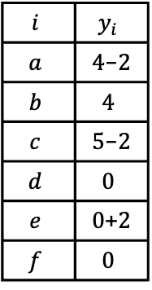
Hungarian Algorithm
Repeat until perfect matching:
Search for an augmenting path in equality graph (primal phase)
Adjust labels to create more tight edges (dual phase)
Find the min cost Δ to create tight edges; tree labels: $L−Δ$, $R+Δ$
$$i$$ | $$y_{i}$$
$$a$$ | $4$-$2$
$$b$$ | $$4$$
$$c$$ | $5$-$2$
$$d$$ | $$0$$
$$e$$ | $0$+$2$
$$f$$ | $$0$$
equality graph
Notes:
As data scales in modern applications and the demand for real-time processing intensifies, parallel computing solutions have become more and more important. A wide range of real-world applications rely on irregular datacentric algorithms. But developing efficient parallel frameworks for such computations is challenging and requires advances in both algorithm design and hardware implementation.

Slide 33
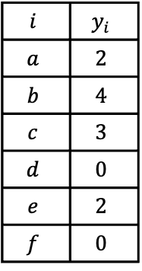
Hungarian Algorithm
Repeat until perfect matching:
Search for an augmenting path in equality graph (primal phase)
Adjust labels to create more tight edges (dual phase)
Find the min cost Δ to create tight edges; tree labels: $L−Δ$, $R+Δ$
$$i$$ | $$y_{i}$$
$$a$$ | $$2$$
$$b$$ | $$4$$
$$c$$ | $$3$$
$$d$$ | $$0$$
$$e$$ | $$2$$
$$f$$ | $$0$$
equality graph
Notes:
As data scales in modern applications and the demand for real-time processing intensifies, parallel computing solutions have become more and more important. A wide range of real-world applications rely on irregular datacentric algorithms. But developing efficient parallel frameworks for such computations is challenging and requires advances in both algorithm design and hardware implementation.

Slide 34
Hungarian Algorithm
Repeat until perfect matching:
Search for an augmenting path in equality graph (primal phase)
Adjust labels to create more tight edges (dual phase)
$$i$$ | $$y_{i}$$
$$a$$ | $$2$$
$$b$$ | $$4$$
$$c$$ | $$3$$
$$d$$ | $$0$$
$$e$$ | $$2$$
$$f$$ | $$0$$
equality graph
Notes:
As data scales in modern applications and the demand for real-time processing intensifies, parallel computing solutions have become more and more important. A wide range of real-world applications rely on irregular datacentric algorithms. But developing efficient parallel frameworks for such computations is challenging and requires advances in both algorithm design and hardware implementation.

Slide 35
Hungarian Algorithm
Repeat until perfect matching:
Search for an augmenting path in equality graph (primal phase)
Adjust labels to create more tight edges (dual phase)
$$i$$ | $$y_{i}$$
$$a$$ | $$2$$
$$b$$ | $$4$$
$$c$$ | $$3$$
$$d$$ | $$0$$
$$e$$ | $$2$$
$$f$$ | $$0$$
equality graph
Notes:
As data scales in modern applications and the demand for real-time processing intensifies, parallel computing solutions have become more and more important. A wide range of real-world applications rely on irregular datacentric algorithms. But developing efficient parallel frameworks for such computations is challenging and requires advances in both algorithm design and hardware implementation.

Slide 36
Hungarian Algorithm
Repeat until perfect matching:
Search for an augmenting path in equality graph (primal phase)
Adjust labels to create more tight edges (dual phase)
$$i$$ | $$y_{i}$$
$$a$$ | $$2$$
$$b$$ | $$4$$
$$c$$ | $$3$$
$$d$$ | $$0$$
$$e$$ | $$2$$
$$f$$ | $$0$$
equality graph
Notes:
As data scales in modern applications and the demand for real-time processing intensifies, parallel computing solutions have become more and more important. A wide range of real-world applications rely on irregular datacentric algorithms. But developing efficient parallel frameworks for such computations is challenging and requires advances in both algorithm design and hardware implementation.

Slide 37
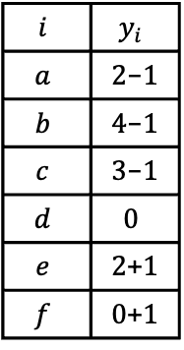
Hungarian Algorithm
Repeat until perfect matching:
Search for an augmenting path in equality graph (primal phase)
Adjust labels to create more tight edges (dual phase)
$$i$$ | $$y_{i}$$
$$a$$ | $2$-$1$
$$b$$ | $4$-$1$
$$c$$ | $3$-$1$
$$d$$ | $$0$$
$$e$$ | $2$+$1$
$$f$$ | $0$+$1$
equality graph
Notes:
As data scales in modern applications and the demand for real-time processing intensifies, parallel computing solutions have become more and more important. A wide range of real-world applications rely on irregular datacentric algorithms. But developing efficient parallel frameworks for such computations is challenging and requires advances in both algorithm design and hardware implementation.

Slide 38
Hungarian Algorithm
Repeat until perfect matching:
Search for an augmenting path in equality graph (primal phase)
Adjust labels to create more tight edges (dual phase)
$$i$$ | $$y_{i}$$
$$a$$ | $$1$$
$$b$$ | $$3$$
$$c$$ | $$2$$
$$d$$ | $$0$$
$$e$$ | $$3$$
$$f$$ | $$1$$
equality graph
Notes:
As data scales in modern applications and the demand for real-time processing intensifies, parallel computing solutions have become more and more important. A wide range of real-world applications rely on irregular datacentric algorithms. But developing efficient parallel frameworks for such computations is challenging and requires advances in both algorithm design and hardware implementation.

Slide 39
Hungarian Algorithm
Repeat until perfect matching:
Search for an augmenting path in equality graph (primal phase)
Adjust labels to create more tight edges (dual phase)
$$i$$ | $$y_{i}$$
$$a$$ | $$1$$
$$b$$ | $$3$$
$$c$$ | $$2$$
$$d$$ | $$0$$
$$e$$ | $$3$$
$$f$$ | $$1$$
equality graph
Notes:
As data scales in modern applications and the demand for real-time processing intensifies, parallel computing solutions have become more and more important. A wide range of real-world applications rely on irregular datacentric algorithms. But developing efficient parallel frameworks for such computations is challenging and requires advances in both algorithm design and hardware implementation.

Slide 40
Hungarian Algorithm
Repeat until perfect matching:
Search for an augmenting path in equality graph (primal phase)
Adjust labels to create more tight edges (dual phase)
$$i$$ | $$y_{i}$$
$$a$$ | $$1$$
$$b$$ | $$3$$
$$c$$ | $$2$$
$$d$$ | $$0$$
$$e$$ | $$3$$
$$f$$ | $$1$$
equality graph
Notes:
As data scales in modern applications and the demand for real-time processing intensifies, parallel computing solutions have become more and more important. A wide range of real-world applications rely on irregular datacentric algorithms. But developing efficient parallel frameworks for such computations is challenging and requires advances in both algorithm design and hardware implementation.

Slide 41
Hungarian Algorithm
Repeat until perfect matching:
Search for an augmenting path in equality graph (primal phase)
Adjust labels to create more tight edges (dual phase)
$$i$$ | $$y_{i}$$
$$a$$ | $$1$$
$$b$$ | $$3$$
$$c$$ | $$2$$
$$d$$ | $$0$$
$$e$$ | $$3$$
$$f$$ | $$1$$
equality graph
Notes:
As data scales in modern applications and the demand for real-time processing intensifies, parallel computing solutions have become more and more important. A wide range of real-world applications rely on irregular datacentric algorithms. But developing efficient parallel frameworks for such computations is challenging and requires advances in both algorithm design and hardware implementation.

Slide 42
Hungarian Algorithm
Repeat until perfect matching:
Search for an augmenting path in equality graph (primal phase)
Adjust labels to create more tight edges (dual phase)
$$i$$ | $$y_{i}$$
$$a$$ | $$1$$
$$b$$ | $$3$$
$$c$$ | $$2$$
$$d$$ | $$0$$
$$e$$ | $$3$$
$$f$$ | $$1$$
equality graph
Notes:
As data scales in modern applications and the demand for real-time processing intensifies, parallel computing solutions have become more and more important. A wide range of real-world applications rely on irregular datacentric algorithms. But developing efficient parallel frameworks for such computations is challenging and requires advances in both algorithm design and hardware implementation.

Slide 43
Hungarian Algorithm
Repeat until perfect matching:
Search for an augmenting path in equality graph (primal phase)
Adjust labels to create more tight edges (dual phase)
primal → dual → primal → dual → primal
$$i$$ | $$y_{i}$$
$$a$$ | $$1$$
$$b$$ | $$3$$
$$c$$ | $$2$$
$$d$$ | $$0$$
$$e$$ | $$3$$
$$f$$ | $$1$$
equality graph
Notes:
As data scales in modern applications and the demand for real-time processing intensifies, parallel computing solutions have become more and more important. A wide range of real-world applications rely on irregular datacentric algorithms. But developing efficient parallel frameworks for such computations is challenging and requires advances in both algorithm design and hardware implementation.

Slide 44
Fundamental Challenges
Search tree growth is inherently sequential
Frequent primal–dual switching creates hard synchronization barriers
Only one augmenting path is returned per iteration
Existing solutions parallelize only within each phase and become impractical at scale
------------------------------------------------------------------------------------------------
Lopes’16 Kawtikwar’24 X-Wim
------------------------------------------------------------------------------------------------
Challenge 1 ✗ ✗ ✓
Challenge 2 ✗ ✗ ✓
Challenge 3 ◐ ◐ ✓
------------------------------------------------------------------------------------------------
Notes:
In distributed ML training, communication is often a bottleneck. When workers need to exchange gradients, parameters, or data shards, each worker may only participate in one high-bandwidth transfer at a time. We can model workers as vertices and pending transfers as edges. A matching gives a set of transfers that can run simultaneously without endpoint conflicts, and a maximum matching maximizes the number of concurrent transfers in each scheduling round.

Slide 45
Fundamental Challenges
Search tree growth is inherently sequential
Frequent primal–dual switching creates hard synchronization barriers
Only one augmenting path is returned per iteration
Existing solutions parallelize only within each phase and become impractical at scale
------------------------------------------------------------------------------------------------
Lopes’16 Kawtikwar’24 X-Wim
------------------------------------------------------------------------------------------------
Challenge 1 ✗ ✗ ✓
Challenge 2 ✗ ✗ ✓
Challenge 3 ◐ ◐ ✓
------------------------------------------------------------------------------------------------
Notes:
In distributed ML training, communication is often a bottleneck. When workers need to exchange gradients, parameters, or data shards, each worker may only participate in one high-bandwidth transfer at a time. We can model workers as vertices and pending transfers as edges. A matching gives a set of transfers that can run simultaneously without endpoint conflicts, and a maximum matching maximizes the number of concurrent transfers in each scheduling round.

Slide 46
Insights
The primal and dual phases are strongly coupled
– label updates depend on the current search tree
– tree growth is limited to only a few tight edges exposed by label updates
Notes:
As data scales in modern applications and the demand for real-time processing intensifies, parallel computing solutions have become more and more important. A wide range of real-world applications rely on irregular datacentric algorithms. But developing efficient parallel frameworks for such computations is challenging and requires advances in both algorithm design and hardware implementation.

Slide 47

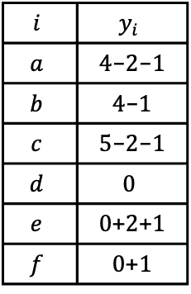
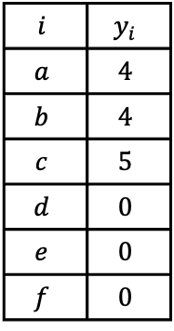
Insights
Label updates can be accumulated instead of applied one by one
– tree root: total update = $\sum{∆}$ over all dual phases
– each tree vertex: total update = $\sum{∆}$ after it joins the tree
$$i$$ | $$y_{i}$$
$$a$$ | $$4$$
$$b$$ | $$4$$
$$c$$ | $$5$$
$$d$$ | $$0$$
$$e$$ | $$0$$
$$f$$ | $$0$$
$$i$$ | $$y_{i}$$
$$a$$ | $4$-$2$-$1$
$$b$$ | $4$-$1$
$$c$$ | $5$-$2$-$1$
$$d$$ | $$0$$
$$e$$ | $0$+$2$+$1$
$$f$$ | $0$+$1$
Notes:
As data scales in modern applications and the demand for real-time processing intensifies, parallel computing solutions have become more and more important. A wide range of real-world applications rely on irregular datacentric algorithms. But developing efficient parallel frameworks for such computations is challenging and requires advances in both algorithm design and hardware implementation.

Slide 48

Phase-Decoupled Framework
Exactly one primal phase to find augmenting path
– each edge carries a cost $δ$ to become tight
– search tree can expand along both tight and non-tight edges
Notes:
As data scales in modern applications and the demand for real-time processing intensifies, parallel computing solutions have become more and more important. A wide range of real-world applications rely on irregular datacentric algorithms. But developing efficient parallel frameworks for such computations is challenging and requires advances in both algorithm design and hardware implementation.

Slide 49
Phase-Decoupled Framework
Exactly one primal phase to find augmenting path
– each edge carries a cost $δ$ to become tight
– search tree can expand along both tight and non-tight edges
Notes:
As data scales in modern applications and the demand for real-time processing intensifies, parallel computing solutions have become more and more important. A wide range of real-world applications rely on irregular datacentric algorithms. But developing efficient parallel frameworks for such computations is challenging and requires advances in both algorithm design and hardware implementation.

Slide 50
Phase-Decoupled Framework
Exactly one primal phase to find augmenting path
– each edge carries a cost $δ$ to become tight
– search tree can expand along both tight and non-tight edges
Notes:
As data scales in modern applications and the demand for real-time processing intensifies, parallel computing solutions have become more and more important. A wide range of real-world applications rely on irregular datacentric algorithms. But developing efficient parallel frameworks for such computations is challenging and requires advances in both algorithm design and hardware implementation.

Slide 51

Phase-Decoupled Framework
Exactly one primal phase to find augmenting path
– each edge carries a cost $δ$ to become tight
– search tree can expand along both tight and non-tight edges
Exactly one dual phase to apply the accumulated label updates
Notes:
As data scales in modern applications and the demand for real-time processing intensifies, parallel computing solutions have become more and more important. A wide range of real-world applications rely on irregular datacentric algorithms. But developing efficient parallel frameworks for such computations is challenging and requires advances in both algorithm design and hardware implementation.

Slide 52
Phase-Decoupled Framework
Remove interleaved primal–dual execution
Allow tree expansion beyond tight edges
Apply only one label update
Enable parallel tree construction to find multiple paths
Notes:
As data scales in modern applications and the demand for real-time processing intensifies, parallel computing solutions have become more and more important. A wide range of real-world applications rely on irregular datacentric algorithms. But developing efficient parallel frameworks for such computations is challenging and requires advances in both algorithm design and hardware implementation.

Slide 53
Fundamental Challenges
Search tree growth is inherently sequential
Frequent primal–dual switching creates hard synchronization barriers
Only one augmenting path is returned per iteration
------------------------------------------------------------------------------------------------
Lopes’16 Kawtikwar’24 X-Wim
------------------------------------------------------------------------------------------------
Challenge 1 ✗ ✗ ✓
Challenge 2 ✗ ✗ ✓
Challenge 3 ◐ ◐ ✓
------------------------------------------------------------------------------------------------
Notes:
In distributed ML training, communication is often a bottleneck. When workers need to exchange gradients, parameters, or data shards, each worker may only participate in one high-bandwidth transfer at a time. We can model workers as vertices and pending transfers as edges. A matching gives a set of transfers that can run simultaneously without endpoint conflicts, and a maximum matching maximizes the number of concurrent transfers in each scheduling round.

Slide 54
Parallel Strategy
Build multiple trees in parallel
Return a batch of disjoint augmenting paths
$$i$$ | $$y_{i}$$
$$a$$ | $$4$$
$$b$$ | $$4$$
$$c$$ | $$5$$
$$d$$ | $$0$$
$$e$$ | $$0$$
$$f$$ | $$0$$
equality graph
Notes:
As data scales in modern applications and the demand for real-time processing intensifies, parallel computing solutions have become more and more important. A wide range of real-world applications rely on irregular datacentric algorithms. But developing efficient parallel frameworks for such computations is challenging and requires advances in both algorithm design and hardware implementation.

Slide 55
Parallel Strategy
Build multiple trees in parallel
Return a batch of disjoint augmenting paths
$$i$$ | $$y_{i}$$
$$a$$ | $$4$$
$$b$$ | $$4$$
$$c$$ | $$5$$
$$d$$ | $$0$$
$$e$$ | $$0$$
$$f$$ | $$0$$
equality graph
Notes:
As data scales in modern applications and the demand for real-time processing intensifies, parallel computing solutions have become more and more important. A wide range of real-world applications rely on irregular datacentric algorithms. But developing efficient parallel frameworks for such computations is challenging and requires advances in both algorithm design and hardware implementation.

Slide 56
Parallel Strategy
Build multiple trees in parallel
Return a batch of disjoint augmenting paths
$$i$$ | $$y_{i}$$
$$a$$ | $$4$$
$$b$$ | $$4$$
$$c$$ | $$5$$
$$d$$ | $$0$$
$$e$$ | $$0$$
$$f$$ | $$0$$
equality graph
Notes:
As data scales in modern applications and the demand for real-time processing intensifies, parallel computing solutions have become more and more important. A wide range of real-world applications rely on irregular datacentric algorithms. But developing efficient parallel frameworks for such computations is challenging and requires advances in both algorithm design and hardware implementation.

Slide 57
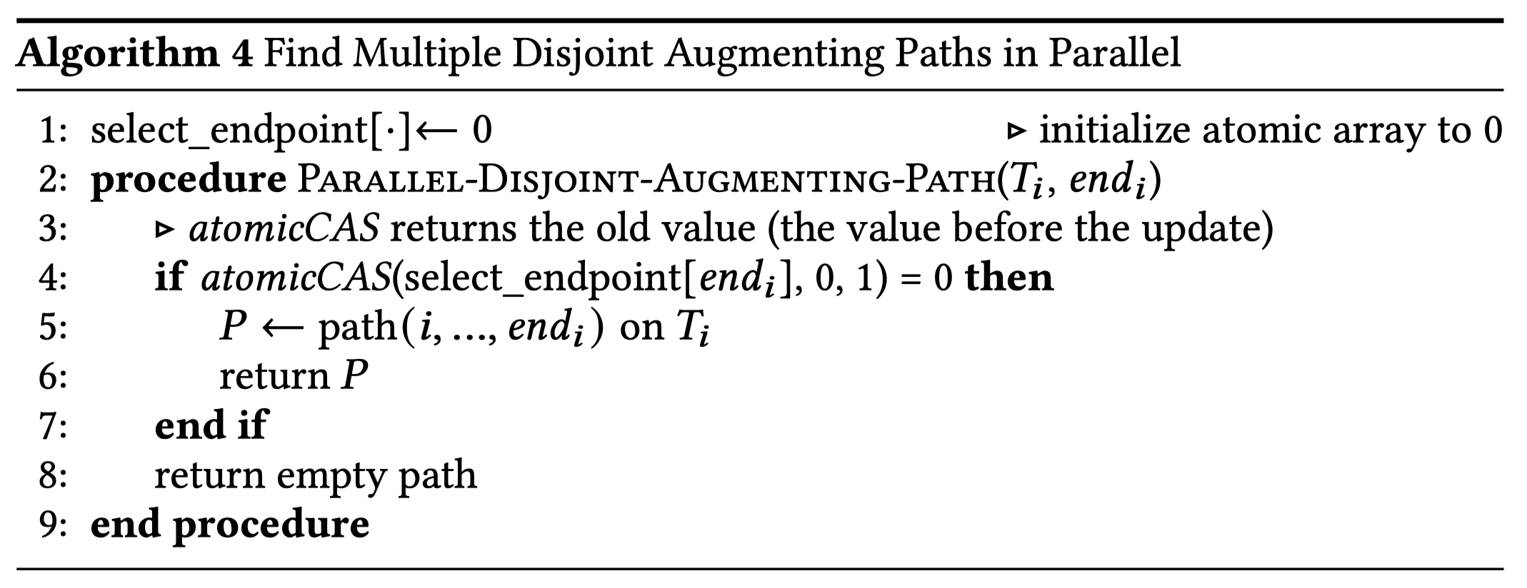
Parallel Strategy
Build multiple trees in parallel
Return a batch of disjoint augmenting paths (lock-free via atomic CAS)
Notes:
As data scales in modern applications and the demand for real-time processing intensifies, parallel computing solutions have become more and more important. A wide range of real-world applications rely on irregular datacentric algorithms. But developing efficient parallel frameworks for such computations is challenging and requires advances in both algorithm design and hardware implementation.

Slide 58
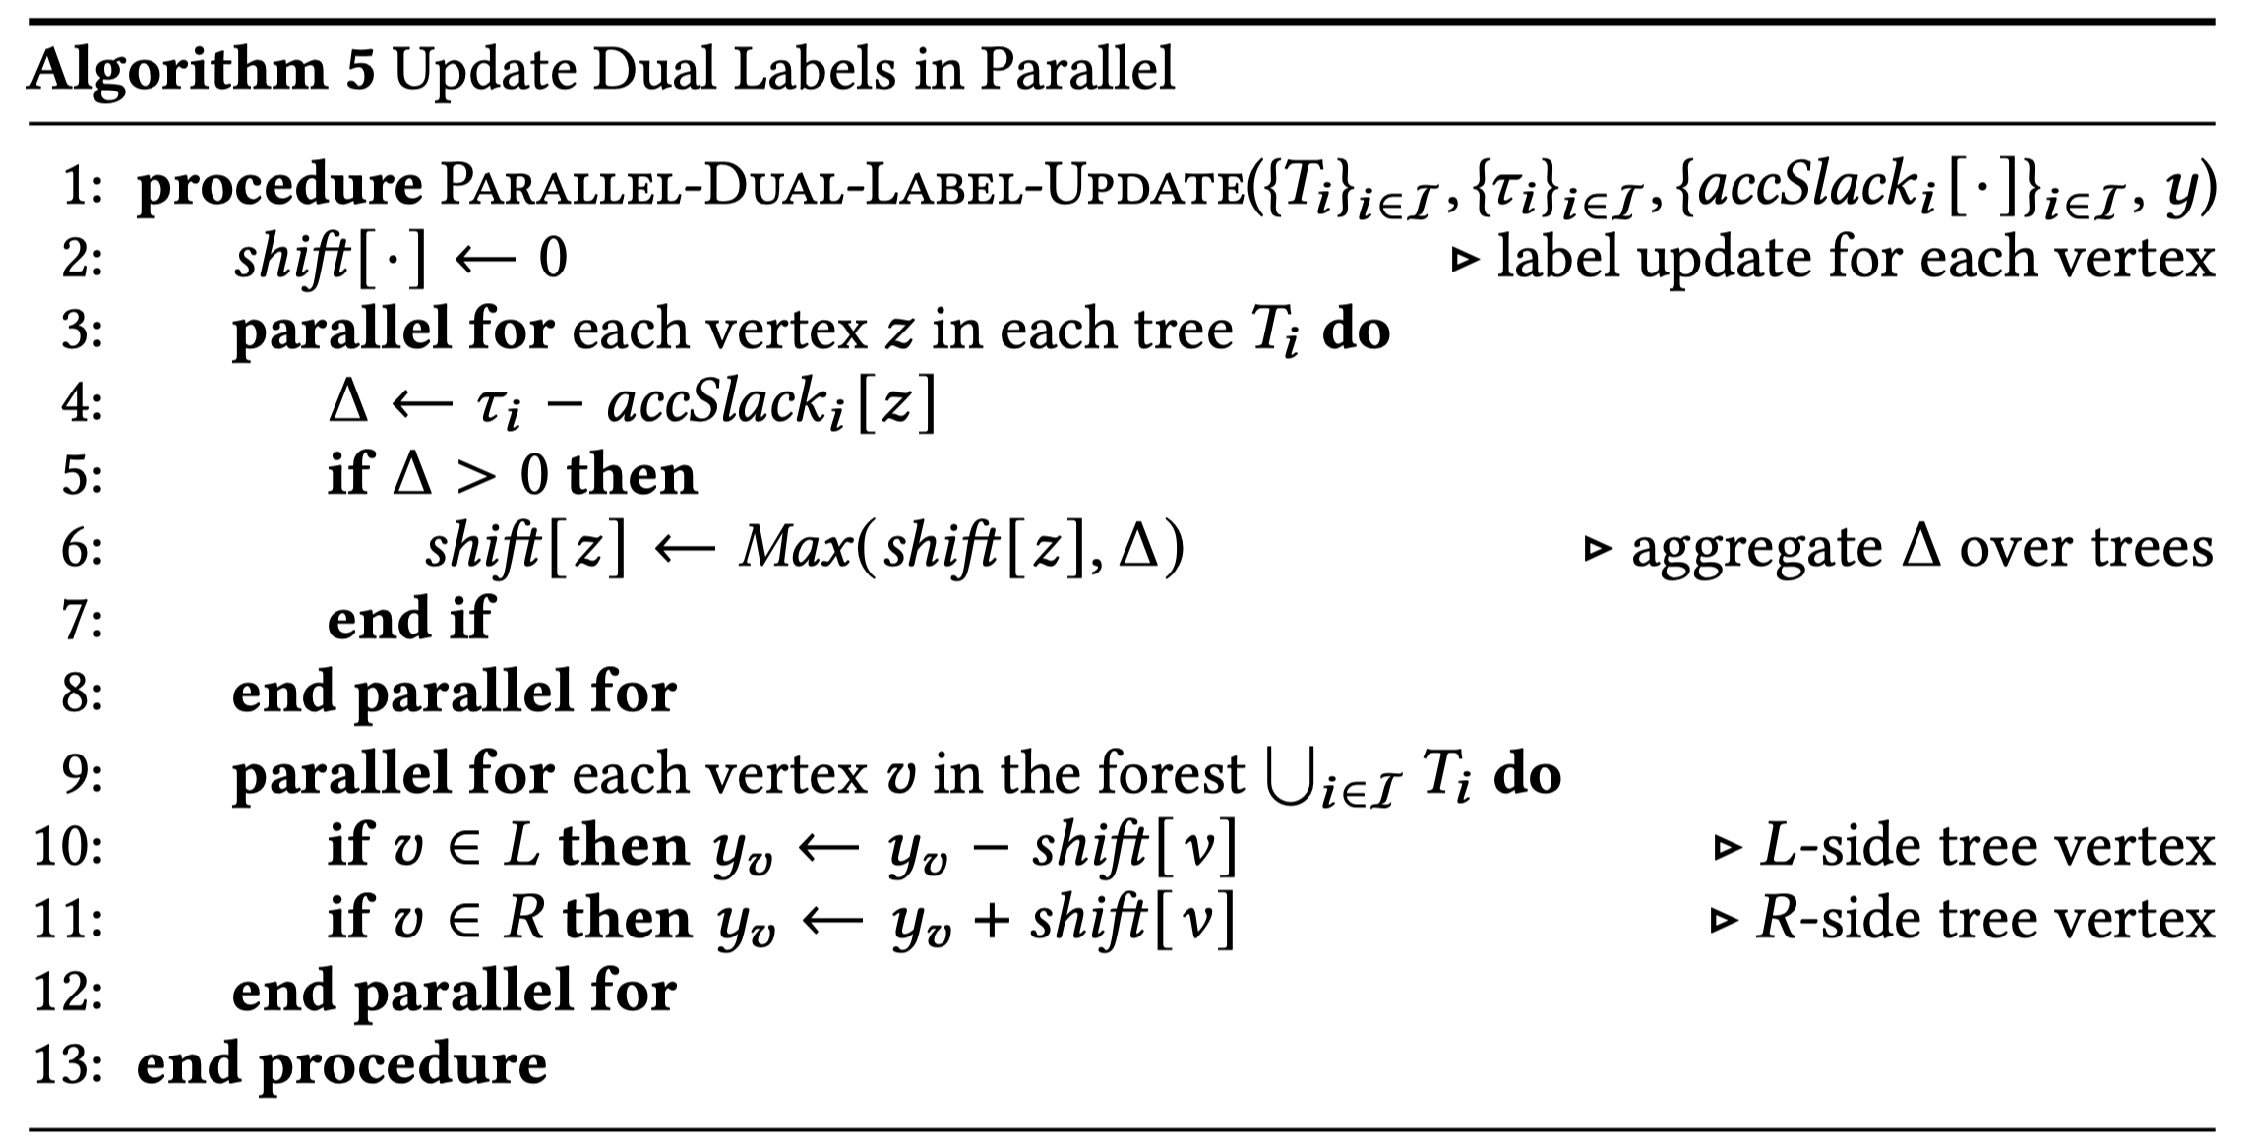
Parallel Strategy
Build multiple trees in parallel
Return a batch of disjoint augmenting paths (lock-free via atomic CAS)
Perform one label update per batch not per path (resolving label conflicts)
Notes:
As data scales in modern applications and the demand for real-time processing intensifies, parallel computing solutions have become more and more important. A wide range of real-world applications rely on irregular datacentric algorithms. But developing efficient parallel frameworks for such computations is challenging and requires advances in both algorithm design and hardware implementation.

Slide 59

Adaptive Search Direction
Performance is determined by $\#$ of disjoint paths per search
Search direction ($L$ → $R$ or $R$ → $L$) affects path contention
$$i$$ | $$y_{i}$$
$$a$$ | $$4$$
$$b$$ | $$4$$
$$c$$ | $$5$$
$$d$$ | $$0$$
$$e$$ | $$0$$
$$f$$ | $$0$$
Notes:
As data scales in modern applications and the demand for real-time processing intensifies, parallel computing solutions have become more and more important. A wide range of real-world applications rely on irregular datacentric algorithms. But developing efficient parallel frameworks for such computations is challenging and requires advances in both algorithm design and hardware implementation.

Slide 60
Adaptive Search Direction
Performance is determined by $\#$ of disjoint paths per search
Search direction ($L$ → $R$ or $R$ → $L$) affects path contention
1 valid path
$$i$$ | $$y_{i}$$
$$a$$ | $$4$$
$$b$$ | $$4$$
$$c$$ | $$5$$
$$d$$ | $$0$$
$$e$$ | $$0$$
$$f$$ | $$0$$
Notes:
As data scales in modern applications and the demand for real-time processing intensifies, parallel computing solutions have become more and more important. A wide range of real-world applications rely on irregular datacentric algorithms. But developing efficient parallel frameworks for such computations is challenging and requires advances in both algorithm design and hardware implementation.

Slide 61
Adaptive Search Direction
Performance is determined by $\#$ of disjoint paths per search
Search direction ($L$ → $R$ or $R$ → $L$) affects path contention
1 valid path
3 disjoint paths
$$i$$ | $$y_{i}$$
$$a$$ | $$4$$
$$b$$ | $$4$$
$$c$$ | $$5$$
$$d$$ | $$0$$
$$e$$ | $$0$$
$$f$$ | $$0$$
Notes:
As data scales in modern applications and the demand for real-time processing intensifies, parallel computing solutions have become more and more important. A wide range of real-world applications rely on irregular datacentric algorithms. But developing efficient parallel frameworks for such computations is challenging and requires advances in both algorithm design and hardware implementation.

Slide 62

Adaptive Search Direction
Performance is determined by $\#$ of disjoint paths per search
Search direction ($L$ → $R$ or $R$ → $L$) affects path contention
Adaptively choose the direction with higher recorded performance
1 valid path
3 disjoint paths
$$i$$ | $$y_{i}$$
$$a$$ | $$4$$
$$b$$ | $$4$$
$$c$$ | $$5$$
$$d$$ | $$0$$
$$e$$ | $$0$$
$$f$$ | $$0$$
Notes:
As data scales in modern applications and the demand for real-time processing intensifies, parallel computing solutions have become more and more important. A wide range of real-world applications rely on irregular datacentric algorithms. But developing efficient parallel frameworks for such computations is challenging and requires advances in both algorithm design and hardware implementation.

Slide 63
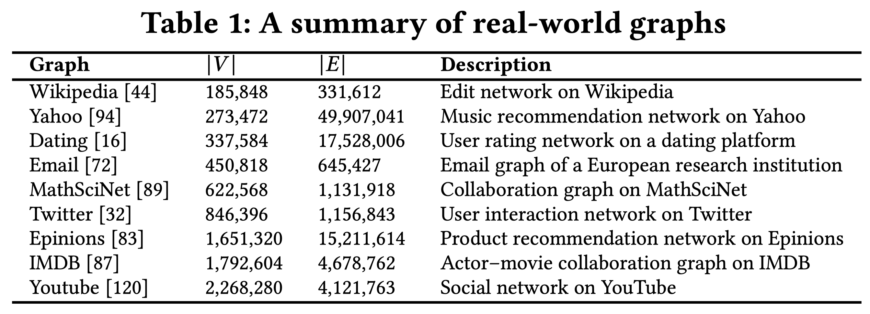
Experiments
Real-world datasets:
Social graphs, collaboration networks, recommendation graphs, …
Notes:
In distributed ML training, communication is often a bottleneck. When workers need to exchange gradients, parameters, or data shards, each worker may only participate in one high-bandwidth transfer at a time. We can model workers as vertices and pending transfers as edges. A matching gives a set of transfers that can run simultaneously without endpoint conflicts, and a maximum matching maximizes the number of concurrent transfers in each scheduling round.

Slide 64
Experiments
Real-world datasets:
Social graphs, collaboration networks, recommendation graphs, …
Synthetic datasets:
Random graphs with specific densities
Random graphs with specific degrees
Random graphs with gamma-distributed degrees
Platform
A server with dual Intel Xeon CPU Max 9470 processors and 512 GB of RAM
Notes:
In distributed ML training, communication is often a bottleneck. When workers need to exchange gradients, parameters, or data shards, each worker may only participate in one high-bandwidth transfer at a time. We can model workers as vertices and pending transfers as edges. A matching gives a set of transfers that can run simultaneously without endpoint conflicts, and a maximum matching maximizes the number of concurrent transfers in each scheduling round.

Slide 65
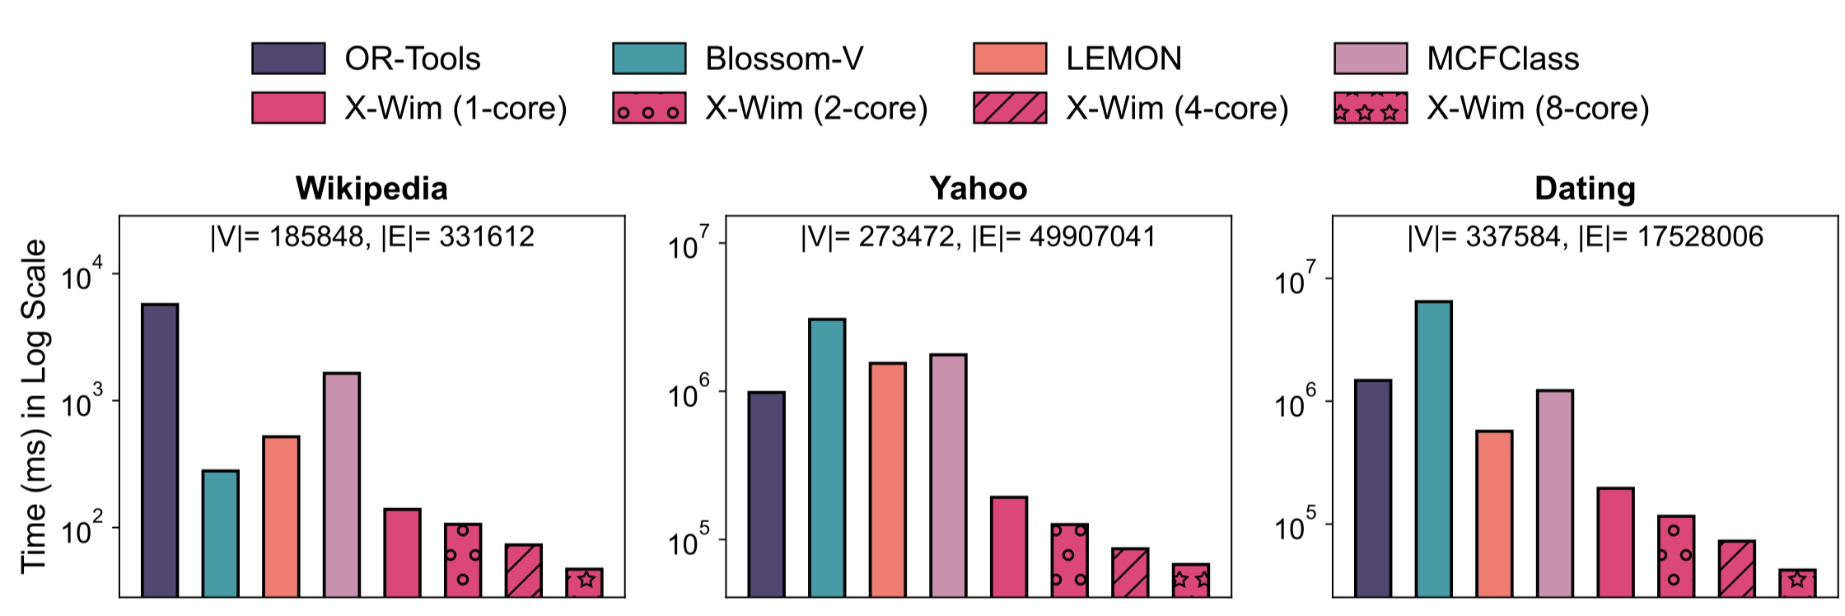
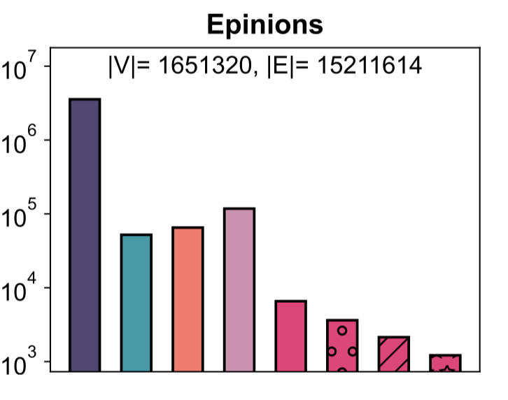
High-Performance Results
Compared with four baselines:
Google Optimization Tools (OR-Tools)
Fast MWPM solver (Blossom-V)
Network-flow solver (MCFClass)
Prior best sequential solution (LEMON)
Speedup of 8-core X-Wim:
- Blossom-V (153x)
- MCFClass (110x)
- LEMON (54x)
Notes:
In distributed ML training, communication is often a bottleneck. When workers need to exchange gradients, parameters, or data shards, each worker may only participate in one high-bandwidth transfer at a time. We can model workers as vertices and pending transfers as edges. A matching gives a set of transfers that can run simultaneously without endpoint conflicts, and a maximum matching maximizes the number of concurrent transfers in each scheduling round.

Slide 66
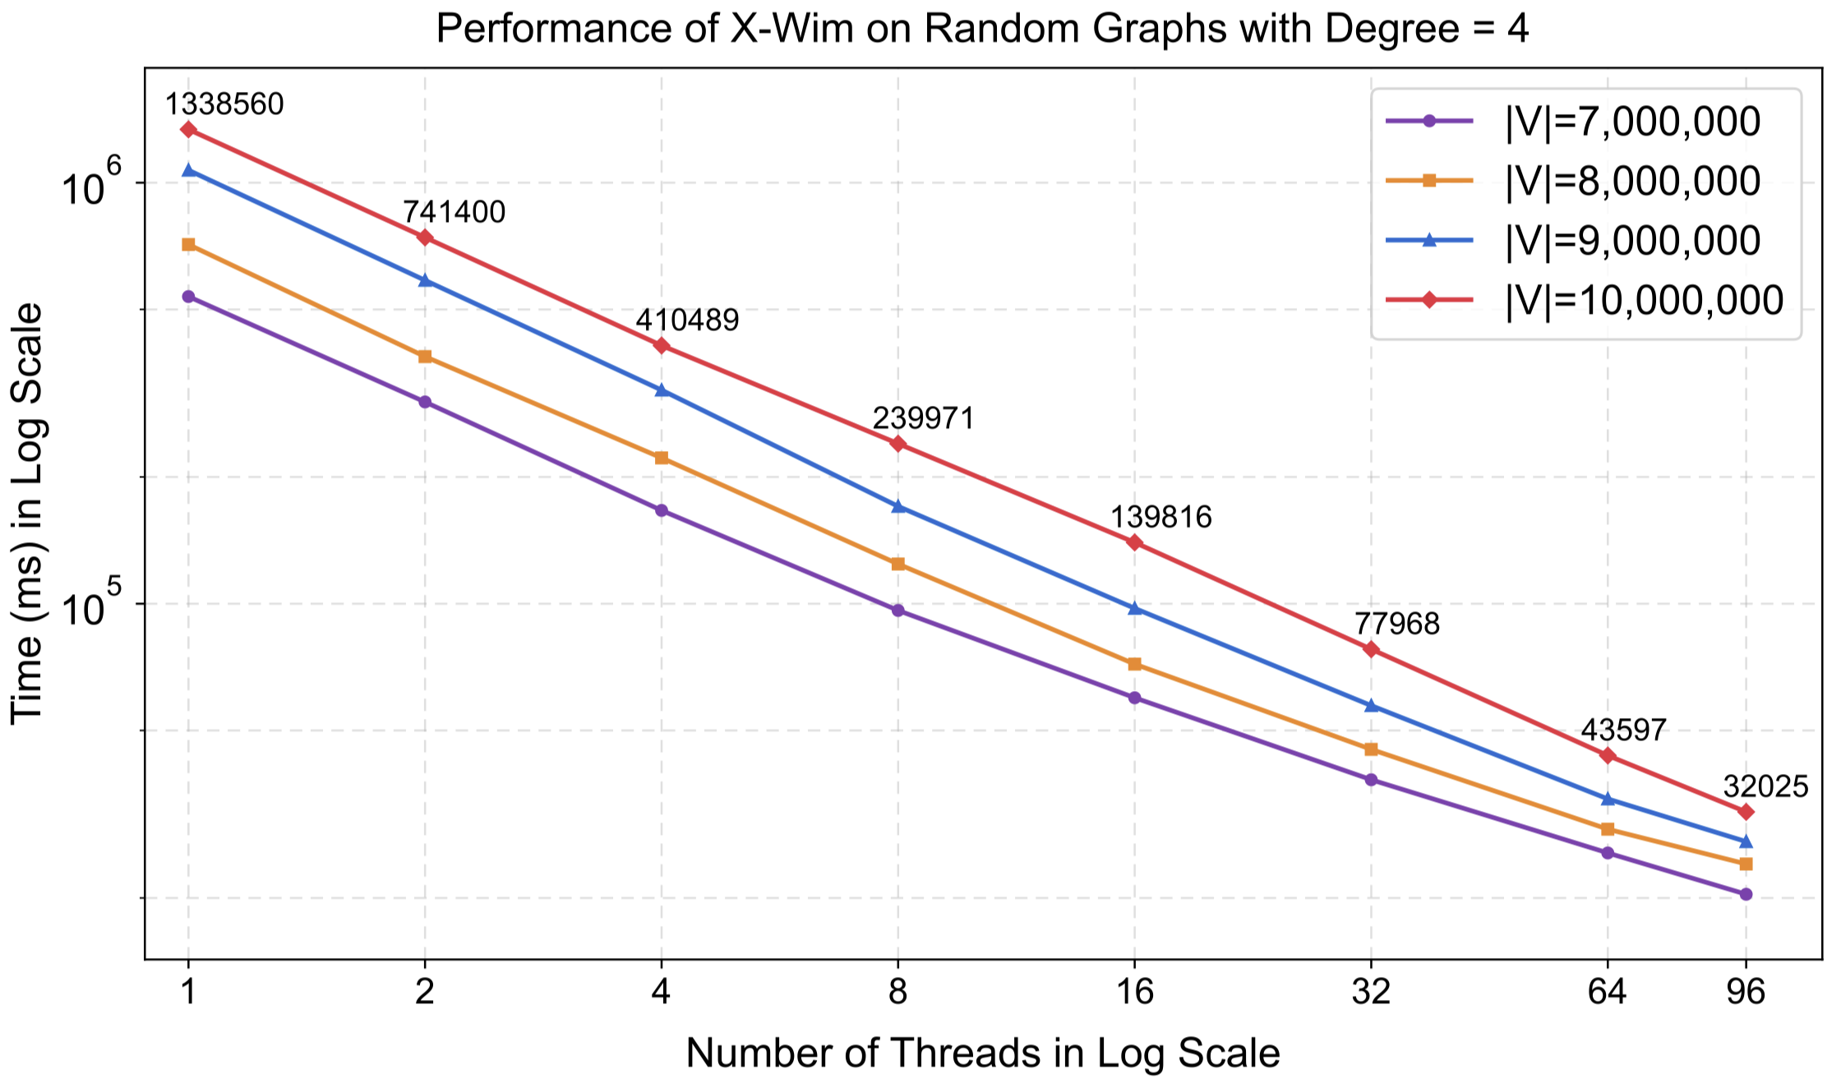
Scalability Test
When # of threads doubles, the average speedup is 1.70x
Notes:
In distributed ML training, communication is often a bottleneck. When workers need to exchange gradients, parameters, or data shards, each worker may only participate in one high-bandwidth transfer at a time. We can model workers as vertices and pending transfers as edges. A matching gives a set of transfers that can run simultaneously without endpoint conflicts, and a maximum matching maximizes the number of concurrent transfers in each scheduling round.

Slide 67
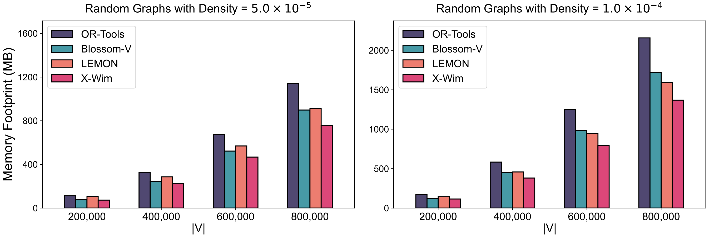
Memory Footprint
Reduces memory usage by avoiding the global set of tight edges
Notes:
In distributed ML training, communication is often a bottleneck. When workers need to exchange gradients, parameters, or data shards, each worker may only participate in one high-bandwidth transfer at a time. We can model workers as vertices and pending transfers as edges. A matching gives a set of transfers that can run simultaneously without endpoint conflicts, and a maximum matching maximizes the number of concurrent transfers in each scheduling round.

Slide 68
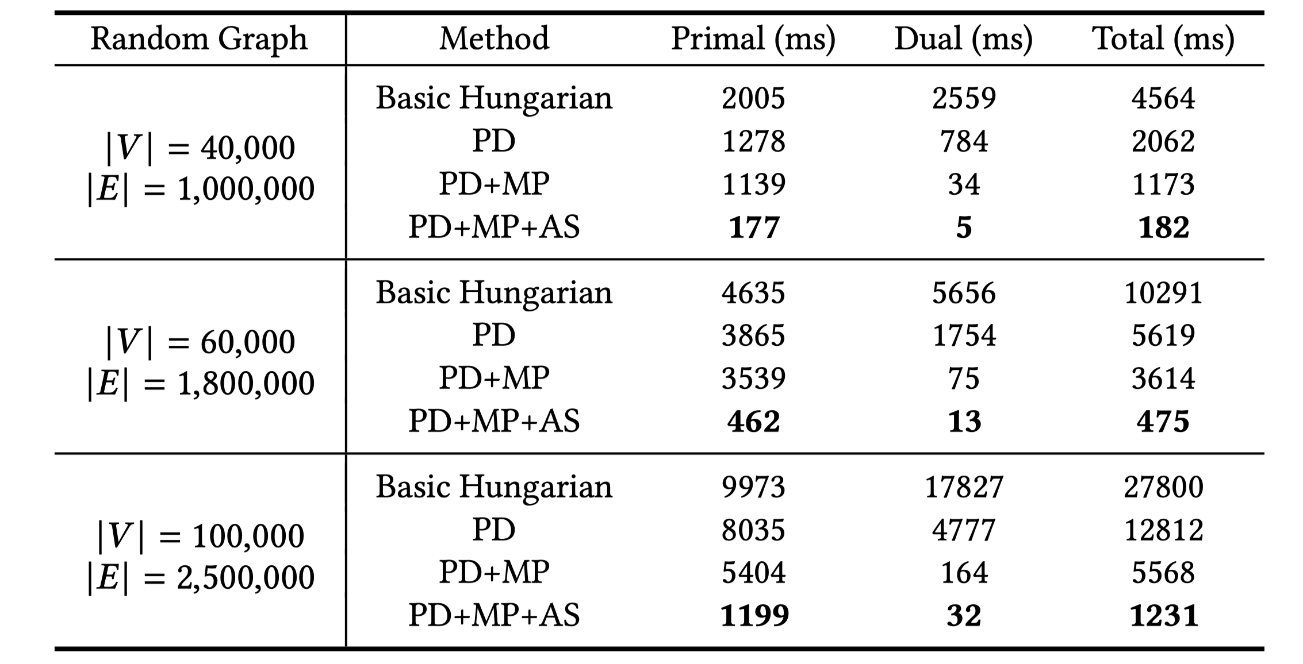
Ablation Study
The three strategies achieve 25x speedup in the single-thread setting
Notes:
In distributed ML training, communication is often a bottleneck. When workers need to exchange gradients, parameters, or data shards, each worker may only participate in one high-bandwidth transfer at a time. We can model workers as vertices and pending transfers as edges. A matching gives a set of transfers that can run simultaneously without endpoint conflicts, and a maximum matching maximizes the number of concurrent transfers in each scheduling round.

Slide 69
X-Wim Summary
X-Wim (https://github.com/Davis-Fan/X-Wim)
- a massively parallel computation framework for bipartite weighted matching
- the best parallel solution so far
- phase-decoupled + multi-path batching + adaptive search
Published in VLDB 2026
Dayi Fan, Simon Zhang, Rubao Lee, Hanqi Guo, and Xiaodong Zhang. X-Wim: Massive Parallelization of Weighted Matching in Bipartite Graphs. PVLDB, 19(10): 2643-2657, 2026.
Notes:
As data scales in modern applications and the demand for real-time processing intensifies, parallel computing solutions have become more and more important. A wide range of real-world applications rely on irregular datacentric algorithms. But developing efficient parallel frameworks for such computations is challenging and requires advances in both algorithm design and hardware implementation.

