Slide 2
Presentation Outline
Question to group (Michael)
Theory (Nirmal)
Describe data sets used (Allyson)
Questions to answer (TBD)
Category plots (all)
Conclusions (TBD)
Next steps
Notes:
Presentation Outline
Question to group (Michael)
Theory (Nirmal)
Describe data sets used (Allyson)
Questions to answer (TBD)
Category plots (all)
Conclusions (TBD)
Next steps

Slide 3
?
Notes:
A. Question to group (Michael)
Let’s start off by asking a question
Everyone raise your hand
How many of you could predict who is going to win an election based on Census data?

Slide 4
B. Theory (Nirmal)
Our theory:
Single demographic categories are effective predictors of which political party wins
Notes:
B. Theory (Nirmal)
Our theory:
Single demographic categories are effective predictors of which political party wins

Slide 5
C. Describe data sets used
2016 Indiana election results by county
Harvard Dataverse (as maintained by the MIT Election Data and Science Lab)
What race/candidates
2016 Five Year American Community Survey (ACS) conducted by the U.S. Census Bureau
Why use the five year?
There are approximately 20,000 variables available
Data was available by country, state, county, and other geographic categories
Methodology
Notes:
C. Describe data sets used (Allyson)
Data sets used
2016 Indiana election results by county
How many counties
What race/candidates
2016 annual American Community Survey (ACS) conducted by the U.S. Census
Used API
There were ### variable available to select
Data was available by country, state, county, and other geographic categories
We selected six

Slide 6
D. Questions to answer (TBD)
?
?
?
Notes:
D. Questions to answer (TBD)
?
?
?

Slide 7
E. Category plots (all)
Education & Home Value (Michael)
Income & Race (Nirmal)
Age & Employment (Allyson)
Notes:
Category plots (all)
Education & Home Value (Michael)
Income & Race (Nirmal)
Age & Employment (Allyson)

Slide 8
Notes:
Education & Home Value (Michael)

Slide 9
Notes:
Income & Race (Nirmal)

Slide 10
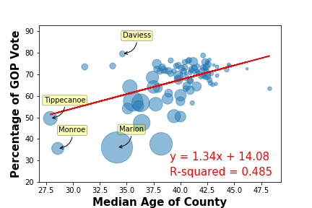
What effect does median age have on the GOP vote?
Notes:
Age & Employment (Allyson)

Slide 11
Voter Turnout per Age Group
18-29 year olds: 46.1%
30-44 year olds: 58.7%
45-64 year olds: 66.6%
65 years and oldes: 70.9%
https://www.census.gov/newsroom/blogs/random-samplings/2017/05/voting_in_america.html

Slide 12
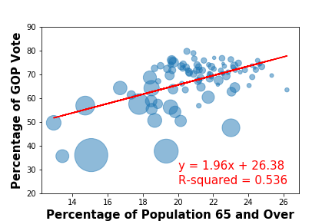

Slide 13
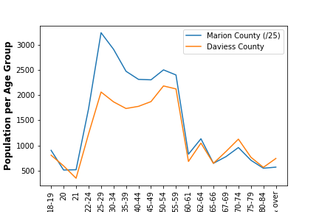

Slide 14
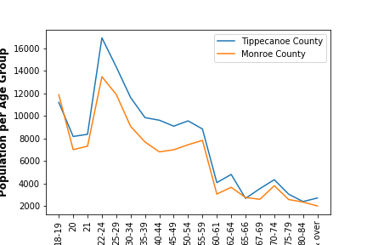

Slide 15
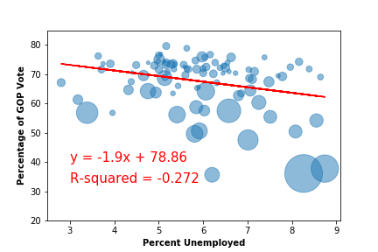
What effect does unemployment have on the GOP vote?

Slide 16
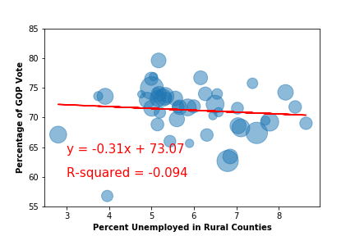
Unemployment in Rural Counties
https://www.ers.usda.gov/webdocs/DataFiles/53180/25569_IN.pdf?v=0

Slide 17
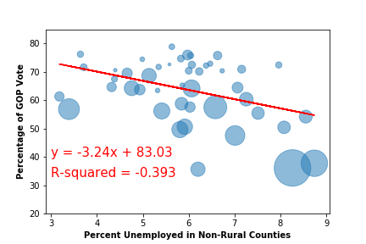

Slide 18
F. Conclusions (TBD)
Any single demographic category is NOT a good predictor of which 2016 presidential candidate won any Indiana county.
?
?
Notes:
Conclusions (TBD)
Any single demographic category is NOT a good predictor of which 2016 presidential candidate won any Indiana county.
?
?

Slide 19
G. Next steps
With more time, we would develop a prediction model comparing actual vs. expected results and run ttests (Michael)
We would add:
More exit polling data
Election results from additional years and races
We would incorporate and test more Census variables
We would combine Census variables
Notes:
Next steps
With more time, we would develop a prediction model comparing actual vs. expected results and run ttests (Michael)
We would add:
More exit polling data
Election results from additional years and races
We would incorporate and test more Census variables
We would combine Census variables

Slide 20
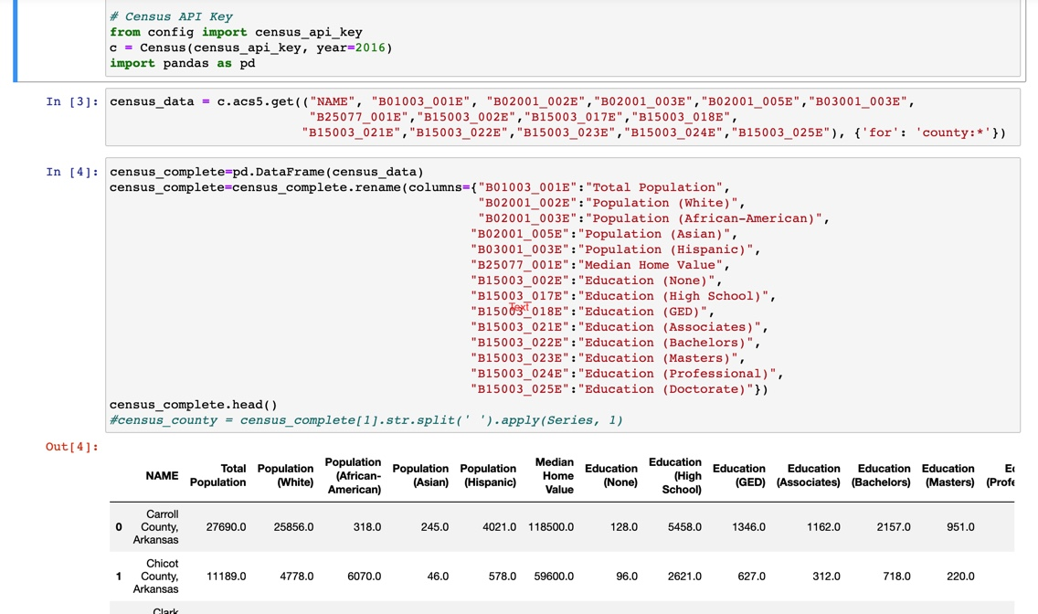
Data Acquisition and Cleanup

Slide 21
Data Acquisition and Cleanup

Slide 22
Data Acquisition and Cleanup

