Slide 2
Presentation Outline
Question to group (Michael)
Theory (Nirmal)
Describe data sets used (Allyson)
Questions to answer (TBD)
Category plots (all)
Conclusions (TBD)
Next steps
Notes:
Presentation Outline
Question to group (Michael)
Theory (Nirmal)
Describe data sets used (Allyson)
Questions to answer (TBD)
Category plots (all)
Conclusions (TBD)
Next steps

Slide 3
?
Notes:
A. Question to group (Michael)
Let’s start off by asking a question
Everyone raise your hand
How many of you could predict who is going to win an election based on Census data?

Slide 4
Theory
Our theory:
A Single demographic category is an effective predictor of which political party wins
Education
Median Income
Race
Median Home Value
Employment
Age
Notes:
B. Theory (Nirmal)
Our theory:
Single demographic categories are effective predictors of which political party wins

Slide 5
Describe data sets used
Data sets used
2016 Indiana election results by county Harvard Dataverse as maintained by the MIT Election Data and Science Lab
All 92 counties
2016 Presidential Election between Hillary Clinton and Donald Trump
2016 annual American Community Survey (ACS) conducted by the U.S. Census
Used API
There were approximately 20,000 variables available to select
Data was available by country, state, county, and other geographic categories
We selected six
Methodology
Notes:
C. Describe data sets used (Allyson)
Data sets used
2016 Indiana election results by county from Harvard Dataverse as maintained by the MIT Election Data and Science Lab
How many counties
What race/candidates
5-year continuous American Community Survey (ACS) covering 2012-2016 conducted by the U.S. Census
Used API
There were approximately 20,000 different variables available to select
Data was available by country, state, county, and other geographic categories
We selected six broad categories
Methodology
Reach of 3.5M households per year
Data cleanup & restructuring
Merging
Column headings
Finding correct Census codes to specific categories we wanted

Slide 6
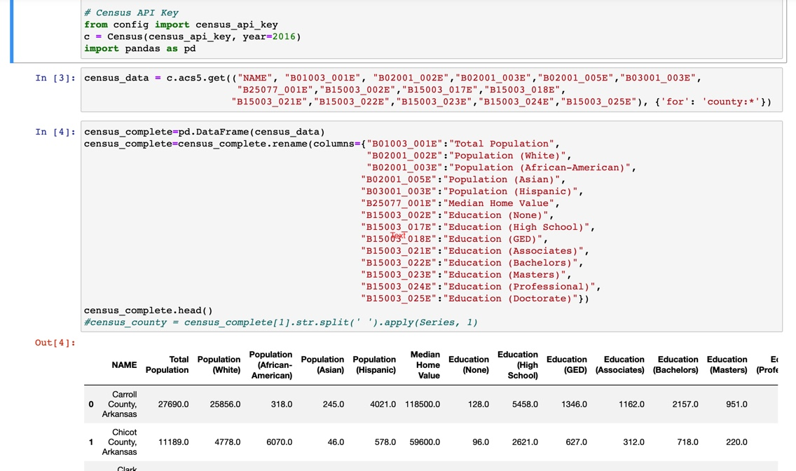
Data Acquisition and Cleanup

Slide 7
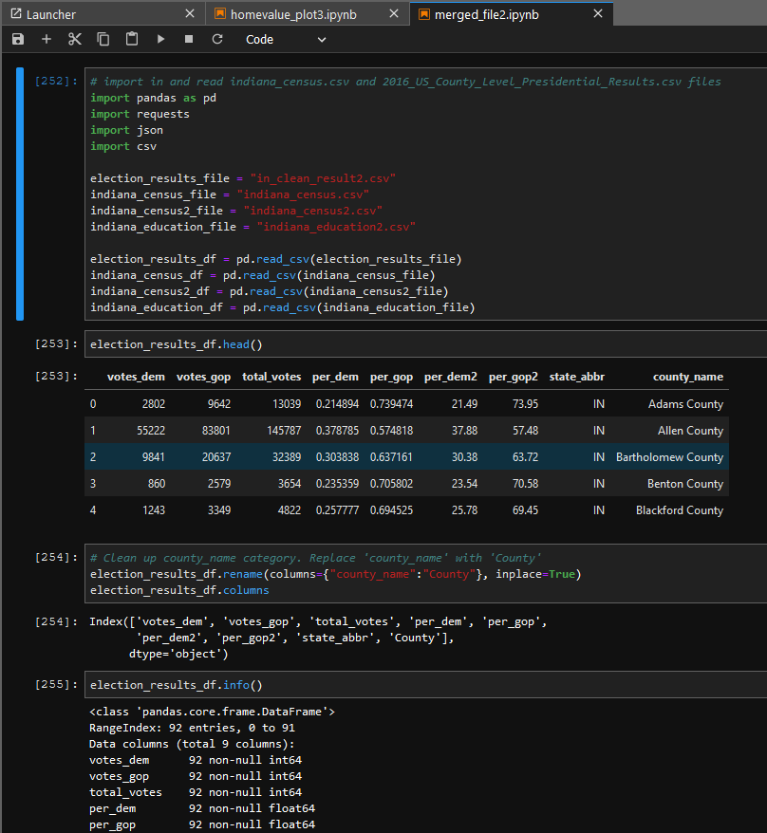
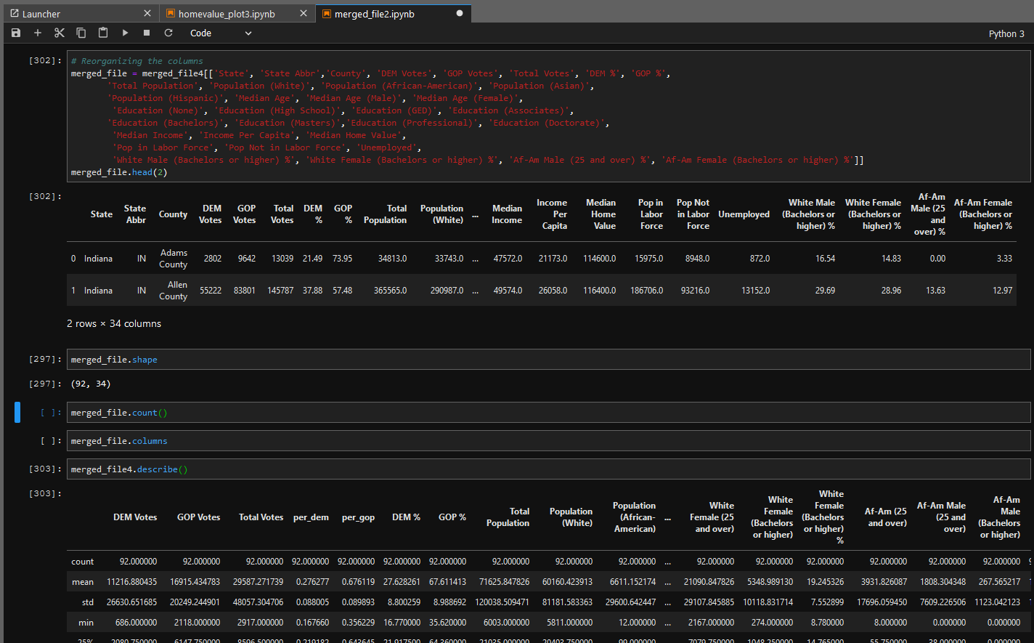
Data Acquisition and Cleanup

Slide 8
Questions to answer
Does median age/unemployment predict the DEM/GOP % vote in a county
Does median home value/education predict the DEM/GOP % in a county
Does race/median income predict the DEM/GOP % in a county
Notes:
D. Questions to answer (TBD)
?
?
?

Slide 9
Category plots
Education & Home Value (Michael)
Income & Race (Nirmal)
Age & Employment (Allyson)
Notes:
Category plots (all)
Education & Home Value (Michael)
Income & Race (Nirmal)
Age & Employment (Allyson)

Slide 10
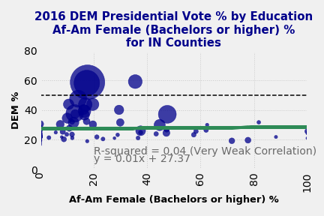
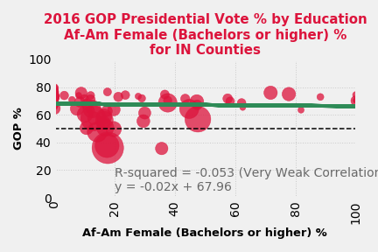

Slide 11
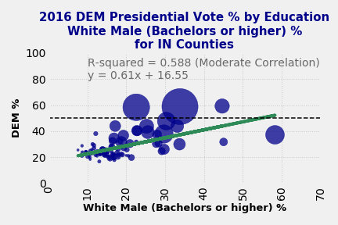
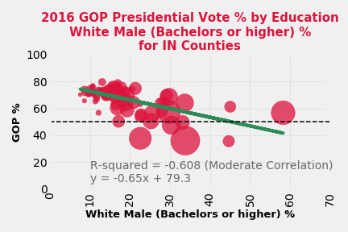

Slide 12
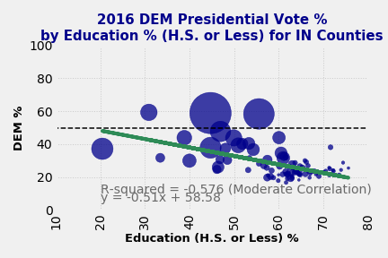
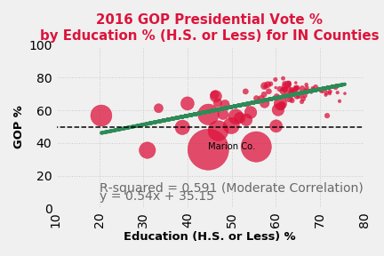
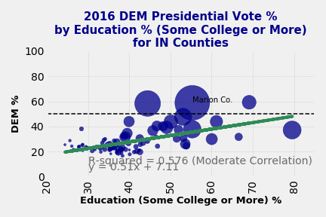
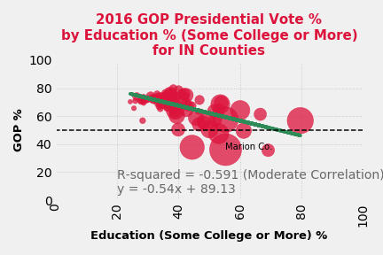

Slide 14
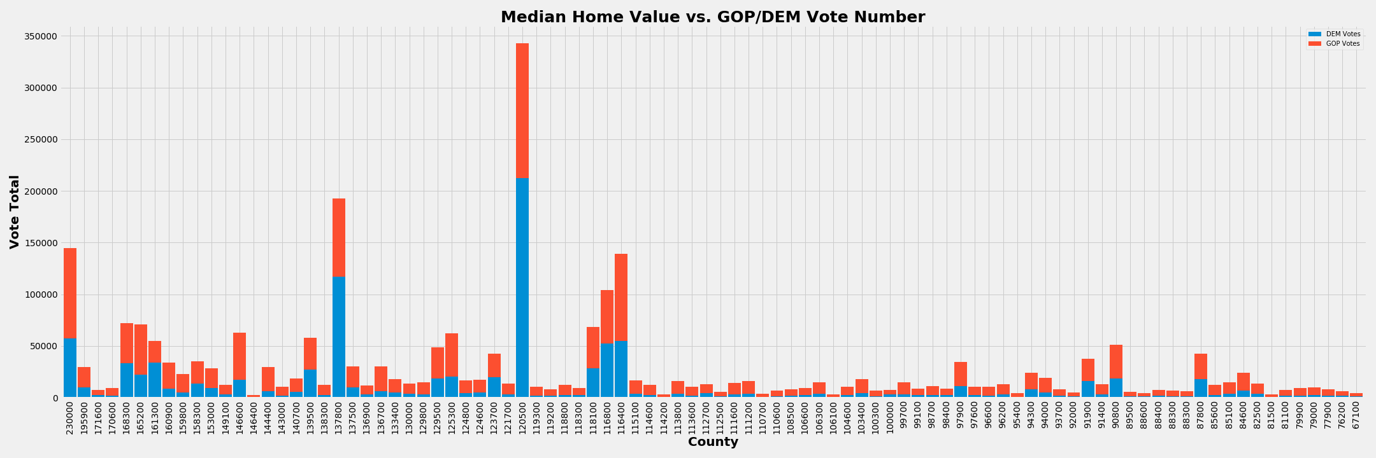
Notes:
Income & Race (Nirmal)

Slide 15
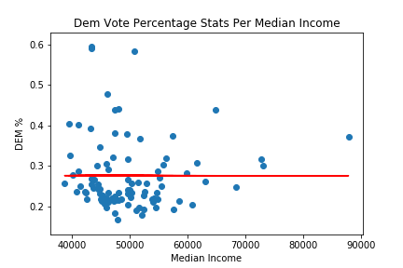
Notes:
Income & Race (Nirmal)

Slide 16
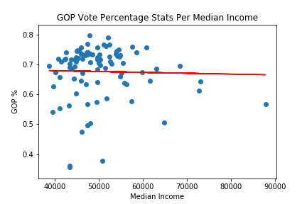
Notes:
Income & Race (Nirmal)

Slide 17
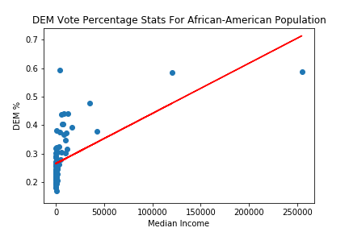
Notes:
Income & Race (Nirmal)

Slide 18
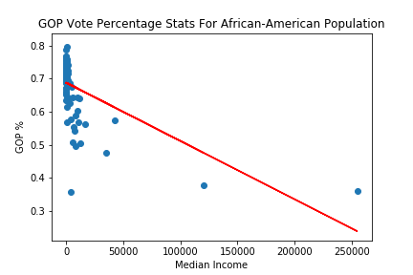
Notes:
Income & Race (Nirmal)

Slide 19
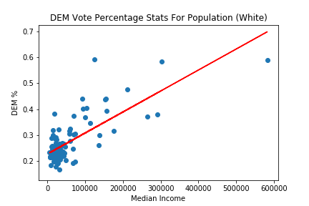
Notes:
Income & Race (Nirmal)

Slide 20
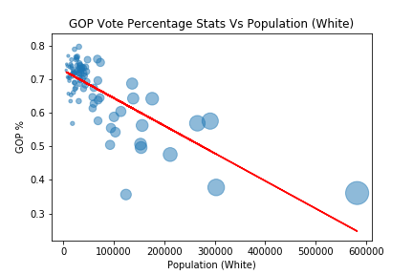
Notes:
Income & Race (Nirmal)

Slide 21
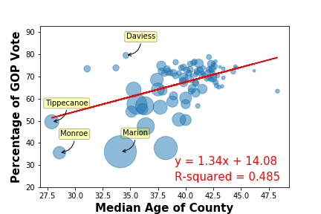
What effect does median age have on the GOP vote?
Notes:
Age & Employment (Allyson)

Slide 22
Voter Turnout per Age Group
18-29 year olds: 46.1%
30-44 year olds: 58.7%
45-64 year olds: 66.6%
65 years and oldes: 70.9%
https://www.census.gov/newsroom/blogs/random-samplings/2017/05/voting_in_america.html

Slide 23
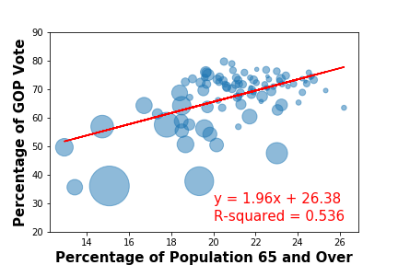

Slide 24
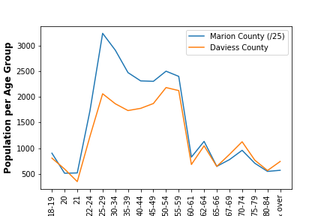

Slide 25
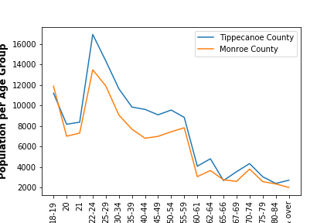

Slide 26
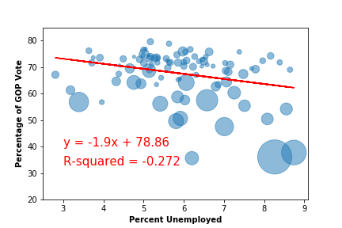
What effect does unemployment have on the GOP vote?

Slide 27
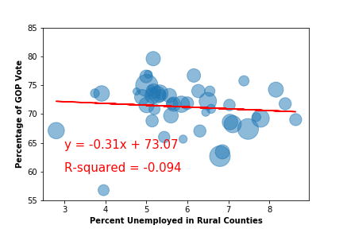
Unemployment in Rural Counties
https://www.ers.usda.gov/webdocs/DataFiles/53180/25569_IN.pdf?v=0

Slide 28
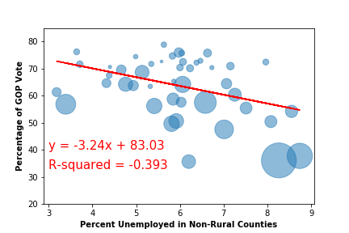

Slide 29
Conclusions
Any single demographic category is NOT a good predictor of which 2016 presidential candidate won any Indiana county.
None of the plots we ran provided us with a moderate or strong correlation
When multiple variables are introduced, we saw improved correlation between the census variable and the election results
Pearson’s correlation testing provided us with moderate to strong correlation on several of the plots we ran
Education with race vs. DEM/GOP vote
Race (white) vs. GOP vote
Age (65+) vs GOP vote
Notes:
Conclusions (TBD)
Any single demographic category is NOT a good predictor of which 2016 presidential candidate won any Indiana county.
?
?

Slide 30
G. Next steps
With more time, we would develop a prediction model comparing actual vs. expected results and run ttests (Michael)
We would add:
More exit polling data
Election results from additional years and races
We would incorporate and test more Census variables
We would combine Census variables
Notes:
Next steps
With more time, we would develop a prediction model comparing actual vs. expected results and run ttests (Michael)
We would add:
More exit polling data
Election results from additional years and races
We would incorporate and test more Census variables
We would combine Census variables

