Slide 1
Direct Multi-Horizon GATv2 for Train Delay Prediction
TRAIN DELAY FORECASTING · NYC SUBWAY
Predicting the next three train events at once, so errors stop piling up
Thinh Duy Do
Halıcıoğlu Data Science Institute · University of California San Diego
Notes:
(0:00–0:20) Good afternoon, everyone. My name is Thinh Do, from the Halıcıoğlu Data Science Institute at UC San Diego. My project is Direct Multi-Horizon GATv2 for Train Delay Prediction. In short: instead of forecasting train delays one step at a time, I forecast the next three events at once, and I'll show that this keeps errors from piling up.

Slide 2

One late train makes others late
01 · MOTIVATION
Train X
Arr A
Dep A
Arr B
Dep B
Trains share tracks, platforms and headway limits. A primary delay on one train spreads to the next train as a knock-on delay, and can cascade across a dense network.
primary delay
headway → knock-on
Train Y
$170M–$389M
Arr A
Dep A
Arr B
Dep B
estimated yearly cost of NYC subway delays in lost work time (NYC Comptroller, 2017)
Delay propagation between two trains, adapted from Nguyen & Li (2025)
Notes:
(0:20–0:55) Train delays rarely stay isolated. Here, Train X suffers a primary delay arriving at station B. Because trains share tracks, platforms and headway limits, that delay spreads to Train Y as a knock-on delay, and across a dense network like the New York City subway these delays cascade. And they are expensive: the NYC Comptroller estimated that subway delays cost the city between 170 and 389 million dollars a year in lost work time. Forecasting delays a few events ahead gives operators time to react before they spread.

Slide 3
Autoregressive rollout lets errors pile up
01 · THE PROBLEM
Strength: graph-based autoregressive (AR) models, such as GATv2 (Nguyen & Li, 2025), use the railway topology to capture how delays spread between connected trains.
Weakness: they forecast t+1, t+2, t+3 (the train’s next three events) one at a time, feeding each prediction back in, so errors accumulate.
t+1 · next event
t+2 · fed back
t+3 · fed back
2.41 min
2.86 min
3.12 min
AR mean absolute error by horizon: error grows about 30% from t+1 to t+3.
Research question: can direct multi-horizon decoding reduce error at later horizons?
Notes:
(0:55–1:40) Graph-based autoregressive models, like the GATv2 model of Nguyen and Li, are good at one important thing: they use the railway topology, how trains and stations are connected, to capture how delays spread. Their weakness is how they forecast. t+1, t+2 and t+3 are the train’s next three events: its next arrival or departure, the one after that, and the one after that. An autoregressive model predicts t+1, feeds that prediction back in to predict t+2, and again for t+3. Only the first step uses real data, so errors accumulate: mean absolute error grows from 2.41 to 3.12 minutes, about 30 percent. So my research question is: can direct multi-horizon decoding keep the benefit of the graph but reduce error at later horizons?

Slide 4









One graph, three horizons at once, no feedback
02 · MY MODEL
1 · Event graph
2 · GATv2 encoder
3 · Head per horizon
4 · Weighted blend
Every arrival and departure is a node
t+1
t+2
t+3
Train X
Attention 1
dwell
run
1 · Classify
yes
2 · Regress
Blend
Arr A
Dep A
Arr B
late?
how late?
each event's up to 3 forecasts
Attention 2
no
headway
Arr A
Dep A
Arr B
ŷ = 0 (skip)
ŷ = minutes
details on the next slide
Attention 3
Train Y
Same head for t+1, t+2, t+3, all predicted in parallel, no feedback
Dwell: arrive → depart, same stop · Run: depart → next stop · Headway: next train, same stop
learns which neighbours matter
Delay forecast
delayed? + minutes
Each head is a two-stage hurdle: classify whether the event is late, and only if so, regress how many minutes.
Notes:
(1:40–2:40) Here is my model, left to right. First, the event graph: every arrival and every departure is a node. Dwell edges link an arrival to its departure at the same stop, run edges link a departure to the train's next stop, and headway edges link consecutive trains at the same stop. That headway edge is how a delay on one train reaches the next. Second, a three-layer GATv2 encoder, whose attention learns which neighbouring events matter most. Third, my key change: one head per horizon, predicting t+1, t+2 and t+3 at the same time, with no prediction ever fed back. Each head works in two stages: first it classifies whether the event will be late. If not, it predicts zero and skips the second stage. If yes, a regressor estimates how many minutes. Finally, the forecasts are blended into one final delay, which the next slide shows.

Slide 5
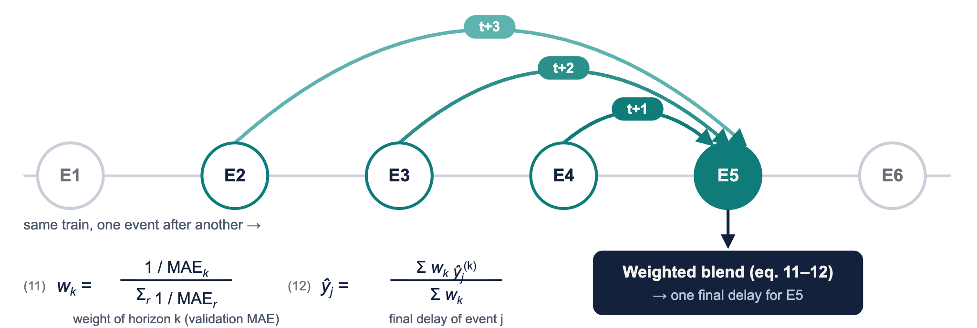
Every event gets three predictions
02 · WEIGHTED BLEND
Each event predicts its next three events, so forecasts overlap. Events near the start of a trip get fewer (E2: one, E3: two); every later event gets all three.
Notes:
(2:40–3:10) Here is what the blend means. Every event predicts the next three events of the same train, so look at event E5: it was predicted one step ahead by E4, two steps ahead by E3, and three steps ahead by E2. That gives three forecasts of the same delay. Equation 11 gives each horizon a weight: one over its validation error, normalised so the weights add up to one, so more accurate horizons count a bit more. Equation 12 takes the weighted average of whichever forecasts an event has, to get one final delay. Events at the very start of a trip get fewer forecasts, but every later event gets all three.

Slide 6
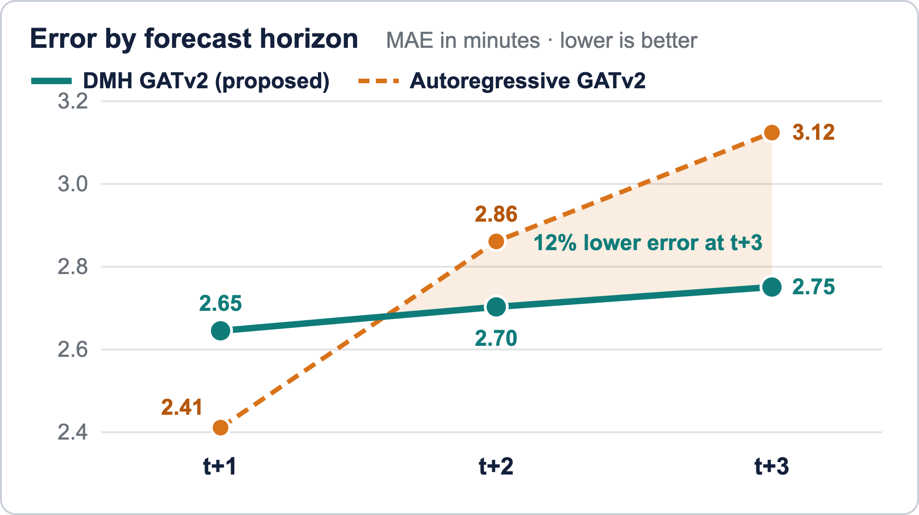
DMH error stays nearly flat across horizons
03 · RESULTS
+4%
−12%
error growth from t+1 to t+3 (autoregressive: +30%)
lower MAE at t+3 (DMH 2.75 vs AR 3.12 min)
94.9%
+3.9
precision, best of all models
recall points over autoregressive (93.8% vs 89.9%)
Trade-off: at t+1 the autoregressive model is slightly better (2.41 vs 2.65 min); DMH wins from t+2 onward. Validation results.
Notes:
(3:10–3:50) This chart is the main result. The dashed orange line is the autoregressive model: its error climbs from 2.41 to 3.12 minutes, about 30 percent growth from t+1 to t+3. The teal line is my model, which stays almost flat, growing only about 4 percent. At t+3 my model's error is 12 percent lower. It also detects delays best: 94.9 percent precision, and almost 4 more recall points than the autoregressive model. To be honest about the trade-off: at t+1 the autoregressive model is slightly better, because it hasn't fed back any guesses yet. The advantage appears at longer horizons, which is exactly where error accumulation matters.

Slide 7
DMH detects delays best of all models
03 · OVERALL PERFORMANCE
Model | MAE | RMSE | Accuracy | Precision | Recall | F1
Zero-delay | 6.710 | 13.711 | 0.517 | 0.000 | 0.000 | 0.000
Persistence | 0.729 | 1.893 | 0.929 | 0.938 | 0.913 | 0.926
Autoregressive GATv2 | 3.124 | 7.597 | 0.922 | 0.938 | 0.899 | 0.918
DMH GATv2 + aggregation (ours) | 2.560 | 6.914 | 0.946 | 0.949 | 0.938 | 0.944
Overall validation performance; MAE and RMSE in minutes. Bold orange = best value in each column.
+3.9 recall points over autoregressive
Persistence still wins raw MAE
93.8% vs 89.9%: DMH misses fewer real delays.
Consecutive subway delays rarely jump, so "no change" is a strong guess.
Notes:
(3:50–4:30) Overall, DMH has the best classification results of all models: 94.9 percent precision, 93.8 percent recall, and 94.4 percent F1. That recall is almost 4 points higher than the autoregressive model. One more honest point: the persistence baseline, which simply assumes the delay stays the same, still wins on raw MAE. Consecutive subway delays rarely jump suddenly, so "no change" is a very strong guess. Where the graph models add value is in detecting delays, which matters for decision support.

Slide 8
Direct decoding curbs error accumulation
04 · CONCLUSION
+4% vs +30%
94.4% F1
Next
MAE growth from t+1 to t+3, DMH vs autoregressive
Best delay detection of all models; persistence still wins raw MAE
Tune the horizon length; test on networks with more sudden disruptions
Notes:
(4:30–4:55) To summarize: direct multi-horizon decoding curbs error accumulation, with MAE growing only 4 percent from t+1 to t+3 versus 30 percent for autoregressive rollout, and it gives the best delay detection of all the models we tested. Next, I plan to tune the horizon length beyond three events and to test on networks with more sudden disruptions, where persistence should struggle and topology should matter more.

Slide 9
Thank you
Questions?
Thinh Duy Do · Halıcıoğlu Data Science Institute, UC San Diego
Notes:
(4:55–5:00) Thank you. I'm happy to take questions.

