Slide 1
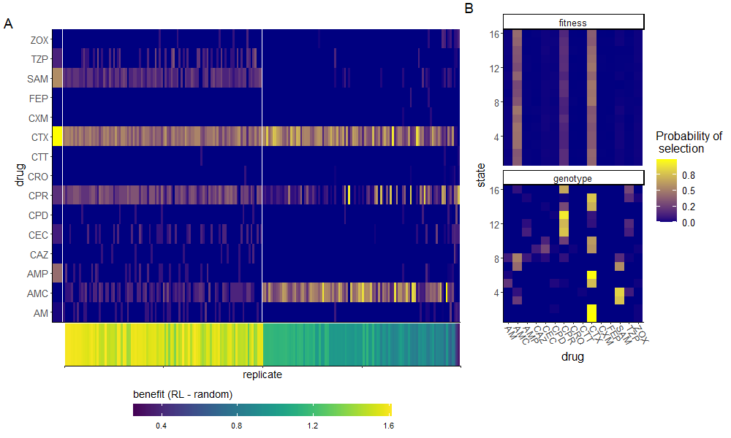
MDP
RL-genotype
RL-fit

