Slide 1

VS
SPELL.MD

Slide 2
TEAM MEMBERS
Search Master
Web and Search Master
Web Designer
John Onyango
Davis
Wafula
Amos
Mwangi
Brian
Kiplimo
Nyakundi Lamech
Scrum master
Web Designer

Slide 3
Problem Statement
Making spelling errors while coding mostly in the readme

Slide 4
Solution
Develop a program that will identify when we make a spelling error.

Slide 5
MVP (Minimum Viable Products)
It can identifies spelling errors

Slide 6
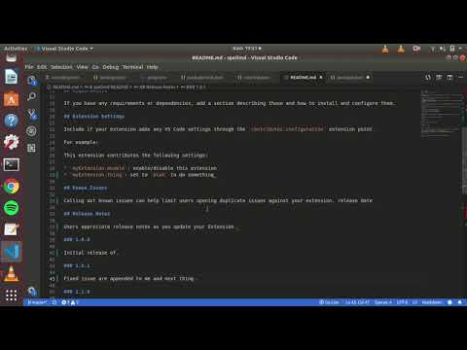

Slide 7



Technologies
Used
TypeScript
JSON
JAVASCRIPT

Slide 8
FUTURE PLANS
Make the spell cheCker for every text editor nit just visual studio.
Add a dictionary with a library that has our local language in the spell checker.

Slide 9
CHALLENGES FACED
Deep research and errors while creating the project.
We had to learn two new languages to develop our project
It was complicated to obtain the publisher ID

Slide 10
OUTRO
THANK YOU
WE WELCOME QUESTIONS OR FEEDBACK

