Slide 1
Self-defense capabilities for Android applications against repackaging
Mentor
Aleksandr PILGUN
Student
Davit POgosian

Slide 2

What is Android ?
What is APK ?
What is repackaging ?

Slide 3
Why you need to protect your APK ?
Your Code and resources that you used
Paid apps
Malwares
Users private information

Slide 4
How they decompiles apk
ApkTool
Dex2Jar
javadecompilers.com
apkdecompilers.com

Slide 5
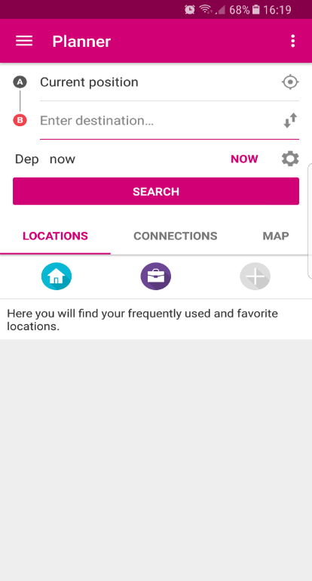
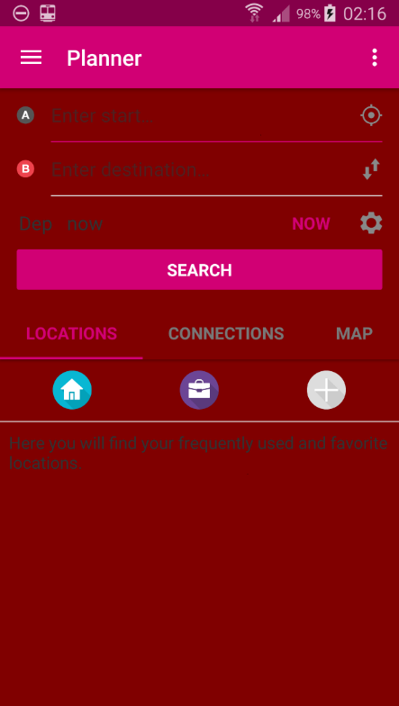

Slide 6
Ways of protection
Proguard
Self-verification
Packer

