Slide 1
Self-defense capabilities for Android applications against repackaging
Mentor
Aleksandr PILGUN
Student
Davit POgosian

Slide 2
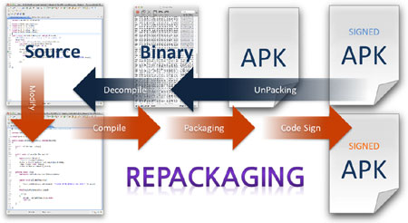

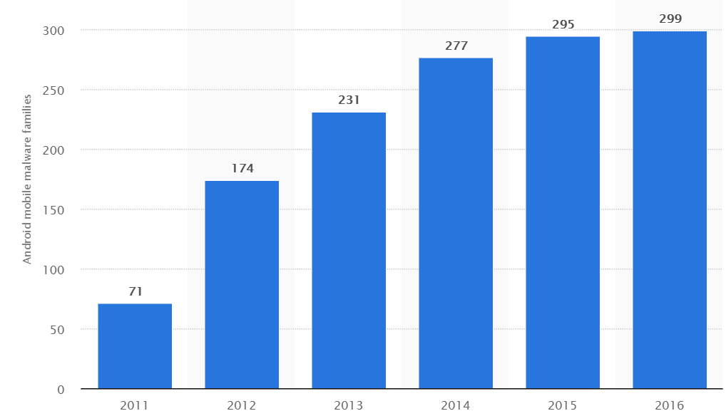
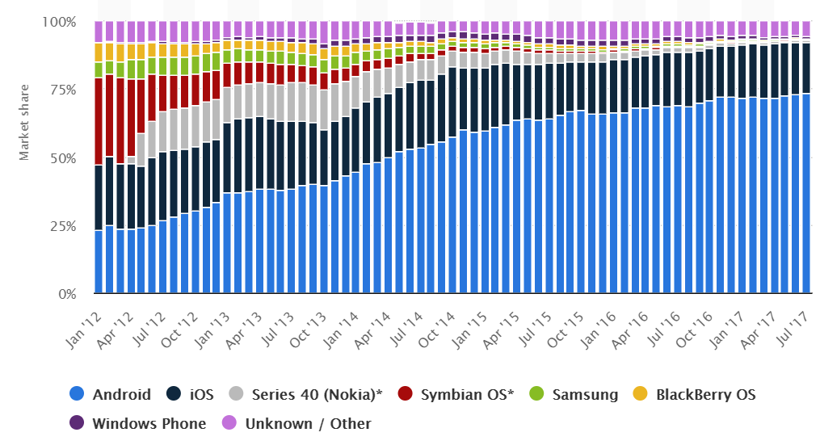

What is Android ?
What is APK ?
What is repackaging ?

Slide 3
Why you need to protect your APK ?
Your Code and resources that you used
Paid apps
Malwares
Users privacy information

Slide 4


How they decompiles APK
ApkTool
Dex2Jar
javadecompilers.com
apkdecompilers.com

Slide 5
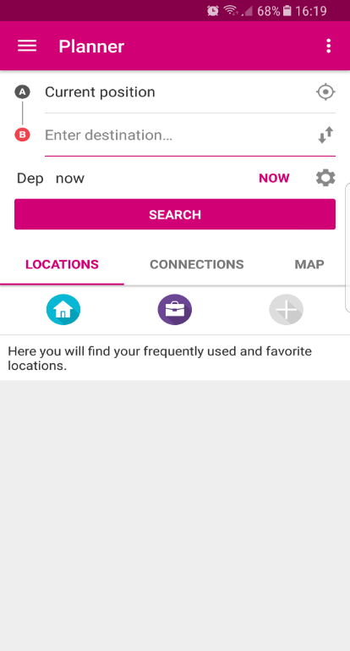
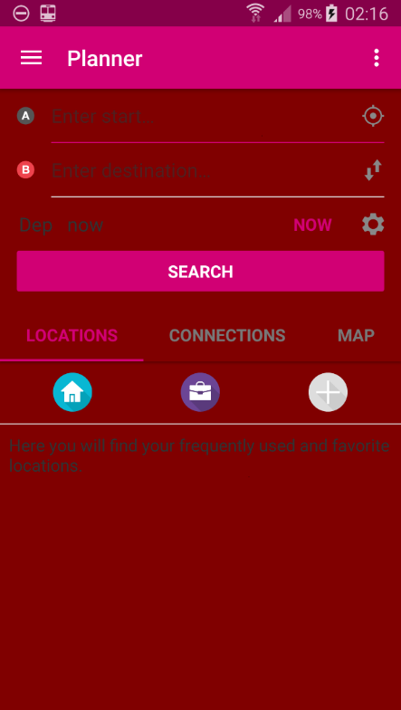
ApkTool
<color name="ar_bg_info">#80000000</color>
<color name=" ar_bg_info ">#80000000</color>
<color name=" ar_bg_more ">#80000000</color>
<color name=" ar_bus ">#80000000</color>
<color name=" ar_main ">#80000000</color>
<color name=" ar_sbahn ">#80000000</color>
<color name=" ar_tram ">#80000000</color>
<color name=" ar_unknown ">#80000000</color>

Slide 6
Dex2Jar
protected void onCreate(Bundle savedInstanceState) { super.onCreate(savedInstanceState); setContentView(R.layout.search); Word= (ListView) findViewById(R.id.wordsearch); editrequest= (EditText) findViewById(R.id.editrequest); mydb = new DBhelper(context); String request=null; request=getIntent().getExtras().getString("request",null); Log.e("this is sparta","request= "+request); final Cursor res = mydb.Search(request); Word.setAdapter(new Adapter (res,this)); } public void find (View v) { if (editrequest.getText().toString().length()==0) { Context context = getApplicationContext(); CharSequence text = "Please provide input"; int duration = Toast.LENGTH_SHORT; Toast toast = Toast.makeText(context, text, duration); toast.show(); } else { Intent go = new Intent(SearchActivity.this, SearchActivity.class); go.putExtra("request",editrequest.getText().toString()); startActivity(go); }}}
public void find(View paramView)
{if (this.editrequest.getText().toString().length() == 0) {
Toast.makeText(getApplicationContext(), "Please provide input", 0).show();
return; }
Intent localIntent = new Intent(this, SearchActivity.class);
localIntent.putExtra("request", this.editrequest.getText().toString());
startActivity(localIntent);
}
protected void onCreate(Bundle paramBundle)
{
super.onCreate(paramBundle);
setContentView(2130968639);
this.Word = ((ListView)findViewById(2131493035));
this.editrequest = ((EditText)findViewById(2131493033));
this.mydb = new DBhelper(this.context);
String str = getIntent().getExtras().getString("request", null);
Log.e("this is sparta", "request= " + str);
Cursor localCursor = this.mydb.Search(str);
this.Word.setAdapter(new Adapter(localCursor, this));}

Slide 7

Ways of protection
Proguard
Self-verification
Packer

Slide 8
Proguard
public DBhelper (Context paramContext) {
super(paramContext, "notebook.db", null, 1);
getWritableDatabase(); }
public Cursor GetWordByID (int paramInt) {
return getWritableDatabase().
rawQuery("Select * from words WHERE ID=" + paramInt, null);
}
public Cursor Search (String paramString)
{
String str = paramString.toLowerCase();
return getWritableDatabase().rawQuery("Select * from words WHERE domain='" +
str + "' or fr='" + str + "' or en ='" + str + "'", null);
}
public void open ()
{
try {
this.db = getWritableDatabase();
return; } catch (Exception localException) {
localException.printStackTrace();
}
}
public b(Context paramContext)
{
super(paramContext, "notebook.db", null, 1);
getWritableDatabase();
}
public Cursor a(int paramInt)
{
return getWritableDatabase().rawQuery("Select * from words WHERE ID=" + paramInt, null);
}
public Cursor a(String paramString)
{
String str = paramString.toLowerCase();
return getWritableDatabase().rawQuery("Select * from words WHERE domain='" +
str + "' or fr='" + str + "' or en ='" + str + "'", null);
}
public void a() {
try {
this.b = getWritableDatabase();
return;
}
catch (Exception localException) {
localException.printStackTrace();
}}

Slide 9
Self-verification
DEX file verification
APK verification
Signature verification

Slide 10
Packer
Obfuscation
Dynamic code modification
Dynamic loading
Anti-debugging

