Slide 1
Intelligent Systems - Agents and Reasoning Sudoku
Davit pogosian

Slide 2
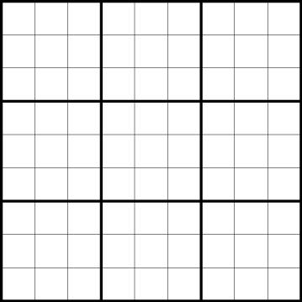
What is Sudoku?
Sudoku is a puzzle game. The puzzle itself is nothing more then. A gird of boxes called “cells”. There are 81 cells total. The puzzle comes with some of cells already filled in
The puzzle has
9 rows
9 columns
9 block

Slide 3
Rules
No repeats are allowed in any row
No repeats are allowed in any column
No repeats are allowed in any block
Evart cell has to be filled in with a number from 1 to 9

Slide 4
My Roles
You can find every number in every row
You can find every number in every column
You can find every number in every block
Evart cell has to be filled in with a number from 1 to 9

Slide 5
Setting block for cells
The cell in the c column and in the r row belongs to the block
(((r - 1) - (r - 1)%3) / 3) * 3 + (((c - 1)-(c - 1)%3) / 3) + 1

Slide 6
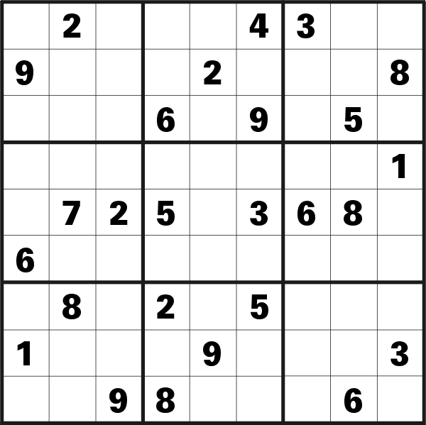
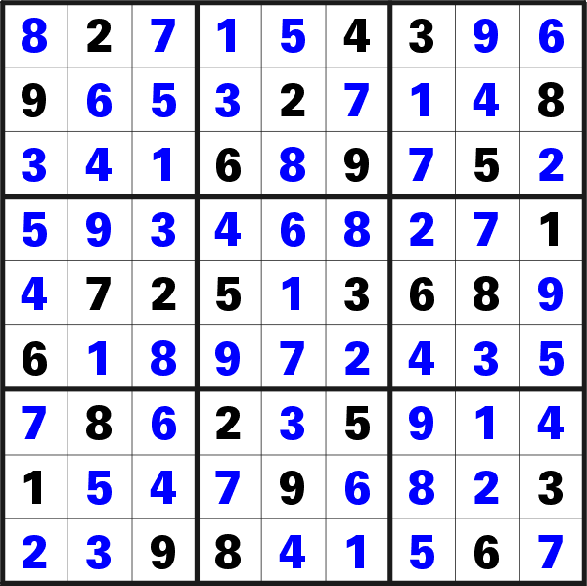
IDP in work
Input
Output

