Slide 1
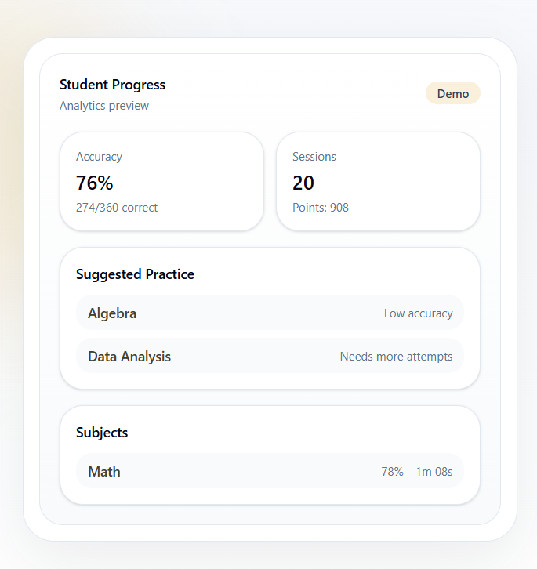

DRILL INSTRUCTOR
Practice. Review.
Improve.
Practice smarter for the tests that matter.
A structured exam-preparation platform for students, educators, and schools.
SCHOOL PARTNERSHIP
2026
Notes:
[Sources]
- First-party product screenshot: public-home-hero.png.

Slide 2
THE PREPARATION GAP
Practice generates answers. Schools need insight.
The work is happening—but the signal is often lost.
01
02
Students practice blindly
Educators see too little
They answer questions without a clear view of which topics to revisit, where pacing breaks down, or why the same mistakes repeat.
Assignments create more grading, yet still may not reveal who is stuck, which concept needs reteaching, or how students used their time.
The opportunity: turn every practice session into useful next steps.
DRILL INSTRUCTOR • SCHOOL PARTNERSHIP
02
Notes:
[Sources]
- Problem framing supplied by the product founder; no external statistics used.

Slide 3
THE PLATFORM
Preparation works best as a disciplined training loop.
Exam preparation is serious work. Drill Instructor makes the repetition purposeful, visible, and easier to sustain.
PRACTICE
→
REVIEW
→
IMPROVE
Focused, timed drills
Corrections and explanations
Analytics guide the next session
Why “Drill Instructor”?
The military is an enduring symbol of discipline. Students may not love every repetition—but structured repetition builds readiness.
DRILL INSTRUCTOR • SCHOOL PARTNERSHIP
03
Notes:
[Sources]
- Product positioning and naming rationale supplied by the founder.

Slide 4
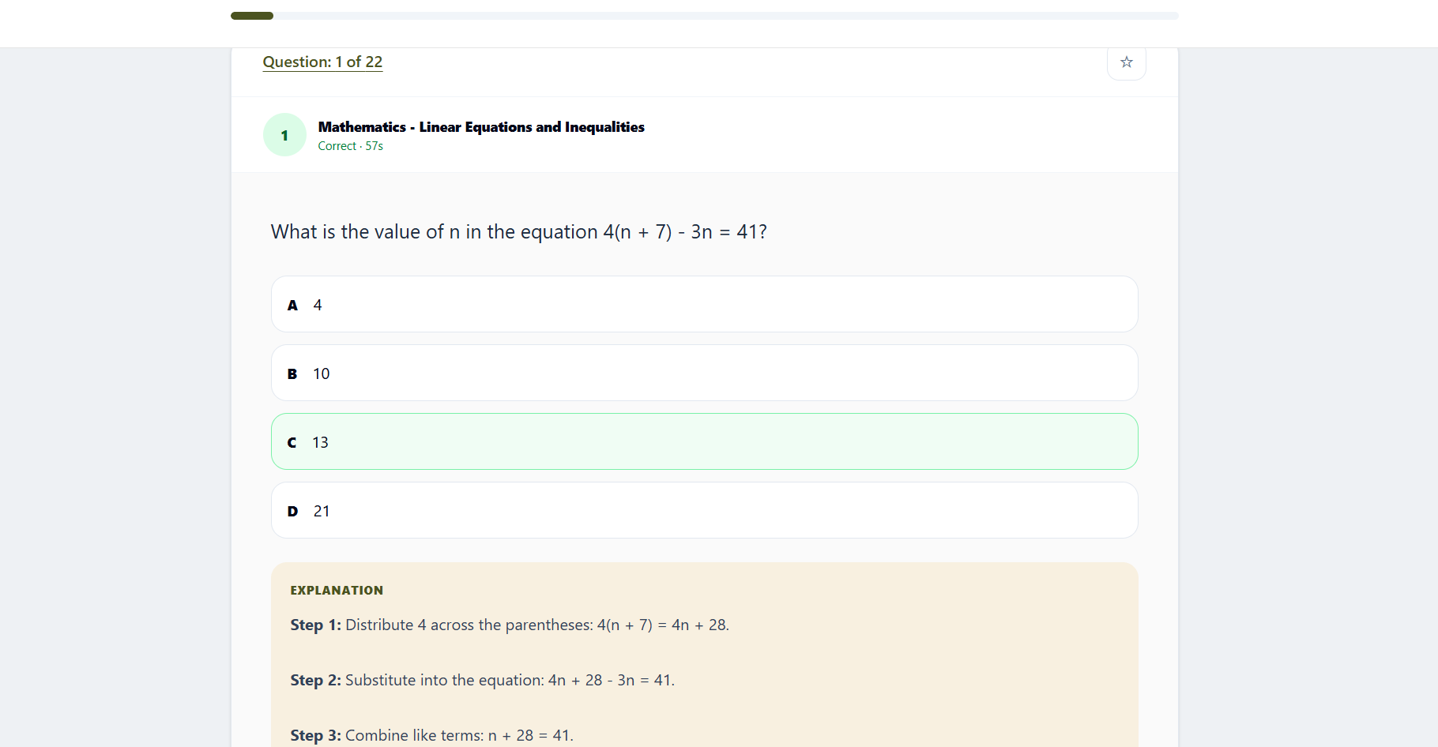
STUDENT EXPERIENCE
Students can build the right practice—and learn from every miss.
DRILL INSTRUCTOR • SCHOOL PARTNERSHIP
04
Notes:
[Sources]
- First-party screenshots: student-drill-builder.png and student-review-full.png.

Slide 5
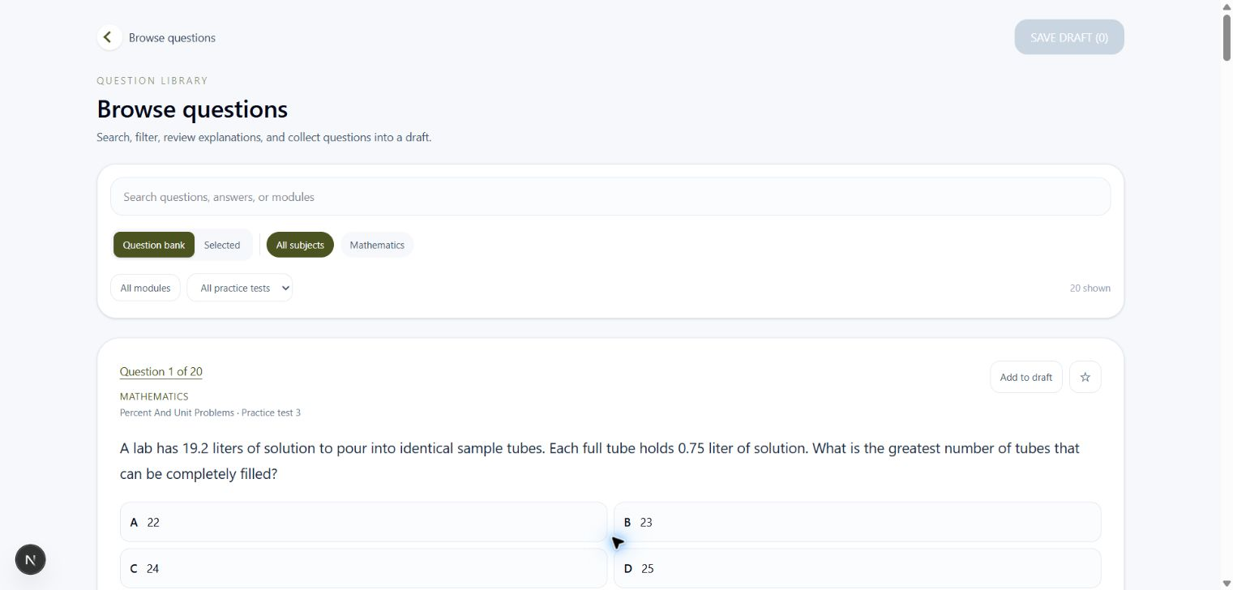
EDUCATOR EXPERIENCE
Assign focused practice without inheriting continuous grading.
Browse the question bank
Filter by subject, module, and practice test. Inspect questions and explanations before assigning.
Set the assignment rules
Choose recipients, due date, score release, correction release, and question-order shuffling.
Review—without re-grading
Submission summaries and corrections are generated from the same server-owned results.
DRILL INSTRUCTOR • SCHOOL PARTNERSHIP
06
Notes:
[Sources]
- First-party screenshot: educator-question-browser.png.

Slide 6
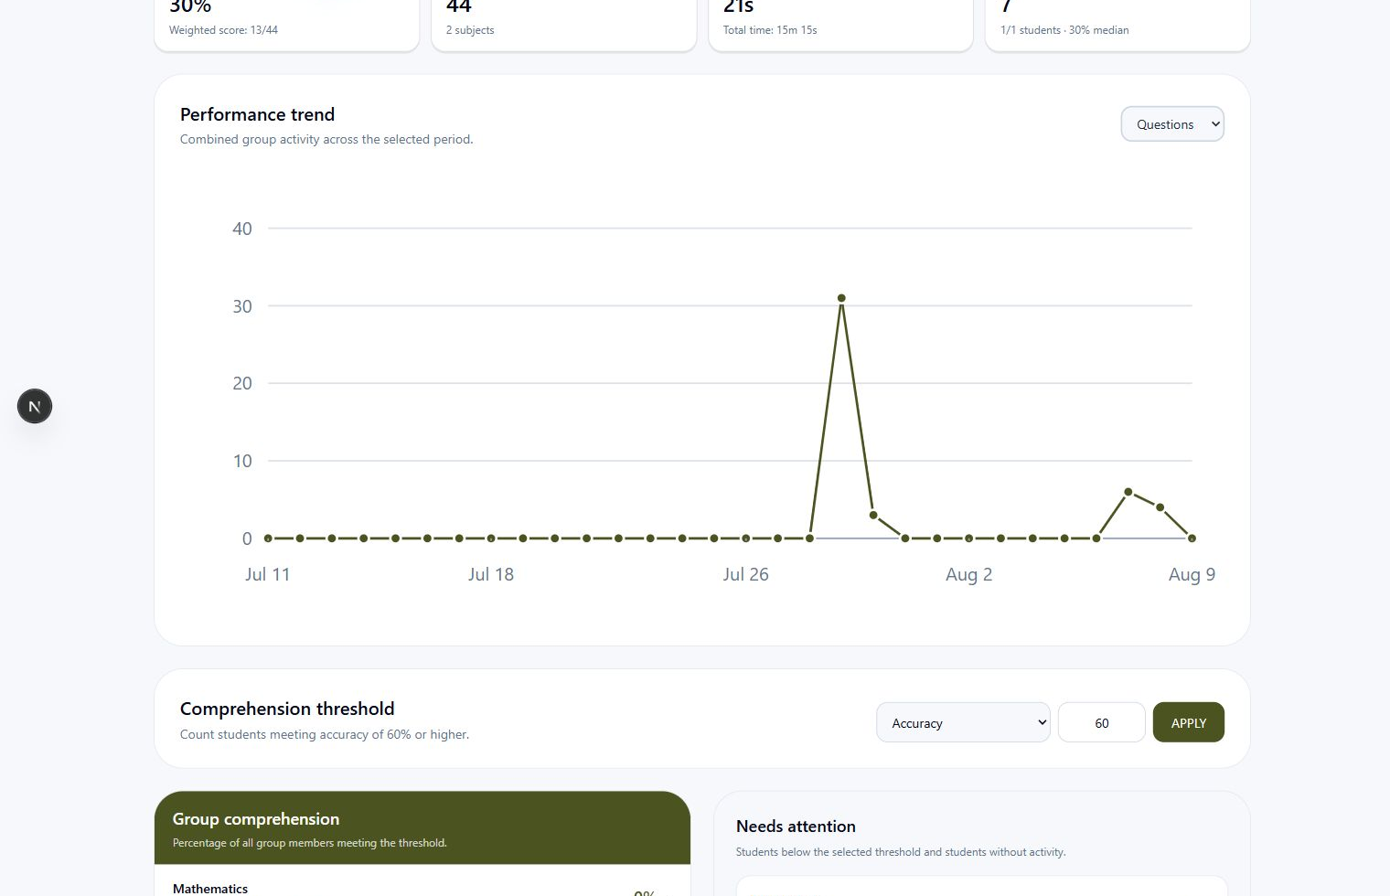
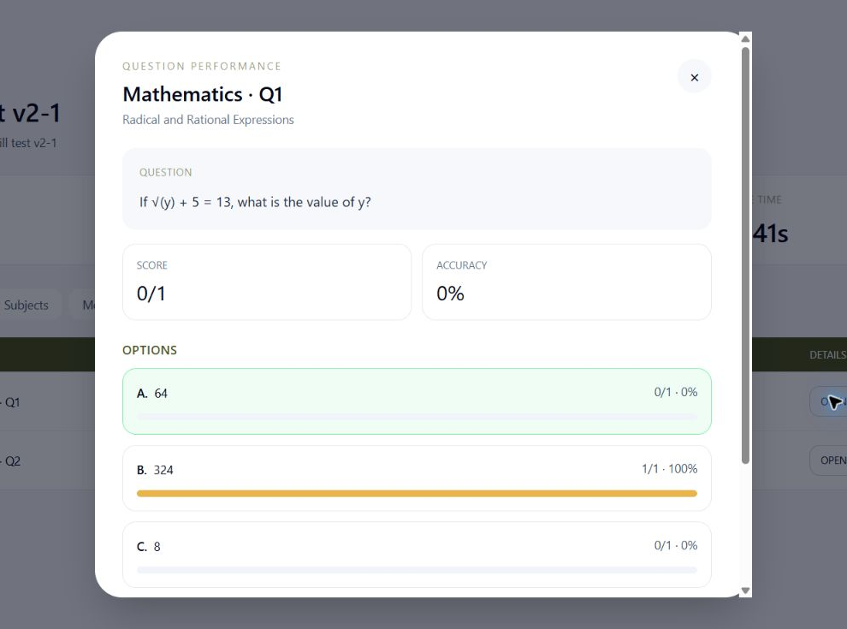
ACTIONABLE VISIBILITY
Zoom from group trends to one answer choice.
WHOLE GROUP
→ subject → module → question → answer choice
Know who needs support—and the concept that needs reteaching.
DRILL INSTRUCTOR • SCHOOL PARTNERSHIP
07
Notes:
[Sources]
- First-party screenshots: educator-group-analytics.png and educator-question-performance.png.

Slide 7
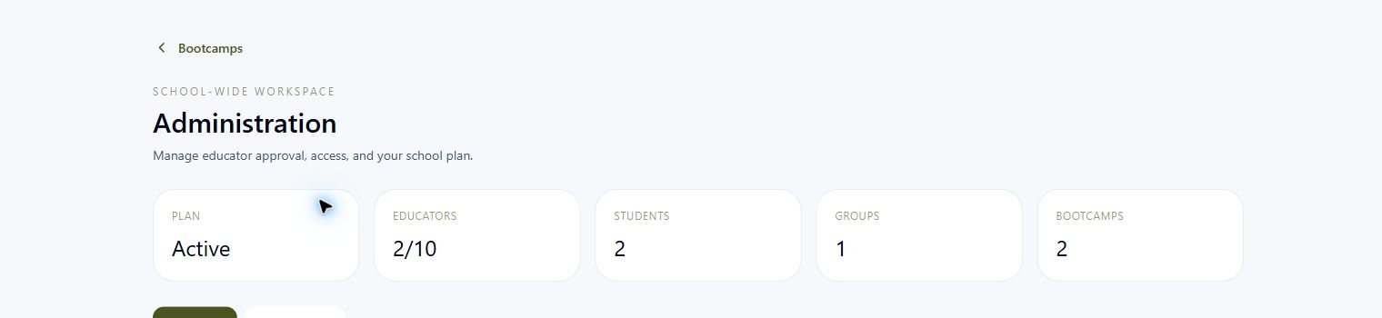
Privacy is a foundation—not an afterthought.
01
Private by choice
Students can keep their profile out of public leaderboards.
02
Scoped educator access
School controls
Limit access by exam, subject, student, or group.
• School-wide educator codes
• Admin approval and audit history
• Flexible permission boundaries
• Aggregate solo-practice visibility
• No sale of analytics data
03
Approval before access
Educators require school authorization; approval can be withdrawn.
Challenge participants see summary performance—not another student’s per-question answers.
DRILL INSTRUCTOR • SCHOOL PARTNERSHIP
08
Notes:
[Sources]
- First-party screenshot: educator-admin-summary.png.
- Privacy and permission statements are based on the implemented product requirements supplied by the founder.

Slide 8
DRILL INSTRUCTOR
Questions?
Let’s walk through a live student and educator demo.
drillinstructorprep.com
Practice. Review. Improve.
12
Notes:
[Sources]
- First-party Drill Instructor brand and product domain.

