Slide 1
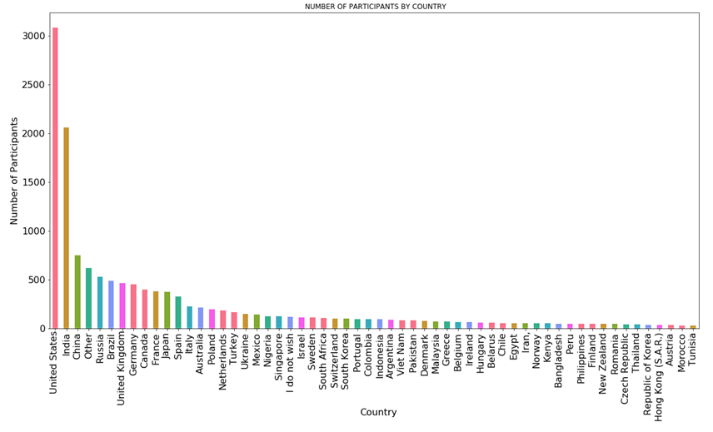
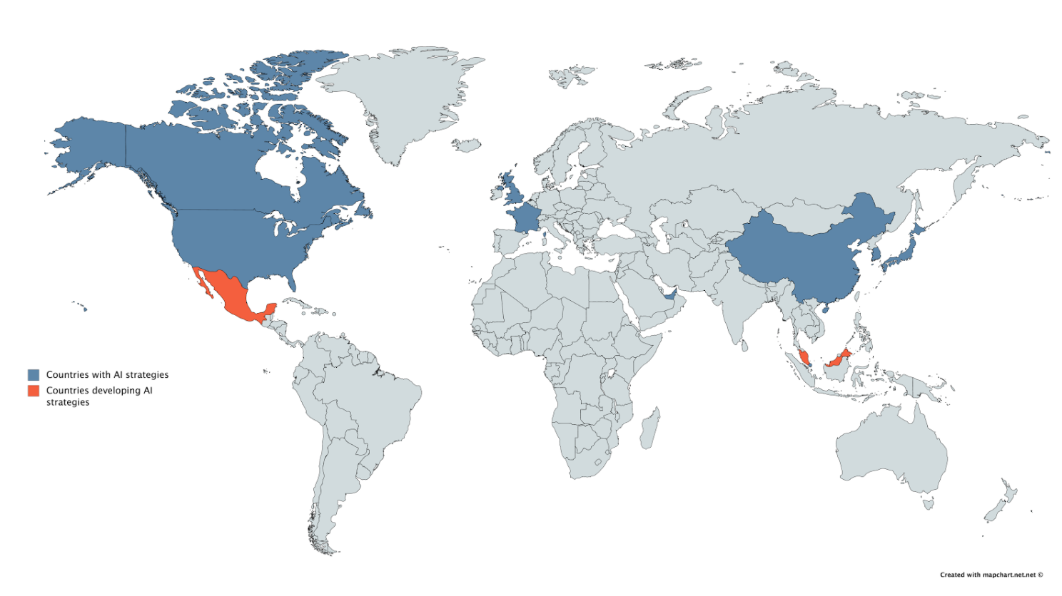
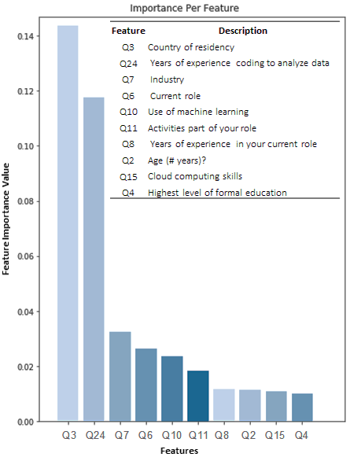
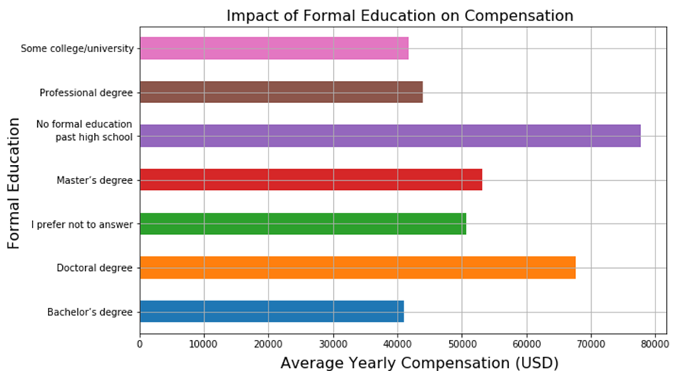
Data Science in developing countries (Opportunities and Disadvantages)
Data: A industry-wide survey about the data sciences community.
23,859 responses
395 features
147 countries
Raw numerical and categorical data
Insights: Developed countries (DvCs), Developing countries (DgCs)
DvCs - ML in the Entertainment and Finance
DgCs have started using ML in Military and Manufacturing.
More experience means a better compensation. However, in DgCs individuals with more than 5-10 years of experience is considerably lower than DgCs.
Countries with an AI strategy have a greater number of individuals with master and PhD degrees working in roles related to the AI field.
Conclusions:
Developing regions (i.e. South America) are excellent places to create AI start-ups and introduce ML into Finance and Insurance and create programs that educate people in the AI/ML field.
Education and opportunities to gain experience in the ML field have produce an enormous gap between DvCs and DgCs.
Prediction of current yearly compensation
Linear regression and Random Forest
90% model performance.
Important features highlight the disadvantages in developing countries such as experience and education

Slide 2
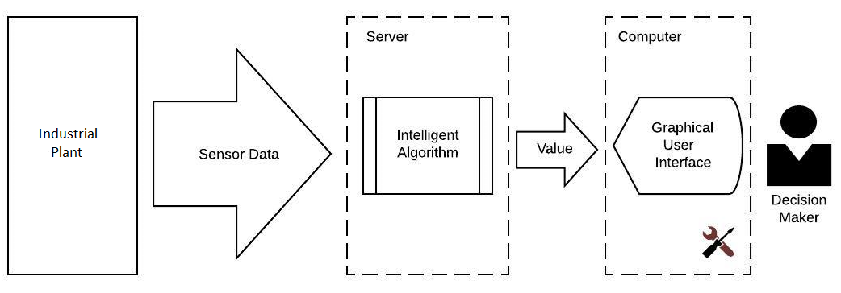
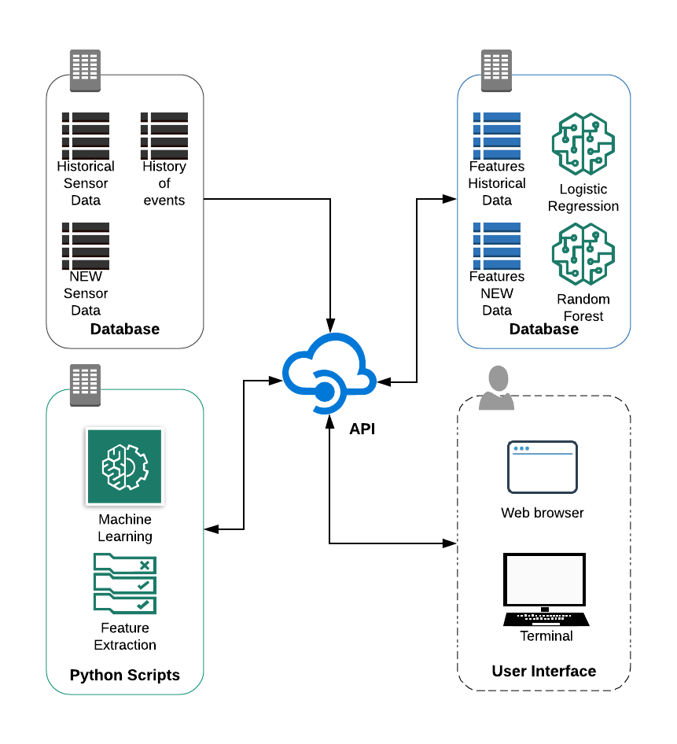
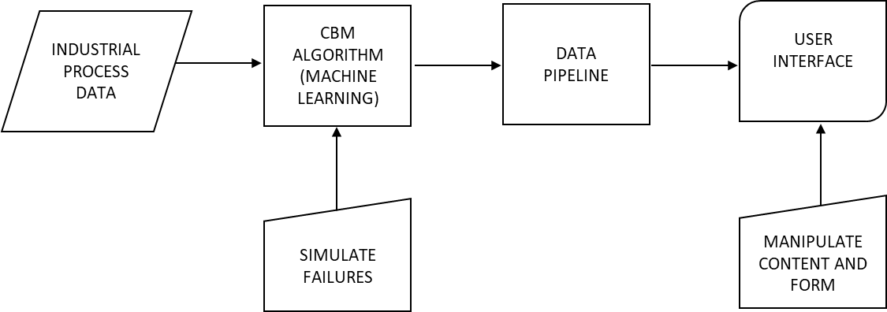
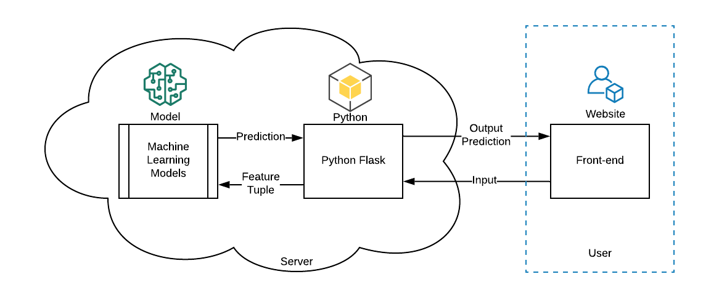
ML-based platform for predictive maintenance ARDAS
Process
Architecture
Maintenance Action
Figure 1: Block diagram of the process simulated by ARDAS
Capabilities
Figure 3: ARDAS platform architecture
Figure 2: Simulation of failures and user interface manipulations
Figure 4: ARDAS data flow diagram

