Slide 1
Automating Infrastructure with Azure


Slide 2

BASIC CONCEPTS
Introduction to Infrastructure as Code concepts and DevOps ideas

AZURE RESOURCE MANAGER
Azure’s 2nd generation provisioning system

DESIRED STATE CONFIGURATION
Have a system automatically configured to a certain state

Slide 3
why automation?

❑


ROI
RISK
RESPONSE
SCALABILITY
Faster development, testing, provisioning, configuration and deployment, means faster return of investment.
Automated processes reduces the risk of human errors and ensures consistent behavior.
Leads to better response times in case of emergencies. Such as security patching and incidents.
Manual processes typically doesn’t scale. With automation large infrastructures can be managed by few people.

Slide 4
infrastructure as code

Treated as Application Code

Reliable & Reproducible

Highly Scalable

Idempotency is Key

Slide 5
Immutable & disposable resources
Delete and recreate infrastructure regularly - in set intervals or every time it changes*
Eliminates configuration drift
Ensures code for provisioning, configuration and deployment are working
Doing something often makes it less scary

Slide 6
new possibilities
Developers and testers can create a new test environment that is provisioned, configured and deployed in a matter of minutes


Slide 7
new possibilities

Upgrading software becomes completely effortless

Slide 8
new possibilities
⧫
Zero downtime with blue/green deployments will be very easy to achieve

Slide 9
Azure Resource Manager

The 2nd generation provisioning system

Slide 10



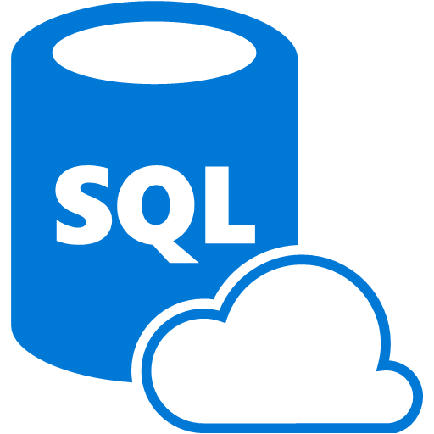

what’s wrong with the first generation?
ProvisionEnvironment.ps1
New-Website Website1
New-Website Website2
New-VirtualNetwork 'c:\NetworkConfiguration.xml'
New-Storage MyStorage
New-SqlAzure Database
New-VirtualMachine VM1
New-VirtualMachine VM2
New-VirtualMachine VM3
System

Slide 11
resource groups
ResourceTemplate.json
{
"apiVersion": "2014-04-01",
"name": "[concat('ForbiddenRequests ', parameters('siteName'))]",
"type": "microsoft.insights/alertrules",
"location": "East US",
"dependsOn": [
"[concat('Microsoft.Web/sites/', parameters('siteName'))]"
],
"tags": {
"[concat('hidden-link:', resourceGroup().id, '/providers/Micros
},
"properties": {
"name": "[concat('ForbiddenRequests ', parameters('siteName'))]
"description": "[concat(parameters('siteName'), ' has some requ
Resource Group

Slide 12

demo

Slide 13
Desired state configuration


Slide 14








Slide 15
what’s desired state configuration?

Built on open standard

Included in and powered by PowerShell

Declarative & file based

Primary management system for Windows

Slide 16
how it works
compiled
Pushed to, or...






MyConfig.ps1
Server1.mof
pulled from
Target Node
DSC Resource
Executed in PS

Slide 17

demo

Slide 18


@davidlindblad

david.lindblad@webstep.no

https://github.com/Davlind/NDC-Oslo2015

Slide 19


