Slide 1
Actors with Project Orleans


Slide 2


Stéphane Erbrech & David Lindblad


@serbrech & @davidlindblad

https://github.com/Davlind/orleans-demo

Slide 3
Actor Model


Slide 4
actor model
The actor model in computer science is a mathematical model of concurrent computation that treats "actors" as the universal primitives of concurrent computation: in response to a message that it receives, an actor can make local decisions, create more actors, send more messages, and determine how to respond ...
Actor model - Wikipedia, the free encyclopedia en.wikipedia.org/wiki/Actor_model

Slide 5
Moore’s law
The number of transistors in chip will double every 18 months
Gordon E. Moore - 1965
Notes:
Thanks to this law, we never really needed to pay attention to performances, just upgrade the hardware, and all is fine.
ex. CW

Slide 6

“The free lunch is over”
Notes:
Moores law
Done with clock rate (where are the 4Ghz cpus?)
We add cache and... we add cores

Slide 7
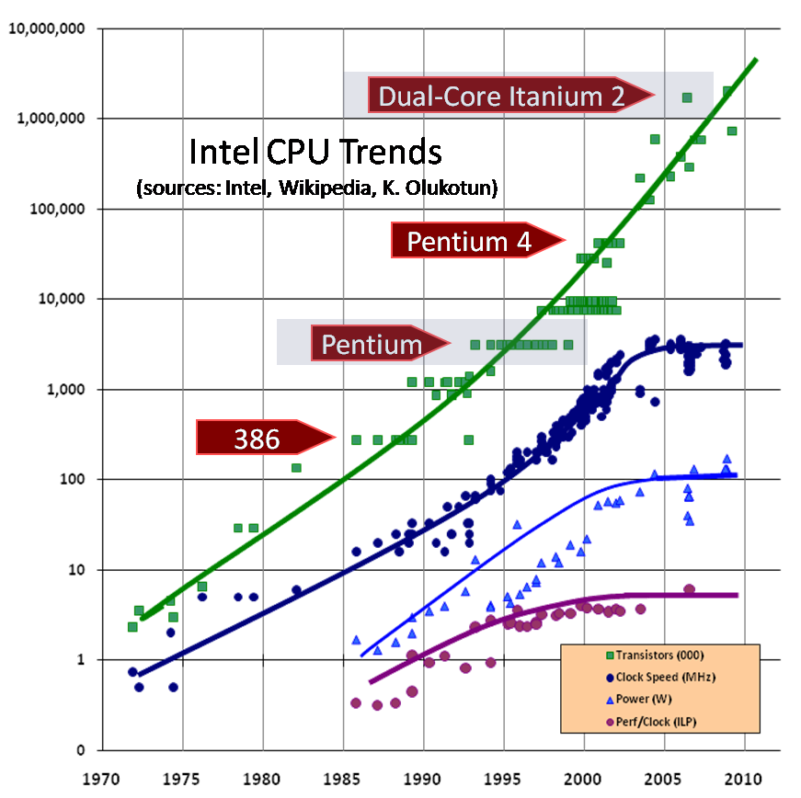

Slide 8
No more free lunch

Performances are not "free" anymore
⧫
You need to develop concurrent application/systems
Notes:
Does not mean you should bring your Matpakke with you
HW jungle
Heterogeneous cores

Slide 9

“I know, I will use threads...”
Notes:
Race condition, hard to reason about.
Locks are hard! too many, too few, in wrong order, dead locks...
If you don’t use it well, you wont get the benefit in performance, making good use of threads is HARD
So let's get back to this actor model

Slide 10

CARL HEWITT - 1973
Research on Artificial Intelligence

ERICSSON
Invents Erlang and open source it
Notes:
AXD301
Nine Nines - Why is this? No shared state, plus a sophisticated error recovery model.
Carl Hewitt -1973
Research on Artificial Intelligence
Ericsson invents and open sources Erlang, based on Actors (90s)
Built a distributed, concurrent, fault tolerant system with 99.99999...% uptime

Slide 11

Isolated Mutability is a design approach in which we can have mutable values but we make sure that for each mutable value only one thread has access to it
Notes:
The Actor Model of concurrency is one in which we have multiple lightweight processes,
known as actors
each actor can have mutable state if it wants because no other actor has access to that state

Slide 12

But, why have I not heard of actors then?
Notes:
The simplicity of this model suggests that it would make programming for a distributed system simpler, but there proved to be difficulties associated with its implementation.
At the time, knowledge of distributed programming and highly concurrent environment were not as known as today.
Our knowledge has grown and the implementations of the actor model have evolved to better abstractions.

Slide 13
what is an actor?
Actors are the fundamental unit of computation
In the original actor model, everything is an actor
Only communicating with one another using asynchronous message passing

Slide 14
what can an actor do?
In response to a message that it receives, an actor can
create more actors
send more messages
modify its internal state
Notes:
Keeping all data for an actor in one location effectively means you can create stateful services allowing you to build a stateful middle tier with the performance benefits of a cache but with no concurrency issues.

Slide 15
what is an actor?
Actor come in systems

They come with addresses


And they send immutable messages
Notes:
Actors react to messages, and as such, they dont have a good reason to exist alone.
So they come in Systems.

Slide 16
how does this help us?

No shared state!

Scalability

Fault tolerance

NO SHARED STATE!
Notes:
Keeps mutable state internal, and communicates with asynchronous messaging.

Slide 17

FACEBOOK CHAT
https://www.facebook.com/notes/facebook-engineering/chat-stability-and-scalability/51412338919

HALO 4
http://www.infoq.com/news/2015/03/halo4-actor-model
Notes:
FB : channels that are responsible to receive and push data from/to the web tier (and to your browser) are actors. 1 user, 1 actor.
Halo : they believes they would not have been successful without using Orleans, due to how easy it was to find developers when using a tool like Orleans helping them write code running in a distributed world, and in that increasing the productivity as the developers could focus on making the experience in the game really great.

Slide 18
Project Orleans


Slide 19

BUILT BY MICROSOFT RESEARCH
Used internally for concurrent, highly scalable systems

VIRTUAL ACTOR FRAMEWORK
Very similar to the well known actor model

DESIGNED FOR AZURE
But can be developed, tested and even ran on-premise

DISTRIBUTED & HIGHLY CONCURRENT
High throughput, high availability & single-threaded

Slide 20
scalability?
Requests/second
Number of Servers

Slide 21
scalability?
Requests/second
Number of Actors

Slide 22
virtual actors (grains)
Actors (grains) never have to be created. They’re always just there when you retrieve them.
Single-Threaded
Asynchronous
Communicates with queued messages

Slide 23
virtual actors (grains)



Employee Actor Instance
(Id #123)
Activation #1 @ 192.168.0.1
Employee Actor Instance
(Id #123)
Employee Actor Type


Employee Actor Instance
(Id #567)
Employee Actor Instance
(Id #567)
Activation #1 @ 192.168.0.8

Slide 24
silo







Slide 25
silo

Manages Actor lifecycles

Coordinates and distributes Actors

Manages communication with Actors in other silos
❑
Error handling

Slide 26



silo




























Slide 27

But… ehh… wait…
how does this really work?

Slide 28
how does it work?


Get all employees for manager #123






Slide 29
how does it work?

Everything is asynchronous

Get all employees for manager #123

Small, single-threaded and queued operations


Super fast serialization (when going over the wire)

No bottlenecks


Slide 30
what about data?
Grains can persist state using StorageProviders
AzureTableStorage
ShardedStorage
BuildYourOwn…

Slide 31

demo

Slide 32
when is it a good fit?

Many loosely coupled entities

Small entities which can be single-threaded

Very large entities

Entities which require shared data

Slide 33


Slide 34
http://dotnet.github.io/orleans/Step-by-step-Tutorials/

