Slide 1
Actor Models

Slide 2
Actor Model History
Dates back to 1973
Intended for concurrent computation
Influenced by packet switched networking and process algebra

Slide 3
Actor Model
Actor
Actor
Actors
Addressable
Isolated
Single-threaded
Concurrent
Message/Queue-based communication
Actor
Actor

Slide 4
Technologies
Erlang (Actor programming languages)
.NET
Actor Framework
NAct
Retlang
PostSharp
Akka.NET (Port of Javas Akka)

Slide 5
Orleans

Slide 6
What’s Orleans?
Actor Platform rather than just a framework
Primeraly intended for running in Azure
High performance
Reliable
Scalable

Slide 7
Virtual Actors (Grains)
Instances of actors can always be ”retrived”. They don’t have to be created, persisted or deleted.
If an actor instance is not active, a message to it will trigger instantiation.
Lifecycle is completely managed by Orleans
Activation failures are handled by Orleans

Slide 8
Virtual Actors (Grains)



Employee Actor Instance (ID#123)
Employee Actor Instance (ID#123)
Activation #1 @ 192.168.0.1


Employee Actor Type
Employee Actor Instance (ID#111)
Employee Actor Instance (ID#111)
Activation #1 @ 192.168.0.7

Slide 9
Silo
Actor
Runtime execution container
Manages communication with Actors in other Silos
Coordinates and distributes Actors physically
Manages Actor lifecycles
Error handling
Silo

Slide 10
New Activation
New Activations
Unavailable Silo
New Silo

Slide 11
Execution Model
Asynchronous messaging is the key
To achive blocking behaviour, callbacks can be used
Everything is plain old .NET
There should be no locking
Actors have built-in persistence providers

Slide 12
Flexibility
Providers
Azure Table
SQL Server
Memory (Grain)
Roll your own
Custom Serializers
Runtime Monitoring
Performance counters
Silo statistics and metrics tables
Liveness Provider
Membership Table Grain
Azure Table
SQL Server
Hosting
Stand-alone Silo
On-Premise Deployment
Azure

Slide 13

Hello World

Slide 14
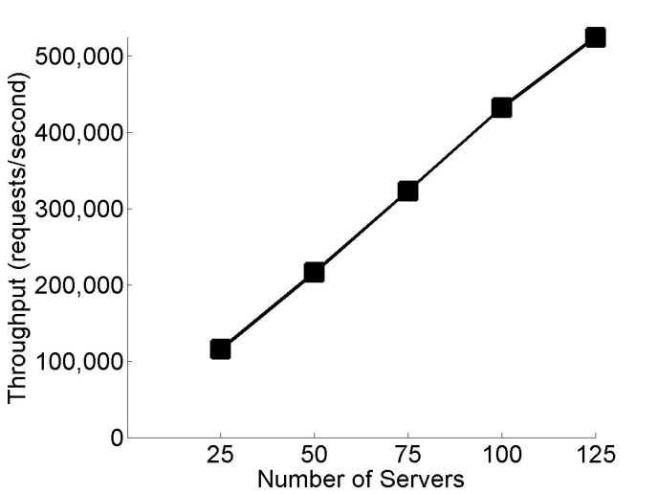
Server Scalability
Test Lab Numbers
Close to linear scalability even for throughput to server ratio.

Slide 15
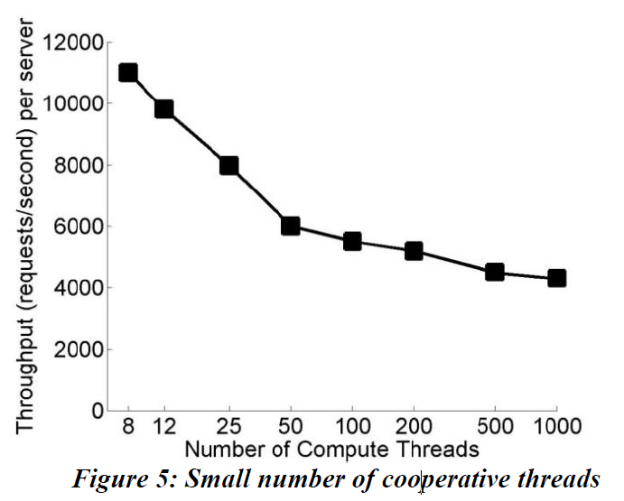
Thread utilization
1000 Actors
By default Orleans tries to keep thread counts down to 1 per CPU core.
Thread context switching, memory pressure and degrades performance.
Scaling out rather than up is therefore preferred.

Slide 16
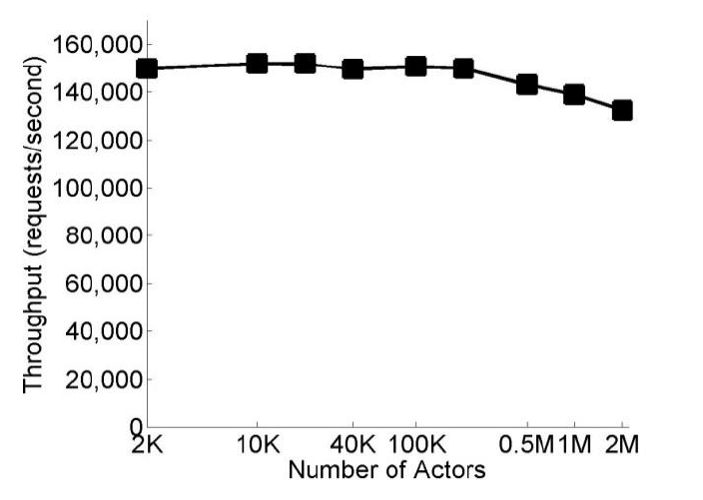
Actor Scalability
Close to constant scalability for number of actors due to Single-Hop DHTs.

Slide 17
What makes it cool?
Ultra scalable
Insane performance
Open Source
Reduces a lot of complexity of building highly concurrent systems
Small learning curve (compared to Erlang)

Slide 18
...and what sucks?
Concurrency is still kind of hard... To debug
Visual studio will fight you every step of the way
Orleans... The name... Apparently there’s this city...
I’m still not comfortable with the model. Actors are not natural entities and aggregate roots become harder to define.
How on earth do you test this thing? Mocking and DI is not obvious to me...

