Slide 1

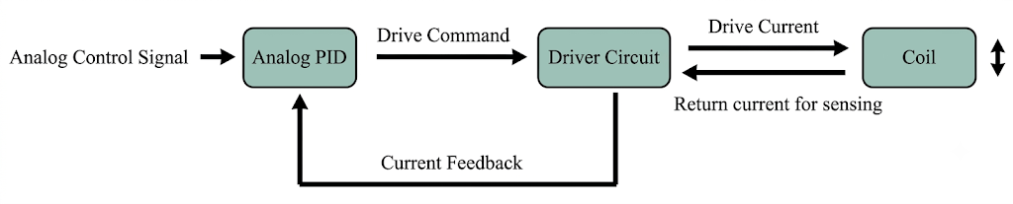
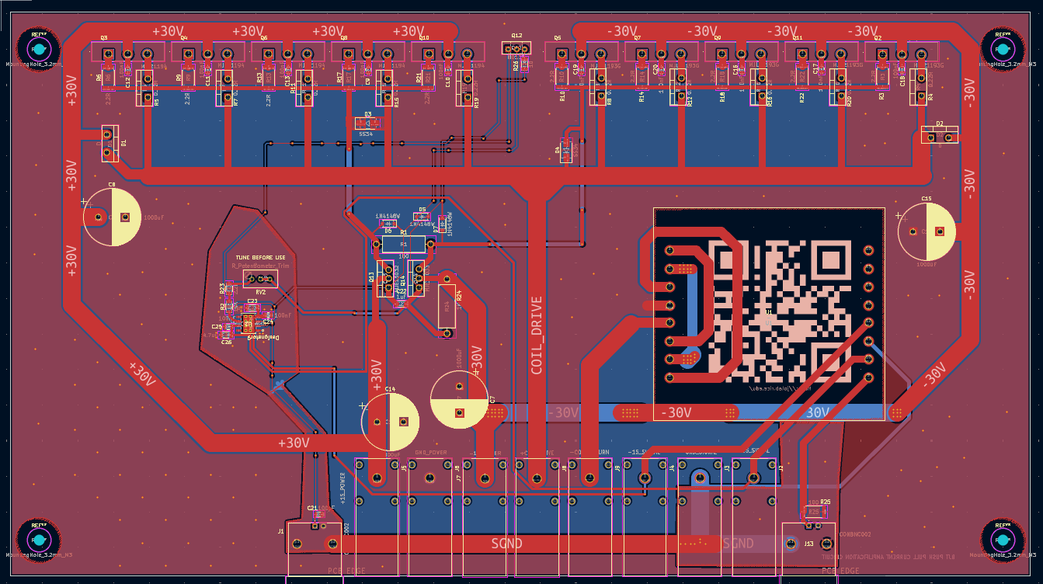
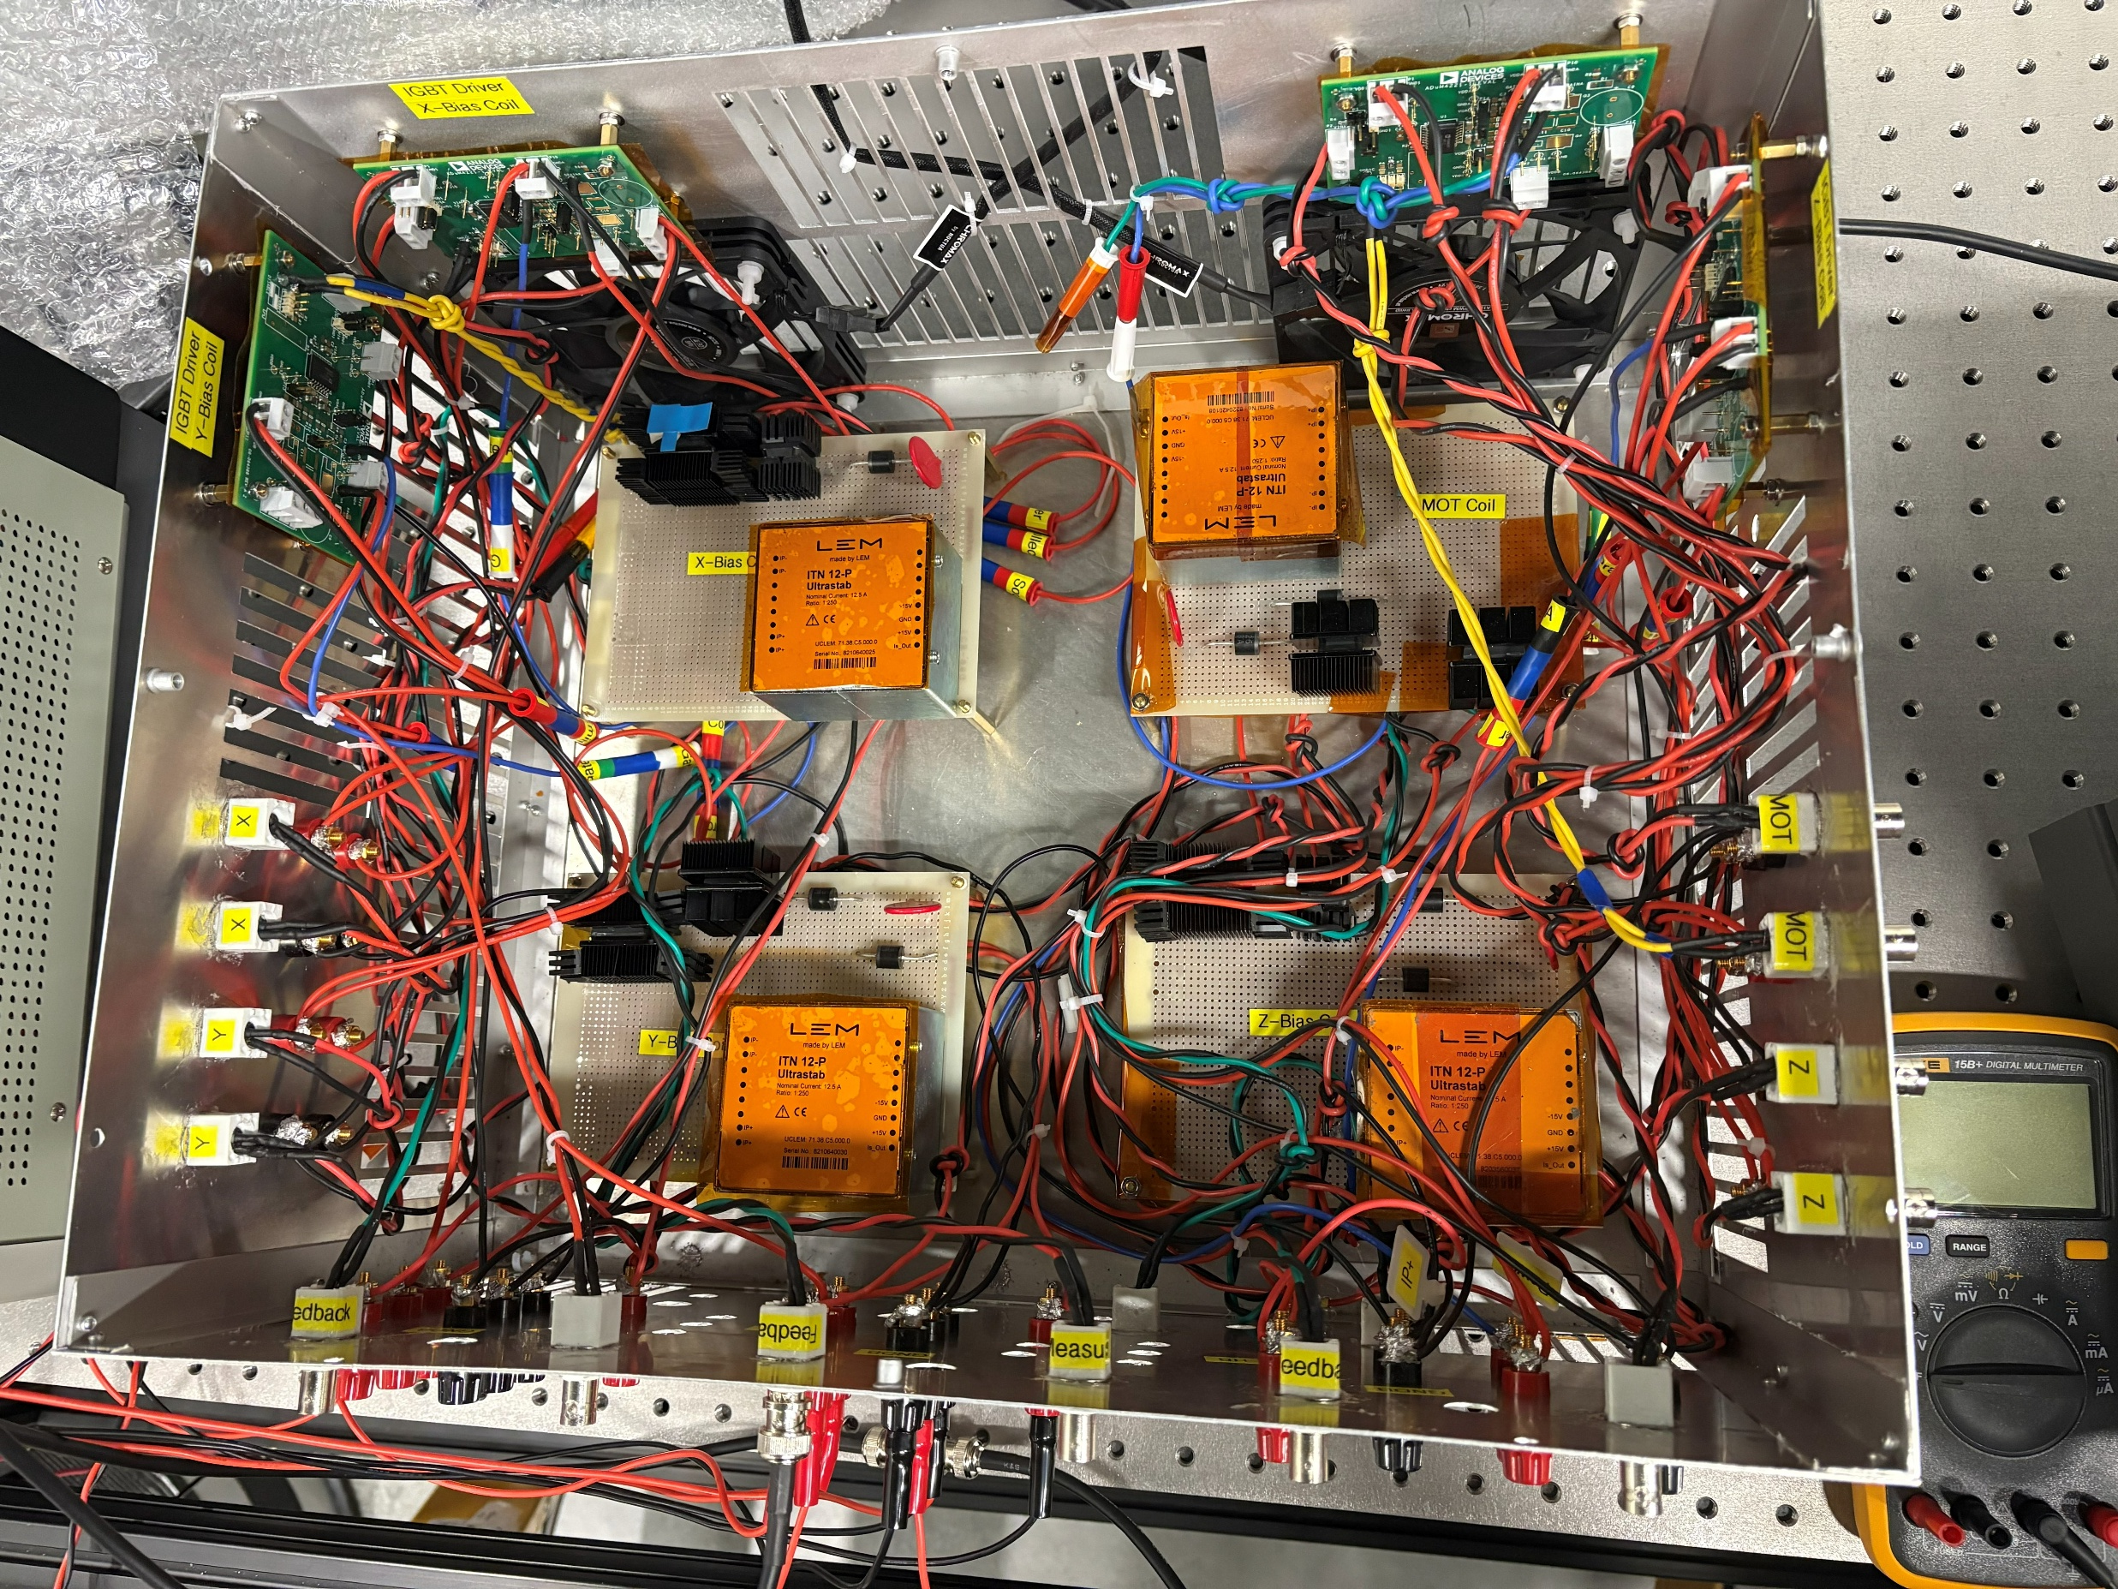
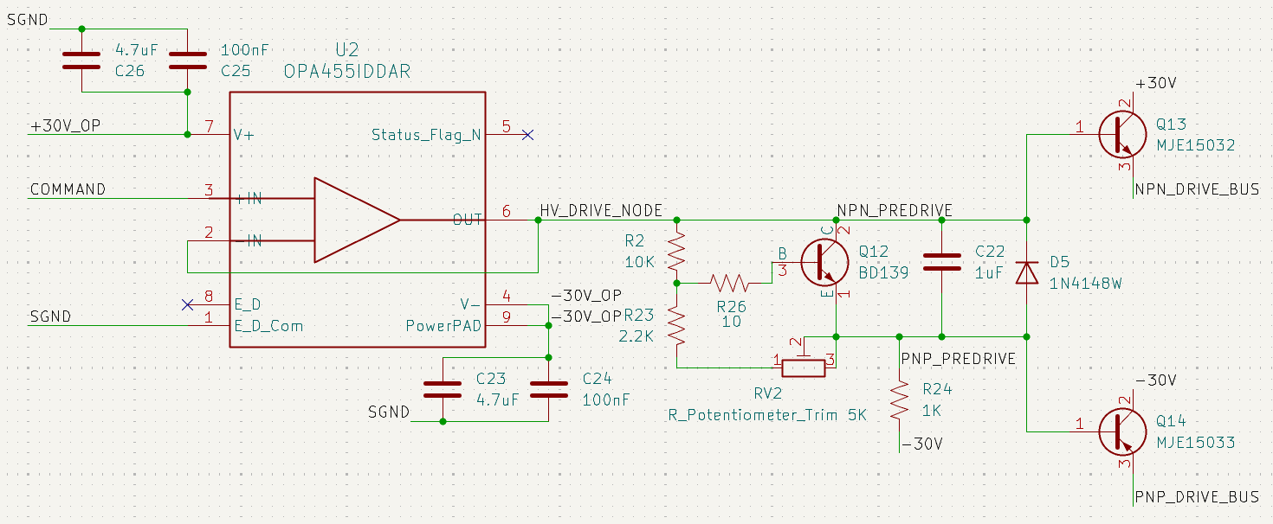
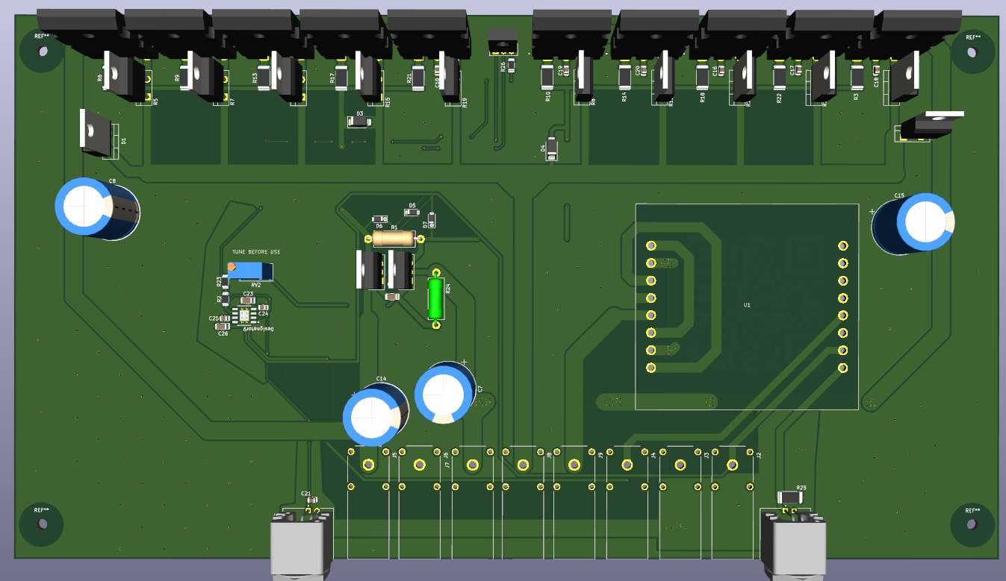
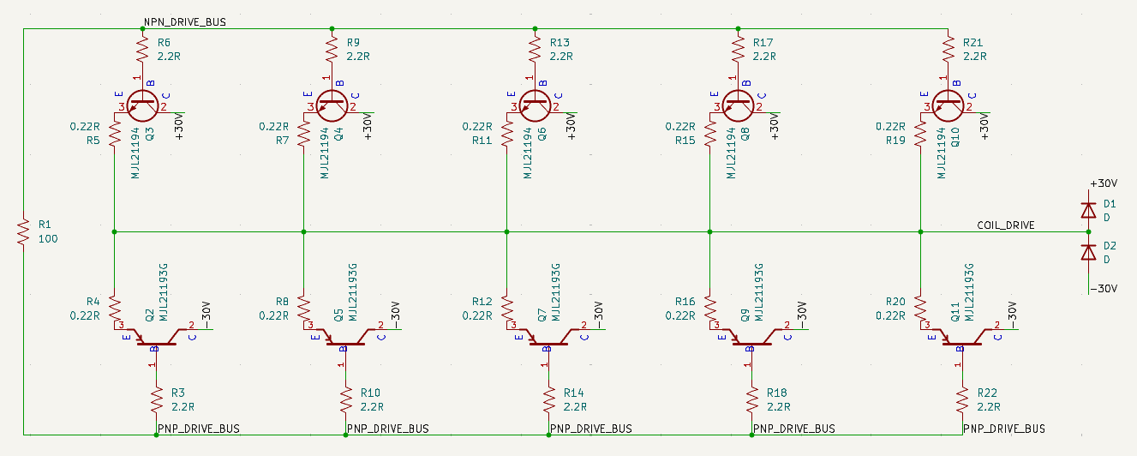


Driving Dipoles: Custom Bipolar BJT Array for AMO Physics
Chuwei Liao¹, Mithilesh Parit², Gyu-Boong Jo¹
¹Department of Physics and Astronomy, Rice University
²Department of Physics, HKUST
Abstract
BJT Array Driver circuit
System Overview
Research into highly dipolar quantum systems relies on precise manipulation of magnetic fields. These sensitive AMO experiments require coil drivers delivering low electrical noise and rapid responses. Traditional drivers introduce crossover deadband and switching deadtime or are just unipolar. To address this, we present a custom high-power linear current driver engineered for zero-deadband closed-loop control. Our design features a parallel array of ten high-power BJTs with active thermal management. By tuning the bias Class AB bias voltage to maintain a microscopic quiescent current, the output stage is kept strictly on the bleeding edge of conduction. This eliminates the zero-crossing gap without generating excessive idle heat and injecting noise.
Role
Output current based on drive command signal through linear mapping from continuous -10V to +10V command
Feedback induced current from the immediate drive command
Architecture
Drive Command
Command + V_Bias
NPN Transistor Bank
Thermal Stability & Current Sharing
Thermal Tracking: The Vbe multiplier (Q12) and the parallel output BJTs share a single heatsink.
Self-Correction: As the output stage heats up, Q12 physically tracks the temperature rise and proportionally lowers the bias voltage.
Coil Physics & Transient Limits
The system's absolute speed limit is dictated by the Erbium trap coils ($R=0.656Ω$, $L=885.6μH$, $τ=1.35 \text{ms}$). The time ($t$) to reach a target current ($I$) via a step voltage ($V$) is:
$$t=−τ\ln\left(1−\frac{I×R}{V}\right)$$
Current Setup (15V Rails): Due to current power supply limits, the fastest theoretical 5A step is 333 µs.
Design Target (30V Rails): Unlocking the full 30V capability will halve this limit to 156 µs.
System Bottlenecks & Future Work
The 14-BJT circuit acts purely as low-noise "analog muscle." System performance is now bottlenecked entirely by external factors:
Control Resolution: The current 100kHz analog PID limits control resolution to 1 mA, well above our 70 µA current-sense noise floor. The microscopic quiescent current tuning also presents a minor resolution boundary.
Digital Upgrade: Future iterations will transition to an FPGA-based digital controller to maximize bit-depth, precision, and loop speed.
Environmental Noise: Ambient magnetic field interference from adjacent laboratories is currently the largest error source.
Next Steps: Active compensation of stray magnetic field and choosing an upgrade
Op-Amp Buffer
Coil
Command Splitter
Legacy Hardware
Command – V_Bias
PNP Transistor Bank
Commercial: Delta Elektronika ES 15-010
  Operation: Utilized in Constant Current (CC) mode.
  Flaw 1 (Noise): Introduces $≈1.5mA$ noise
  Flaw 2 (Topology): Strictly non-bipolar output.
Previous Design (MOSFET H-Bridge)
  Operation: A single-MOSFET architecture utilizing an H-bridge to achieve polarity reversal.
  Flaw 1 (Drive Strength): Lacks gate buffer
  Flaw 2 (Topology): The H-bridge inherently introduces crossover switching delays, voltage spikes, and a prominent zero-crossing deadband.
Circuit Diagram for Op-Amp Buffer, Command Splitter, and EF2 Stage
Core Components:
OPA455 as input buffer
BD139 configured as a thermally-tracking adjustable Vbe multiplier
MJE15032/3 signal buffer before driving main transistor banks
5 MJL21193/4 power BJTs on each polarity for responsive and low heat driving up to 10A
0.22R Ballast resistors to enforce linearity in Vbe to Ie and load sharing across BJTs
Acknowledgements
NPN and PNP Transistor Banks
We gratefully acknowledge Professor Jo for their continuous guidance and the Jo lab team for their invaluable collaborative support throughout this research. We also extend a special thanks to Dr. Mithilesh Parit for his work to create the prototype design.

