Slide 1
THE SECOND OPINION
The screener finds them. This does the homework.
A multi-agent equity research crew that produces one-page, fully cited due-diligence reports
Davon Crane · Building Agentic AI Systems — Final Project · August 2026
github.com/DavonCrane/second-opinion
Notes:
Hi, I'm Davon. This is The Second Opinion — the sequel to my midterm screener. The screener finds candidate stocks; this system does the homework on one: it reads the actual 10-K, pulls live financials and analyst data, and produces a one-page report where every claim is cited, the bear case is as strong as the bull case, and the 12-month view is arithmetic on stated assumptions rather than a prediction. Everything is on GitHub.

Slide 2
The bar to beat: a Google search + one chatbot call
Everything needed to evaluate a company is public. Synthesizing it takes hours, and a single LLM prompt gives you a confident, uncited summary.
1
Primary sources, cited by paragraph
RAG over the 10-K — “Item 1A ¶7”, not an article about it
2
Sources cross-examined
Sentiment vs. fundamentals vs. filing language — divergence is called out
3
A bear case as strong as the bull case
Held to the same evidentiary standard; a critic rejects weak ones
4
Memory
“Since last analysis” — what changed since you last looked
5
Code does the math
12-month view from visible, disputable assumptions — never an oracle number
The Second Opinion · Davon Crane · Building Agentic AI Systems — Final Project
Notes:
The question any research tool has to answer is: why is this better than googling the ticker and asking a chatbot? Five reasons, and each maps to a component you'll see in the architecture: it reads primary sources and cites by paragraph; it cross-examines sources against each other; the bear case is held to the same standard as the bull case; it remembers prior analyses; and anything that's arithmetic is computed by code, not the model.

Slide 3
Architecture — a deterministic orchestrator over six agents
Input guard → Router
Resolve ticker · snapshot
Focused path (cheap)
refuse advice-seeking · full report vs focused question (heuristics → Haiku)
yfinance · load semantic memory
snapshot + RAG retrieve → one cited answer · 1 call, ~$0.01, ~20 s
parallel fan-out (ThreadPool)
Fundamentals
News
Sentiment
Shared workspace (working memory)
10-K RAG (Items 1/1A/7) + statements via calculator
headlines → relevance filter, dated findings
analyst consensus + StockTwits posts (user labels + Haiku)
findings · numbered sources · facts · log · drafts · critiques
Valuation
Writer ⇄ Risk Critic
Output guard
bear/base/bull EPS assumptions (model) × multiples from own P/E history (calculator) · weights from neutral 25/50/25, cited
REJECT → revise (≤2 rounds) → APPROVE · the reflection loop; also the eval ablation
citation coverage ≥ 0.9 · no dangling [n] · no advice phrasing · disclaimer
→ report.md (+PDF) · episodic memory (this run) · semantic memory (durable facts) · Streamlit dashboard
Deliberately NOT a ReAct planner: the workflow has a known shape, so code-driven control is cheaper, testable offline, and produces an identical, observable trace every run.
The Second Opinion · Davon Crane · Building Agentic AI Systems — Final Project
Notes:
The control flow is deterministic code, not an LLM planner — that was a deliberate choice and I'll justify it. A request hits the input guard, which refuses advice-seeking prompts, then the router sends it either down the cheap focused-question path or the full report path. Three analyst agents fan out in parallel and write cited findings to a shared workspace. The valuation agent builds bear/base/bull scenarios — the model proposes assumptions, the calculator does the arithmetic. The writer drafts, the risk critic attacks the draft and can force up to two revisions, and an output guard checks citation coverage and phrasing before anything ships. Memory is updated at the end.

Slide 4
Seven of eight course patterns — and one left out on purpose
1
2
3
4
Routing + parallelization
Reflection / self-critique
Tool use — 6 tools
Multi-agent with handoffs
router.py; ThreadPool fan-out of 3 analysts
Risk Critic → writer revision loop (≤2 rounds)
yfinance · SEC EDGAR · news · StockTwits · Reddit · calculator
6 agents over a shared workspace
5
6
7
8
Memory — 3 types
RAG with citations
Guardrails + eval harness
NOT: LLM planning (ReAct)
working · episodic · semantic
10-K Items 1/1A/7 → ‘Item 1A ¶7’
input/output/weight guards · 12-case eval, 3 arms
known workflow shape → deterministic orchestrator instead
Each pattern is exercised by a named test in tests/ — 27 tests run fully offline against fixtures and a scripted model.
The Second Opinion · Davon Crane · Building Agentic AI Systems — Final Project
Notes:
The course asked for at least four patterns. This implements seven, and each one is there for a reason I can point to. The one I deliberately left out is LLM-driven planning — the workflow has a fixed shape, so a deterministic orchestrator is more reliable and fully testable offline. Every pattern has a named test; the whole suite runs in under 20 seconds without a key or network.

Slide 5
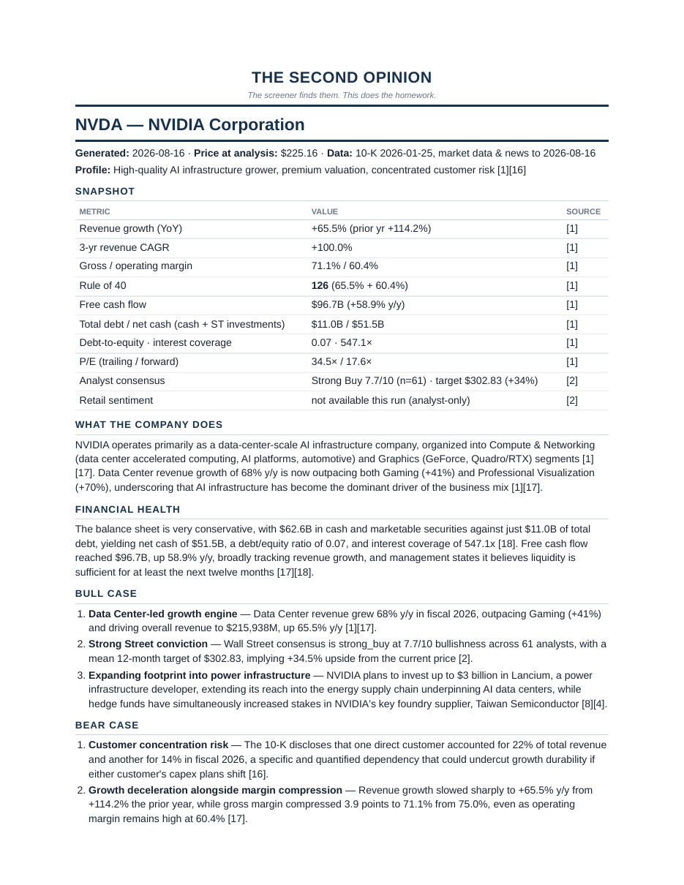
The product: a one-page, fully cited report
Snapshot
growth, margins, Rule of 40, debt, P/E, analyst consensus, retail sentiment — every row sourced
Bull case & bear case
3 bullets each; the critic rejects a bear case vaguer than the bull case
12-month scenarios
bear/base/bull EPS × own P/E bands → implied prices; Claude’s weighted view beside the analyst mean
Sentiment check
cross-examines Street/retail mood against fundamentals — names the divergence
Since last analysis
episodic memory: price change, new findings, weight shifts
Sources + disclaimer
numbered, paragraph-level 10-K citations; ‘not investment advice’ enforced by the guard
Live NVDA report from the evaluation run (Aug 16, 2026)
The Second Opinion · Davon Crane · Building Agentic AI Systems — Final Project
Notes:
This is a real report from the eval run, not a mock. The snapshot table is computed by code from statements — the model never does arithmetic. Bull and bear cases are three cited bullets each. The scenario table shows what has to be true for each outcome, with the implied price computed, and Claude's weighted view sits next to the analyst mean — weights start from a neutral 25/50/25 and only move with cited evidence. The sentiment check looks for divergence. And since-last-analysis is the episodic memory talking.

Slide 6
Evaluation — 12 live cases, three arms
12 / 12
0.936
$0.11
±3 pts
task success
mean citation coverage
per full report
weight stability (5 runs, max σ 0.031)
Ablation: Risk Critic on vs. off (full reports)
Cases
NVDA · MSFT · JPM (bank: Rule of 40 = n/a) · RDDT (recent IPO)
RIVN — loss-making: scenario table correctly declined
“nvidia” → name resolution · ZZZZ → clean error
“NVDA — what’s their debt?” → cheap path, 1 call, cited
“Should I buy NVDA?” → refused, $0
re-run → since-last-analysis diff · news outage → degrades
The Second Opinion · Davon Crane · Building Agentic AI Systems — Final Project
Notes:
Twelve live cases — happy paths, a bank, a recent IPO, a loss-making company, an invalid ticker, a focused question, an advice request that must be refused, a memory re-run, and a simulated news outage. Task success is all-or-nothing per case: right route, all sections, guardrails green, plus case-specific checks. Twelve of twelve on the final run, 93.6% citation coverage, about eleven cents per report. The stability arm ran NVDA five times: the scenario weights moved by at most three points.

Slide 7
Honest findings — what the eval actually taught me
The critic barely moves the metrics — and that's the point
1
RAG index contaminated by fixture data
Illustrative 10-K chunks shared IDs with the real filing; the model itself flagged ‘figures don’t reconcile’. Fix: filing-scoped chunk IDs + retrieval.
Critic off: same 12/12, coverage −0.4 pt, 24% cheaper, 23% faster.
Why: during development the critic rejected drafts for real reasons — a bear bullet that said only “the stock is expensive”, a bear case vaguer than the bull case. Each fix moved into the writer’s prompt. The critic’s lessons migrated upstream.
What remains is insurance: it still rejected 2 of 5 stability-arm drafts with concrete issues. Catch rate went from ~4 in 10 before prompt hardening to ~2 in 14 after.
Decision: keep it on by default; expose --no-critic for cheap bulk screening.
2
Guardrail false positive
“no guaranteed follow-through” tripped the advice filter and trapped the critic in two useless revisions. Fix: promissory-usage pattern + a test.
3
Model reversed a comparison
“price sits below all three scenarios” — it didn’t. Fix: that sentence is now generated by code. Principle: LLM chooses assumptions, code does arithmetic.
The Second Opinion · Davon Crane · Building Agentic AI Systems — Final Project
Notes:
Two things I'm proud of reporting honestly. First, the ablation: turning the critic off barely changed the automated metrics, at a quarter less cost. That's because every time the critic rejected a draft during development, I turned the reason into a writer-prompt rule — so its value moved upstream. It still catches things, roughly two in fourteen now, so I keep it on by default and expose the switch. Second, ten real failures, all fixed and most pinned by tests — the three here are the most instructive, including the one where the model noticed my own contaminated data before I did.

Slide 8
What's next, and where to find it
Dashboard
Repository
Streamlit UI: live agent log, critic verdicts, price & scenario map, follow-up questions, PDF export — cloud-deployable with a password gate
github.com/DavonCrane/
second-opinion
Future work
README — run it from scratch
docs/architecture.md
eval/eval_report.md
27 tests · pytest
tag: final-submission
X/FinTwit as a third sentiment source · 10-Q ingestion · rubric-scored critic · self-hosted deployment
Limitations stated
P/E scenarios don’t apply to loss-makers (declined, not forced) · weights measured for stability, not validated as forecasts · yfinance/StockTwits coverage varies
Not investment advice. A research-synthesis tool that reads public sources and cites them.
Thank you — Davon Crane
Notes:
There's also a Streamlit dashboard on top of the same orchestrator — that's what I demoed. Future work is a second sentiment source, 10-Q ingestion, and a rubric-scored critic. Limitations are stated plainly in the architecture doc. Everything — code, 27 tests, the architecture doc, and the eval report — is in the repo, tagged final-submission. Thank you.

