Slide 1
Hybrid and relational databases comp 5400
Instructed by:
Dr. manar samad

Slide 2
freight forwarders database design
Waheed Williams

Slide 3
Contents
Section 1 - Introduction
Section 2 - Methodology
Section 3 - Results
Section 4 – Discussion and Conclusions

Slide 4
Section 1 introduction

Slide 5
Defining and introducing the relational database and its applications
Freight Forwarder type of shipping database design
Act as liaisons between shipper and carriers (negotiations, booking cargo, preparing shipments, handling customers
Are experts in air, sea, and land arrangements
Database will be implemented using a relational style database management system
Seven tables will be designed and developed using Data Definition Language (DDL)
Seven tables will be populated and manage using Data Manipulation Language (DML)

Slide 6
Database background motivation
Skill development with relational database design
Streamline processes involved with managing shipments, tracking cargo, etc.
Reports generation and analytical analysis as needed by Freight Forwarder style shipping companies (e.g., optimizing operations, customer satisfaction, error reduction)
Manage huge data relating to the flow of goods (location, cargo type, cost)

Slide 7
Database users, data type, data stored or retrieved using DML
Freight Forwarders style shipping companies
The data types used in this database will include:
- INT
- VARCHER
- DATE
- DECIMAL

Slide 8
Section 2 methodology

Slide 9
Database design methods with definitions and roles
Column names: Cargo, Carriers, Consignees, Consignees_has_Shipments, Invoice, Shipments and Shippers.
Shippers table - stores information about companies shipping goods
Carriers table - stores information about companies that transport goods.
Shipments table - stores information about the individual shipments.
Cargo table - stores information about the cargo being shipped.
Consignees table - stores information about the entity receiving the goods.
Invoice table - stores information regarding the amount of the shipment in the Shipments table.
Consignees_has_Shipments (many to many relationship Consignees and shipments.)

Slide 10
Database schema and ER Diagram
Blueprint for outlining organization of a database.
Defines the structure of the database, tables, columns, and relationships.
Specifies the data types and constraints for each column.
Ensures data consistency and integrity through PK, FK etc.

Slide 11
Entity Relation (ER) Diagrams
Graphically represent the relation between the various attributes of the database schema.
Ensures that the structure of the database is well constructed and implemented.
Visual representation and helps for navigating when errors or conflicts may arise.

Slide 12
DDL Usage for database manipulation
Set of SQL commands used to create and modify database structures.
Some of the common commands are:
Create (create a database and or the tables within the database structure.)
Alter (affect in place database structure and or tables.)
Drop (delete a table or an entire database.)
Mechanism used to define data integrity constraints such as primary keys, foreign keys, and unique constraints.

Slide 13
Section 3 results

Slide 14
Database schema
PK: CargoID INT
FK: shipmentID References shipment(shipmentID)
cargoName VARCHAR(45)
cargoDescription VARCHAR(255)
PK: carrierID INT
carrierName, carrierAddress, carrierCity VARCHAR(45), carrierState VARCHAR(2), carrierZip(5), carrierPhone VARCHAR(20)

Slide 15
Database schema cont’d
PK: consigneeID INT
consigneeFname, consigneeLname, consigneeAddress, consigneeCity, VARCHAR(45), consigneeState VARCHAR(2), consigneeZip(5), consigneePhone VARCHAR(20), consigneeEmail VARCHAR(255)
PK: shipmentID INT
PK: consignee ID INT
FK: shipmentID References shipment(shipmentID)
FK: consigneeID References consignee(consigneeID)

Slide 16
Database schema cont’d
PK: invoiceID INT
invoiceNumber VARCHAR(50), InvoiceAmount DECIMAL(10, 2)
PK: shipmentID INT
FK: shipperID References shipper(shipperID)
FK: carrierID References carrier(carriertID)
FK: invoiceID References invoice(invoiceID)
shipmentDate, arrivalDate DATE, originCity, destinationCity VARCHAR(45), trackingNumber VARCHAR(6), durationOfShipmentInDays INT

Slide 17
Database schema cont’d
PK: shipmentID INT
shipperFname, shipperLname, shipperAddress, shipperCity, VARCHAR(45), shipperState VARCHAR(2), shipperZip(5), shipperPhone VARCHAR(20), shipperEmail VARCHAR(255)

Slide 18
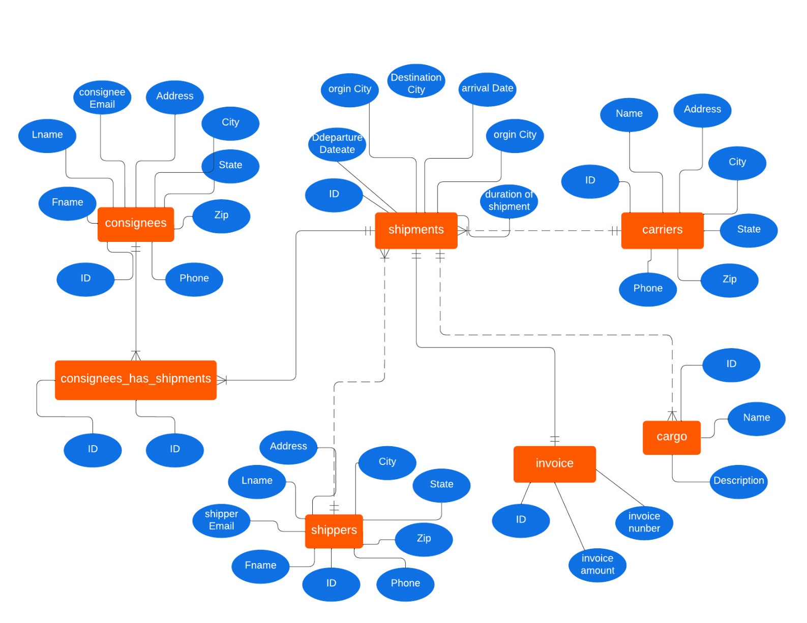
Database design er model

Slide 19
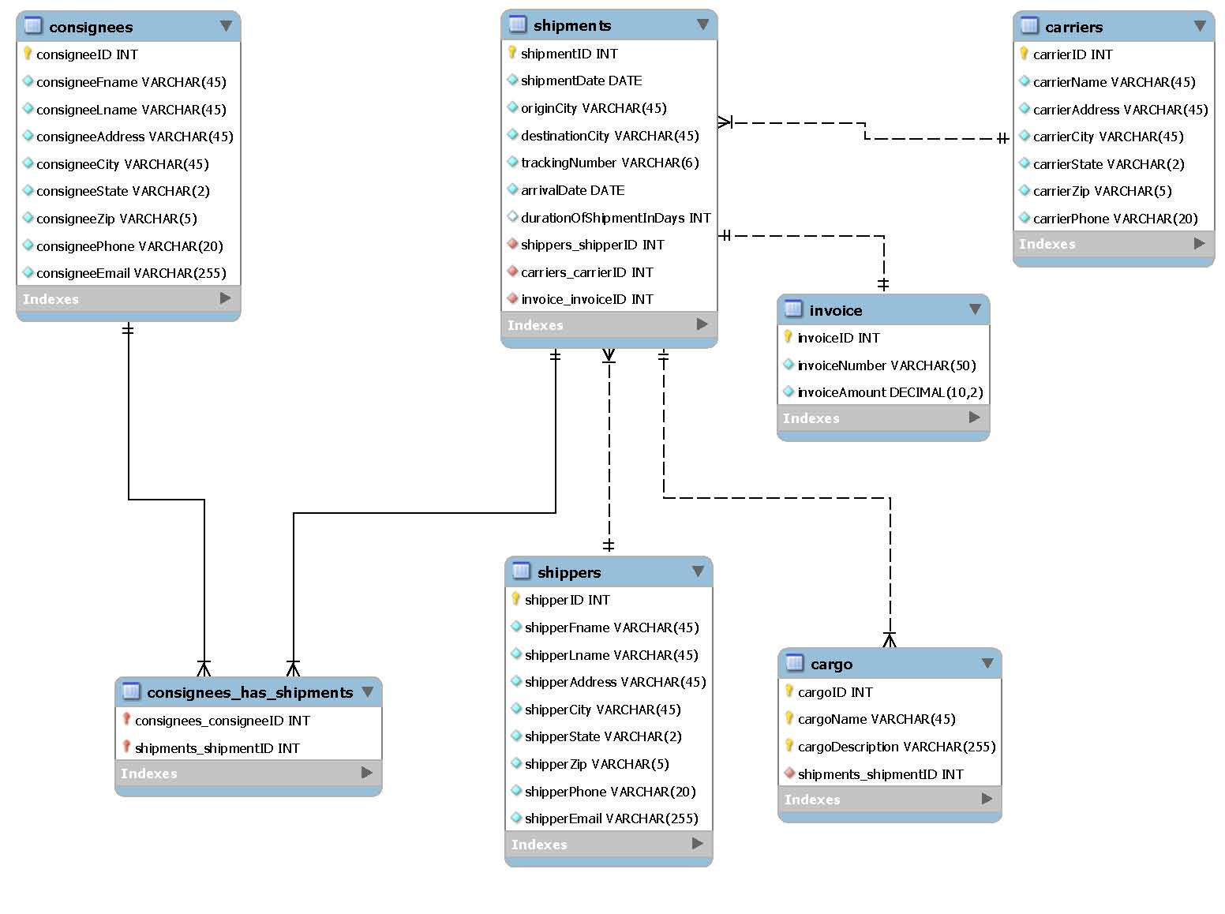
Database design ER diagram

Slide 20
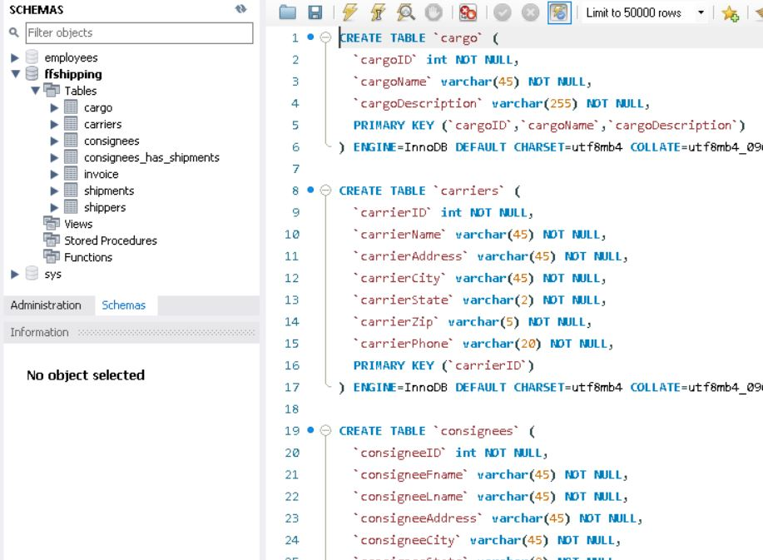
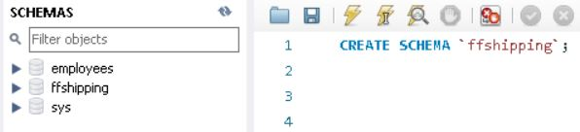
DDL Usage for database and table creation

Slide 21
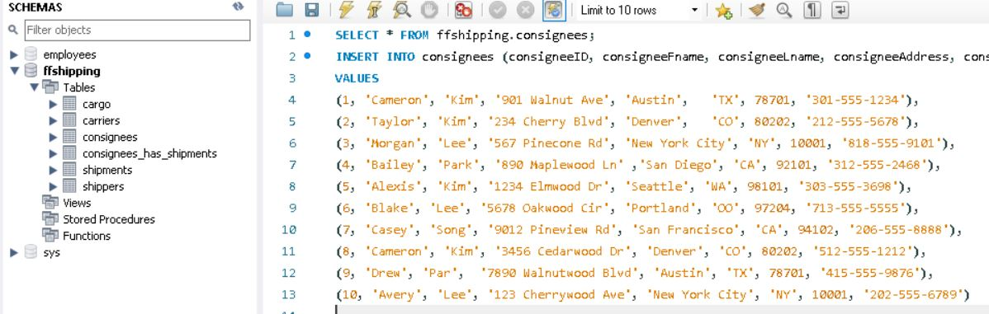
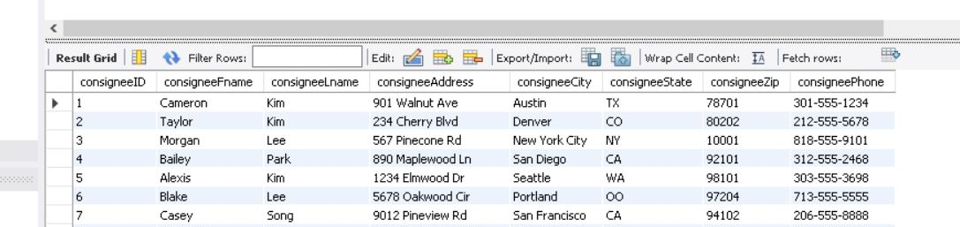
Database population

Slide 22
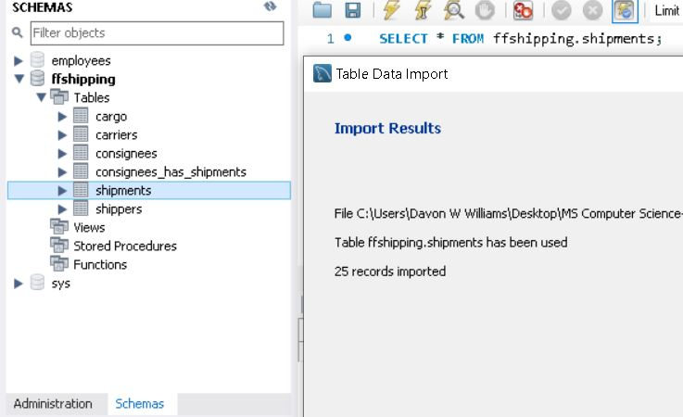
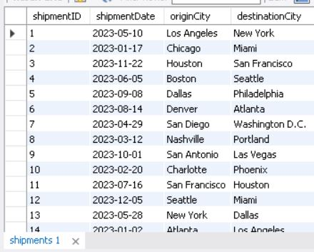
Database population cont’d

Slide 23
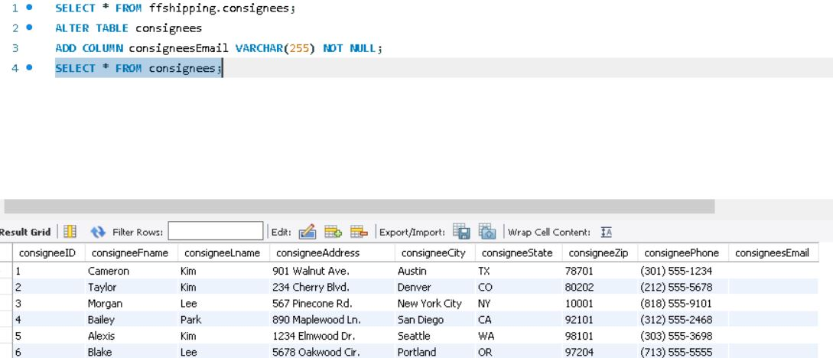
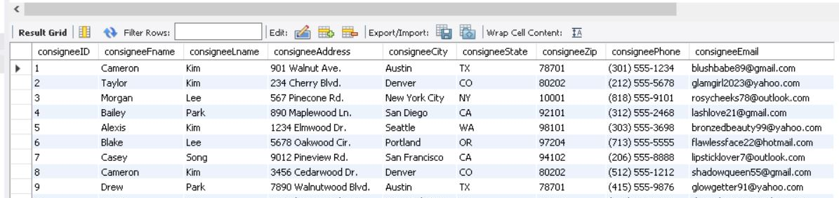
Database manipulation with MySQL usage

Slide 24
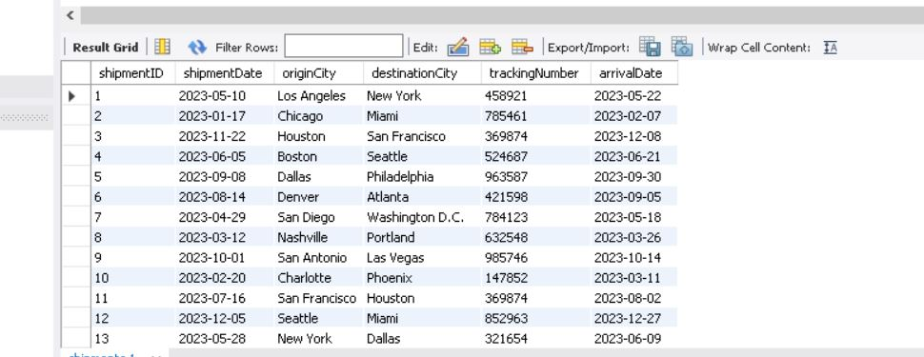
Database manipulation with MySQL usage cont’d

Slide 25
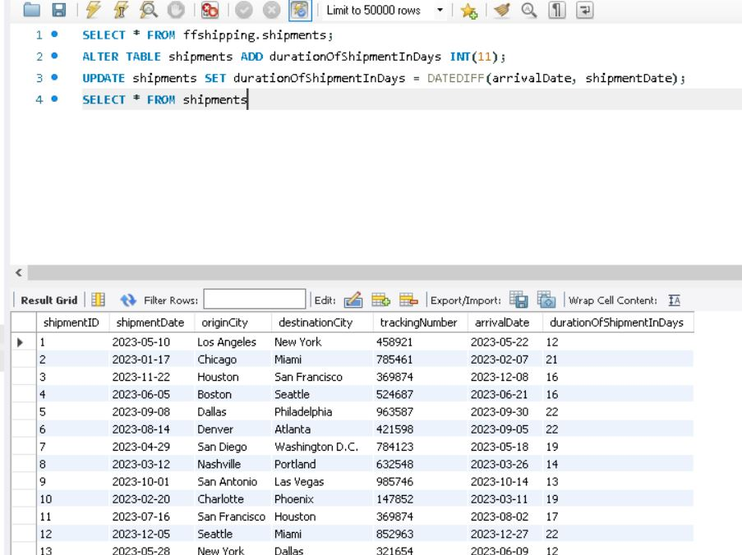
Database manipulation with MySQL usage cont’d

Slide 26
Section 4 Discussion and conclusion

Slide 27
Deliverables challenges faced and solutions
1) Database Schema development
2) ER model and ER diagram developed
3) Implementation of one to one, one to many and many to many relationships
4) Population of tables using both the insert MySQL code and csv import
5) Addition of new columns to several tables
6) Determination of days for a shipment to arrive to its destination
7) Exporting final and complete data tables in a csv/dump file format for sharing.
Understanding relationship between the entities to ensure the three types of relationships were developed.
ER model diagram was used to visualize the data and then consider the relationships after.

Slide 28
Design limitations
Not being able to exhaust all the possible entity relationships.
Potential missing some constraints or other needed information
Learning curve at the beginning of the design development

Slide 29
Future considerations
Adding additional relational entities
Using an ORM approach like SQL Alchemy.
Understanding more of the theory for more practical implementation.

Slide 30
Thank you
Questions ?

