Slide 1
Predicting 30-Day Hospital Readmission Risk Among Emergency Inpatient Encounters With Diabetes
End-to-end healthcare data-science project
SQL SERVER
JUPYTER NOTEBOOK
STREAMLIT
Source + database layer
→
Primary data-science environment
→
Application layer
Diabetes encounter data
Connection → extraction → cleaning → EDA → ML
Trained model made interactive
PROJECT OBJECTIVE
Identify demographic, clinical, and healthcare-utilization factors associated with 30-day readmission and develop a machine-learning-ready risk model.
Cohort: 19,689 emergency inpatient encounters with diabetes | Outcome: readmission within 30 days

Slide 2
Executive Summary: What I Built
The entire data-science workflow was performed in Jupyter Notebook, connected directly to SQL Server.
19,689
Emergency inpatient encounters
Workflow completed in the Jupyter Notebook
01
SQL Server connection
Connected Jupyter/Python to SQL Server and queried the healthcare data.
2,231
30-day readmissions
02
Cohort + cleaning
Built the diabetes emergency-admission cohort and cleaned/standardized the data.
03
Analysis
Performed EDA, clinical/utilization analysis, and feature engineering.
0.626
Final ROC-AUC
04
Machine learning
Trained and compared Logistic Regression, Random Forest, and XGBoost.
05
Evaluation + deployment
Compared models, evaluated calibration and thresholds, selected calibrated Logistic Regression + 0.10, saved the model, and deployed it in Streamlit.
73.5%
Final recall
Key message: SQL Server supplied the data; Jupyter Notebook performed the project; Streamlit provided the application layer.

Slide 3
Clinical Question & Cohort
03 CLINICAL QUESTION & COHORT
From a clinical problem to an analyzable population
Research question
Which demographic, clinical, and healthcare-utilization factors are associated with 30-day hospital readmission among emergency inpatient encounters with diabetes?
Cohort construction
Workflow
• Source: Diabetes 130-US Hospitals dataset (101,766 encounters; 50 variables). • Diabetes-related encounters identified using ICD-9 diagnosis codes beginning with 250%. • Emergency admissions selected using admission_type_id = 1. • Final cohort: 19,689 emergency inpatient encounters. • Target: <30 days = 1; NO or >30 = 0.
SQL Server ↓ Cohort extraction → cleaning → EDA ↓ Feature engineering → stratified split ↓ Modeling → evaluation → interpretation ↓ Saved model for deployment
Diabetes 30-Day Readmission Risk | Clinical Data Science Project
03 / 17
3

Slide 4
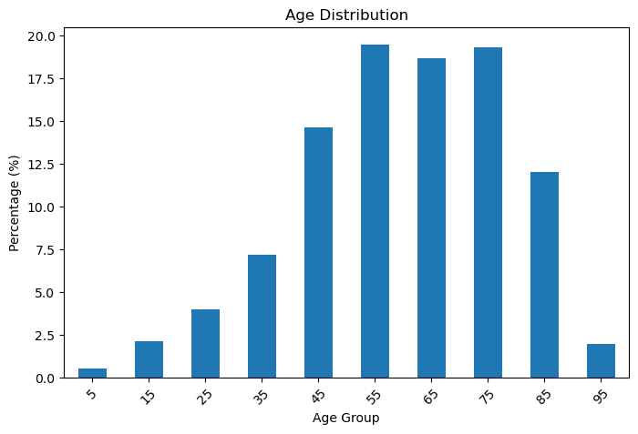
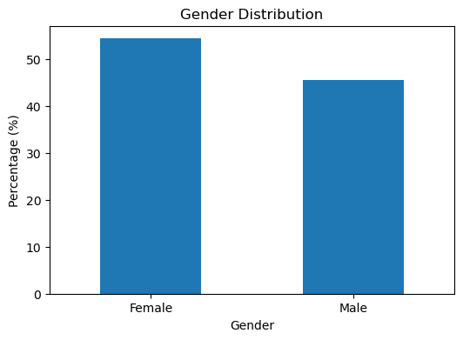
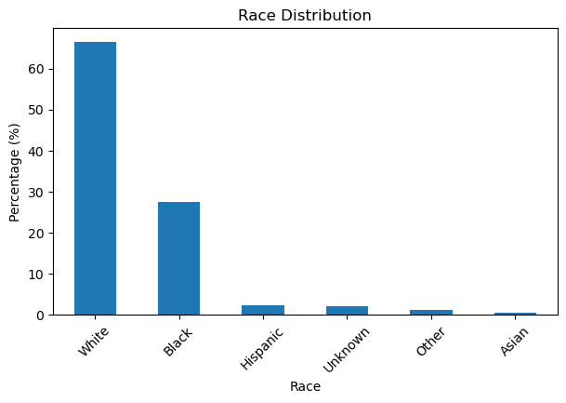
Who Is in the Cohort?
04 COHORT PROFILE
Cohort profile from the emergency inpatient encounter dataset
Female 54.4% | Male 45.6% | White 66.5% | Black 27.4%
Age is concentrated around the 55-, 65-, and 75-year groups. This demographic mix matters when considering model transportability to a different hospital or patient population.
Cohort: emergency inpatient encounters with diabetes
Diabetes 30-Day Readmission Risk | Clinical Data Science Project
04 / 17
4

Slide 5
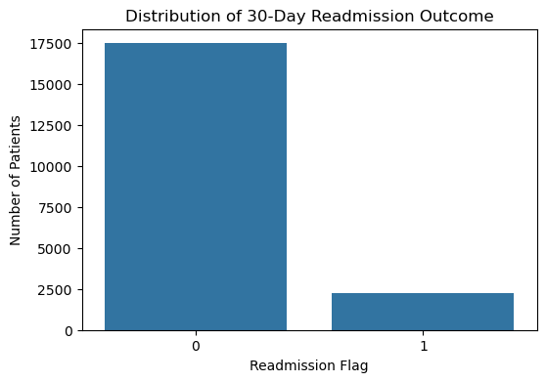
The Clinical Outcome: 30-Day Readmission
05 OUTCOME
The target is clinically meaningful—and strongly imbalanced
17,458
2,231
88.67%
11.33%
no 30-day readmission
30-day readmissions
non-readmission
readmission
Why imbalance matters A model can look “accurate” while still missing many encounters that actually readmit. That is why recall, precision, F1, and ROC-AUC are all important.
Cohort: emergency inpatient encounters with diabetes
Diabetes 30-Day Readmission Risk | Clinical Data Science Project
05 / 17
5

Slide 6
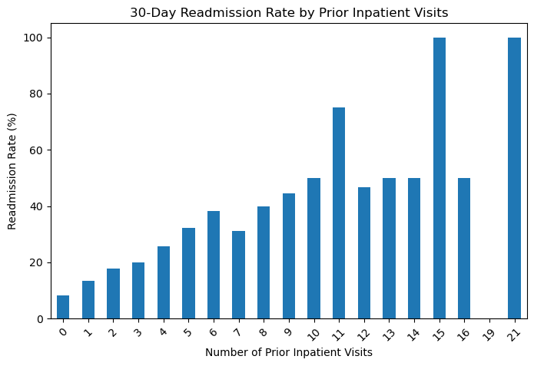
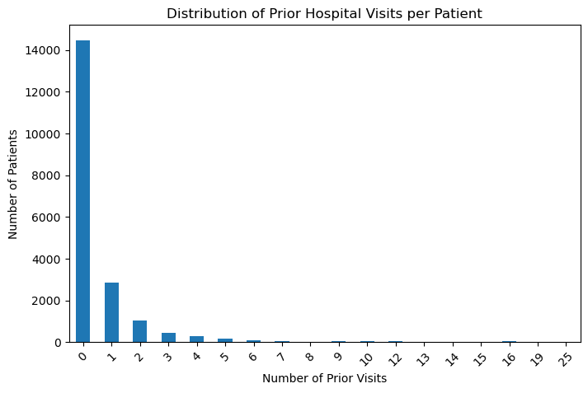
Healthcare Utilization Emerged as a Key Signal
06 EXPLORATORY FINDINGS
Observed utilization showed the clearest risk pattern
• Mean observed inpatient encounters: 1.51 among encounters without 30-day readmission vs 2.81 among 30-day readmission encounters. • Mean length of stay: 3.82 vs 4.39 days. These are observed cohort-level patterns, not confirmed prior visits.
Cohort: emergency inpatient encounters with diabetes
Diabetes 30-Day Readmission Risk | Clinical Data Science Project
06 / 17
6

Slide 7
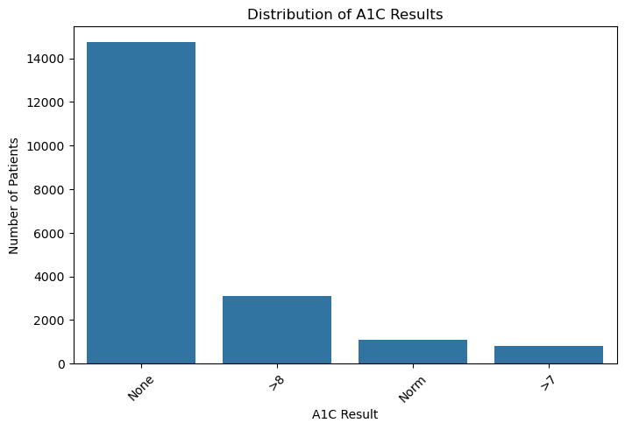
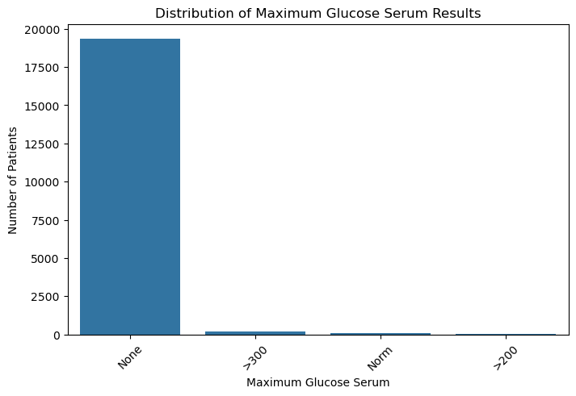
Clinical & Diabetes-Management Signals
07 CLINICAL VARIABLES
Glycemic and treatment variables were evaluated alongside utilization
A1C, maximum glucose, insulin, and medication-change indicators were evaluated as candidate predictors. In the fitted model, utilization variables provided stronger positive signal than many individual glycemic categories.
Cohort: emergency inpatient encounters with diabetes
Diabetes 30-Day Readmission Risk | Clinical Data Science Project
07 / 17
7

Slide 8
Machine-Learning Design
08 MODEL DEVELOPMENT
Three supervised classifiers were compared
Model | Strength | Tradeoff
Logistic Regression | Interpretable coefficients; clinical explanation | Moderate discrimination
Random Forest | Nonlinear ensemble | Weak readmission recall in this experiment
XGBoost | Gradient-boosted nonlinear model | Below Logistic Regression on ROC-AUC
Modeling dataset: 19,689 emergency inpatient encounters × 23 encoded predictors. The model began with 13 predictors before one-hot encoding. Stratified train/test split: 15,751 training and 3,938 testing encounters.
Cohort: emergency inpatient encounters with diabetes
Diabetes 30-Day Readmission Risk | Clinical Data Science Project
08 / 17
8

Slide 9
Model Performance
09 MODEL PERFORMANCE
Calibrated Logistic Regression + 0.10 was selected as the final configuration
Metric | Final Calibrated Logistic Regression
Accuracy | 45.4%
Precision | 13.9%
Recall | 73.5%
F1-score | 0.234
ROC-AUC | 0.626
PR-AUC | 0.175
Final selection prioritized recall because the project objective was to identify as many 30-day readmission encounters as possible. The calibrated Logistic Regression model with the locked 0.10 threshold achieved 73.5% recall on the held-out test set. Calibration improved the Brier score from 0.2376 to 0.0986. The baseline 0.50 model had stronger precision, F1, ROC-AUC, PR-AUC, and accuracy, but the calibrated 0.10 configuration was retained because recall was prioritized.
Cohort: emergency inpatient encounters with diabetes
Diabetes 30-Day Readmission Risk | Clinical Data Science Project
09 / 17
9

Slide 10
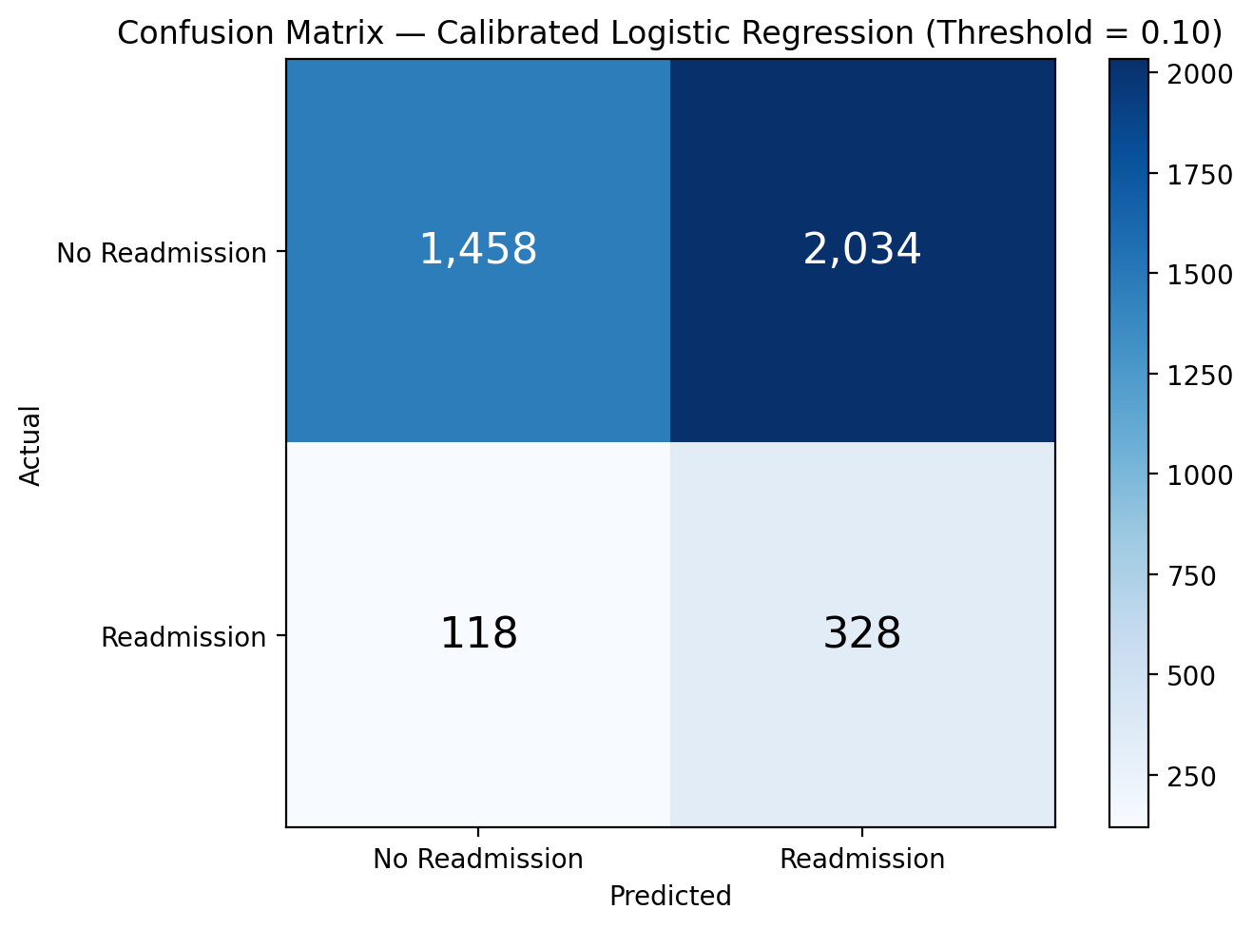
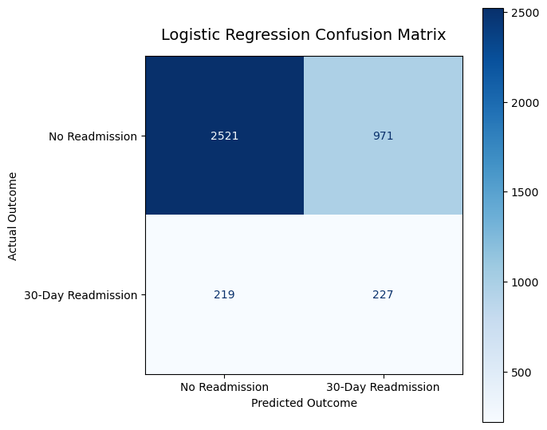
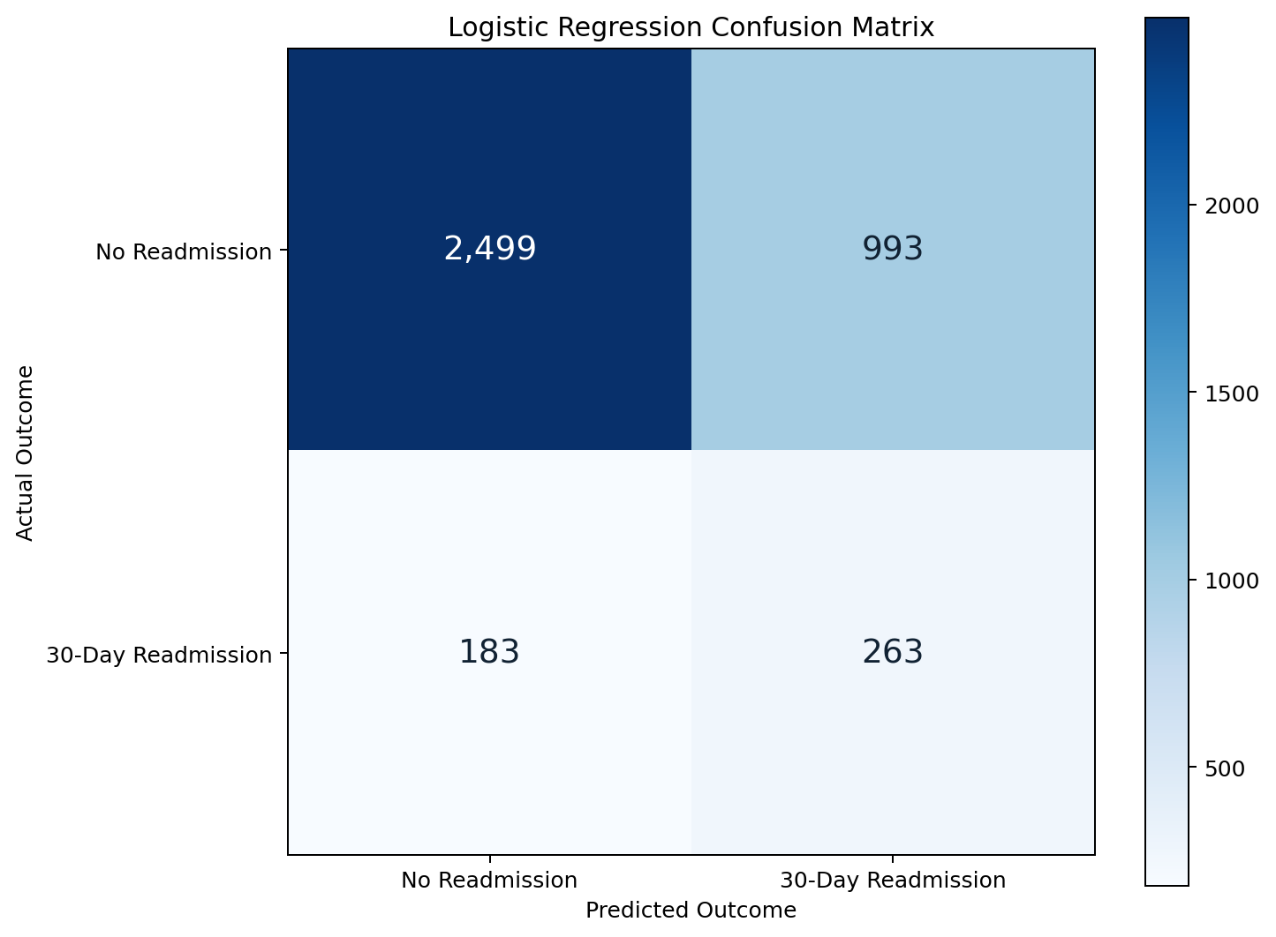
What the Selected Model Actually Catches
10 MODEL INTERPRETATION
Confusion matrix from the final calibrated Logistic Regression test set
Final test-set interpretation
• 446 actual 30-day readmission encounters in the test set.
• 328 true positives identified.
• 118 readmission encounters missed (false negatives).
• 2,034 false positives flagged.
Best current use: a recall-oriented risk-enrichment list for human review—not autonomous clinical action.
Cohort: emergency inpatient encounters with diabetes
Diabetes 30-Day Readmission Risk | Clinical Data Science Project
10 / 17
10

Slide 11
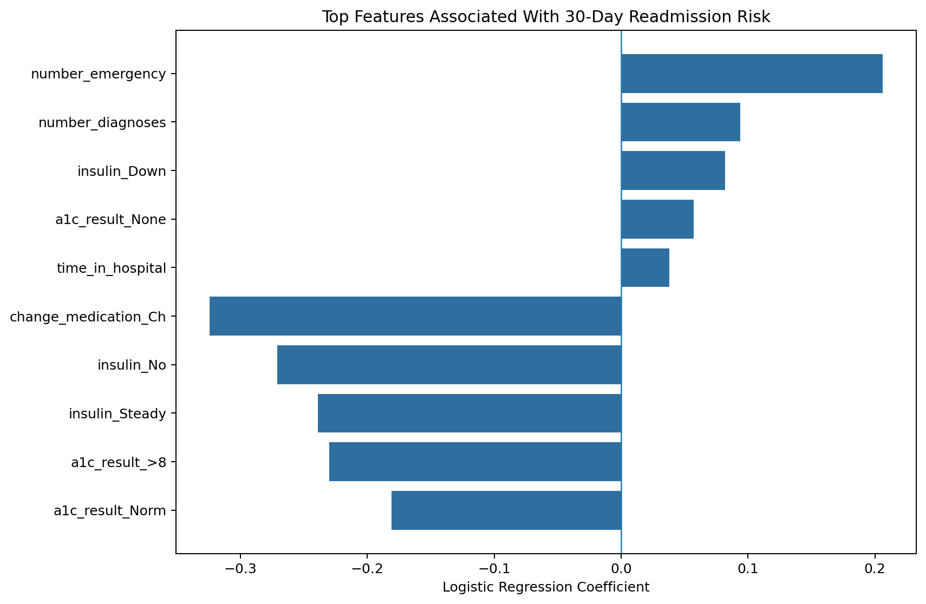
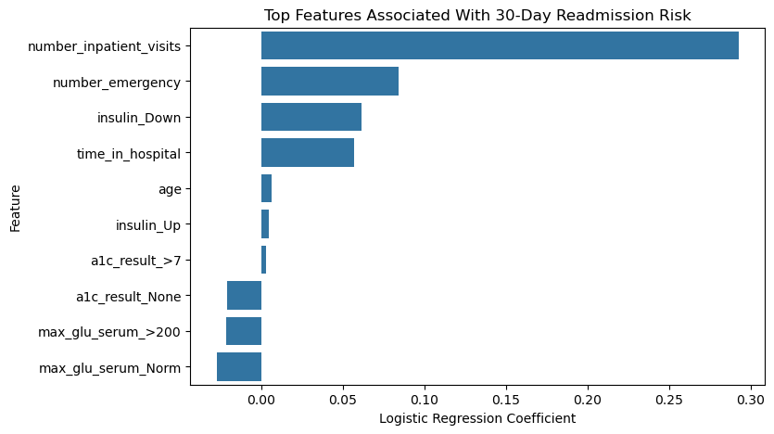
Interpretable Drivers of Predicted Risk
11 MODEL DRIVERS
Logistic Regression provides an explainable starting point
Key model signals
• number_emergency: strongest positive coefficient (+0.206; OR 1.229) • number_diagnoses: positive association (+0.094; OR 1.098) • insulin_Down: positive association (+0.082; OR 1.086) • time_in_hospital: positive association (+0.038; OR 1.039)
Coefficients describe associations in the fitted model—not causal effects.
Cohort: emergency inpatient encounters with diabetes
Diabetes 30-Day Readmission Risk | Clinical Data Science Project
11 / 17
11

Slide 12
Model Deployment: From Jupyter Notebook to Streamlit
The complete data-science workflow was performed in the Jupyter Notebook environment.
1
SQL SERVER
2
JUPYTER NOTEBOOK
3
STREAMLIT
Data storage + SQL queries
→
→
Application using the calibrated final model
Connection, extraction, cleaning, EDA, feature engineering, ML, calibration, evaluation
JUPYTER NOTEBOOK = PRIMARY DATA-SCIENCE ENVIRONMENT
SQL Server connection → data extraction → cohort construction → cleaning → EDA → feature engineering → model training → calibration → threshold selection → evaluation → model saving
CURRENT PROJECT
FUTURE CLINICAL WORK
SQL Server + Jupyter + calibrated Logistic Regression + Streamlit prototype
External validation + threshold validation + clinical workflow integration + monitoring
Diabetes 30-Day Readmission Risk | Clinical Data Science Project
12

Slide 13
What Must Happen Before Clinical Use
13 CLINICAL VALIDATION
Validation is the next major milestone
• External validation on a separate hospital, health system, or time period.
• Probability calibration and clinically meaningful operating thresholds.
• Review false positives and false negatives with clinicians/case managers.
• Evaluate performance and fairness across demographic subgroups.
• Define the intervention attached to a high-risk flag.
• Prospective monitoring after implementation.
Stakeholder decision
If the score were accurate enough for your setting, what clinical action would you want it to trigger?
The intervention should be designed before deployment.
Diabetes 30-Day Readmission Risk | Clinical Data Science Project
13 / 17
13

Slide 14
Bottom Line
14 CONCLUSION
A complete clinical data-science workflow—not just a model
• Historical multi-hospital dataset; local generalizability is unknown. • Outcome imbalance limits the value of accuracy alone. • Associations should not be interpreted as causal effects. • High-utilization groups with small counts require caution. • Model has not undergone external validation, clinical threshold validation, fairness assessment, or prospective workflow validation.
Portfolio / stakeholder value
Clinical cohort definition + healthcare data cleaning + feature engineering + class-imbalance handling + model comparison + explainability + deployment planning
Source: uploaded Diabetes Readmission Project notebook. Figures shown are screenshots from the notebook analysis.
Diabetes 30-Day Readmission Risk | Clinical Data Science Project
14 / 17
14

Slide 15
Appendix A — Technical Validation: Jupyter Notebook ↔ SQL Server
APPENDIX A SQL SERVER CONNECTION
The uploaded notebook explicitly establishes the SQL Server connection from Python/Jupyter.
Jupyter Notebook
→
PyODBC + SQLAlchemy
→
SQL Server
Python / pandas analysis
ODBC Driver 17
SQLEXPRESS → diabetes_db
Evidence in notebook
conn = pyodbc.connect( "DRIVER={ODBC Driver 17 for SQL Server};" "SERVER=.\\SQLEXPRESS;" "DATABASE=diabetes_db;" "Trusted_Connection=yes;" ) df = pd.read_sql(query, conn)
• pyodbc connection is established from the Jupyter notebook. • SQL Server instance: .\SQLEXPRESS • Database: diabetes_db • pandas uses pd.read_sql() to pull SQL query results into the notebook. • SQLAlchemy is used to write the cleaned dataset back to SQL Server.
This is a genuine database-connected workflow: SQL Server → Jupyter/pandas → analysis/modeling, with the cleaned dataset also written back to SQL Server.
Diabetes 30-Day Readmission Risk | Verified against uploaded Jupyter notebook
15

Slide 16
Appendix B — Cohort Extraction & Data Lineage
APPENDIX B DATA LINEAGE
The cohort definition and resulting dimensions match the notebook exactly.
SQL cohort query
Verified notebook outputs
• 19,689 emergency inpatient encounters
• 26 cohort variables
• 23 ML predictors after one-hot encoding
• 15,751 training / 3,938 testing
• 2,231 30-day readmissions
SELECT * FROM dbo.diabetes_data_clean WHERE ( diag_1 LIKE '250%' OR diag_2 LIKE '250%' OR diag_3 LIKE '250%' ) AND admission_type_id = 1
Data lineage
Raw diabetes_data → cleaned/standardized diabetes_data_clean → SQL cohort extraction → readmission_flag → one-hot encoded ML feature matrix → Logistic Regression / Random Forest / XGBoost
Diabetes 30-Day Readmission Risk | Verified against uploaded Jupyter notebook
16

Slide 17
Bottom Line & Next Steps
What this project demonstrates—and what must happen before clinical use
What the project demonstrates
Before clinical deployment
• Cohort of 19,689 emergency inpatient diabetes encounters. • Reproducible SQL Server → Jupyter/pandas workflow. • Feature engineering and comparison of Logistic Regression, Random Forest, and XGBoost. • Final calibrated Logistic Regression: 73.5% recall, 0.234 F1, 0.626 ROC-AUC at the 0.10 threshold. • Emergency utilization and clinical complexity were important predictive signals.
1. Externally validate on a separate population or time period. 2. Externally validate calibration and confirm a clinically appropriate operating threshold. 3. Review false positives and false negatives with clinicians. 4. Evaluate performance and fairness across patient subgroups. 5. Define the clinical intervention triggered by a high-risk result. 6. Prospectively monitor performance after implementation.
Stakeholder question: What clinical action should a high-risk score trigger?
Diabetes 30-Day Readmission Risk | Clinical Data Science Project
17

