Slide 1

Deep Reinforcement Learning-based Text Anonymization against Private-Attribute Inference
Ahmadreza Mosallanezhad, Ghazaleh Beigi, Huan Liu
amosalla@asu.edu
EMNLP-IJCNLP 2019

Slide 2
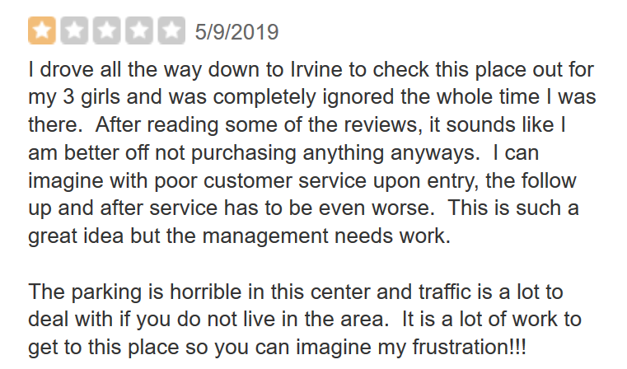
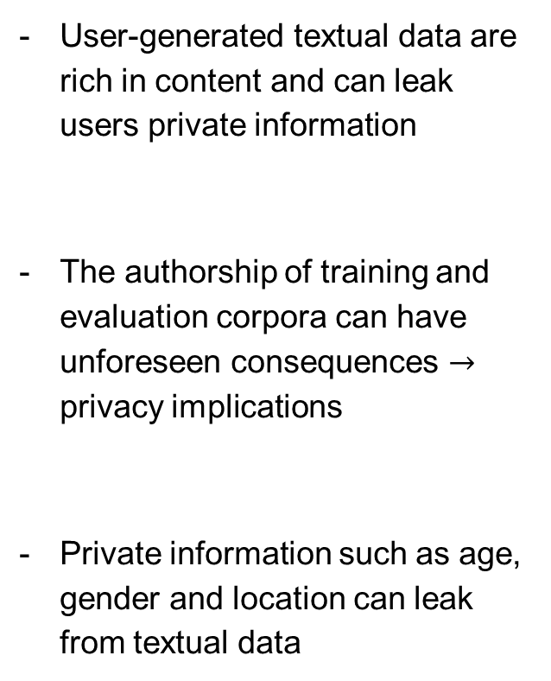
Introduction
User-generated textual data are rich in content and can leak users private information
The authorship of training and evaluation corpora can have unforeseen consequences $→$ privacy implications
Private information such as age, gender and location can leak from textual data
Location?
Age?
Gender?
What if we have more data of a user?
Notes:
Picture + example
1st bullet: Textual data is rich in content

Slide 3
Challenges
Use embedded text instead of actual text data
Current methods use adversarial learning:
Attacker’s feedback to train a safe embedding
We do not have control over changes in the embeddings
May generate a very different embedding vectors

Slide 4
Reinforcement Learning Text Anonymizer
Has two main steps:
Creating useful text embedding for a utility task
We use combination of an encoder with a classifier layer
Anonymizing private information from embedded text
An RL agent is trained to hide the private attributes

Slide 5


Step 1: Creating Text Embeddings
We train the network with respect to the given utility task:
Encoder + Attention Layer
Classifier for the utility task
Context
+
3 Layer Classifier
I
went
to
L.A.
last
week
to
…

Slide 6
















Step 1: Creating Text Embeddings (cont’d)
Encoder + Attention Layer
Review $1$
Review $2$
Review $3$
.
.
.
Review $N$
+
$$v_{1}^{1}$$
$$v_{2}^{1}$$
$$…$$
$$v_{m}^{1}$$
$$v_{1}^{2}$$
$$v_{2}^{2}$$
$$…$$
$$v_{m}^{2}$$
$$v_{1}^{3}$$
$$v_{2}^{3}$$
$$…$$
$$v_{m}^{3}$$
$$…$$
$$v_{1}^{N}$$
$$v_{2}^{N}$$
$$…$$
$$v_{m}^{N}$$

Slide 7

















Step 2: Anonymizing private information from embedded text
The RL agent changes each user’s embedded text to another
Changes for each user is different
user $i$’s text embedding
$$v_{1}^{1}$$
$$v_{2}^{1}$$
$$…$$
$$v_{m}^{1}$$
$$v_{1}^{2}$$
$$v_{2}^{2}$$
$$…$$
$$v_{m}^{2}$$
$$0.9$$
$$0.2$$
$$−0.8$$
$$0.5$$
$−0.5$ ….
$$v_{1}^{3}$$
$$v_{2}^{3}$$
$$…$$
$$v_{m}^{3}$$
change $10\%$
$$…$$
$$0.1$$
$$0.2$$
$$−0.8$$
$$0.5$$
$0.98$ ….
$$v_{1}^{N}$$
$$v_{2}^{N}$$
$$…$$
$$v_{m}^{N}$$
RL Agent
Notes:
Add two bullets for info
Add labels for arrays
Changes for each user is different

Slide 8
Step 2: Anonymizing private information from embedded text (cont’d)
1. Environment
2. State
3. Actions
4. Reward

Slide 9








2- Anonymizing private information from embedded text (cont’d)
1. Environment:
Includes the private-attribute inference attackers, utility classifier, and the text embeddings:
Environment
Attackers
$$reward$$
Reward
Utility
$$next state$$
$$action$$
$$0.1$$
$$0.2$$
$$−0.8$$
$$0.5$$
$−0.5$ ….
$$0.9$$
$$0.2$$
$$−0.8$$
$$0.5$$
$−0.5$ ….
Notes:
- Add animation for steps in the env

Slide 10
2- Anonymizing private information from embedded text (cont’d)
2. State:
state is the current text embedding vector:
$$0.9$$
$$0.2$$
$$−0.8$$
$$0.5$$
$−0.5$ ….

Slide 11
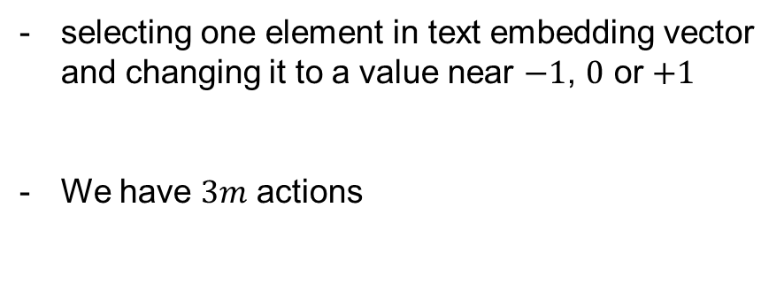






2- Anonymizing private information from embedded text (cont’d)
3. Actions:
selecting one element in text embedding vector and changing it to a value near $−1$, $0$ or $+1$
We have $3m$ actions
$$0.9$$
$$0.2$$
$$−0.8$$
$$0.5$$
$−0.5$ ….
Change value of $v_{0}$ to a value near 0
$$0.1$$
$$0.2$$
$$−0.8$$
$$0.5$$

Slide 12
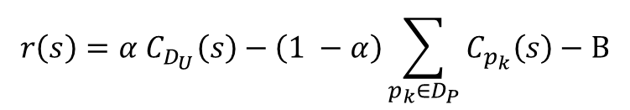
2- Anonymizing private information from embedded text (cont’d)
4. Reward:
It is defined based on how successfully the agent obfuscated the private-attribute information against the attacker(s) and preserved the utility:
utility classifier
attackers’ classifiers
$$r\left(s\right)=α C_{D_{U}}\left(s\right)−\left(1 −α\right)\sum_{p_{k}∈D_{P}}{C_{p_{k}}\left(s\right)}−Β$$
Balancing utility and privacy
Base reward
$$C=\operatorname{Pr}\left(label=i | state\right)−\min_{j}{\operatorname{Pr}{(label=j|state)}}$$
Notes:
- Add labels for D_U and D_P

Slide 13



2- Anonymizing private information from embedded text (cont’d)
We train the RL using Q-Learning algorithm
The agent should return the action we need to perform:
3 Layer Neural Network
($N$, $H$, $3N$)
$$0.9$$
$$0.2$$
$$−0.8$$
$$0.5$$
$−0.5$ ….
Action

Slide 14


Evaluation and Dataset
Experiments are designed to answer 3 questions:
Q1: How well RLTA can obscure users’ private-attribute information?
Q2: How well RLTA can preserve utility of the textual data w.r.t. the given task?
Q3: How does improving user privacy affects loss of utility?
We have used real-world dataset from Trustpilot
Utility Task
Attackers Task
Location
Gender
Notes:
- Talk about trustpilot dataset

Slide 15
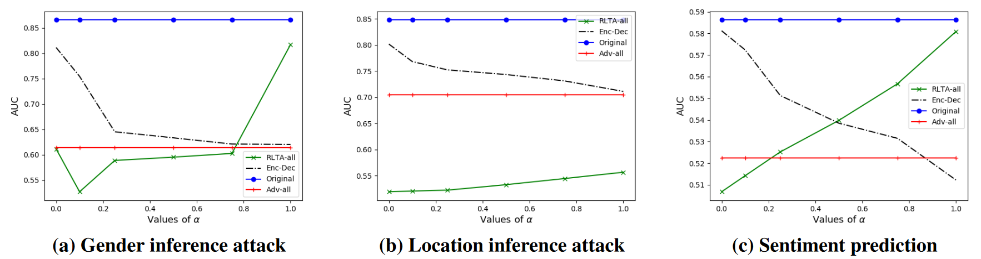
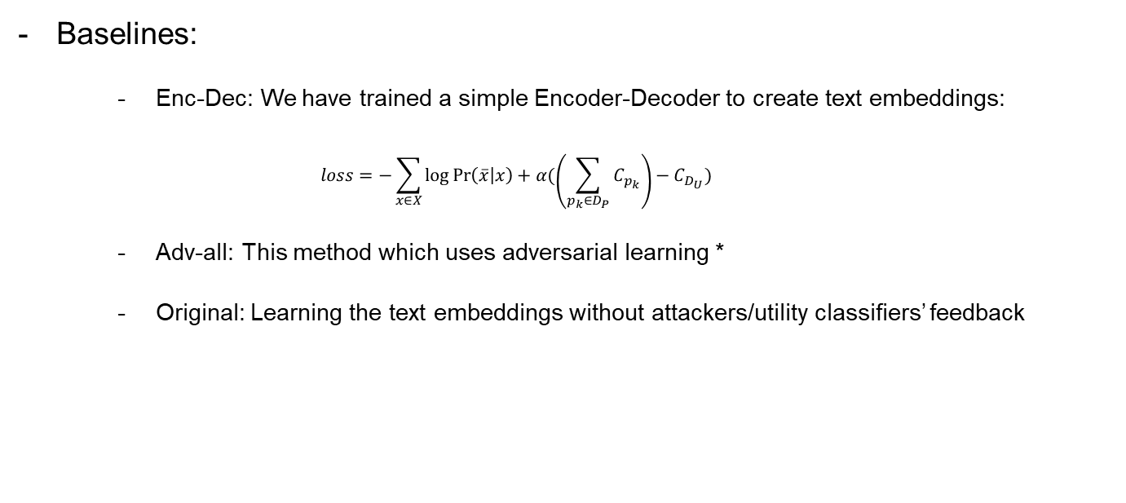
Results
Baselines:
Enc-Dec: We have trained a simple Encoder-Decoder to create text embeddings:
$$loss=−\sum_{x∈X}{\log{\operatorname{Pr}\left(\overline{x} | x\right)+α(\left(\sum_{p_{k}∈D_{P}}{C_{p_{k}}}\right)−C_{D_{U}})}}$$
Adv-all: This method which uses adversarial learning *
Original: Learning the text embeddings without attackers/utility classifiers’ feedback
* Towards Robust and Privacy-preserving Text Representations, Li, Yitong and Baldwin, Timothy and Cohn, Trevor
Proceedings of the 56th Annual Meeting of the Association for Computational Linguistics (Volume 2: Short Papers) Association for Computational Linguistics. p. 25--30. 2018
Notes:
- Refer

Slide 16
Results (cont’d)
Impact of different components:
Method | Location | Gender | Utility
Original | 84.77 | 86.54 | 58.57
Enc-Dec | 71.55 | 58.35 | 53.78
Adv-All | 70.37 | 57.15 | 52.15
RLTA | 53.34 | 56.41 | 54.83
RLTA-Gender | 56.64 | 55.02 | 56.67
RLTA-Location | 52.04 | 56.64 | 54.13
Notes:
- Add bullet for impact of different components

Slide 17
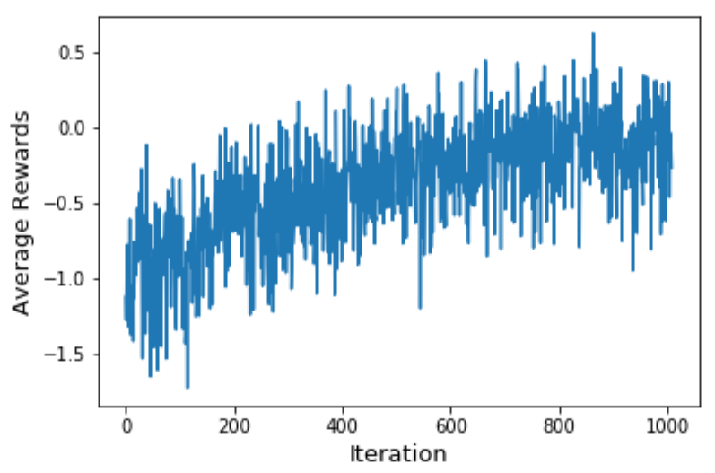
Results (cont’d)
Agents reward over time shows convergence of RL algorithm

Slide 18
Summary
We proposed a deep RL-based text anonymizer:
Considers both privacy and usefulness of the embedded text
Can control the balance of privacy and utility using a single parameter
We have used Q-learning to train the RL agent
More efficient on less data than policy gradient
For future directions:
Adopt RLTA to other data types
Use different RL settings for this problem

