Slide 1
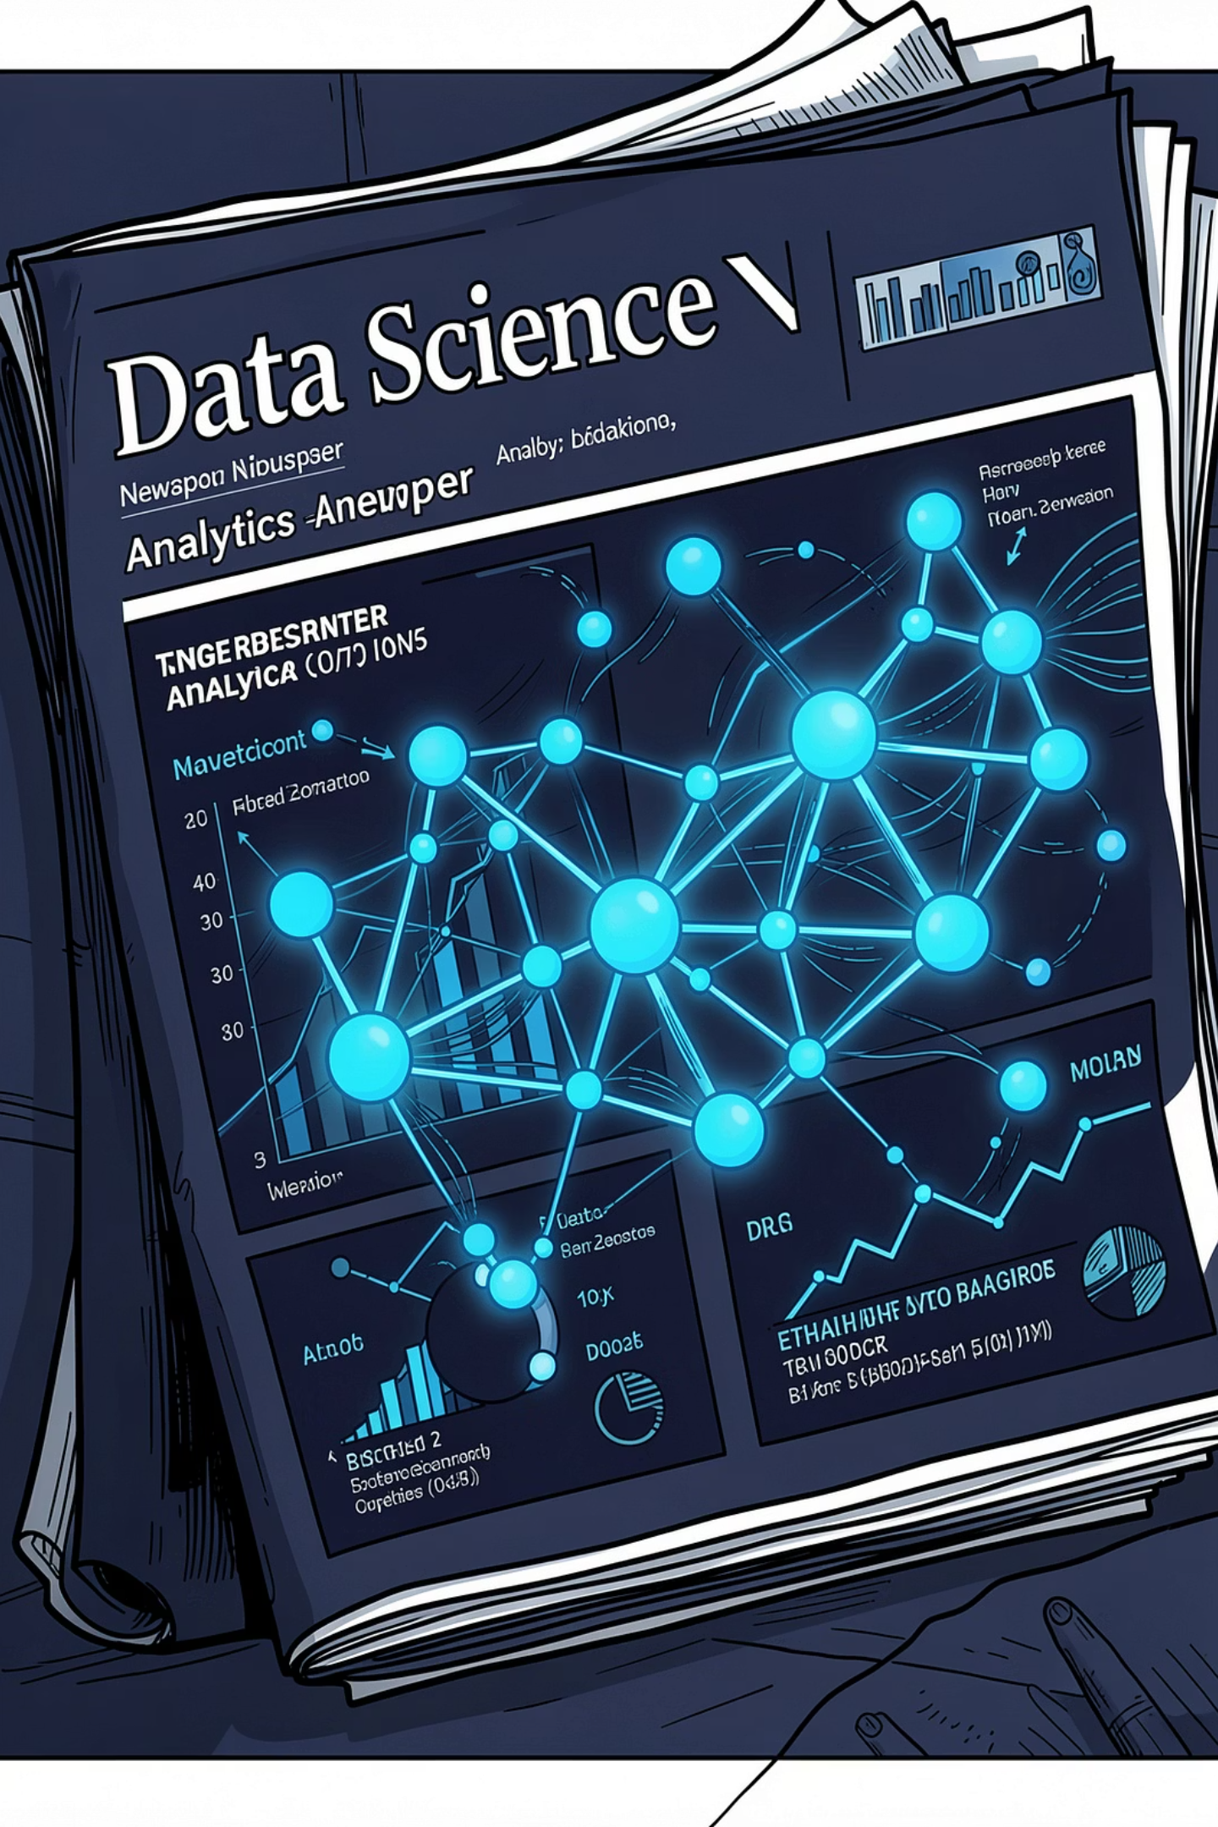
SCENARIO 09 · MODULE 3 + MODULE 4
📰 BBC News Popularity Prediction
Cleaning → Preprocessing → Training — a full ML pipeline from raw CSV to trained classifiers.
Coder: Aliqulov Davron | Team Lead: Ilyos O'ralov Business analist: Ibrohim Tursunov

Slide 2

🎯 Why Does This Matter?
"Every article costs money to write. Before we publish, I want to know one thing — will this article be popular?" — Daniel, Head of Content Strategy
❌ Without ML
✅ With ML
Guessing based on intuition
Wasted editorial budget
Missed viral opportunities
Data-driven publishing decisions
Smarter content allocation
Measurable ROI improvement
39,644
61
Articles
Columns
2013–15
100%
Coverage
Numeric
No text cleaning required — all features are already numerical.

Slide 3

🗺️ Project Workflow
Two modules, one end-to-end ML pipeline — from raw data to evaluated models.
Raw CSV
Module 3
Module 4
Model-Ready
39,644 rows · 61 columns
Clean, fix columns, remove bad rows
Scale features, train models, eval
BBC _clean.parquet · F1 scores
Each stage produces a clean, validated deliverable that feeds directly into the next — ensuring reproducibility and honest evaluation at every step.

Slide 4

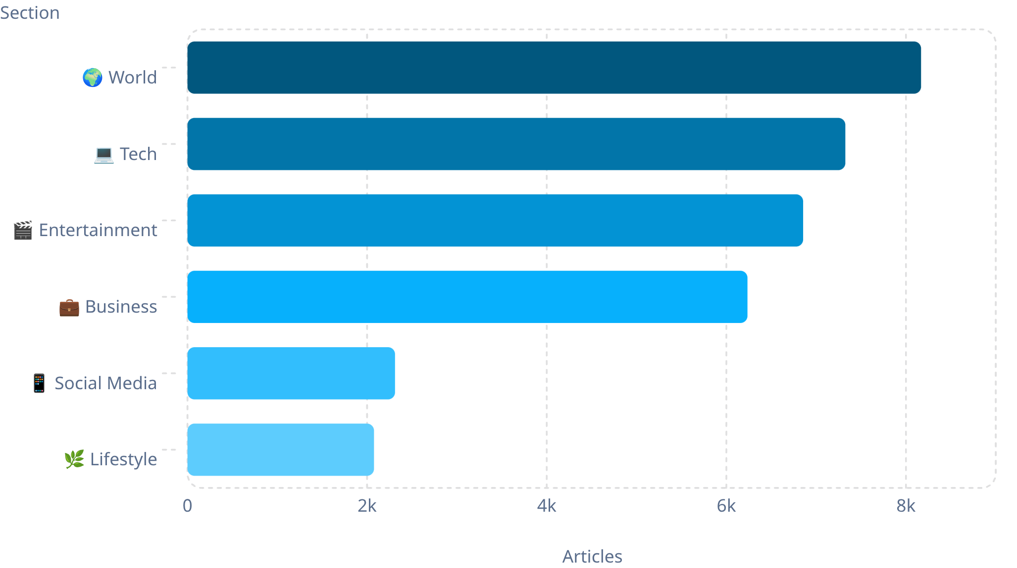
🧹 Module 3: Data Cleaning & Preprocessing
1
Fix Column Names
Strip leading spaces. Shape: 39,644 × 61
2
Remove Bad Rows
Drop 1,181 empty articles + 1 corrupt outlier.
3
Drop Non-Features
Remove url and timedelta — not predictive.
4
Result
✅ 38,462 rows remaining, clean and ready.
📂 News Sections Distribution
Golden Rule: Always inspect data before cleaning.

Slide 5
🎯 Build is_popular
Why Median, Not Mean?
Final Dataset
Shares are highly skewed — viral articles create extreme outliers that inflate the mean. The median = 1,400 shares is a robust, realistic threshold.
18 features selected from 61 columns
shares dropped to prevent data leakage
Deliverable: BBC _clean.parquet
Shape: 38,462 rows × 20 columns
🟢 Popular
🔵 Not Popular
20,463 articles
17,999 articles

Slide 6
🤖 Module 4: Model Development
Train / Test Split
Models Trained
80% Training · 20% Testing
random_state = 42 for reproducibility
stratify = y preserves class balance
📈 Logistic Regression
🌳 Random Forest
Linear classifier — fast, interpretable, strong baseline.
100 decision trees with majority voting — captures non-linear patterns.
Scaling Rule
Fit scaler on train data only — never on the full dataset. This prevents information leakage into the test set.

Slide 7
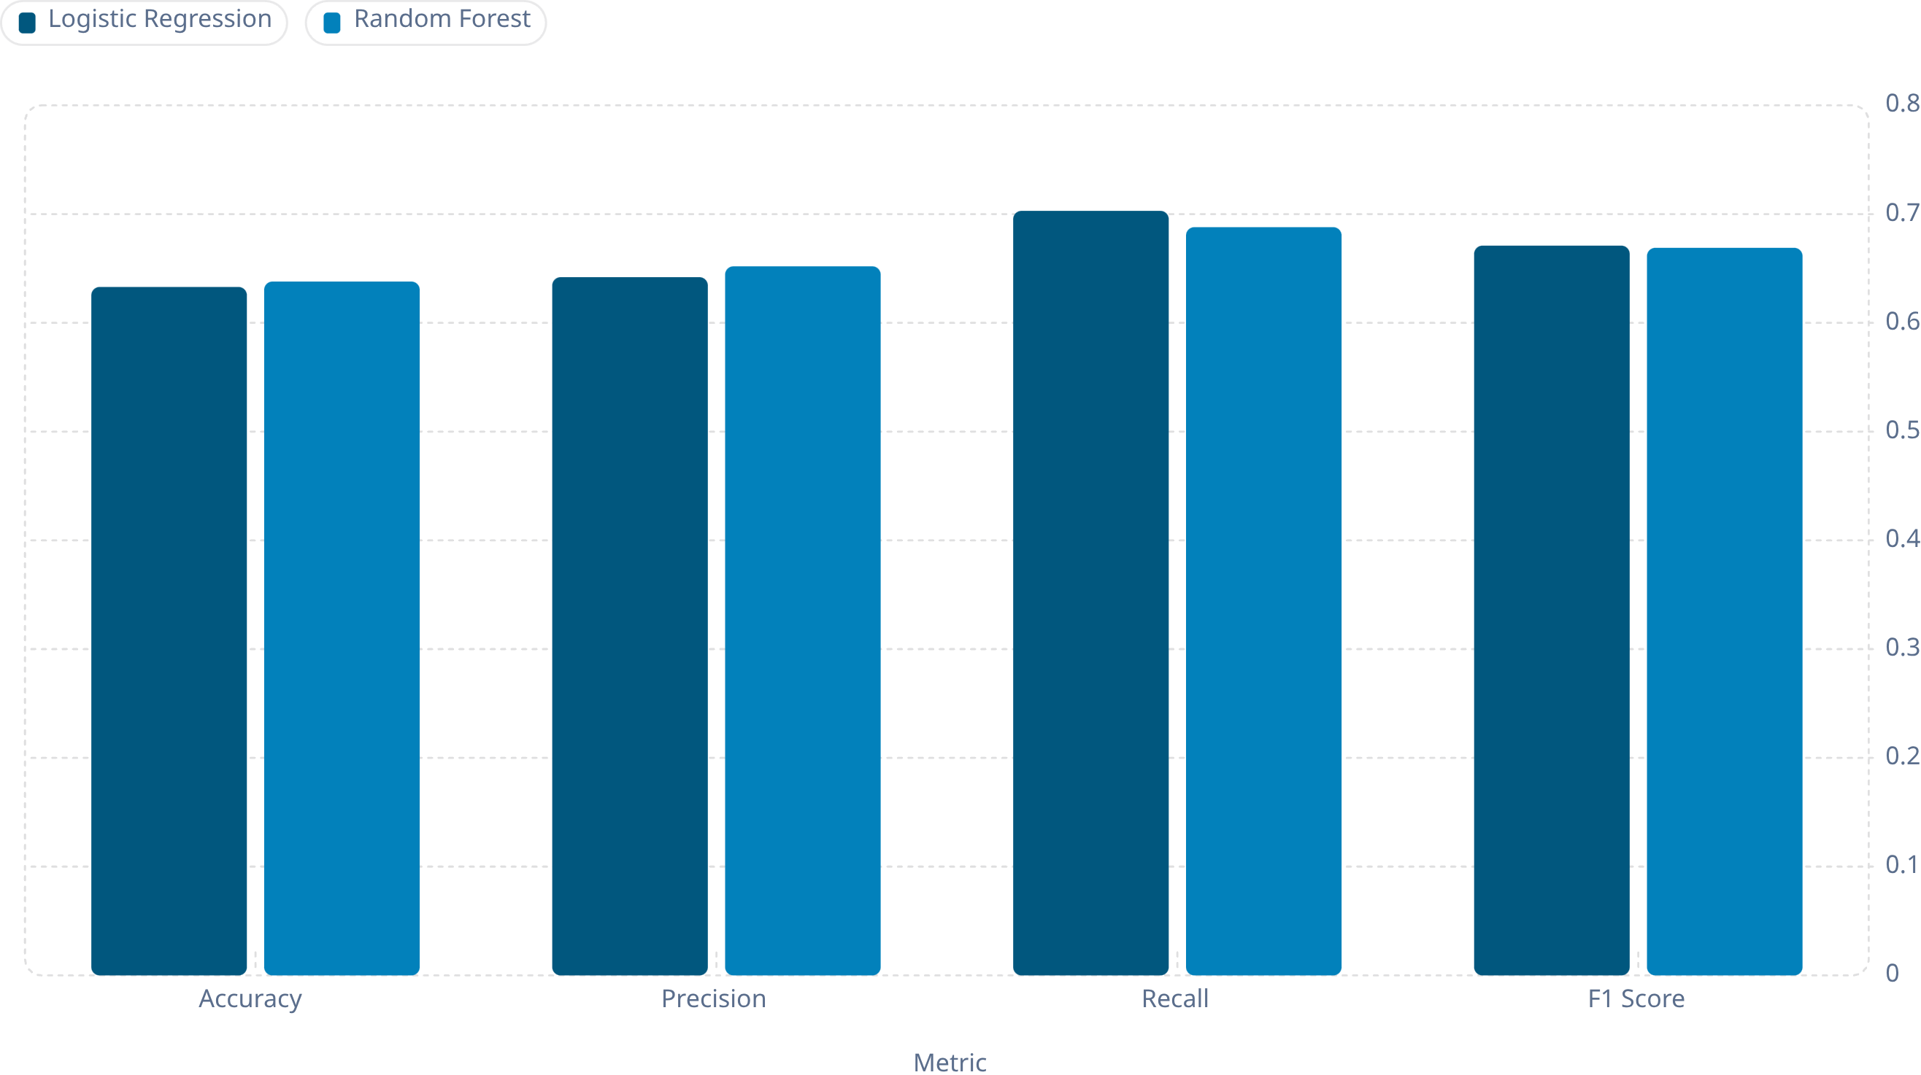

📊 Model Performance
Both models perform comparably. Random Forest edges out Logistic Regression slightly on accuracy and precision, while Logistic Regression achieves higher recall.
Key Message: Predicting virality is inherently difficult. Achieving ~65% accuracy on human behavior is a meaningful and honest result.

Slide 8
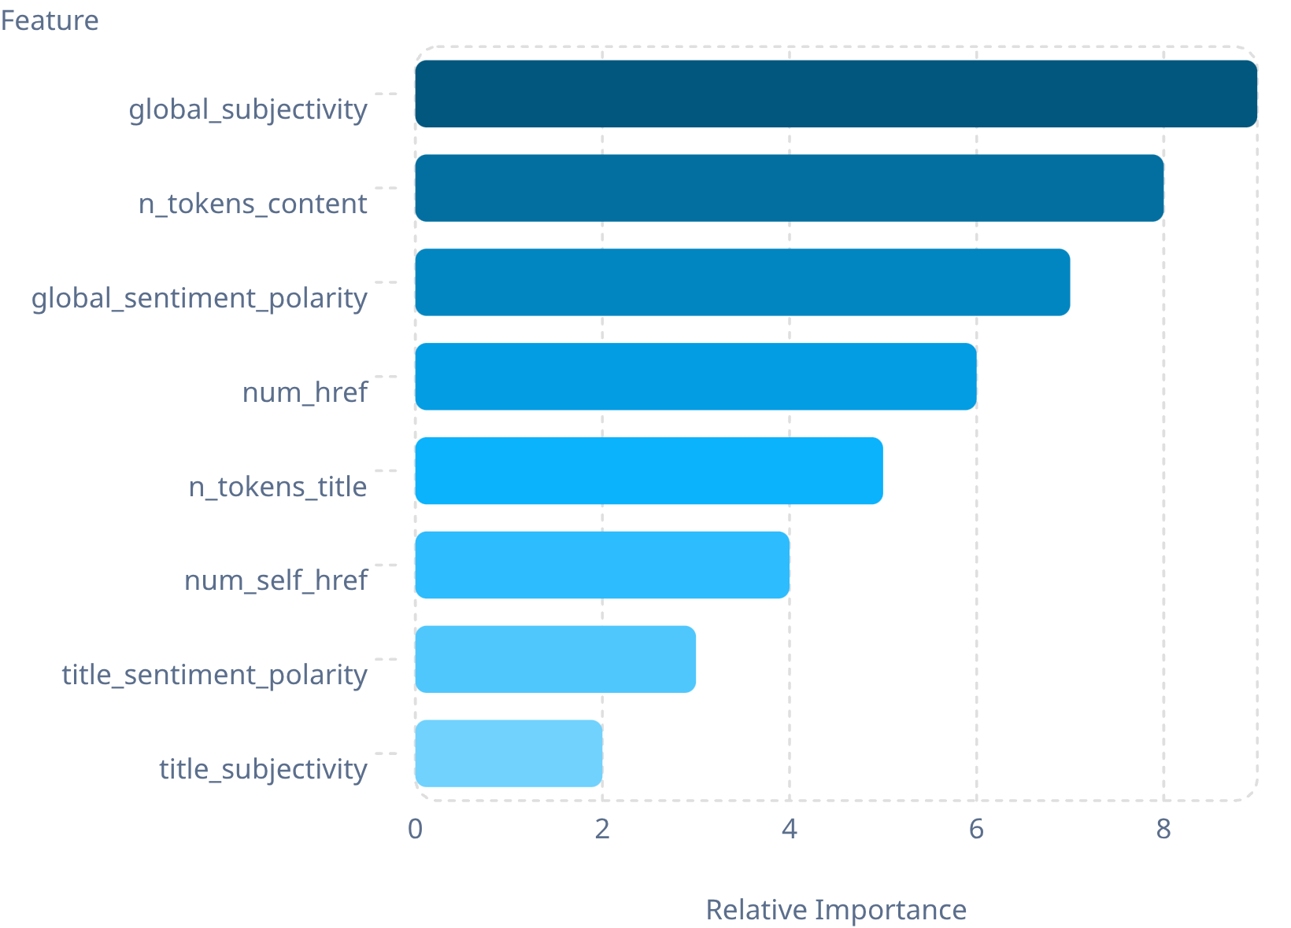

🔍 What Drives Popularity?
Top Insights
Content quality (subjectivity, token count) dominates
Sentiment polarity — both global and title-level — matters
Link density (num_href, num_self_href) signals shareability
Article category and publication day rank lower than expected
"Content quality and sentiment matter more than article category or publication day."

Slide 9

📚 Lessons Learned
Data Cleaning
Inspect before transforming. Broken rows and malformed columns silently corrupt results.
Target Engineering
Median-based thresholds handle skewed distributions better than arbitrary cutoffs.
Data Leakage
Dropping shares before training is critical — leakage creates false confidence.
Honest Evaluation
Stratified splits and train-only scaling ensure metrics reflect real-world performance.
Discussion Questions
1
Why is popularity prediction harder than many ML tasks?
2
Which matters more: Section or Weekend publication?
3
Should BBC optimize for Precision or Recall?

Slide 10
🏁 Project Complete
Module 3 Achievements
Module 4 Achievements
✅ Cleaned dataset (38,462 rows)
✅ Removed bad rows and outliers
✅ Built is_popular target label
✅ Saved BBC _clean.parquet
✅ Trained Logistic Regression & Random Forest
✅ Evaluated fairly with stratified split
✅ Best F1 Score: 0.671
"Clean data first, then model. Honest results are more valuable than artificially high accuracy."
Credits
Coder
Team Lead
Dataset
Tools
Aliqulov Davron
Ilyos O'ralov
UCI Online News Popularity
Google Colab · pandas · scikit-learn · matplotlib

